Slide 1
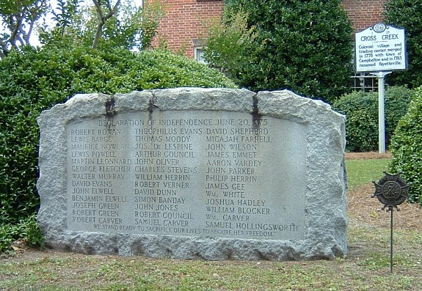
The Search for the Burial Sites of the Cumberland Association Signers
Kaitlyn Santos-Porter
Cumberland County Public Library
Local & State History Department

Slide 2
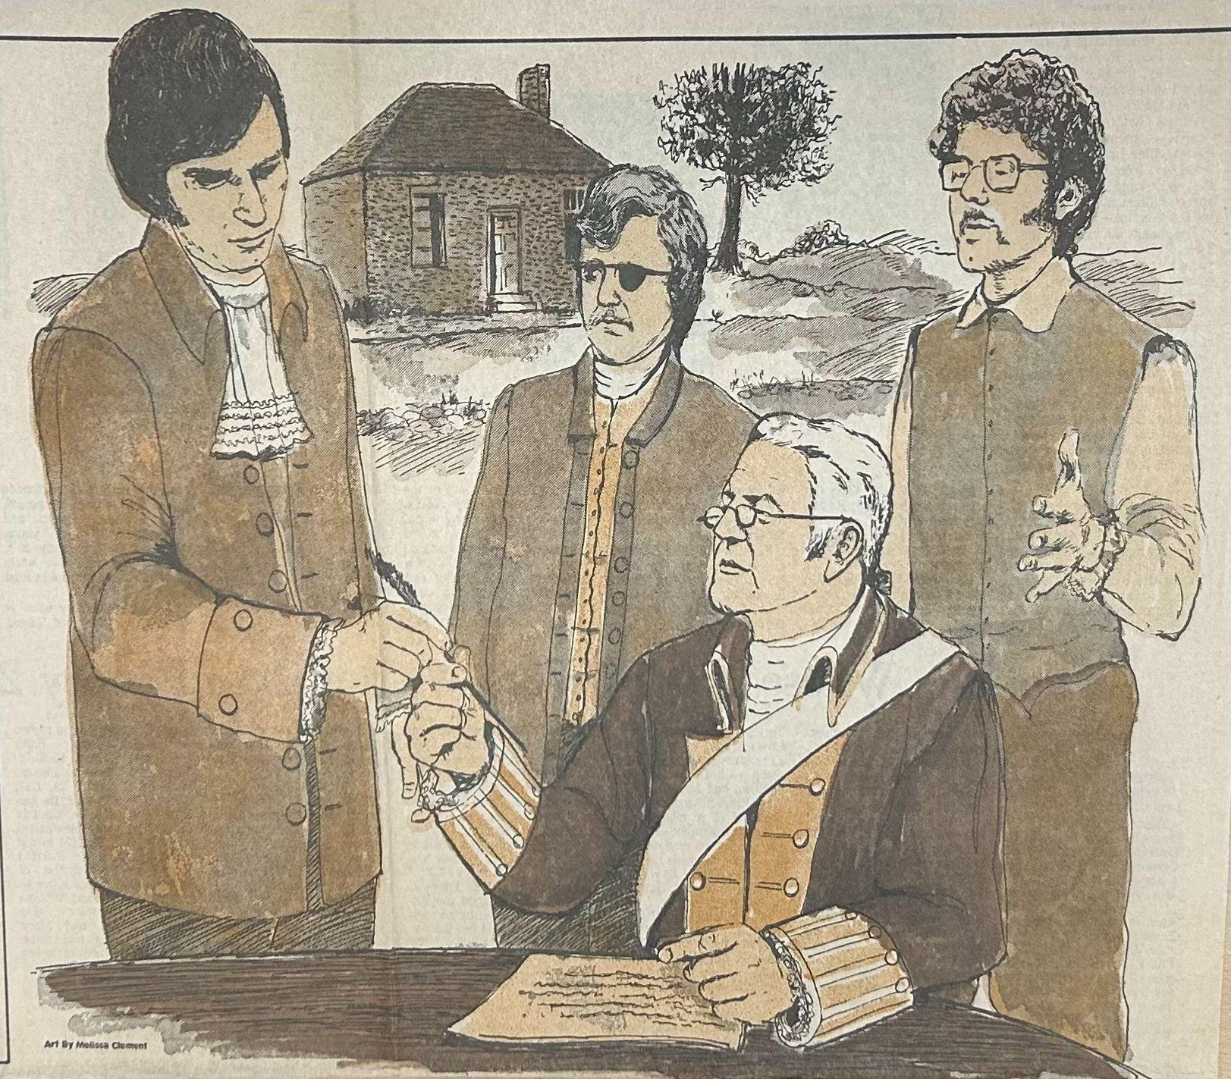
Cumberland Association
55 Signers of the Liberty Point Resolves
Signed June 20, 1775
Signers’ Burial Sites:
James Gee
John Elwell
Thomas White
Robert Rowan
Theophilus Evans
Evans & Carvers
Notes:
Overview: New Hanover Resolves, recognized as the Wilmington District Resolves, were signed June 19, 1775. Immediately after, on June 20, 1775, specific residents of Cumberland County signed the “Liberty Point Resolves”, also known as the “Cumberland Association.” This event is significant, since Cumberland County was a majority-Loyalist/Tory region, and these members risked their safety and status to dispute British actions.

Slide 3
Methods
Researched archival documents about the signers and their burial locations, including:
Cumberland County’s “vertical files”
Census, probate and estate records, court abstracts, land deeds
Used previously-recorded cemetery surveys for Cumberland County
Conducted physical visits and on-site observational surveys
Cross Creek #1
Evans Family Cemetery
Gee Family Cemetery
Cumberland County Land (by Big Rockfish Creek & Little Rockfish Creek)

Slide 4
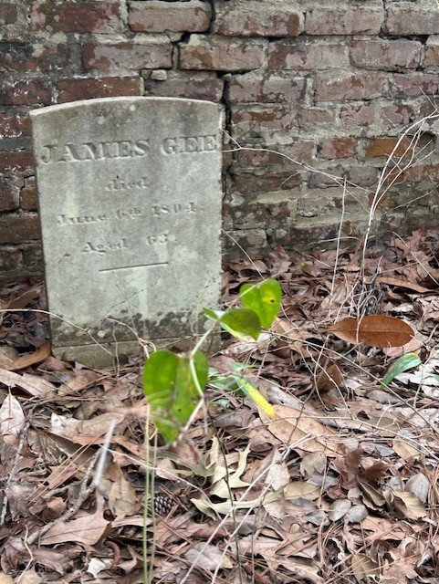
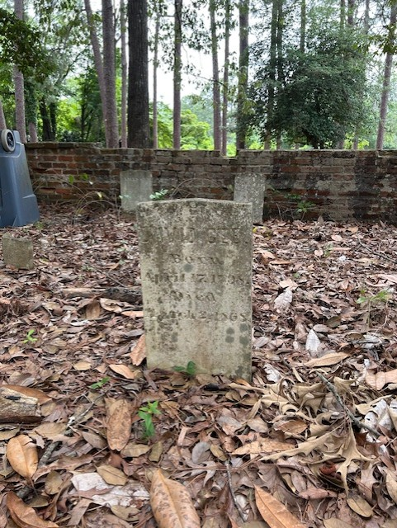
James Gee
Gee Family Cemetery
Between neighborhood houses and Terry Sanford High School
No official maintenance (still attended)
Across from the Confederate Women’s Cemetery

Slide 5
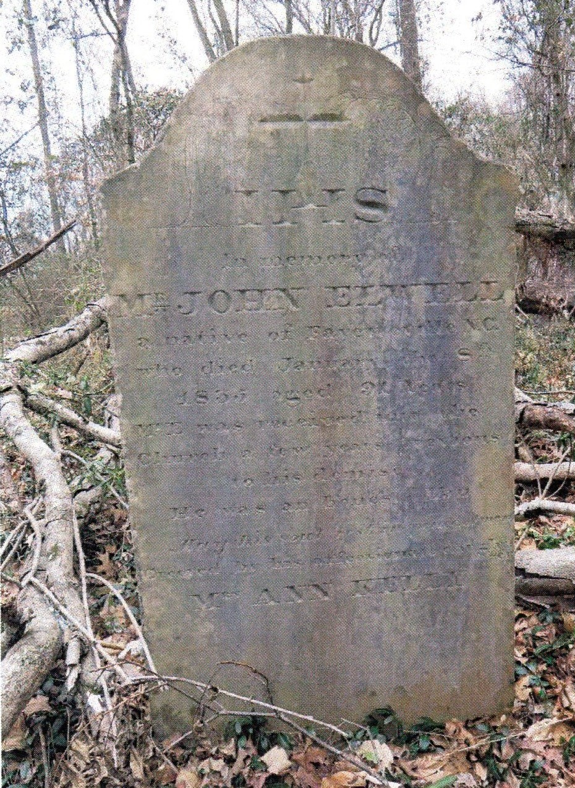
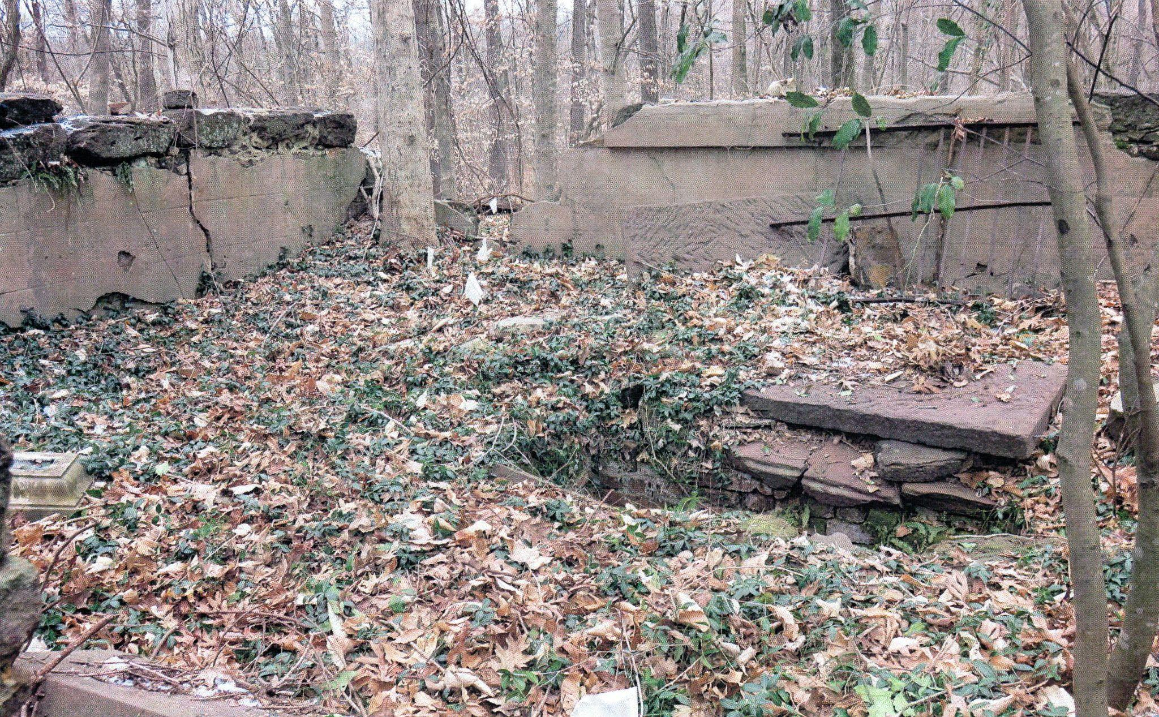
John Elwell
“Kelly Steps”
Within an HOA neighborhood under construction, in John Kelly Family Catholic Cemetery
Maintained by the Knights of Columbus of St. Patrick Catholic Church
Used a collection of historical research and previous surveys
Cumberland County Public Library, “VF- Cemeteries; Kelly Steps,” Vertical File Collection

Slide 6
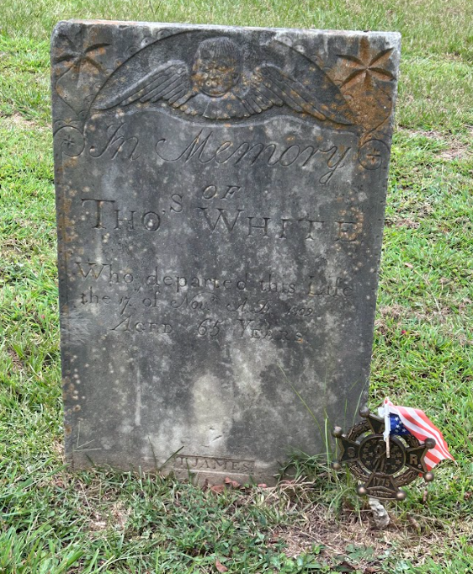
Thomas White
Cross Creek #1
SAR memorial on grave site
Official maintenance
Not gated, near the oldest portion of the cemetery

Slide 7
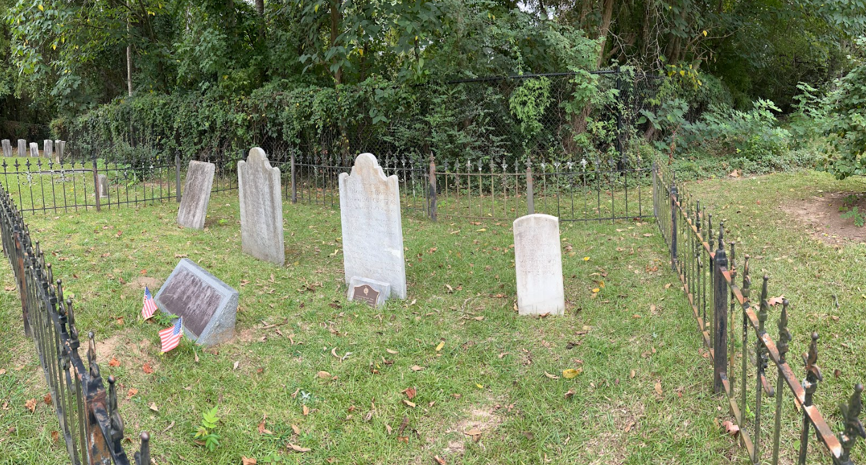
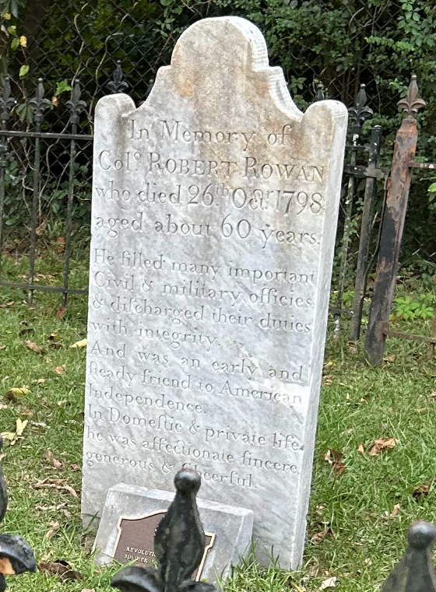
Robert Rowan
Cross Creek #1
SAR memorial on grave site
Official maintenance
Previously located at a family cemetery before relocation
Gated section by the walkway

Slide 8
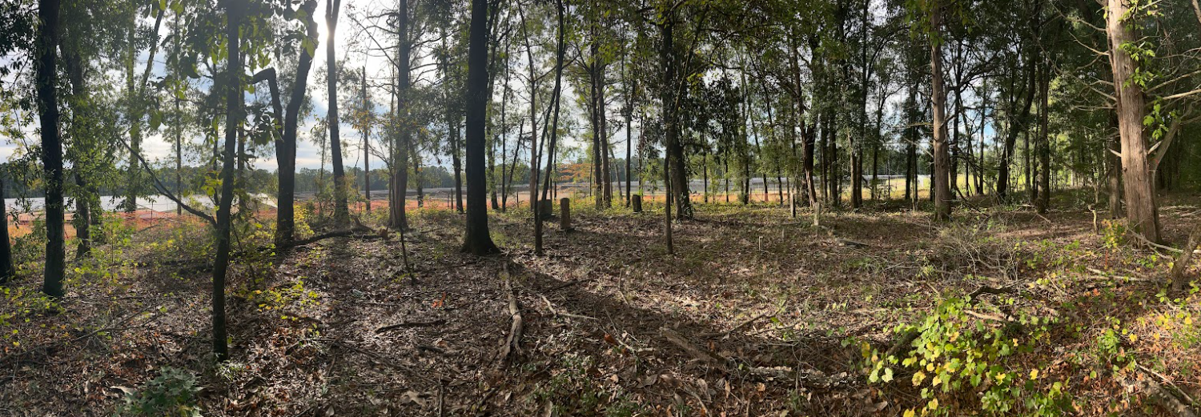
Theophilus Evans
Evans Family Cemetery
Plot next to a PWC facility
No official maintenance (still attended)
The signer is not buried here

Slide 9
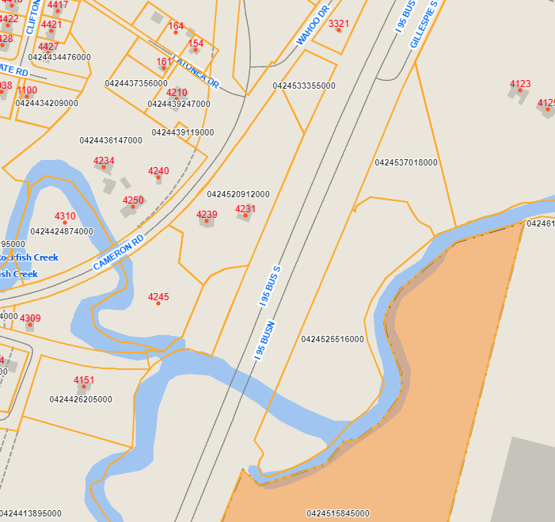
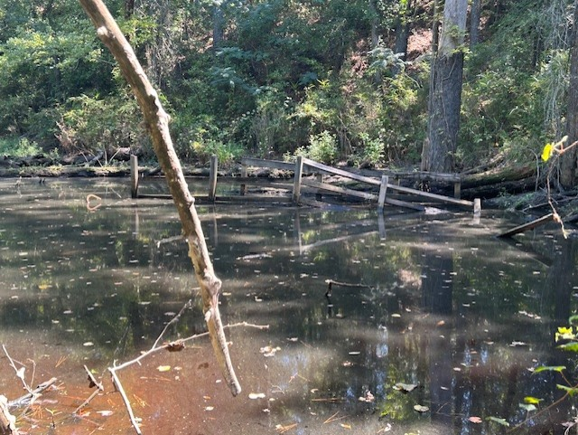
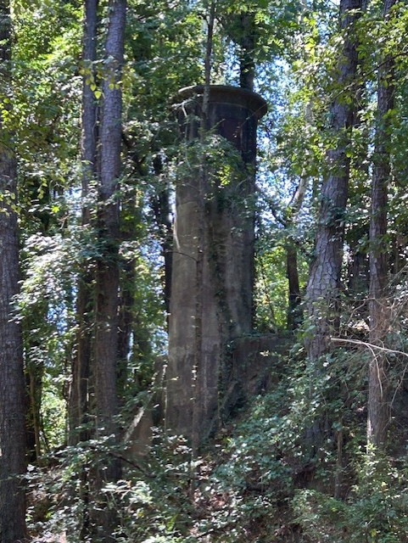
Evans & Carvers

Slide 10


Slide 11
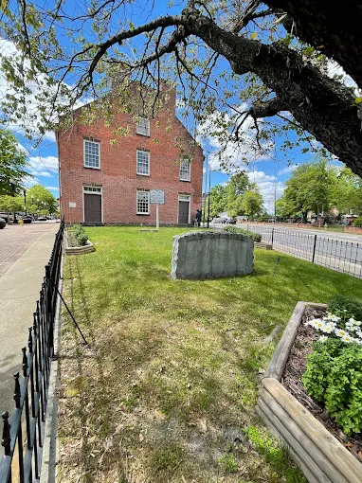
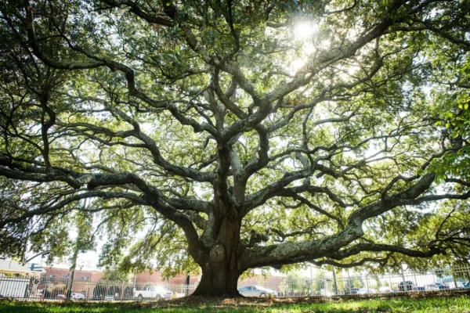
Discussion
Historic memorials and sites meant for the public are gated and privately-accessible; however, the public often celebrates the material objects related to the events.
Basic maintenance of the cemeteries are better with publicly-funded plots, while family cemeteries are overtaken by nature or missing in records.
The burial sites of the signers are mixed between public and private access, with both experiencing preservation and conservation through private efforts.

Slide 12
Future Expectations
Investigating the burial sites of the remaining signers
Searching through remaining records for the Evans and Carvers burial site to identify precisely where it is physically located
Survey the cemeteries not listed on the NC Archaeological Cemetery List and send documentation
Potential programming ideas related to the cemeteries, such as gravestone preservation and historical tours

Slide 13
Acknowledgements
This project was supported through a grant from America 250 NC, a program of the NC Department of Natural and Cultural Resources.
Melissa Timo & the NC Office of State Archaeology’s Historic Cemetery Program
Cumberland County, NC & City of Fayetteville
Local & State History Department & Cumberland County Public Library

