Slide 1
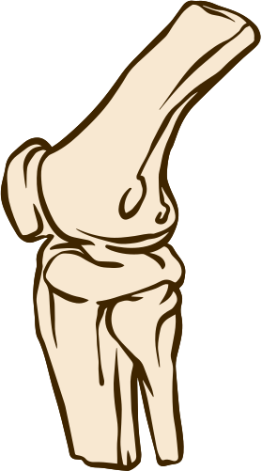

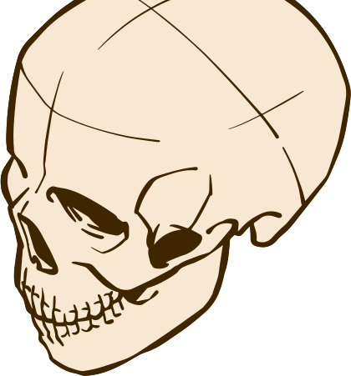



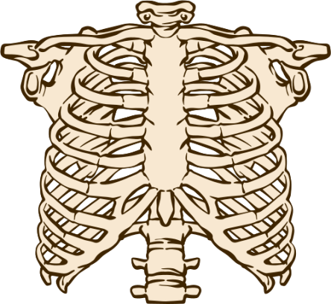
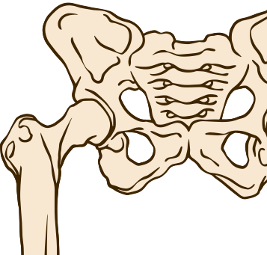

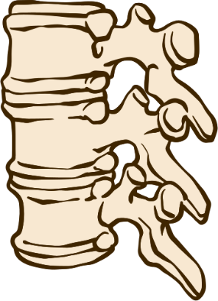
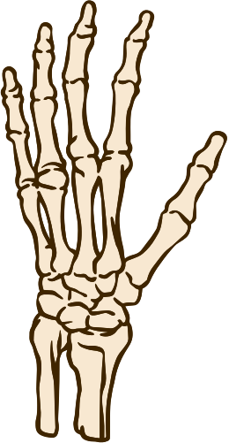
WARNING!
GRAPHIC CONTENT:
Processing and Exhibiting Sensitive Medical Materials

Slide 2

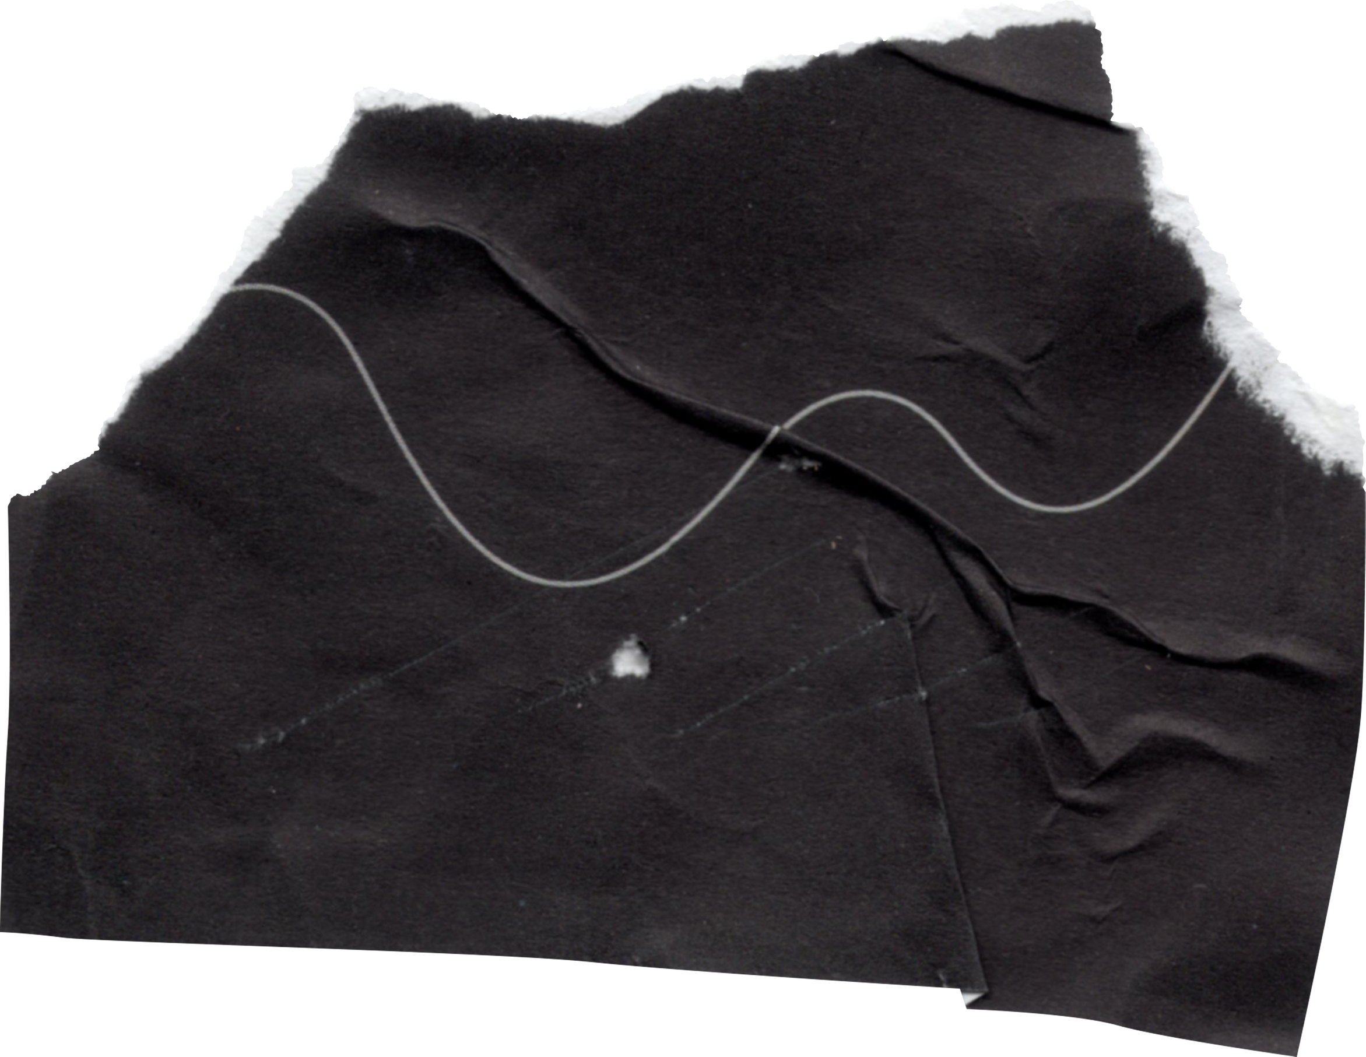
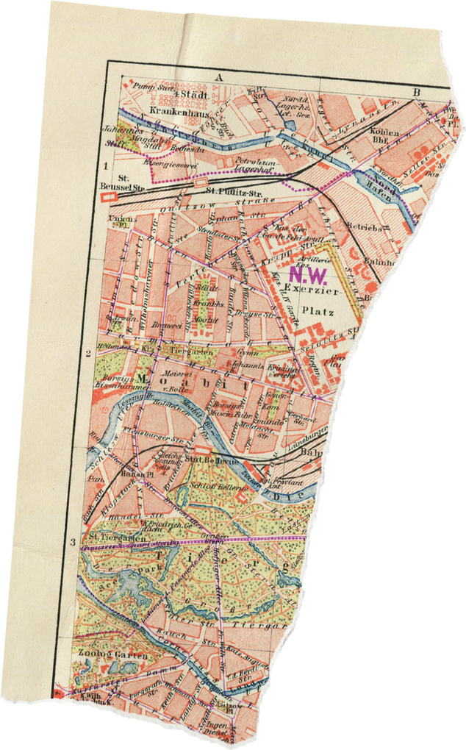
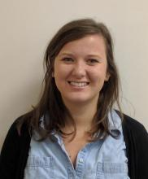



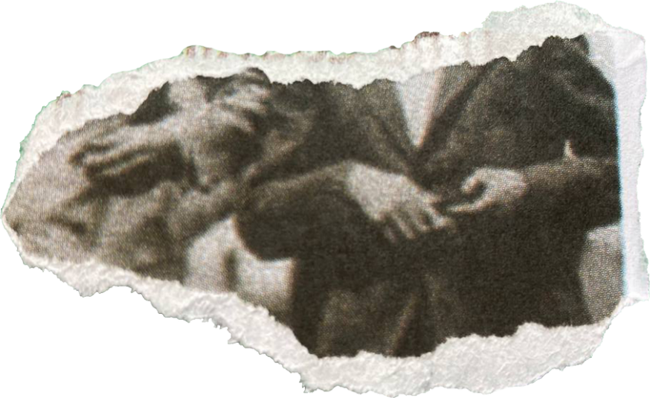
DUKE UNIVERSITY
MEDICAL CENTER ARCHIVES
Archives Research, Outreach, & Education Librarian
Rebecca
Assistant Director for Medical Center Archives & Head of Archives Technical Services
Lucy

Slide 3



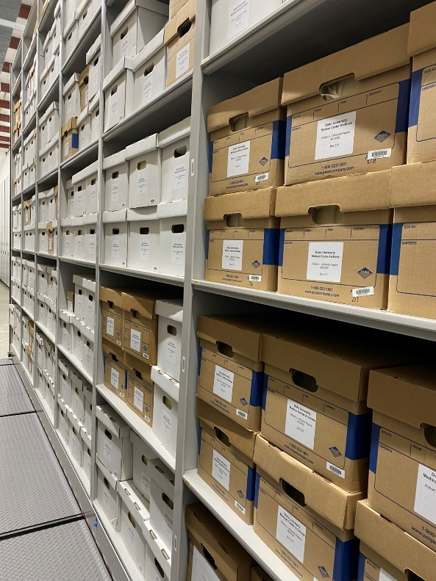
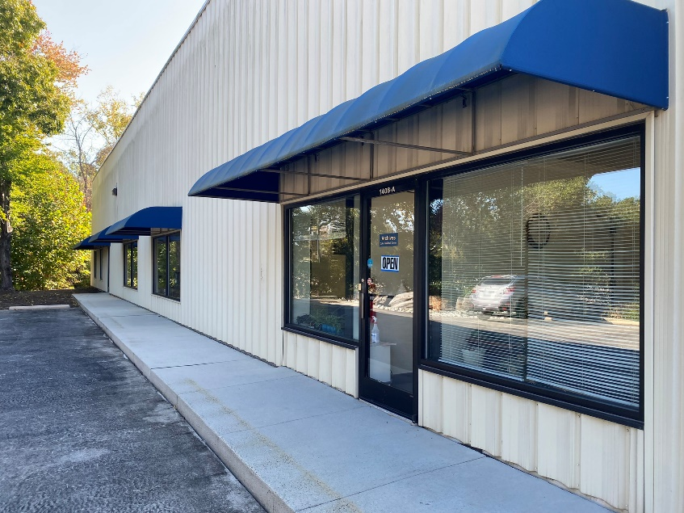

OUR CONTEXT
Duke University
School of Medicine
Medical Center Archives
Notes:
Risk adverse culture/administration
Historically, the Archives maintained a risk adverse mentality combined with the archival approach of More Product Less Process or MPLP.
What this means is—Protected health information (or PHI) or even the possibility of PHI was indicated or noted, but not separated from the rest of the collection materials
If a researcher requested materials in a box or folder that was marked as having PHI, I would then have to go through every single page to review.
In the end, this process pushed researchers towards IRB approval, which is a long and very bureaucratic process and is a high barrier for many.
Okay so now a brief overview of the collection we’re discussing today-

Slide 4



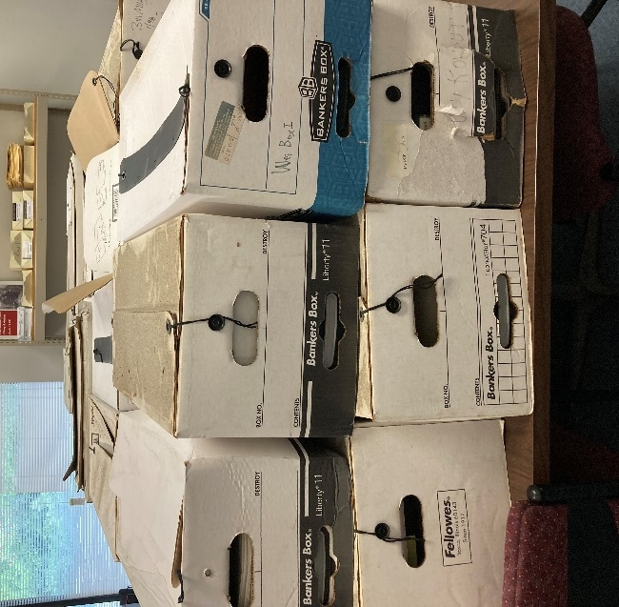

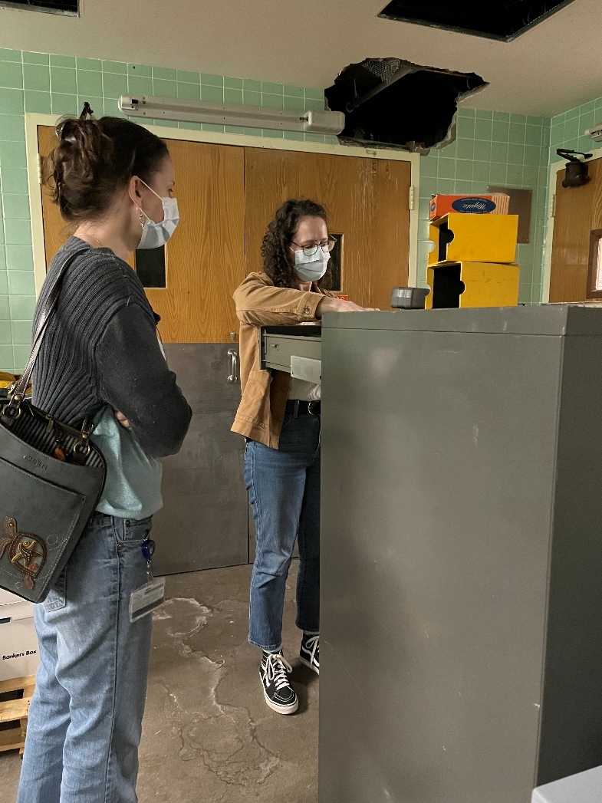

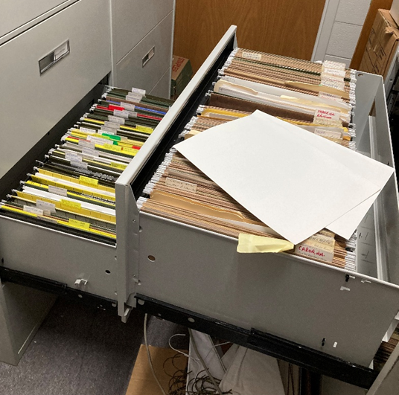

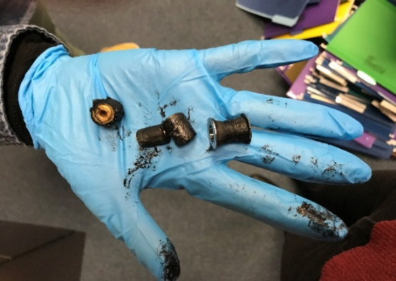







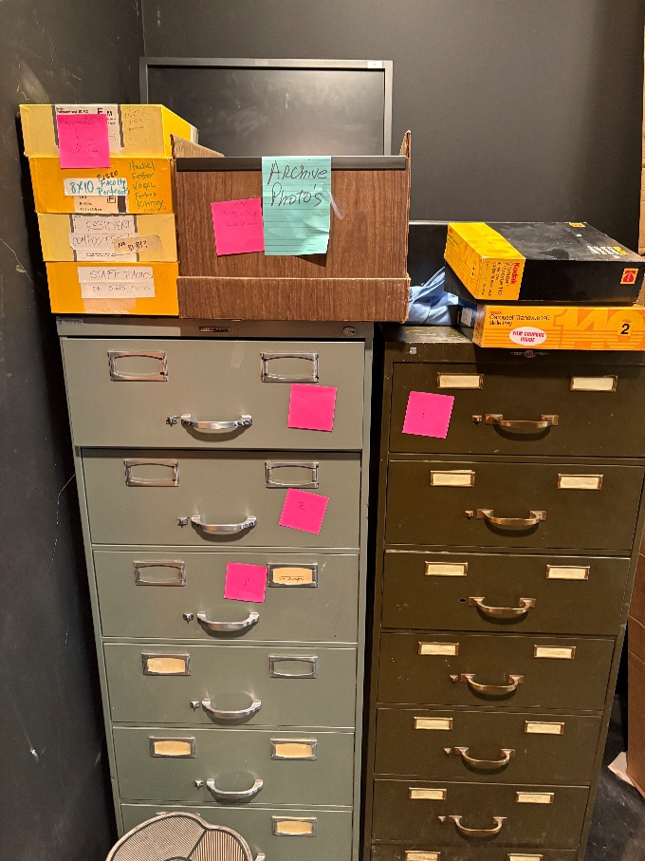

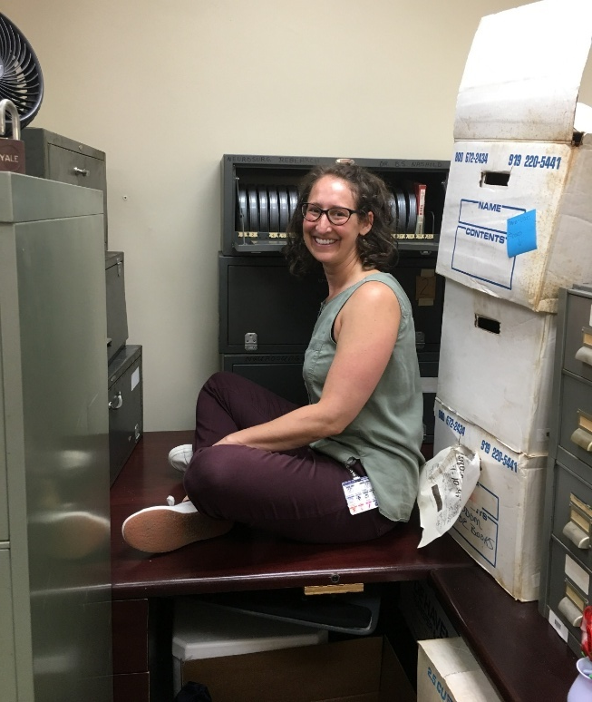
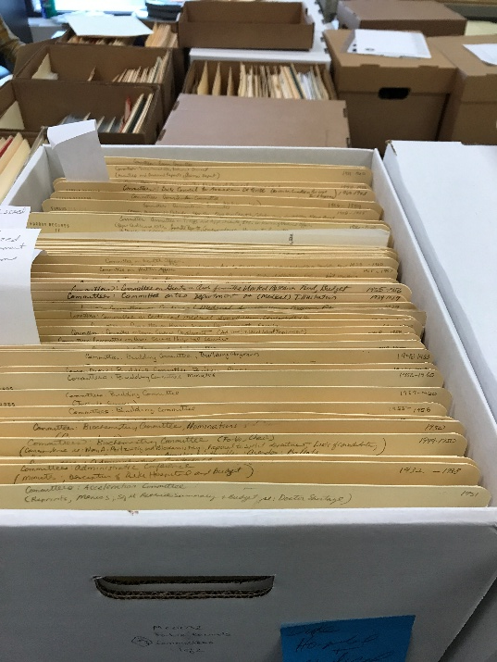



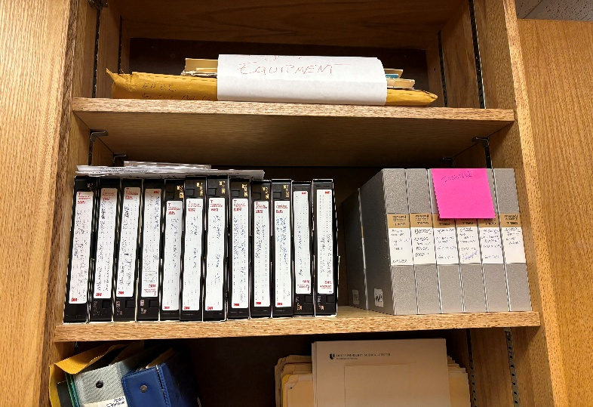




A Day in the Life Of...

Slide 5



Boxes delivered to the Archives after being discovered in a non-climate controlled storage facility.

Slide 6


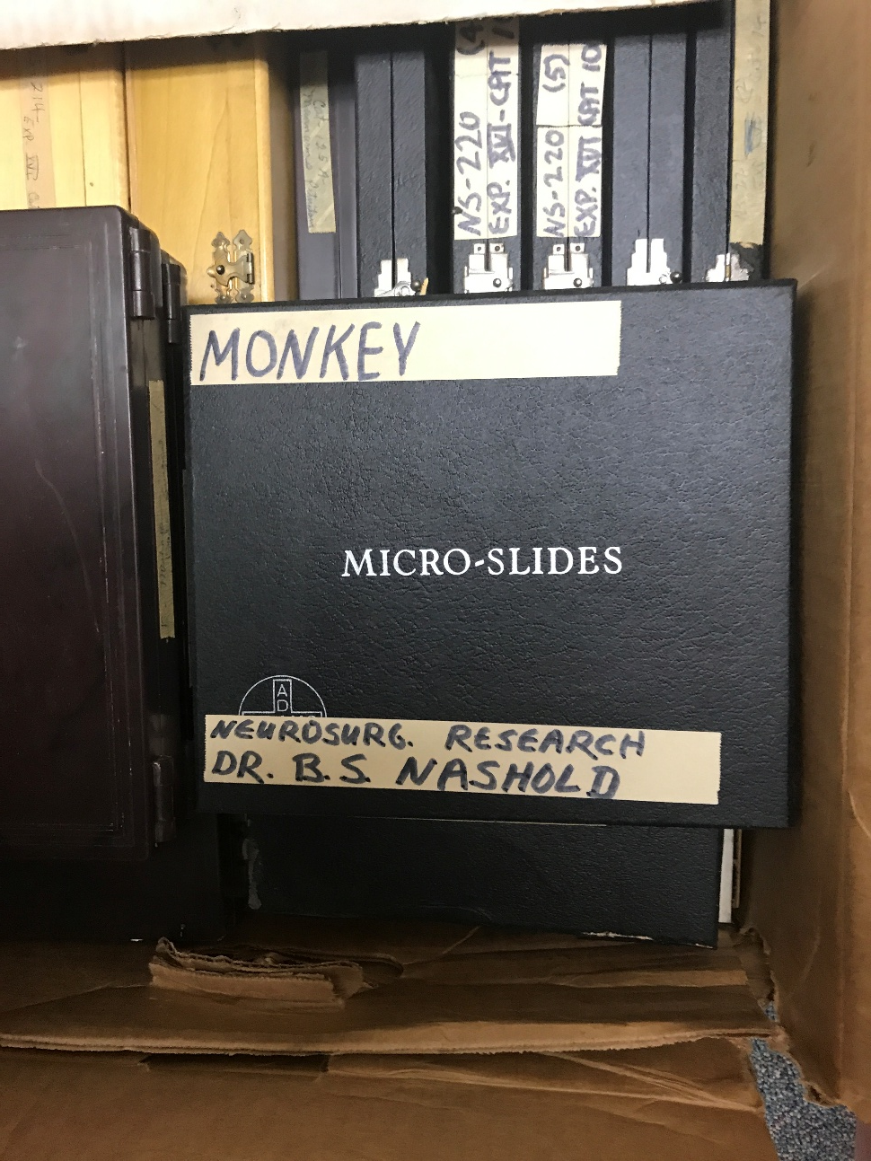

Exhibit #1:
Department of Neurosurgery

Slide 7


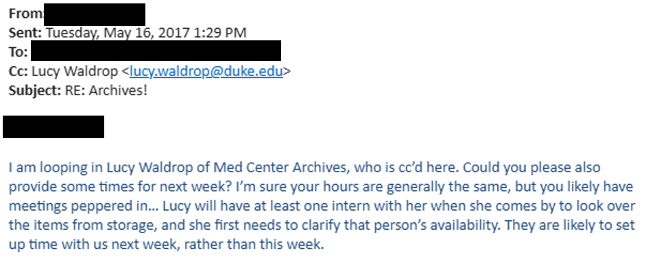
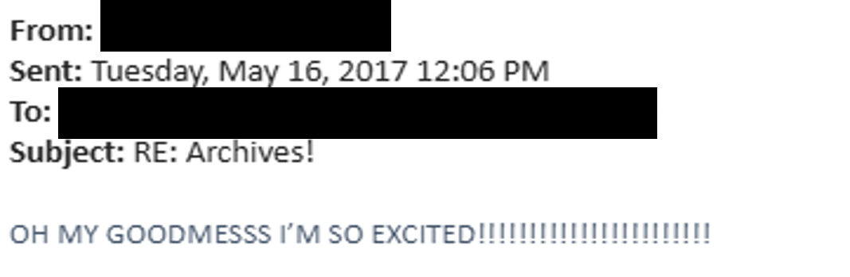
Exhibit #1a: The Request

Slide 8
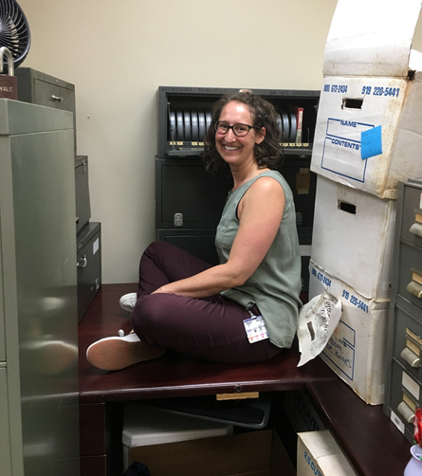


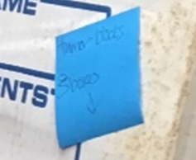
Exhibit #1b: The Pickup
Post-it Note
Tumor blocks
3 boxes

Slide 9
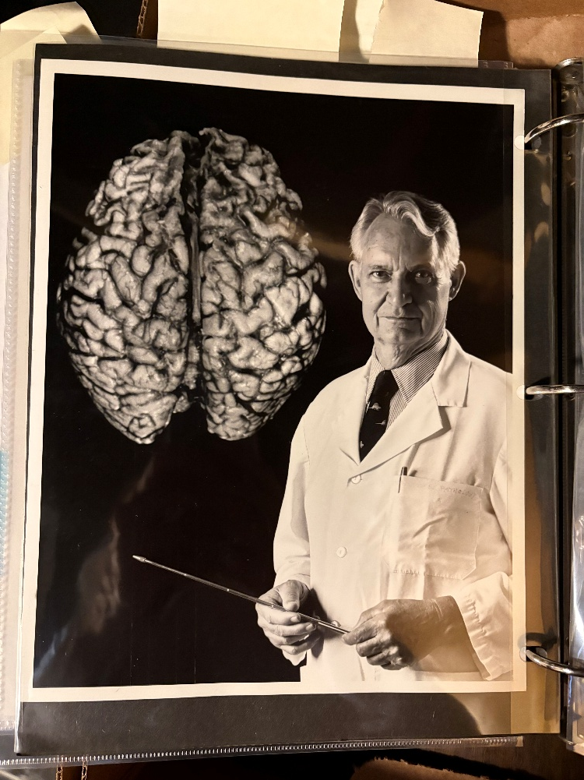
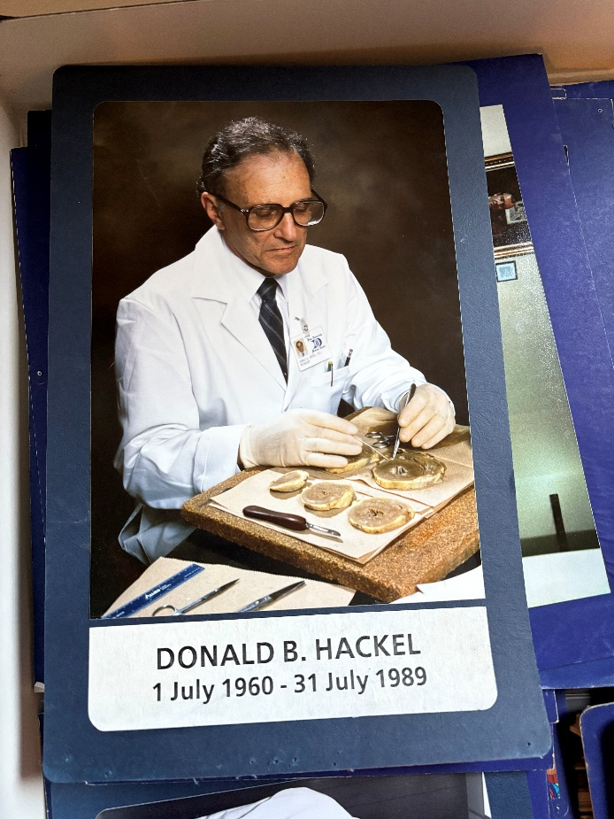
Exhibit #2: Department of Pathology

Slide 10
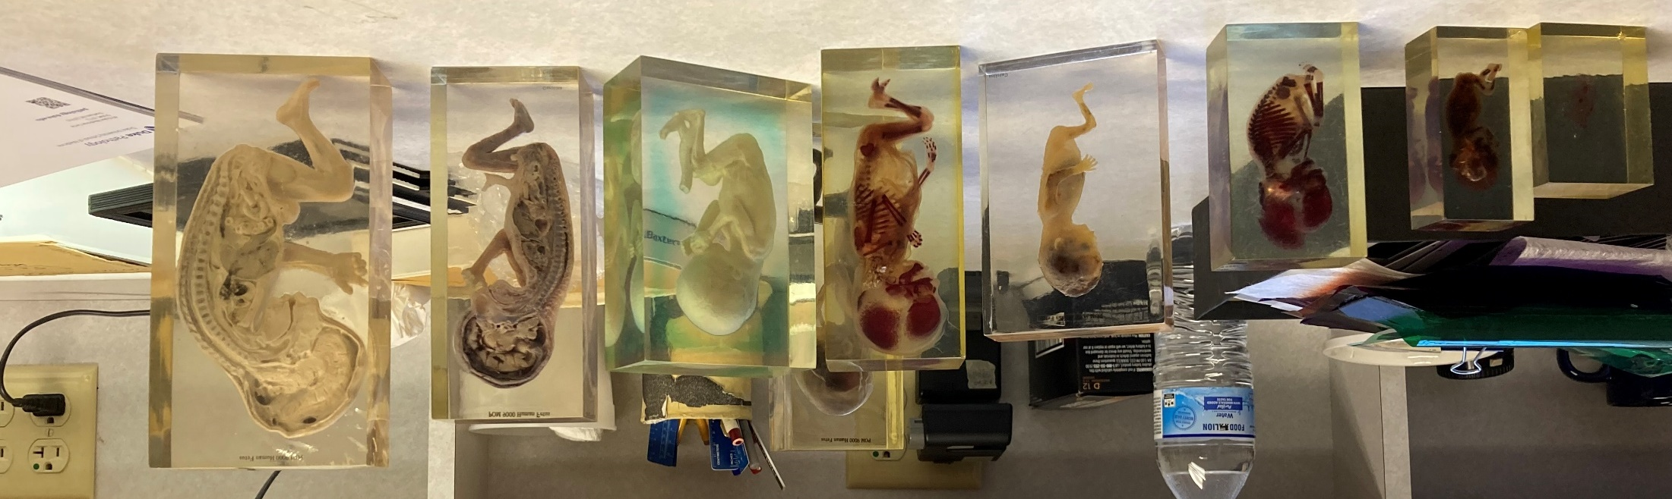

Exhibit #2a: Pathology Photographer

Slide 11
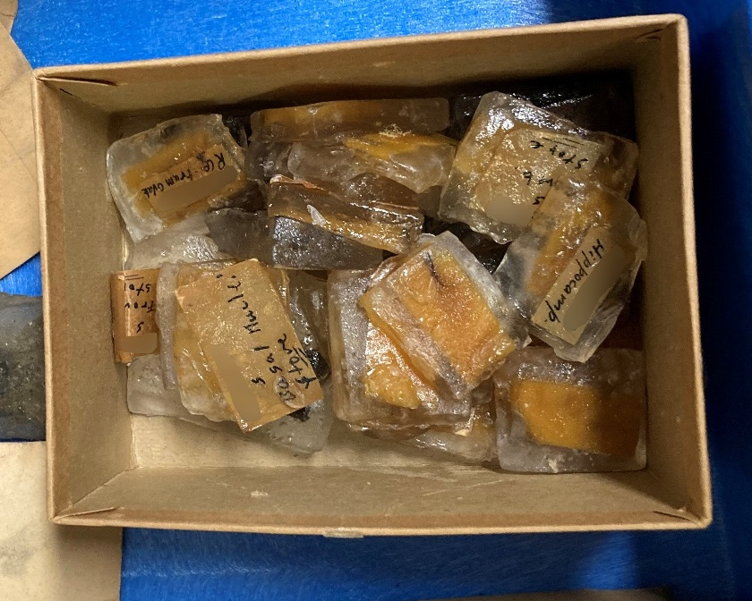
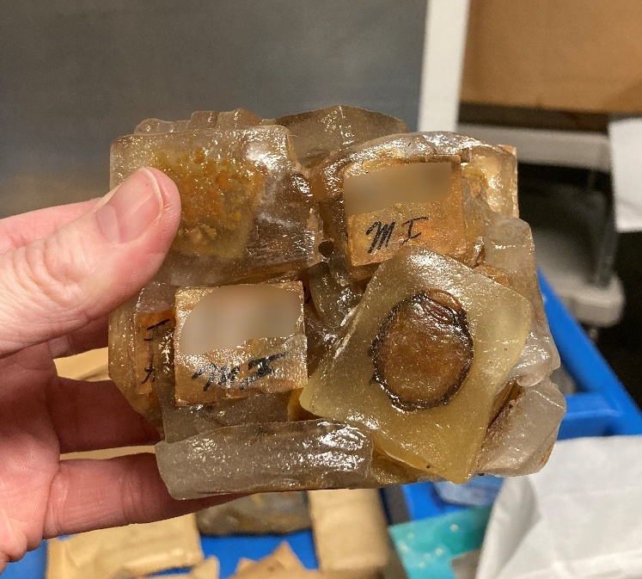
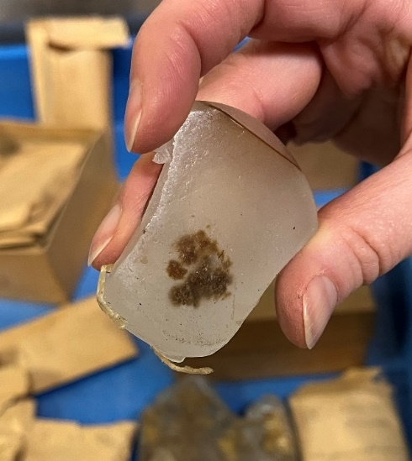
Exhibit #2b: Specimens From Storage

Slide 12
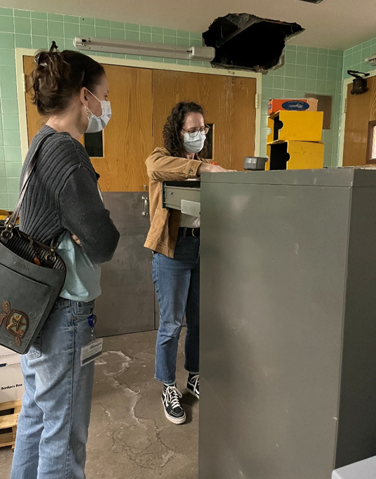

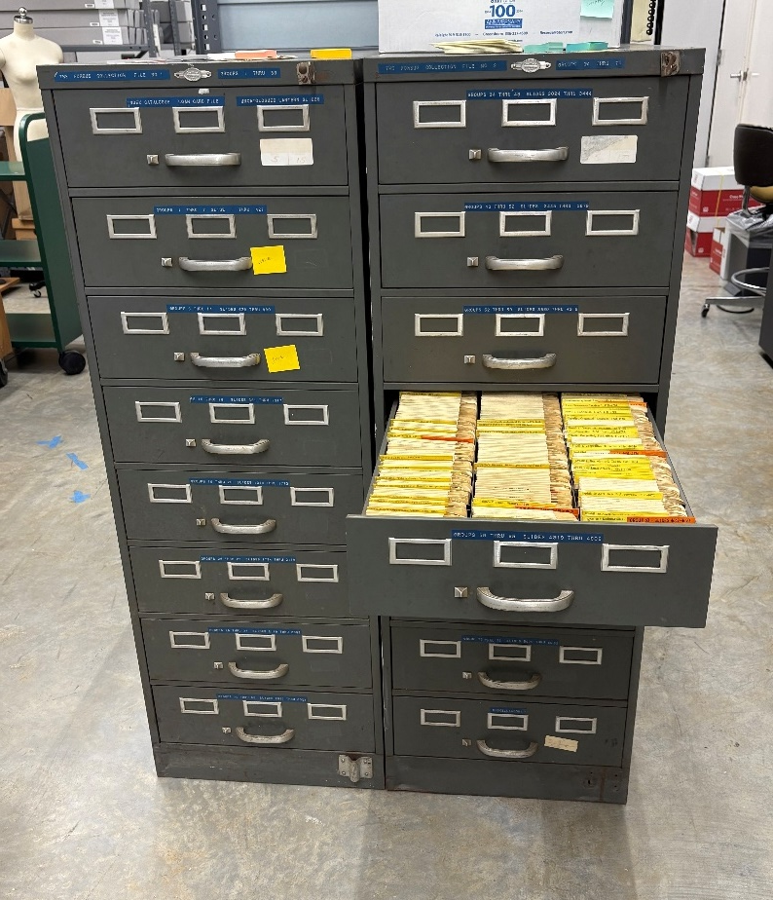
Exhibit #2c: Forbus Pathology Slide Library

Slide 13

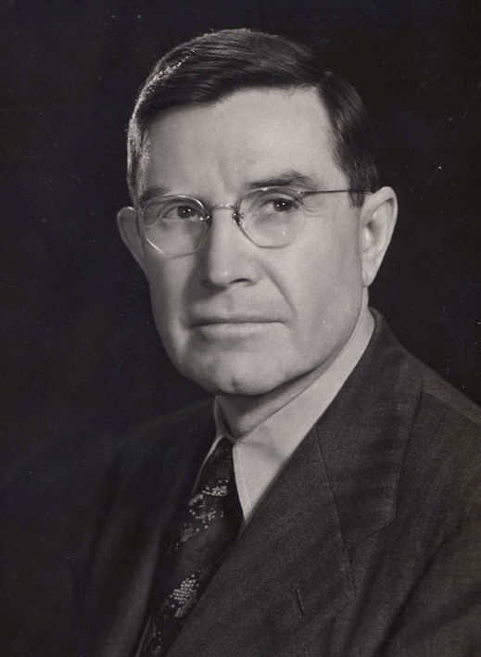
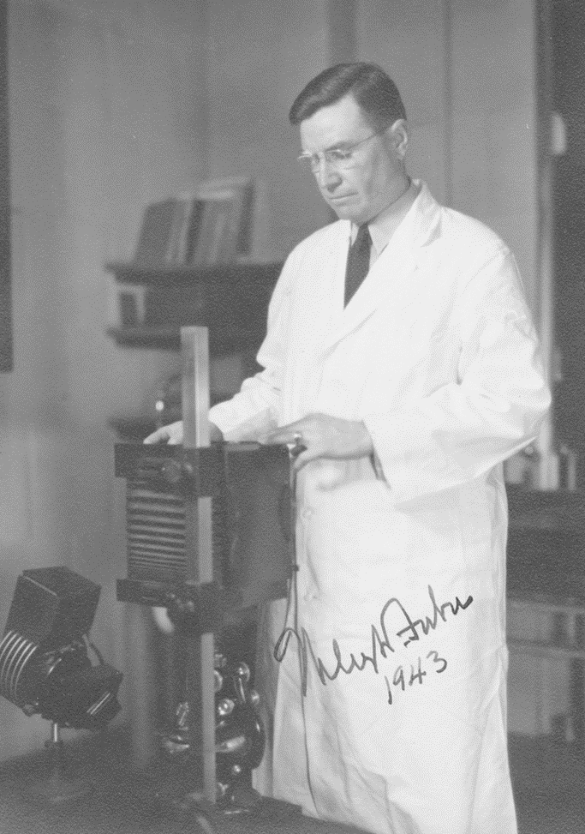
Exhibit #3: Wiley D. Forbus Records, 1849-1979

Slide 14


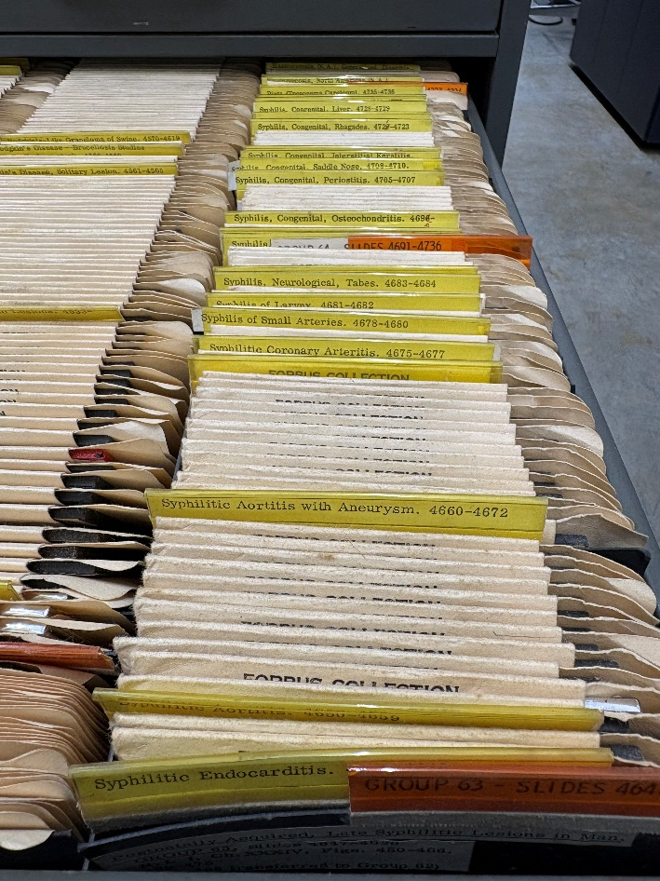
Exhibit #3a: Forbus Pathology Slide Library
Added to the Wiley D. Forbus Records
Needs to be inspected for mold
Needs be reviewed for PHI
Needs to be reviewed for human tissue

Slide 15

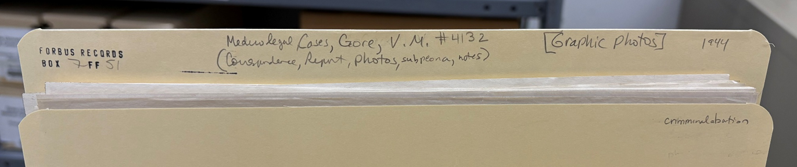
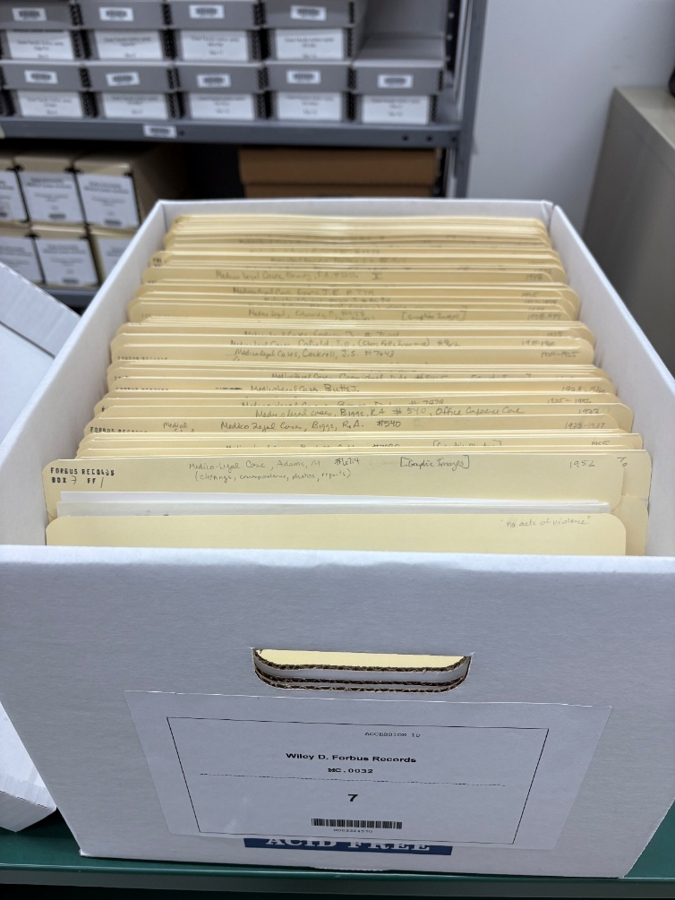
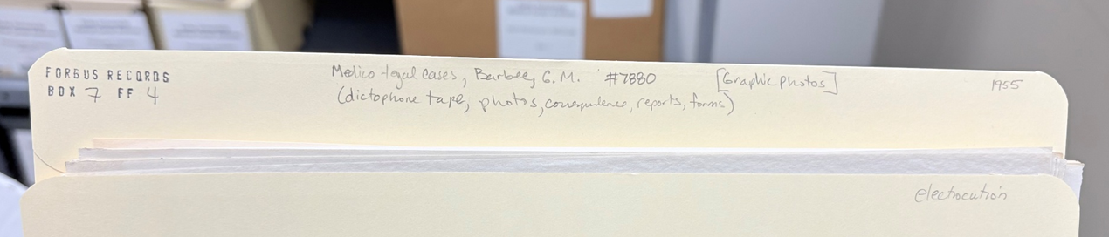
Exhibit #3b: Describing Graphic Materials

Slide 16
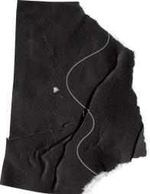

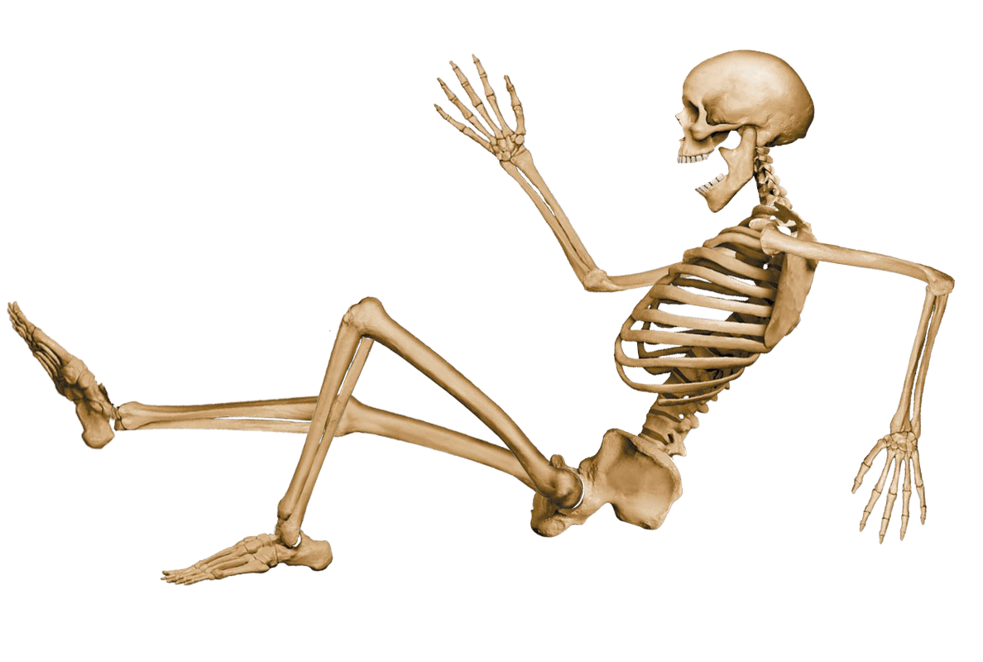
Lessons from Technical Services
Always expect the unexpected
Be flexible
Ask questions and document
Use your collection development policy
Always provide as much context and description for the person who comes after you
Don’t be like me! Remember to pack gloves
Notes:
Always expect the unexpected, especially when you work at a medical archives
Don’t be afraid to say no when you have a collection development policy to back you up; and just because you say no to an item, doesn’t mean you cannot help the donor find another repository or a way to correctly dispose of the organic materials
Always try to provide as much context and description for the person who comes after you in order to prepare them for what they are going to see

Slide 17
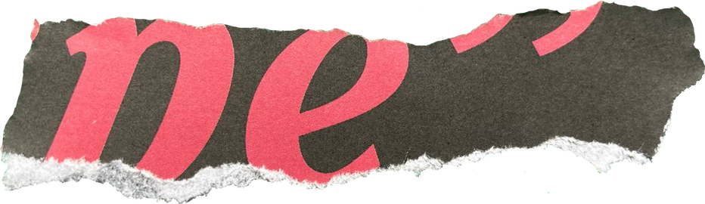

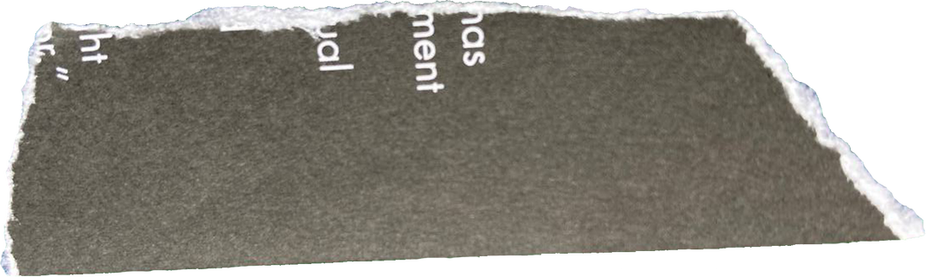
Reference Services
& Outreach

Slide 18

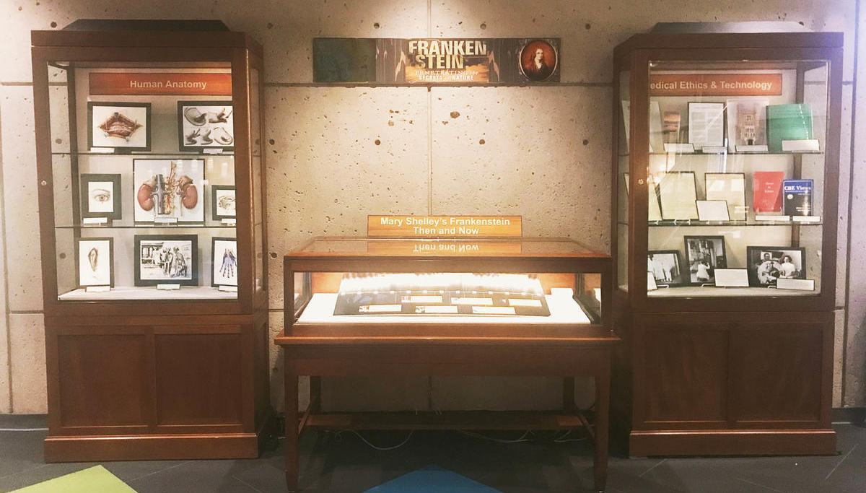

Slide 19
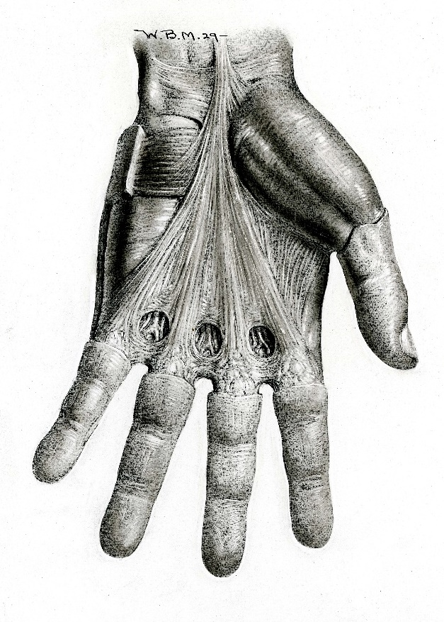
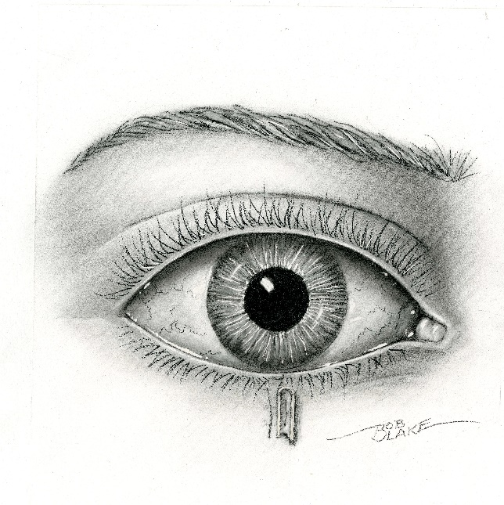
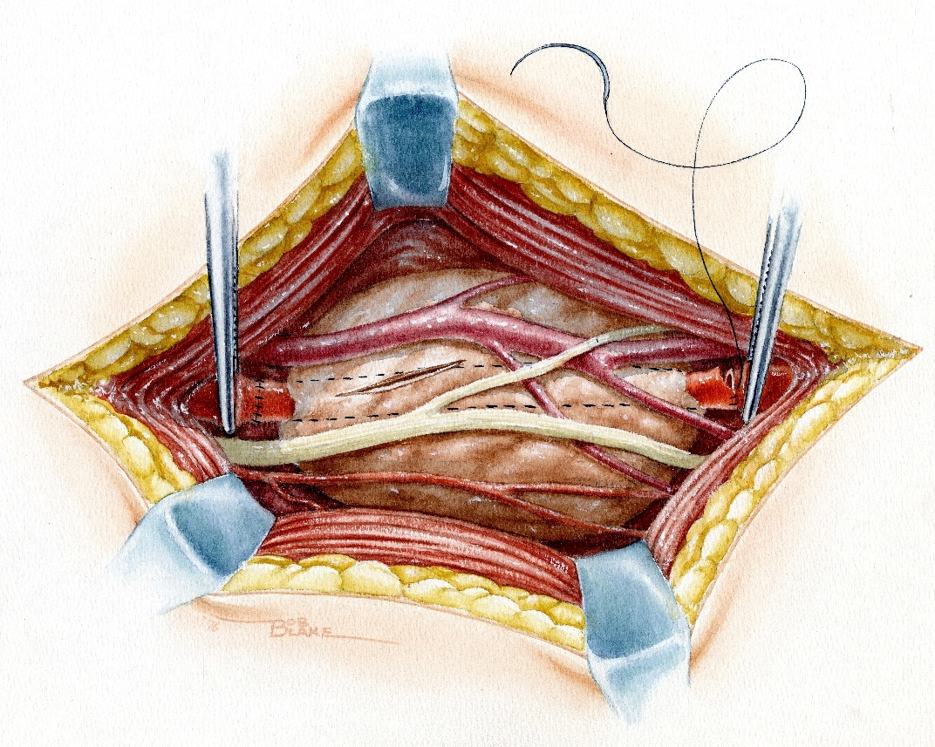
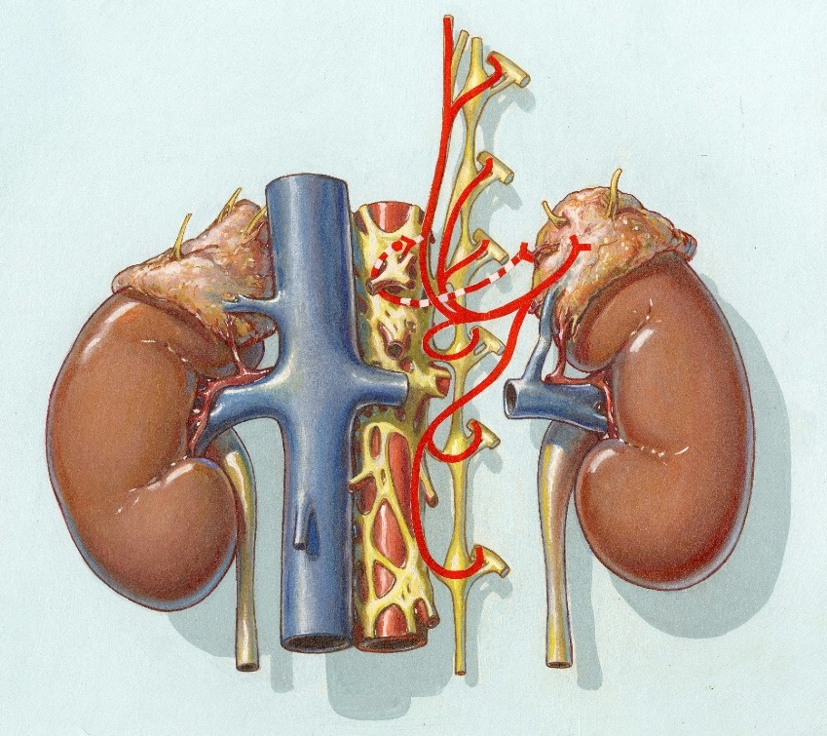
Exhibit #1: Medical Illustrations

Slide 20
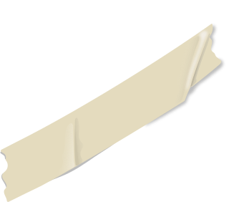

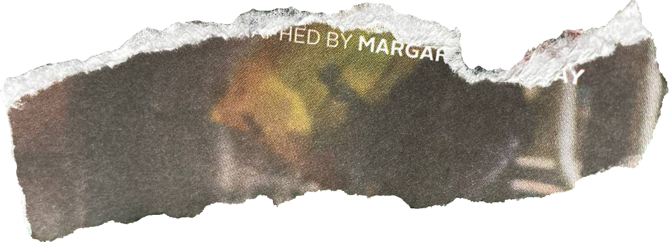
CLUE # 4
This small, triangular bone sits in front of the knee joint.
It protects the joint and enhances the leverage of quadriceps muscles during movement.

Slide 21



Exhibit #2:
Surgery Film

Slide 22
AUDIENCE
MATTERS

Slide 23




Exhibit #3: It Came From the Archives

Slide 24



Exhibit #3a:
Death Masks

Slide 25

Exhibit #3b:
Anatomy Film

Slide 26



Exhibit #3c:
Autopsy Records

Slide 27


CONCLUSIONS
Who is the audience?
What is the context?
What information can you provide?

Slide 28
Thank you!
lucy.waldrop@duke.edu
rebecca.j.williams@duke.edu

