Slide 1

Reflections and Tales From Bentonville Battlefield
NCPC Conference
November 14th, 2025
Rachel McLaughlin
Project Archivist, The Winthrop Group
Notes:
My name is Rachel McLaughlin and currently I'm a project archivist working with the Winthrop Group. However
from the summer of 2023-summer of 2024, I had the honor of working as a part time historic interpreter and MLIS intern and Bentonville Battlefield State Historic Site.

Slide 2
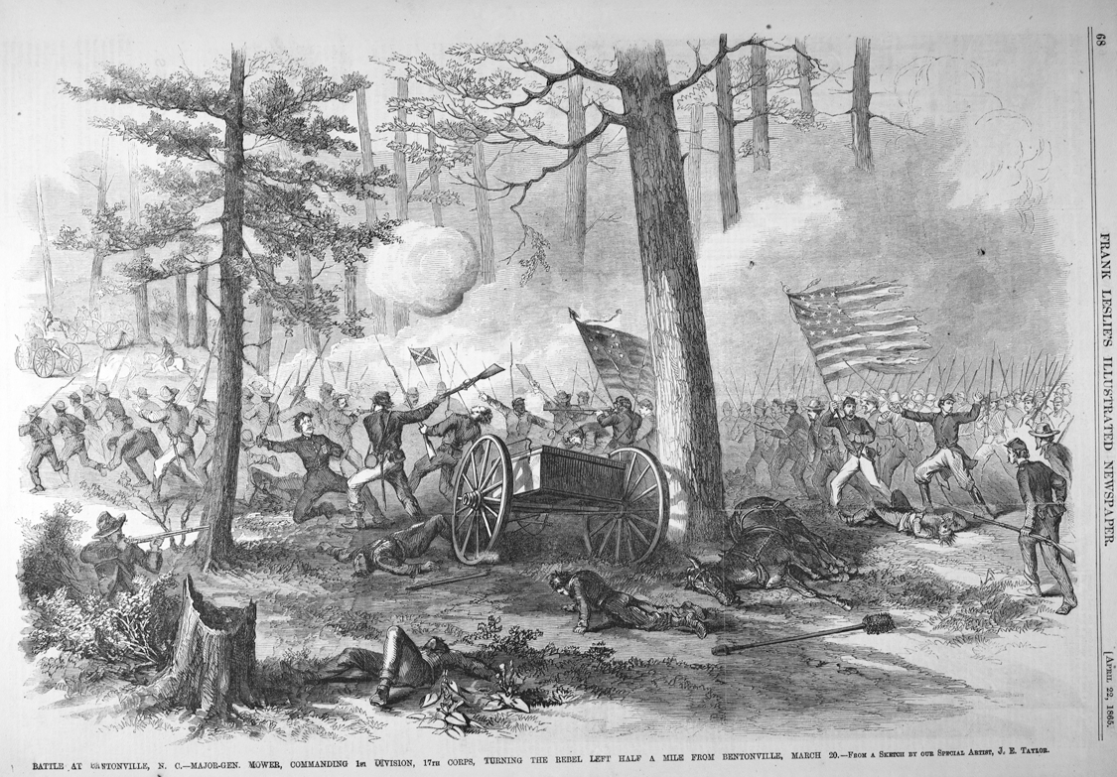
Bentonville Battlefield State Historic Site
  Located in Johnston County, North Carolina
  3 day Civil War Battle held March 19th-21st 1865
  Largest Civil War Land Battle fought in NC
  Total Casualties: 4,133 (1,527 Union vs 2,606 Confederate ( American Battlefield Trust)
Appeared in April 22, 1865, issue of Frank Leslie's Illustrated Newspaper. From Original Prints, Audio Visual Materials, Special Collections, State Archives of North Carolina.
Notes:
The Battle of Bentonville was one of the last major battles of the Civil War before Confederate General Joseph Johnston would surrender to Union General William Sherman down the road at Bennett Place in Durham.
At the Historic Site, you can see a portion of the Battlefield that is currently preserved, the museum, a monument area, and tour the historic Harper House that was used as a Union field hospital during the three day Battle.

Slide 3
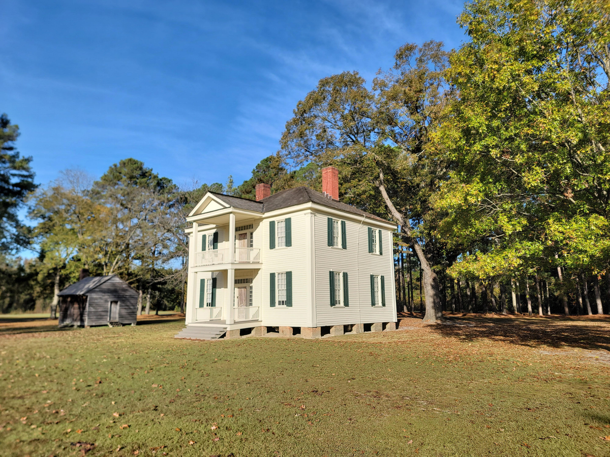
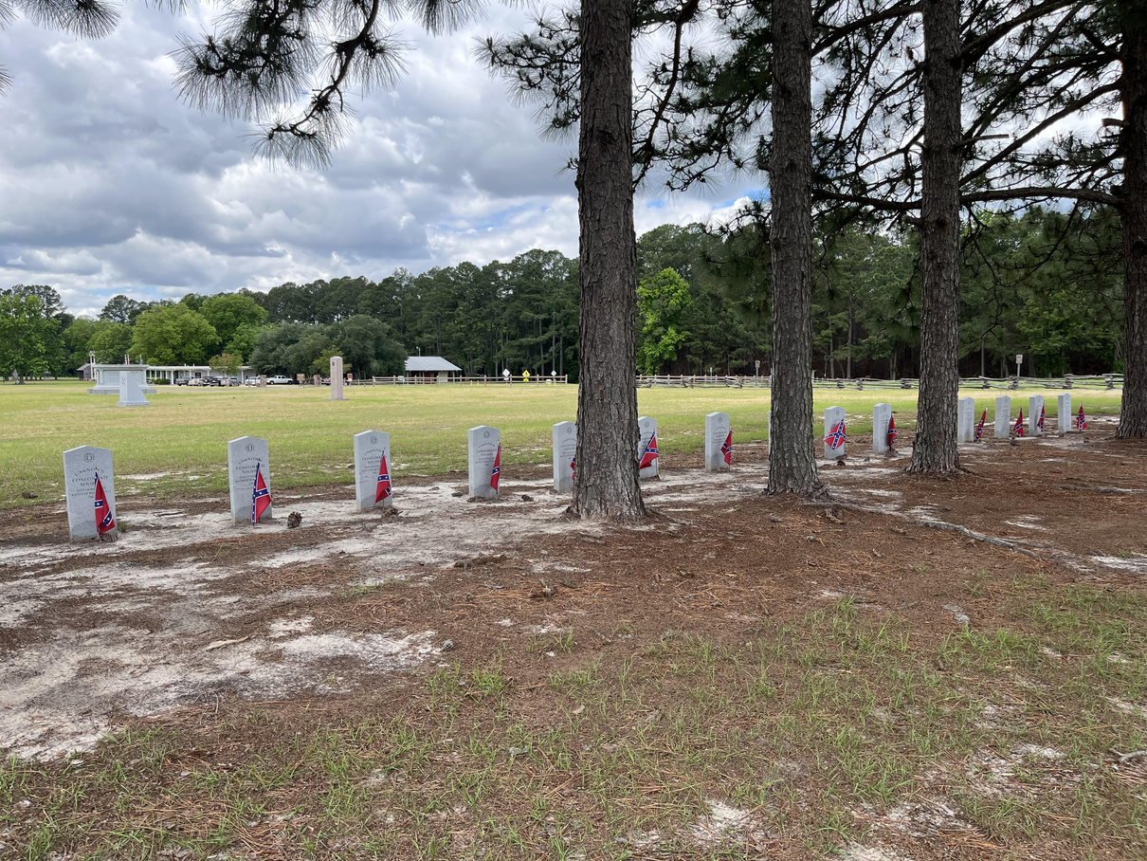
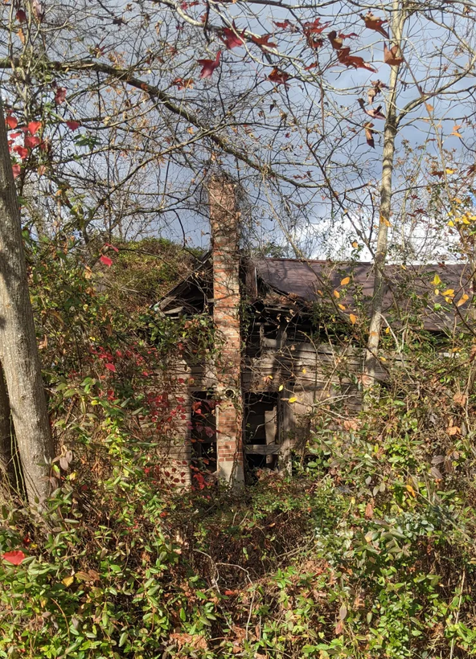
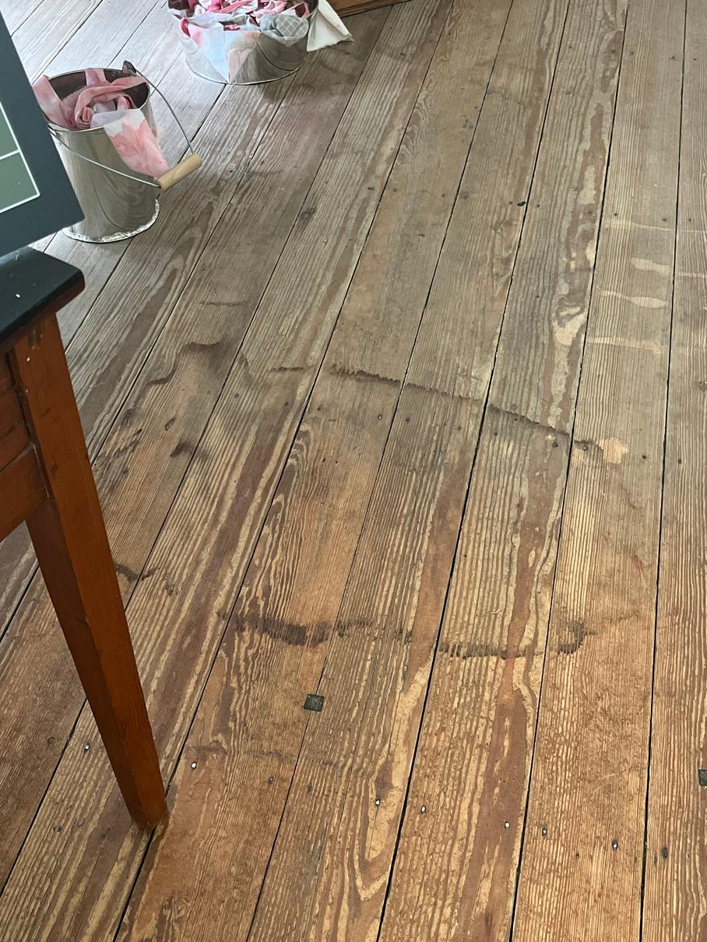
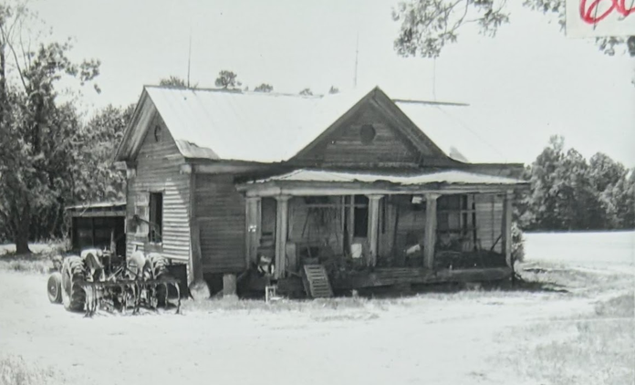
Thousands of Stories...
The Levin Cole House
Photo by Fred Claridge
Confederate Cemetery
Photo by Rachel McLaughlin
Historic Harper House
Blood Stain in Front Room
Photos by Bentonville Staff and Rachel McLaughlin
The Levin Cole House
The Historic Architecture of Johnston County, NC
Notes:
Bentonville Battlefield holds thousands of stories and every time I worked at the site, I was reminded of stories related to
- the doctors and surgeons who worked endlessly to save lives
- the Confederate Prisoners of War who would be left by the Union Army and are now buried at the site
- People like the Harpers who lived in the village
- and people like Levin Cole who were enslaved by others in the village but would later stay in the area upon emancipation in order to build a life.
Thousands of stories, but today I'm only going to go into detail about two different stories. In particular of cemetery visits I conducted in order to tell some of these stories.

Slide 4
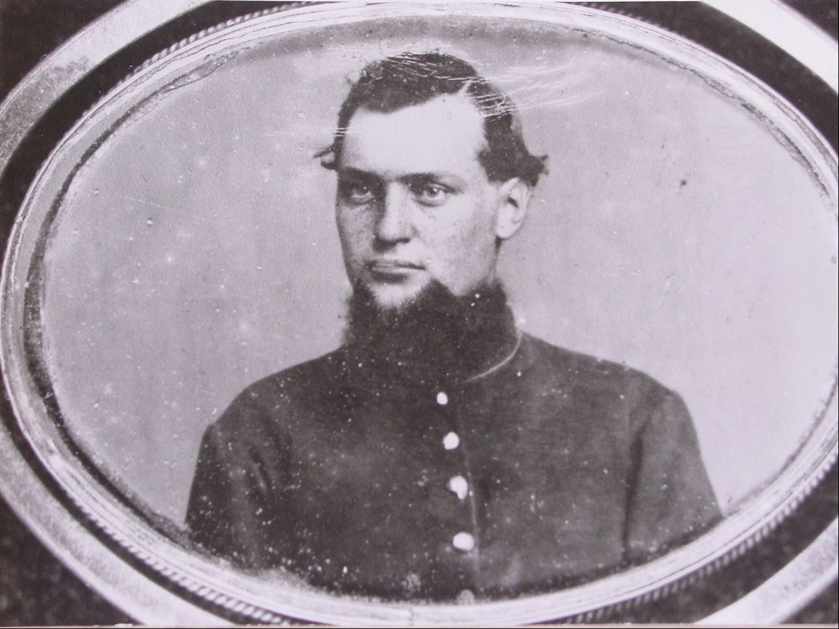
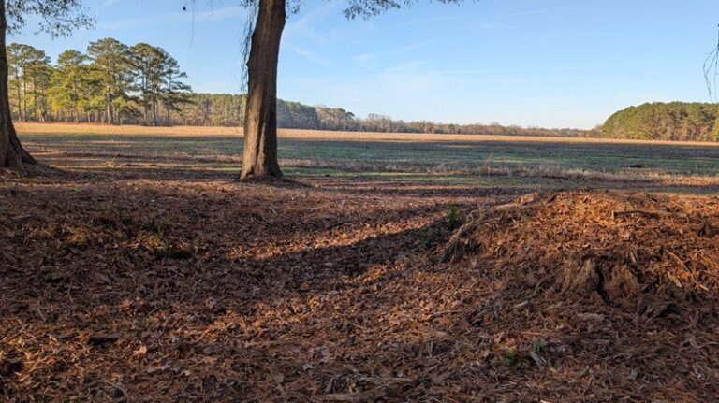
John M. Knapp
Image overlooking Cole Plantation where John M. Knapp was wounded
Photo from Emerging Civil War
John M. Knapp
Courtesy of Bentonville Battlefield
Notes:
The first story is that of a Union Soldier. Mr. John M. Knapp a 21 years old, who enlisted on August 9th, 1862 at Grand Rapids, MI as a Private.
During his 2.5 years in the Union army he travelled and fought throughout the South...
- 1863-1864 worked on Engineer Duty in Tennessee
- Battle of Stones River, Tennessee, (Dec. 31st-Jan. 2nd, 1865) Knapp was wounded and taken prisoner but was later paroled
- On the first day of fighting at Bentonville Battlefield, March 19th, he was wounded again after intense fighting. There is once source that says: that he “stopped a moment to aid a wounded comrade and was himself shot through while performing this human act. He crawled along while thus wounded, for more than a mile, but died a few hours later.”
- As was common, Knapp would have been buried somewhere on the battlefield. Sherman's army stayed after the Battle on the 22nd in order to remove the wounded and buried the dead.

Slide 5
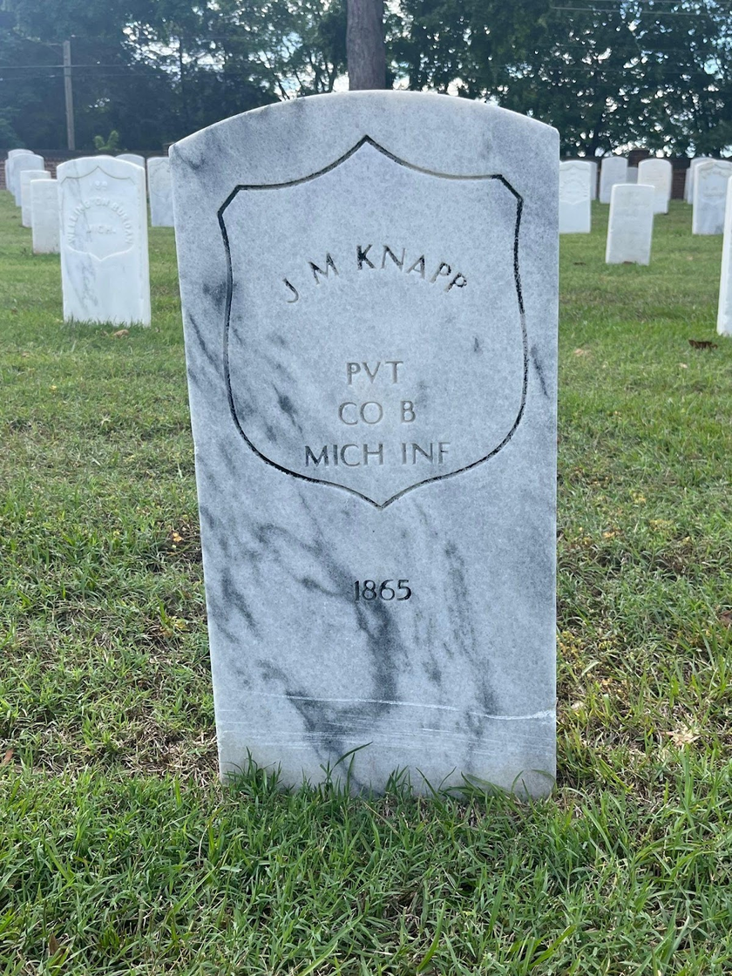
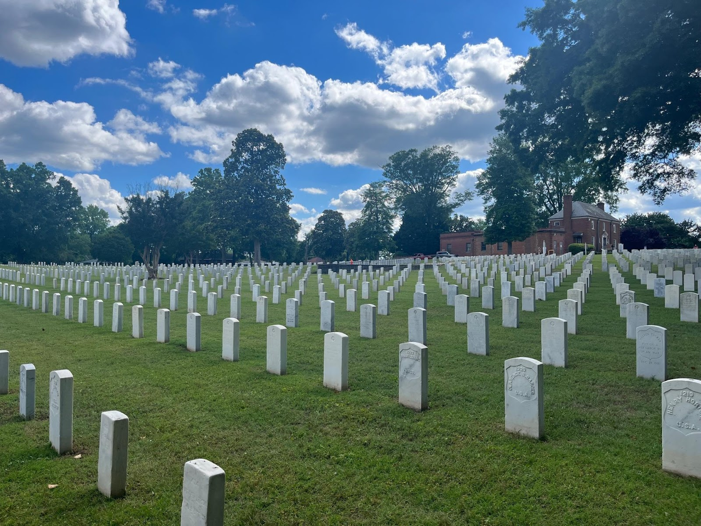
Raleigh National Cemetery
Raleigh National Cemetery and John M. Knapp Granite Grave Marker
Photos by Rachel McLaughlin
Notes:
But Knapp's final resting place would not be at Bentonville.
While Sherman occupied Raleigh in 1865, the Raleigh National Cemetery was established and soldiers from Averasboro, Bentonville, Goldsboro, Greensboro, Franklinton, and Henderson.
Confederate Soldiers were not allowed to be buried unless they were prisoners of war. Consequently, you can find Confederate Soliders buried just a mile away from this National Cemetery at Oakwood Cemetery.
Originally were wooden painted headboards.

Slide 6
Clark L. Reed to John Knapp’s Parents writes:
“As the last token of friendship and remembrance of my Brother Soldier and companion in arms, I plucked from our Earth a nice little wild plum tree filled with white blossoms and planted it at his head praying as I done so.”
Notes:
Knapp was only around 24 when he passed. His story stands as a testament really to those left behind as everyone remembers him.
In Michigan there is a cenotaph near Knapp's parents memorializing his life. Though buried in North Carolina, his legacy lies in Michigan.
We have a wonderful letter by someone who considered him a friend who wrote about the loss of Knapp:

Slide 7
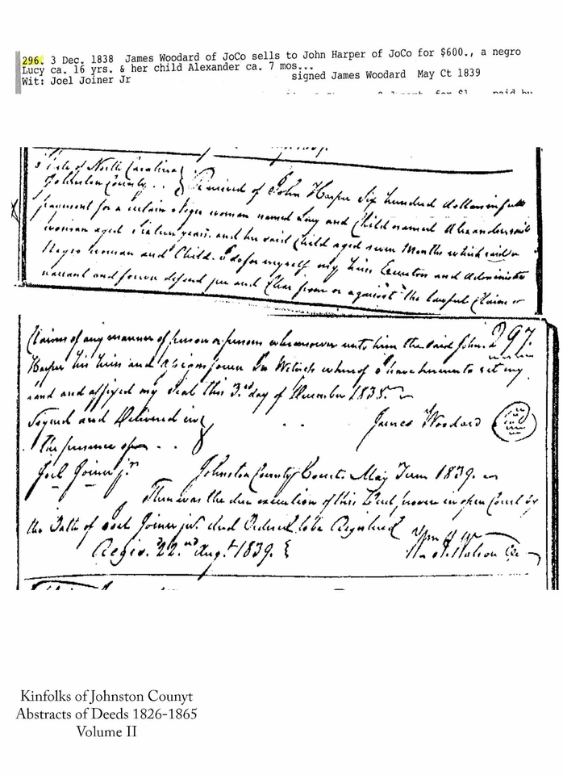
Looking for Lucy and Alex...
“Our home was one of those very large,
perfectly square two story buildings, of ye olden time,
when the servants prepared the meals
away down in the kitchen and took them
up to the “Big House,” as they expressed it.”
Mary F. Harper in Reminiscences of The Battle of Bentonville.
Deed of Sale for Lucy and Alexander Harper
Notes:
The 2nd story revolves around people who called Bentonville Home--the family that was enslaved by the Harpers on their homestead.
Tracing genealogy for formerly enslaved individuals, you follow the records. However, those records can only take you so far. In 1870-1880 you can census records that you can follow, but prior to that, enslaved individuals were merely represented by numbers on slave schedules, maybe named in deeds or receipts. The deed you see here is the first and oldest documentation for the family I or anyone else at Bentonville have been able to trace.
This is the only mention of the enslaved people who lived on the homestead and it occurs in speech given by Mary Harper in her elderly years at a United Daughters of the Confederacy meeting.
So Lucy's story starts with this deed:
Lucy was 16 when she was bought by John Harper with her 7 month old son Alex for $600 or with inflation, almost $12,000 in 1838. John bought Lucy and Alex by James Woodard, his soon to be father-in-law. Suggesting that Amy Harper would have known, they actually would have been around the same age of 16-17.
By 1850, there is another woman enslaved by the Harpers named Clarsey who Alex would later marry and begin to have children with.
By 1865 there were up to 7 people who were enslaved by John and Amy Harper.
They would leave by the Battle of Bentonville--but they didn't go far.

Slide 8
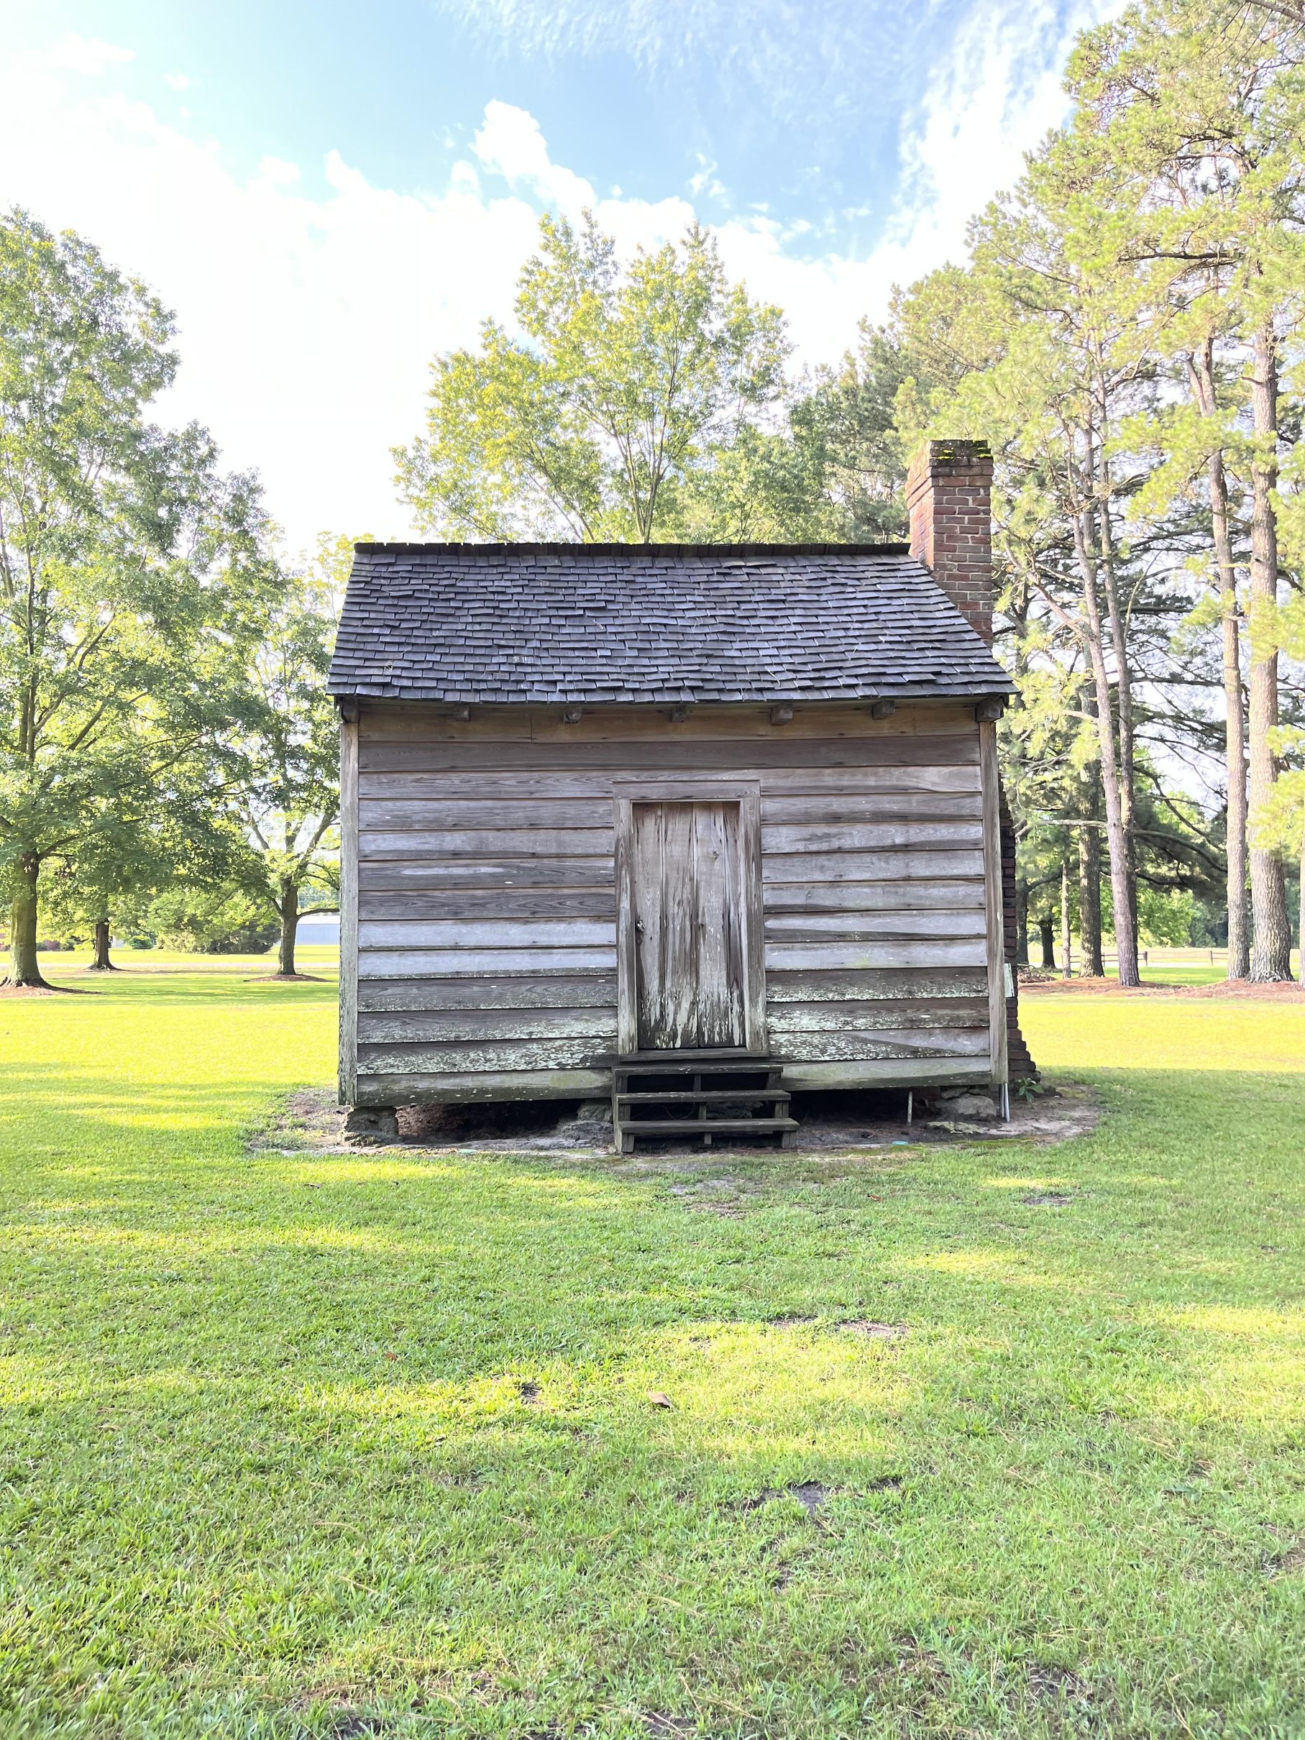
Looking for Lucy and Alex...
Outbuilding Representing Enslaved Peoples Living Quarters
Bentonville Battlefield
Photo by Rachel McLaughlin
Notes:
By 1850, there is another woman enslaved by the Harpers named Clarsey who Alex would later marry and begin to have children with.
By 1865 there were up to 7 people who were enslaved by John and Amy Harper.
They would leave by the Battle of Bentonville--but they didn't go far.

Slide 9
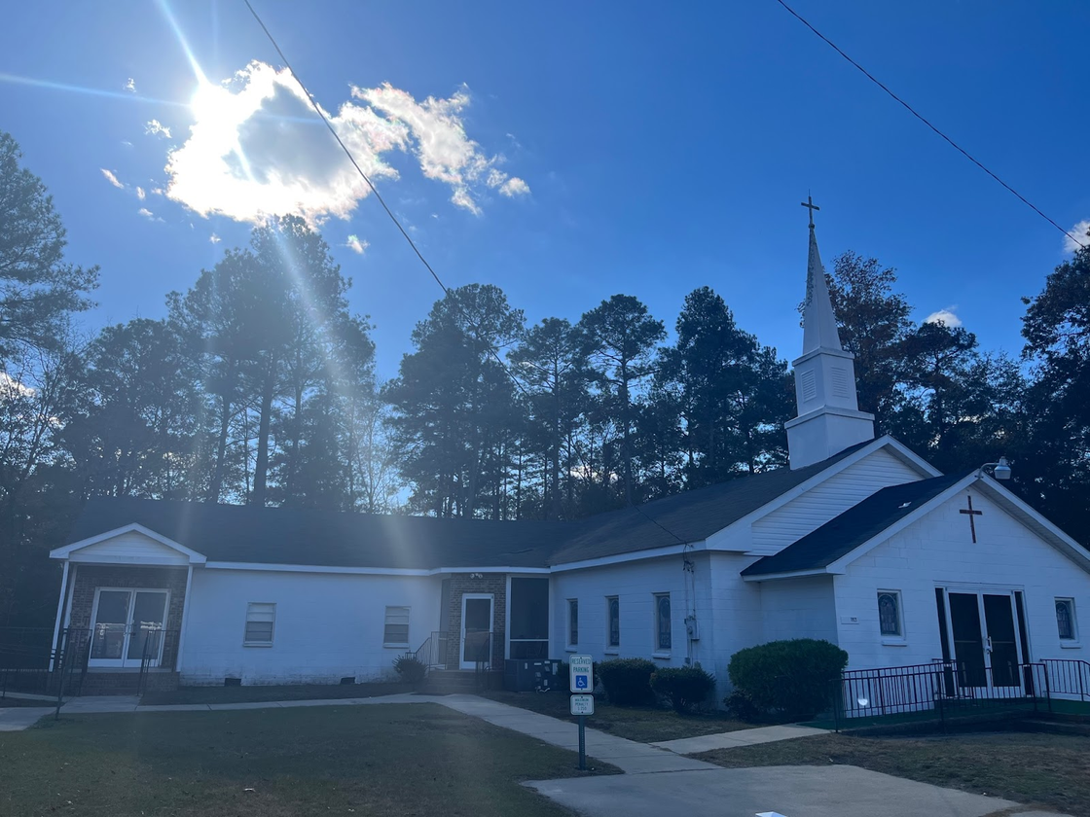
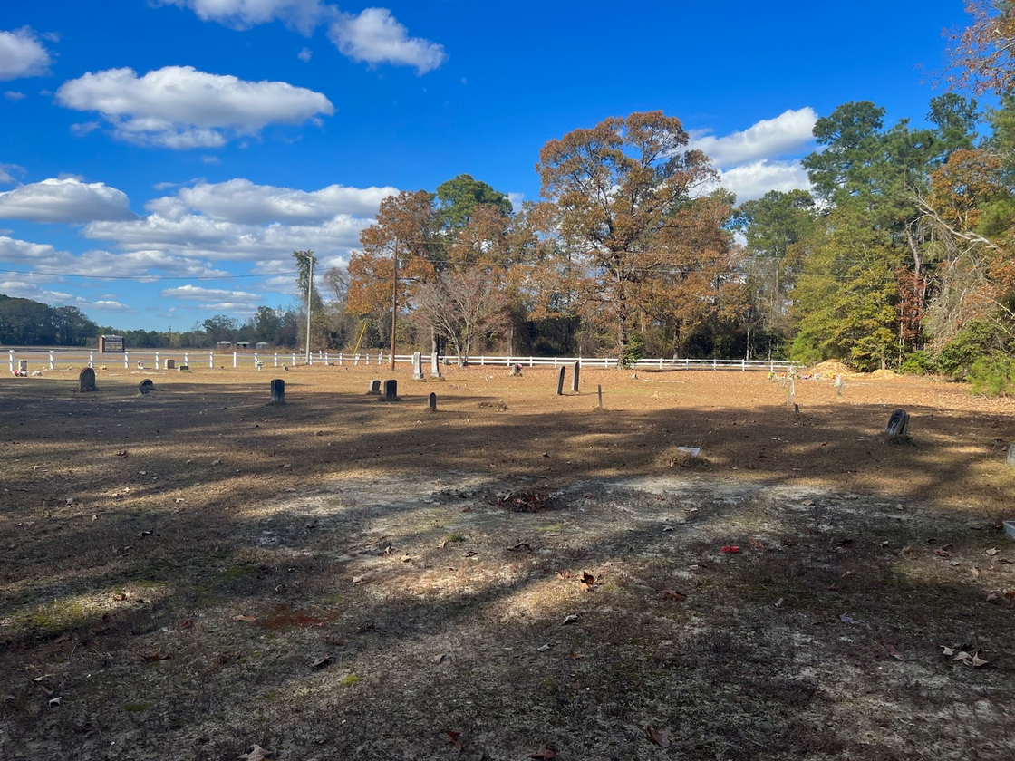
New Disciples Long Branch Church-Rebecca Harper Ingram
Photos by Rachel McLaughlin
Notes:
Rebecca Harper Ingram is the child of Alex and Clarsey, and granddaughter of Lucy Harper.
Following the records, it led me to New Disciples Long Branch Church but sadly, this cemetery was is such deterioration, it was hard to read any of the headstones--if such existed for Rebecca Harper Ingram. However, this is the burial place written on her death certificate, and there are other members of the Ingram family buried here.

Slide 10
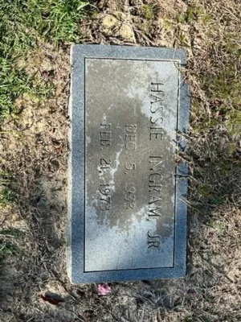
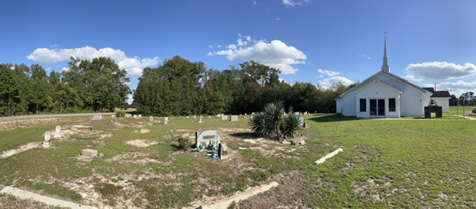
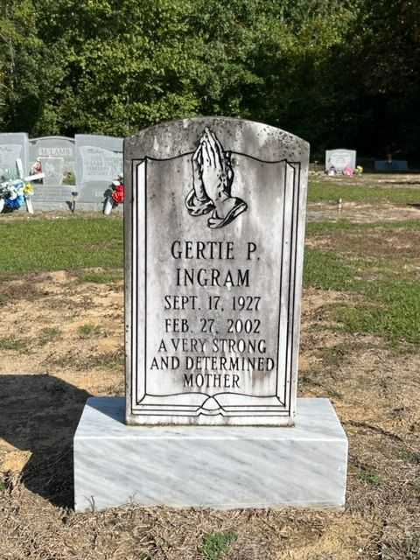
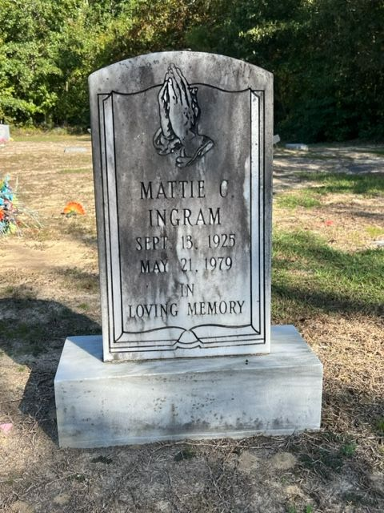
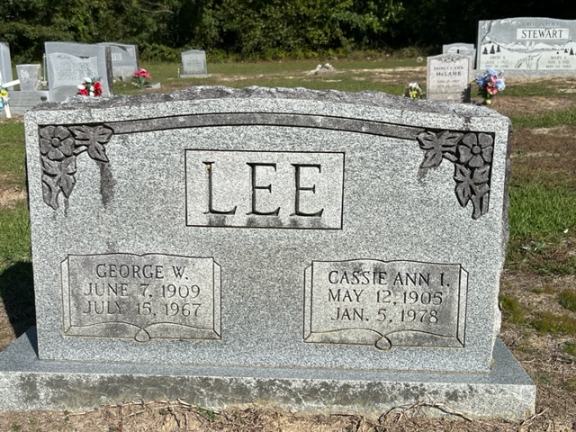
Point Level Hope Church
Notes:
Another trip out to Point Level Hope Church in Sampson County proved to be more successful finding 4 descendants of Lucy, Alex, and Clarsey. Cassie and Hassie are the children of Rebecca (from previous slide). and Cassie's children Gertie P. Ingram and Mattie C. Ingram.
This was the last trip I made to a cemetery for the genealogy research. However, I did end up reaching out to a congregation member of Point Level Hope Church who was also a genealogist who remembered people like Cassie Ingram--people who were only mere steps away, being the great granddaughter of Lucy Harper. Since then, we have brought this research to more light with a programming table, and more signage being brought into the Enslaved People's living quarters.

Slide 11
“Remember friends, as you pass by,
As you are now, so once was I.
As I am now, so you must be.
Prepare for death and eternity”
Notes:
I am often reminded of this epitaph when thinking about these stories that reads
Working in the history field, of course we are surrounded by reminders of the dead and that truly Dead Men Do Tell Tales. It is these tales that make up that history that we work so hard to preserve and become stewards of.
And it's two small stories like Union Solider John M. Knapp or the family of Lucy, Alex, and Clarsey that help to shape that history. Although their stories may end physically with their headstones, we still get to share and learn from them today.
I want to thank you for your time today!

