Slide 1
Mystery in the
Ivey-Ellington House

Slide 2
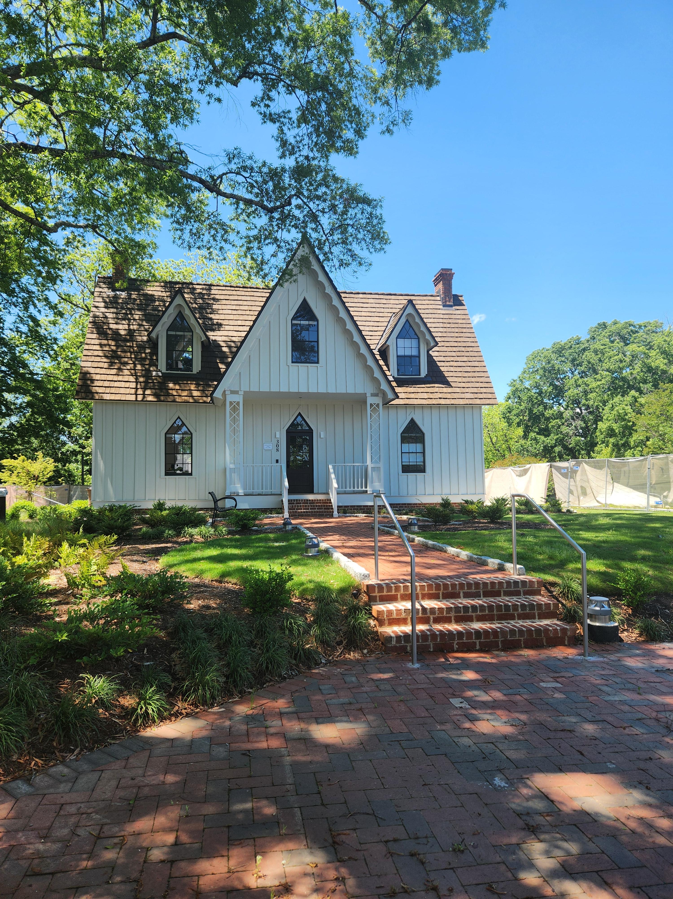
The Ivey-Ellington House
Gothic Revival
Cottage

Slide 3
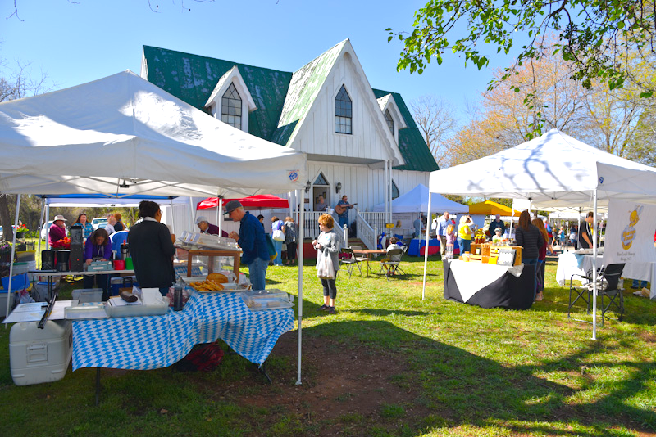
Home to the farmer’s market

Slide 4
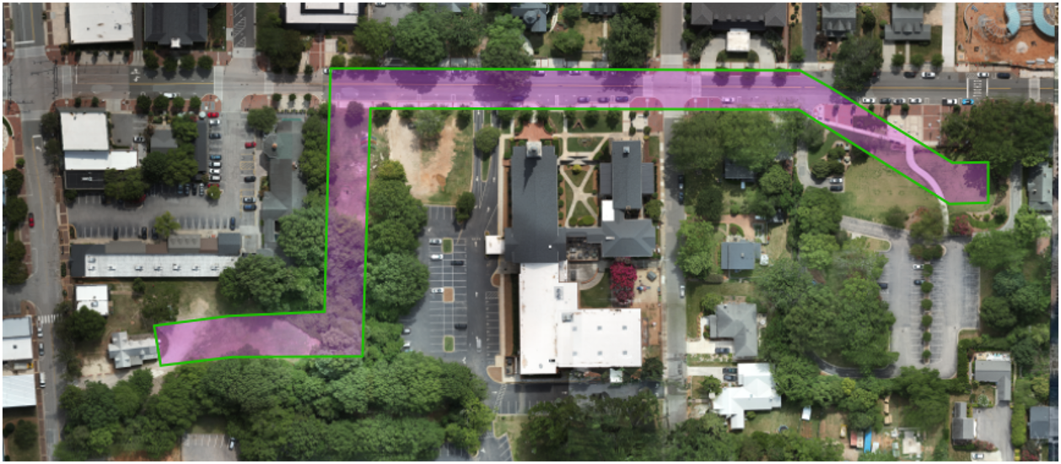
The journey to its new home…

Slide 5
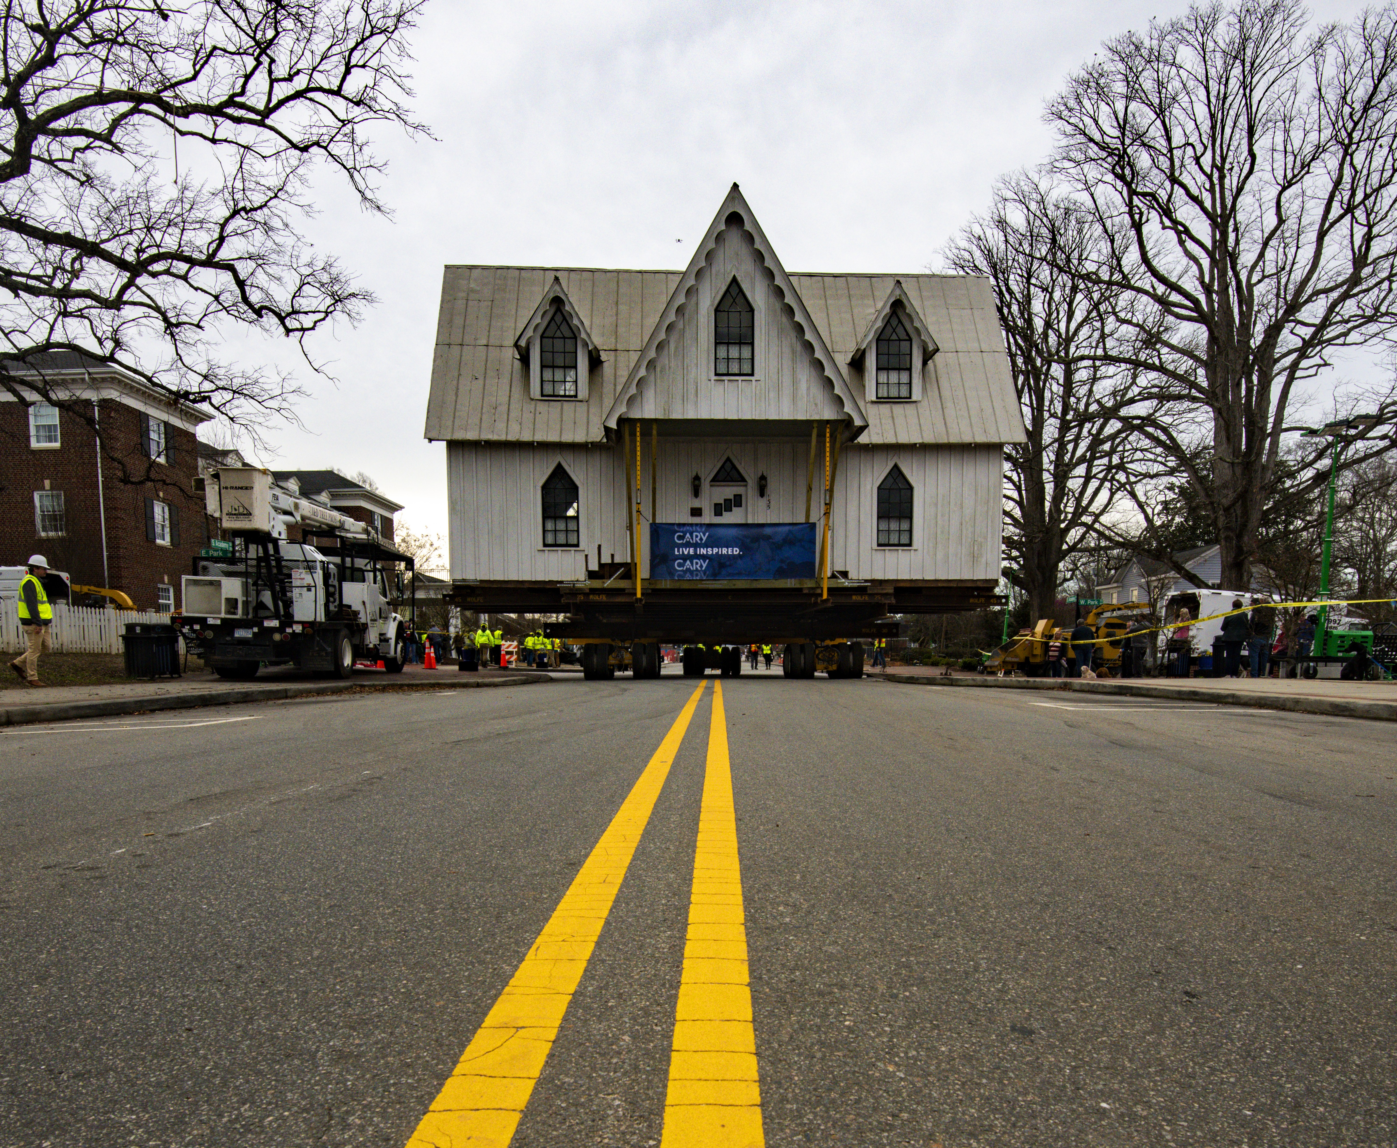
Almost home…

Slide 6
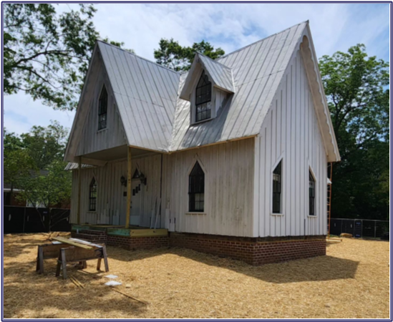
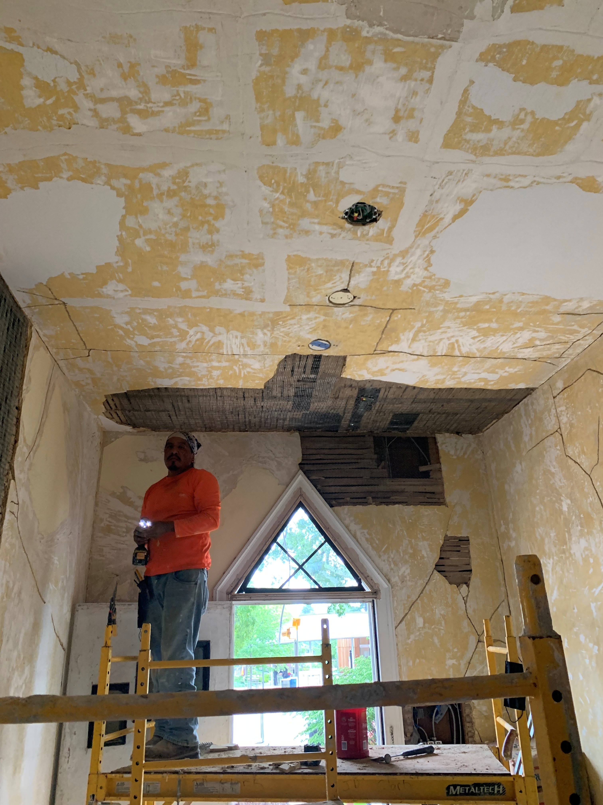
Rehabilitation & plasterwork underway…

Slide 7
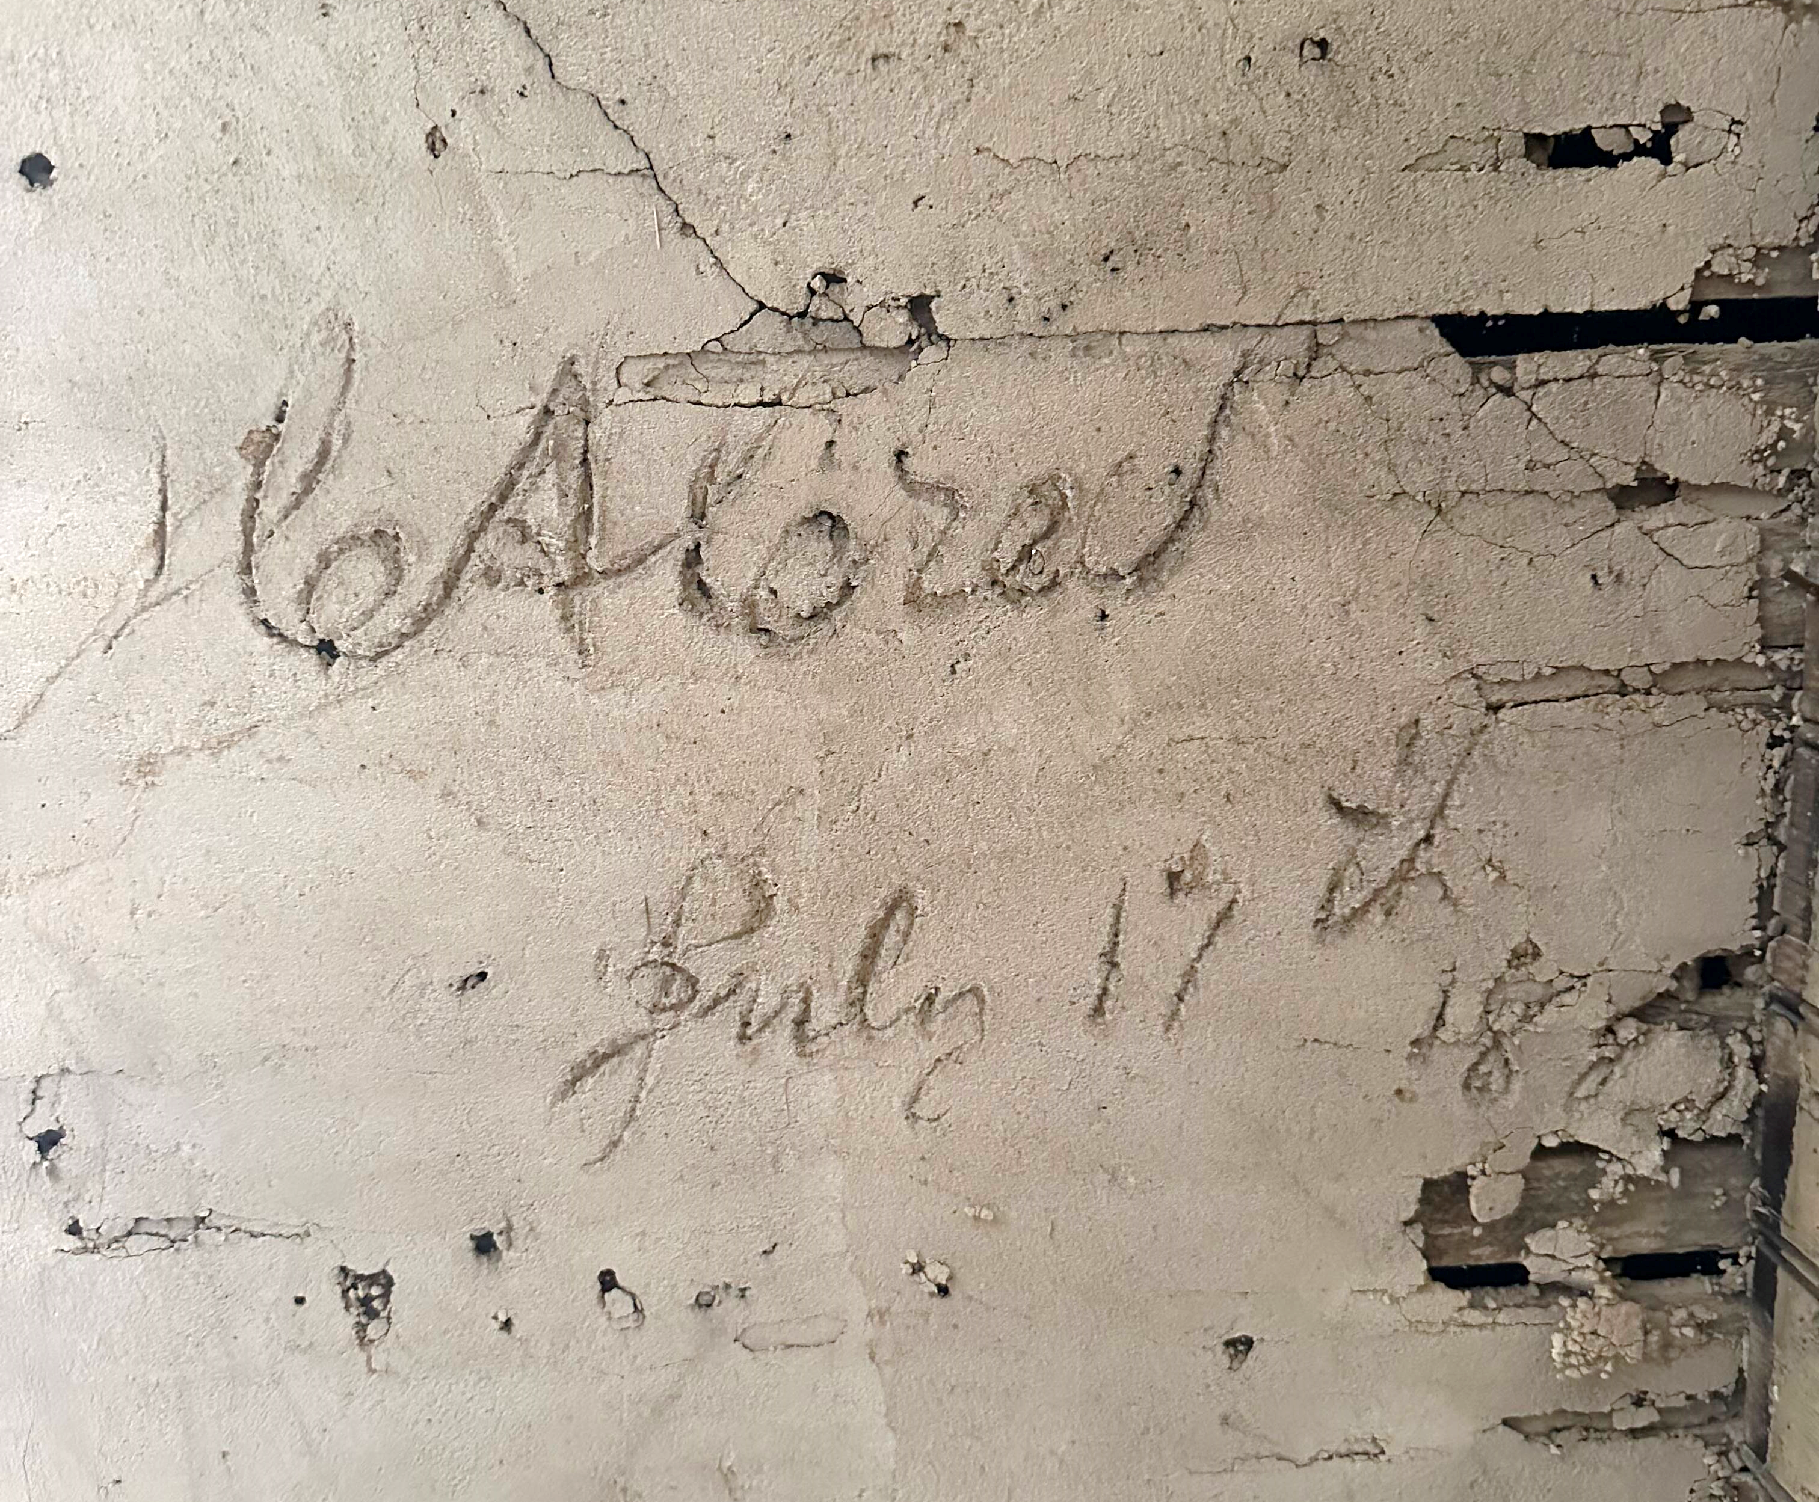
Inscription in plaster work
What does this say & mean?

Slide 8
I have a mystery for you…
Kris Carmichael,
Supervisor of Historic Properties, Town of Cary
March 2024

Slide 9
Inscription in plaster work

Slide 10
Untangling facts about the house
Early owners of the land
Construction Dates
Frank Page
Alonzo T Mial
First Confirmed Owners
J T & Bettie Pool
1871, 1874 or 1882?

Slide 11
C A Creel
July 17th 1882
The eureka moment!

Slide 12
Who were the Creels?

Slide 13
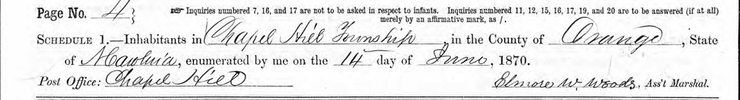
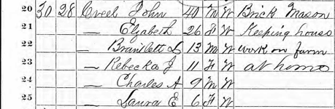
Note Charles A Creel,
son of a brick mason
in Orange County in 1870

Slide 14
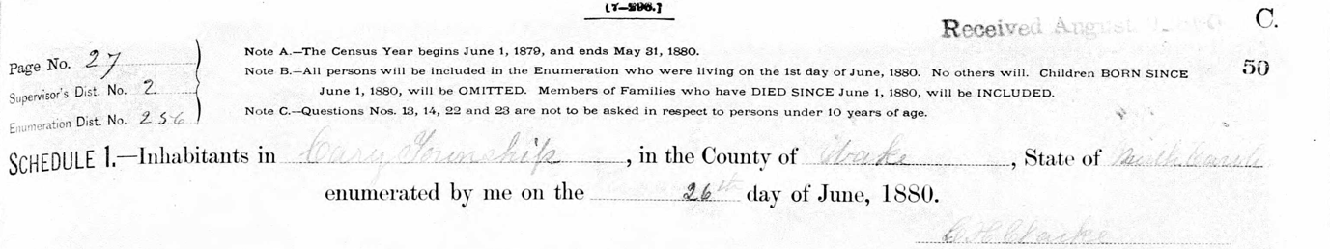
In 1880, Charles A Creel,
now a brick mason,
is in Cary Township.

Slide 15
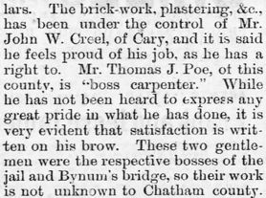
Yes, brick work & plaster work go hand in hand

Slide 16
But wait, there was a marriage!
November 21, 1881

Slide 17
Tragedy strikes…

Slide 18
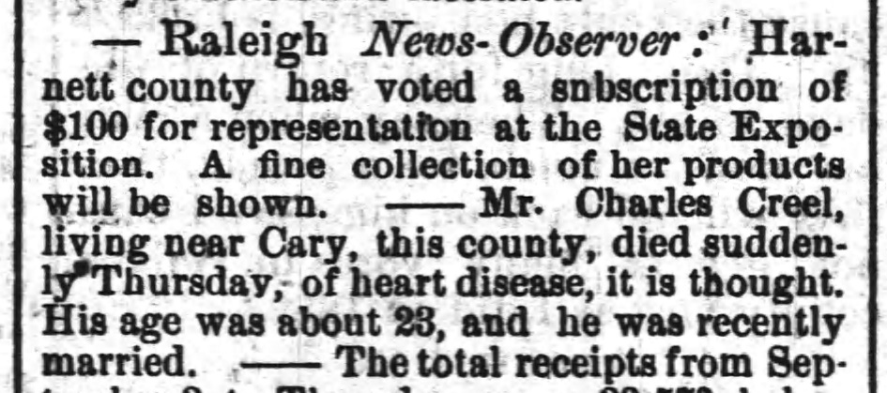

Slide 19
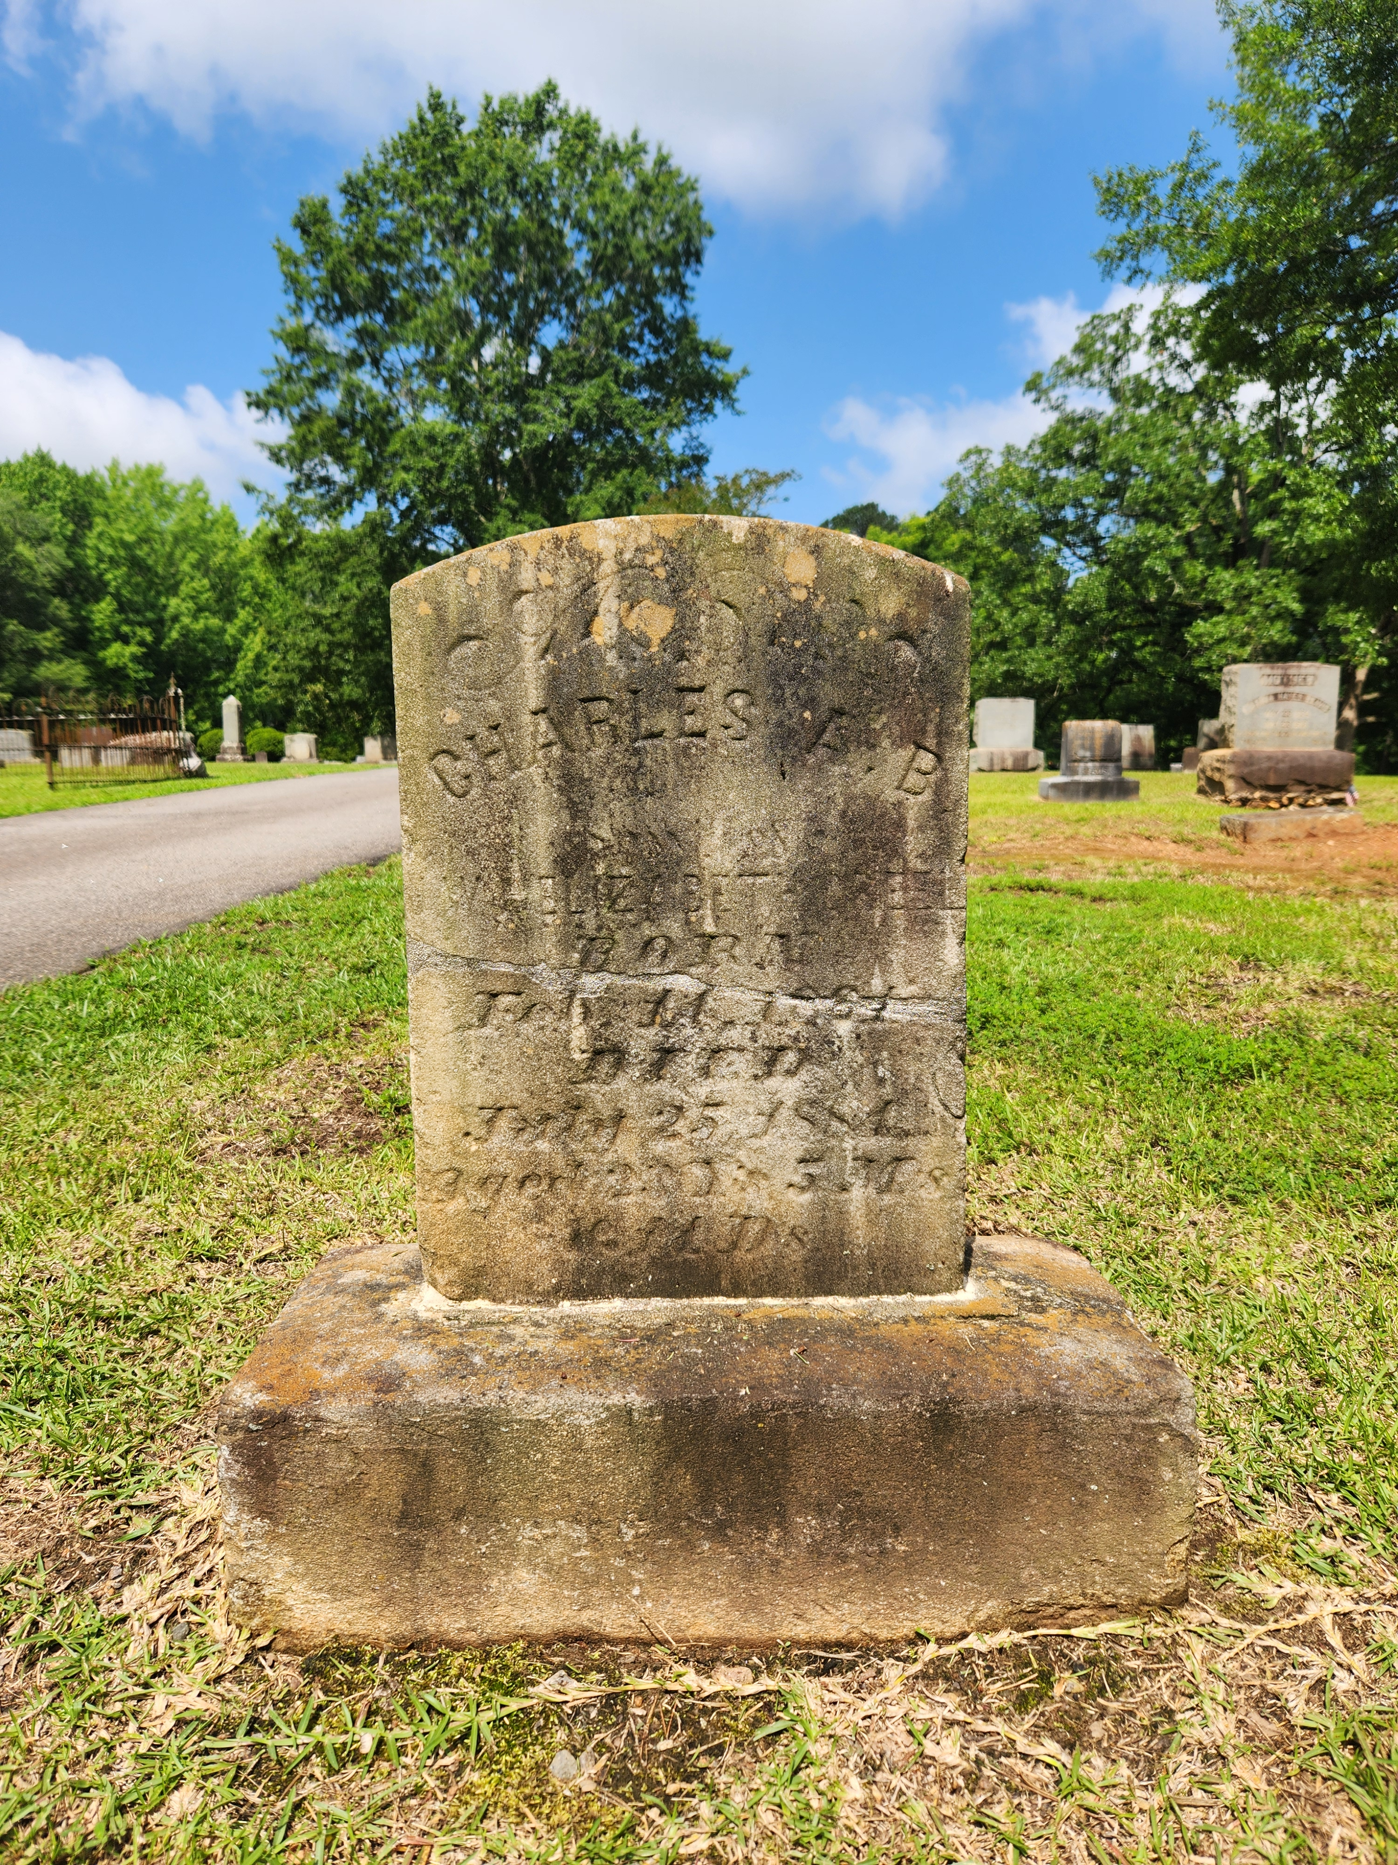
Burial at historic hillcrest cemetery in
Cary

Slide 20
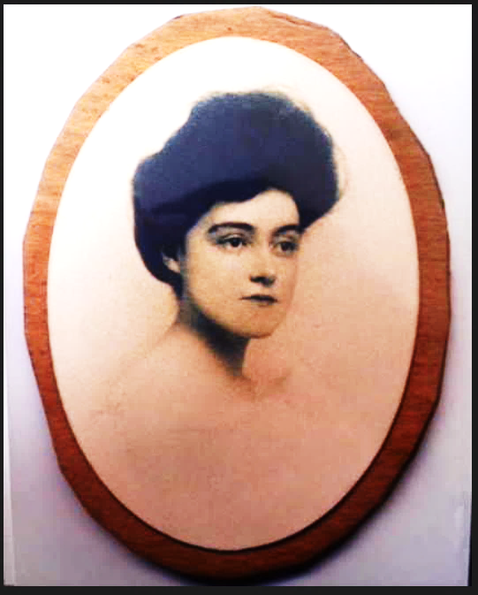
Charlie – the child he never knew…

Slide 21
Protecting the plaster…

Slide 22
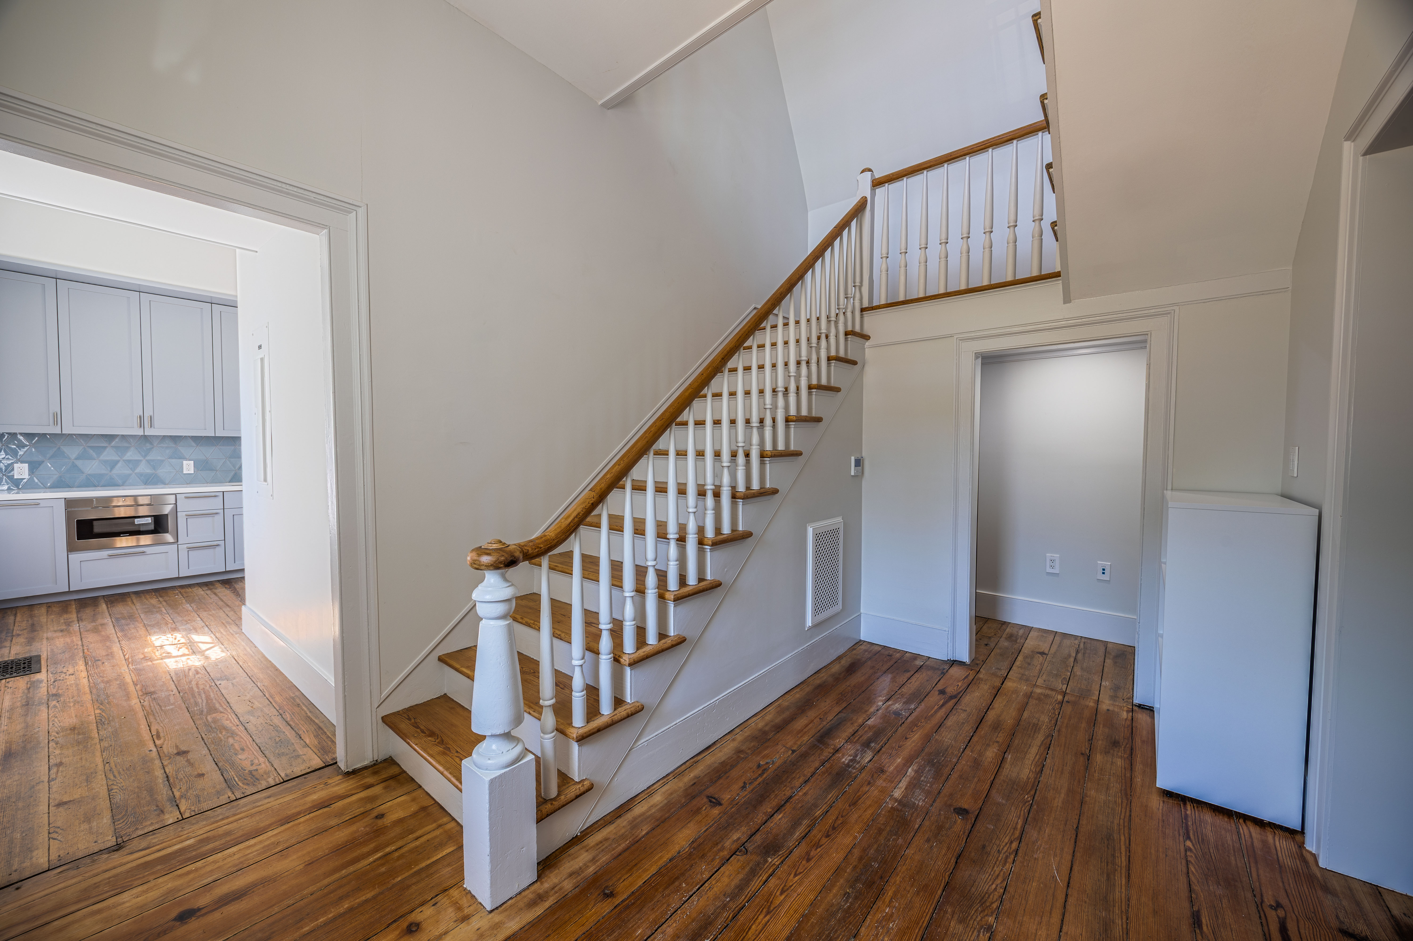
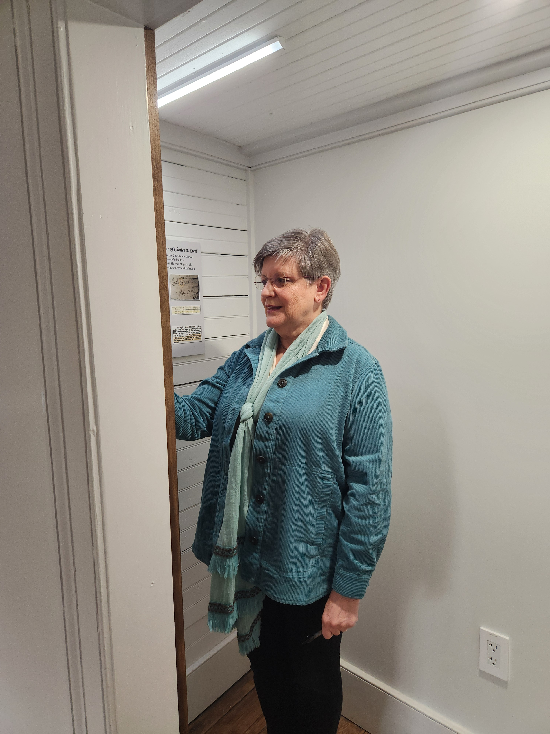
a peek at the small display area..

Slide 23
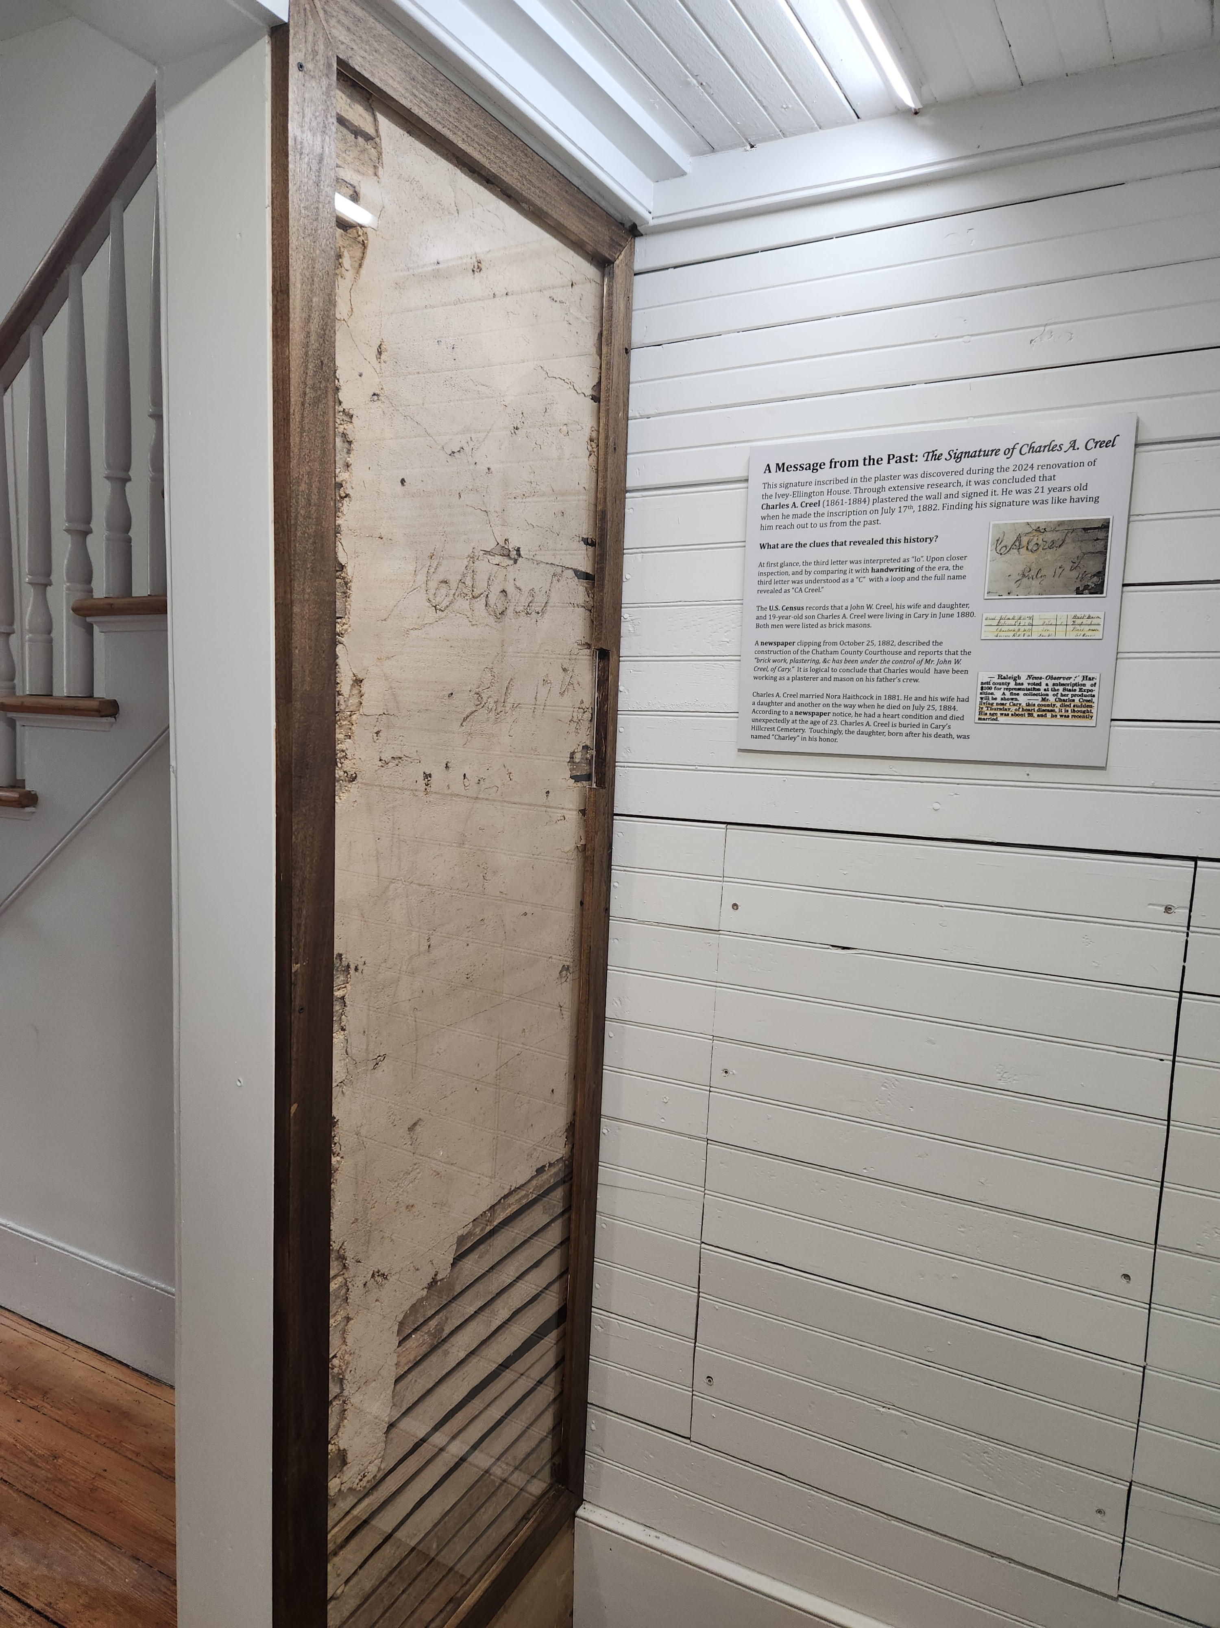
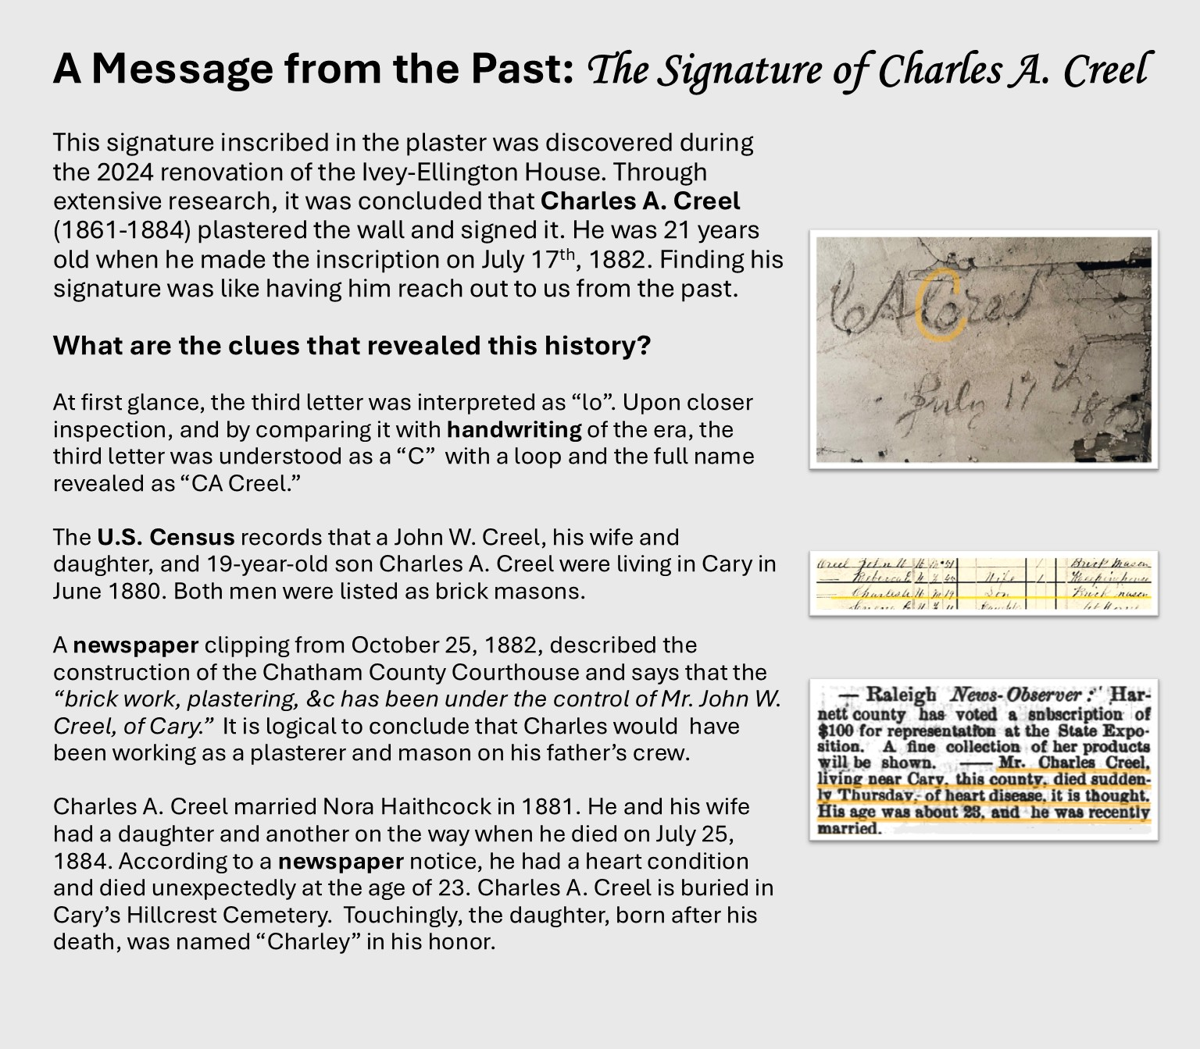
Interpretive signage beside the inscription

Slide 24
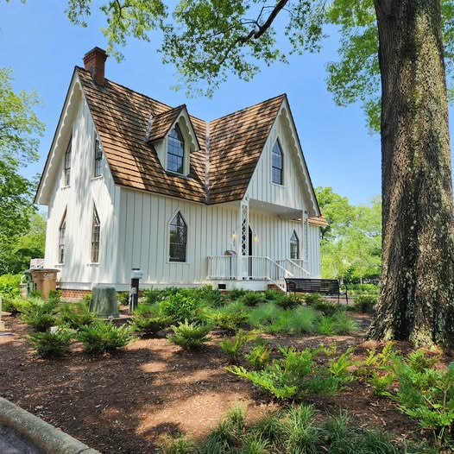
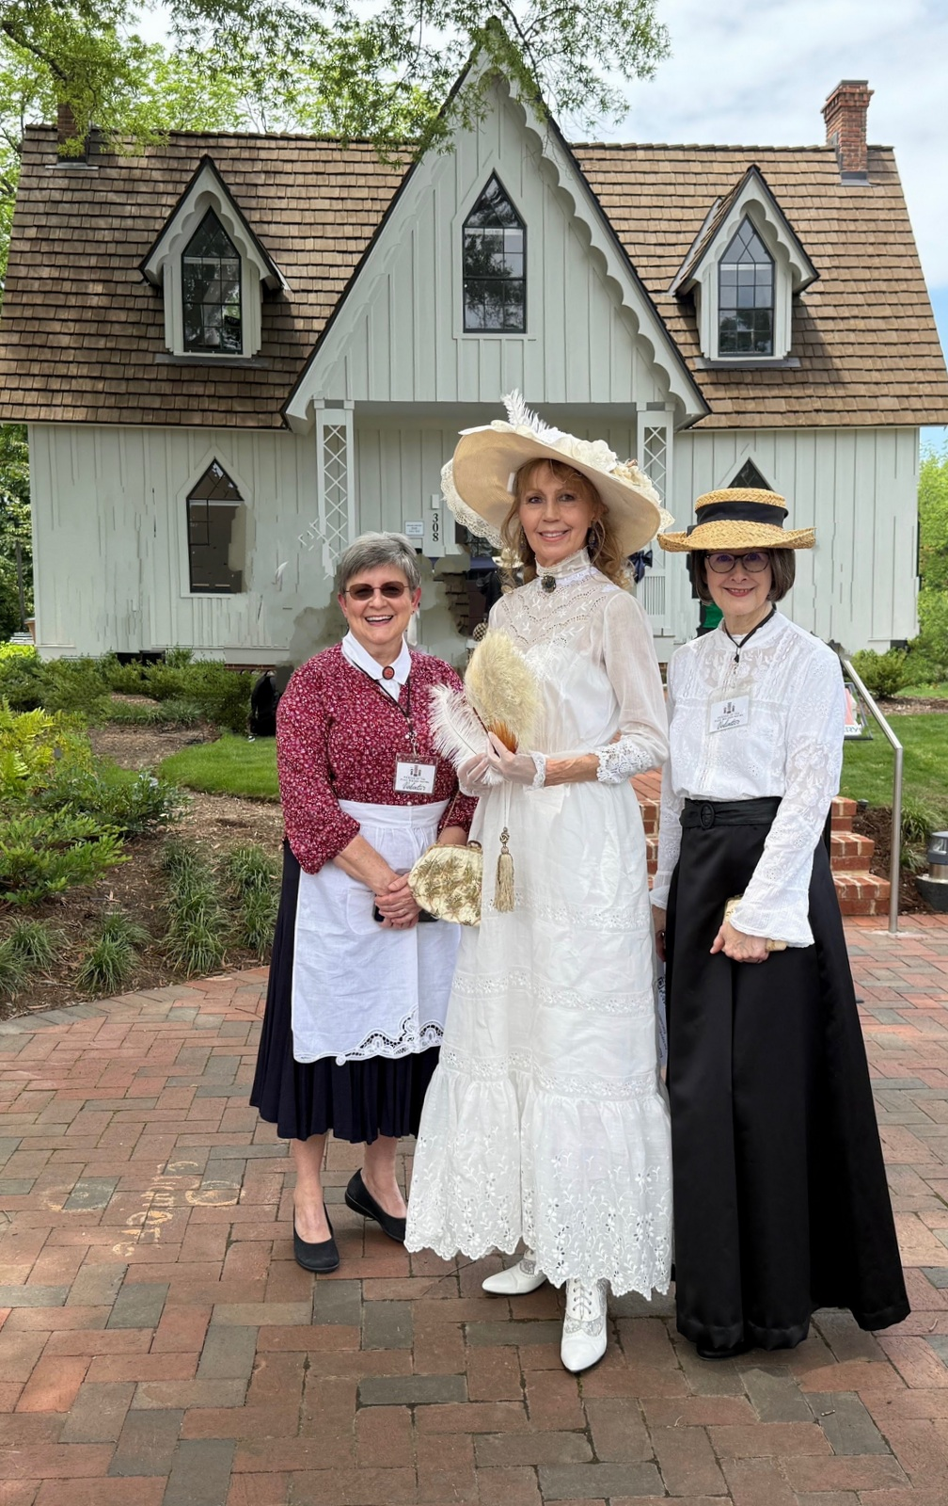

Slide 25
www.friendsofpagewalker.org/Mailing-List
Sign up for our newsletter!

