Slide 1
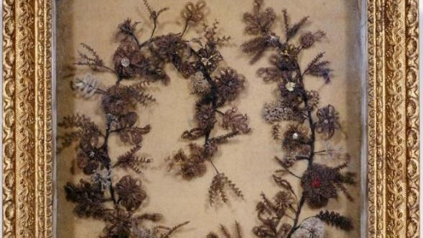
Hair Wreaths
Memorializing Women’s Families & Communities

Slide 2
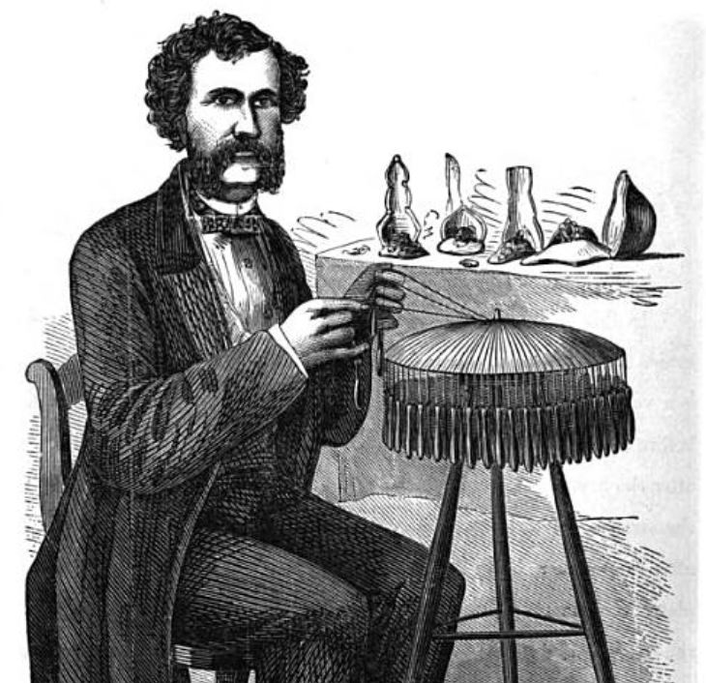
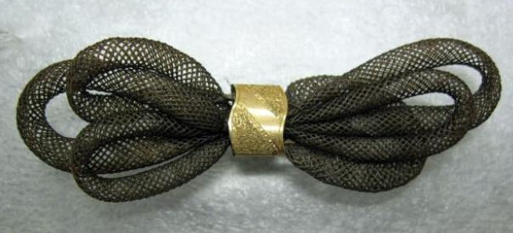
Hair Jewelry
North Carolina Museum of History 1999.84.1
Mark Campbell, Self-Instructor in the Art of Hairwork, 1867

Slide 3
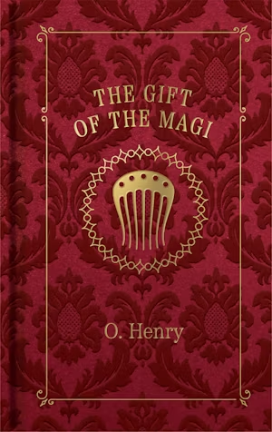
Madame Sophronie’s
“Hair Goods of All Kinds” in Greensboro native author William Sidney Porter’s (aka O. Henry) 1905 story
Image courtesy Arcadia Publishing

Slide 4
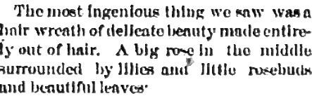
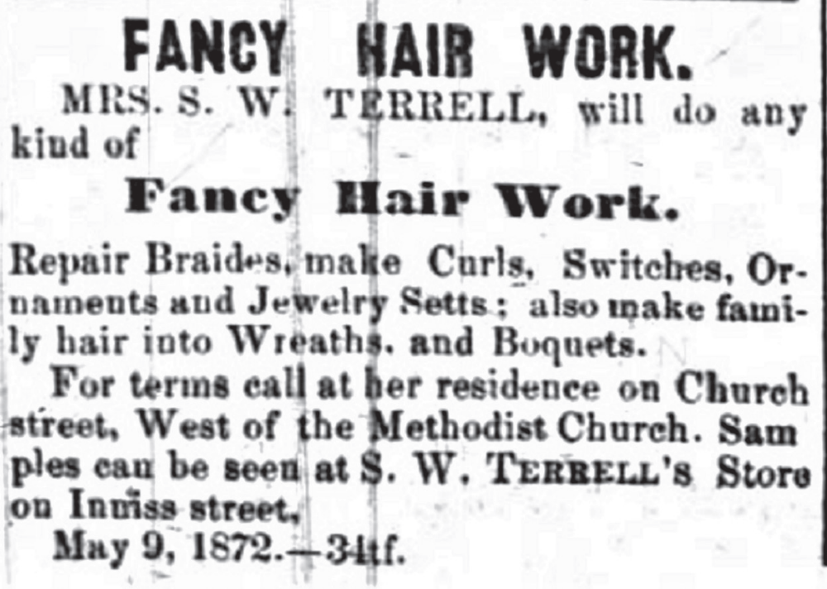
“Border Fair,” Hillsborough Recorder, November 2, 1870, p. 3
Salisbury Carolina Watchman, June 7, 1872

Slide 5
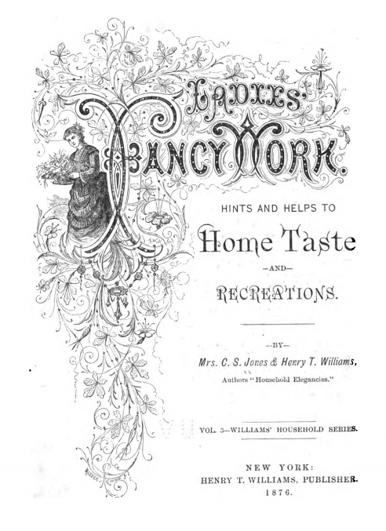
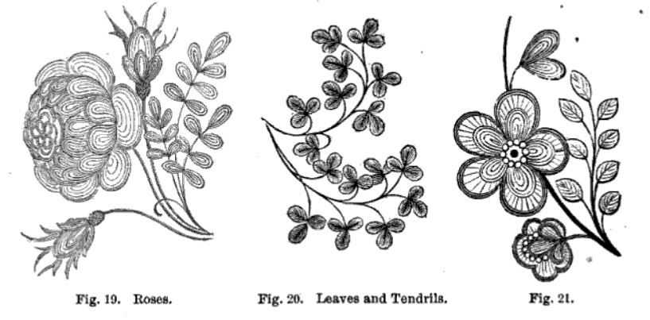
Periodicals and Household Guides

Slide 6
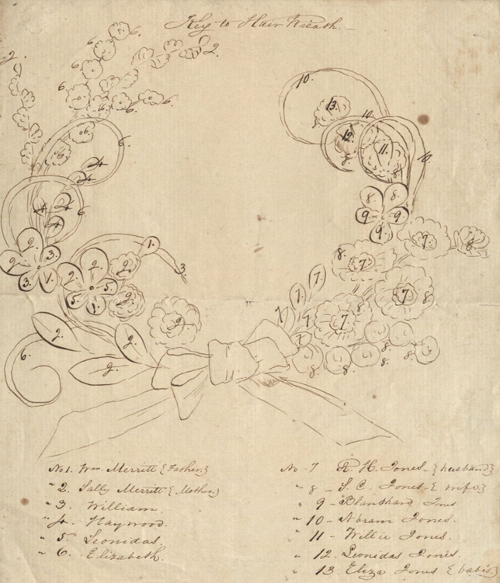
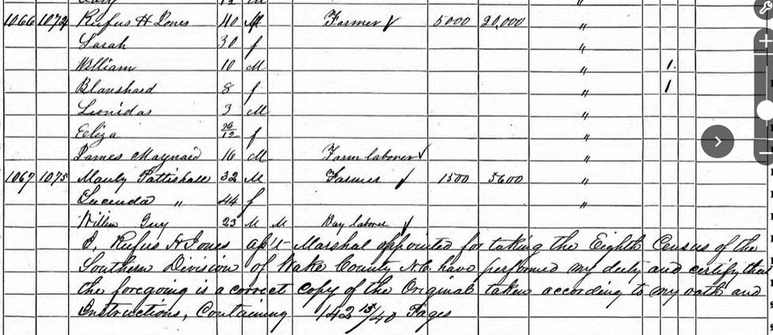
Sarah Merritt Jones,
Cary N.C., [1829-1904]
Sketch, Rufus Henry Jones Collection, Rubenstein Rare Book and Manuscript Library, Duke University.
Research courtesy Carla Michaels and Barbara Wetmore, Friends of Page-Walker
1860 Census for the Southern Division of Wake County, p. 143.

Slide 7
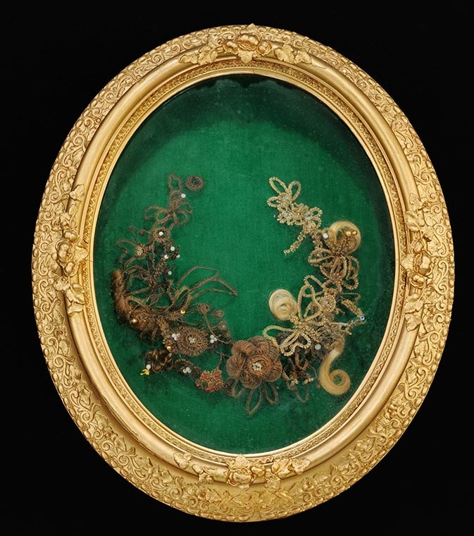
Christena Doverspike Kells’ Hair-Wreath
N.C. Museum of History 2007.8.1

Slide 8
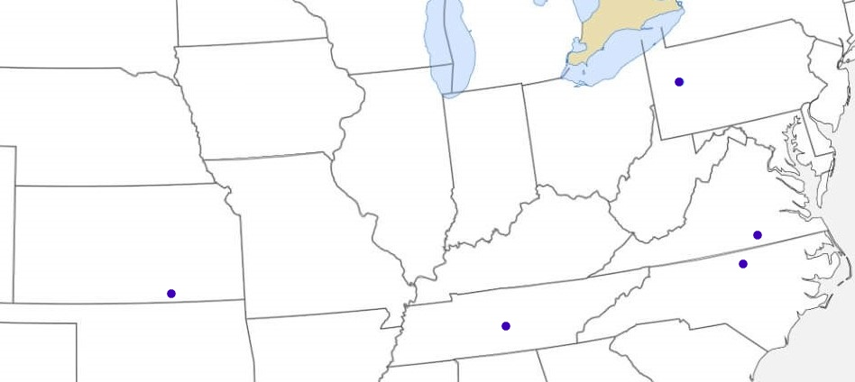
Christena’s Homes
Armstrong County PA, 1850 – 1878
Bedford County TN, 1878 - early 1880s
Creswell County KS, early 1880s – 1887
Clarksville VA, 1887 – 1910
Durham NC, 1910 – 1921

Slide 9
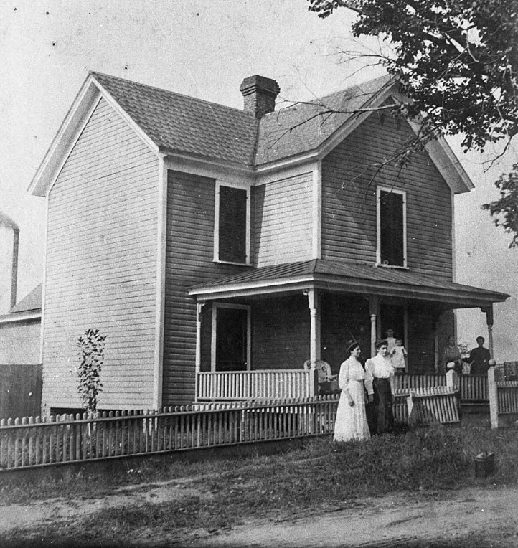
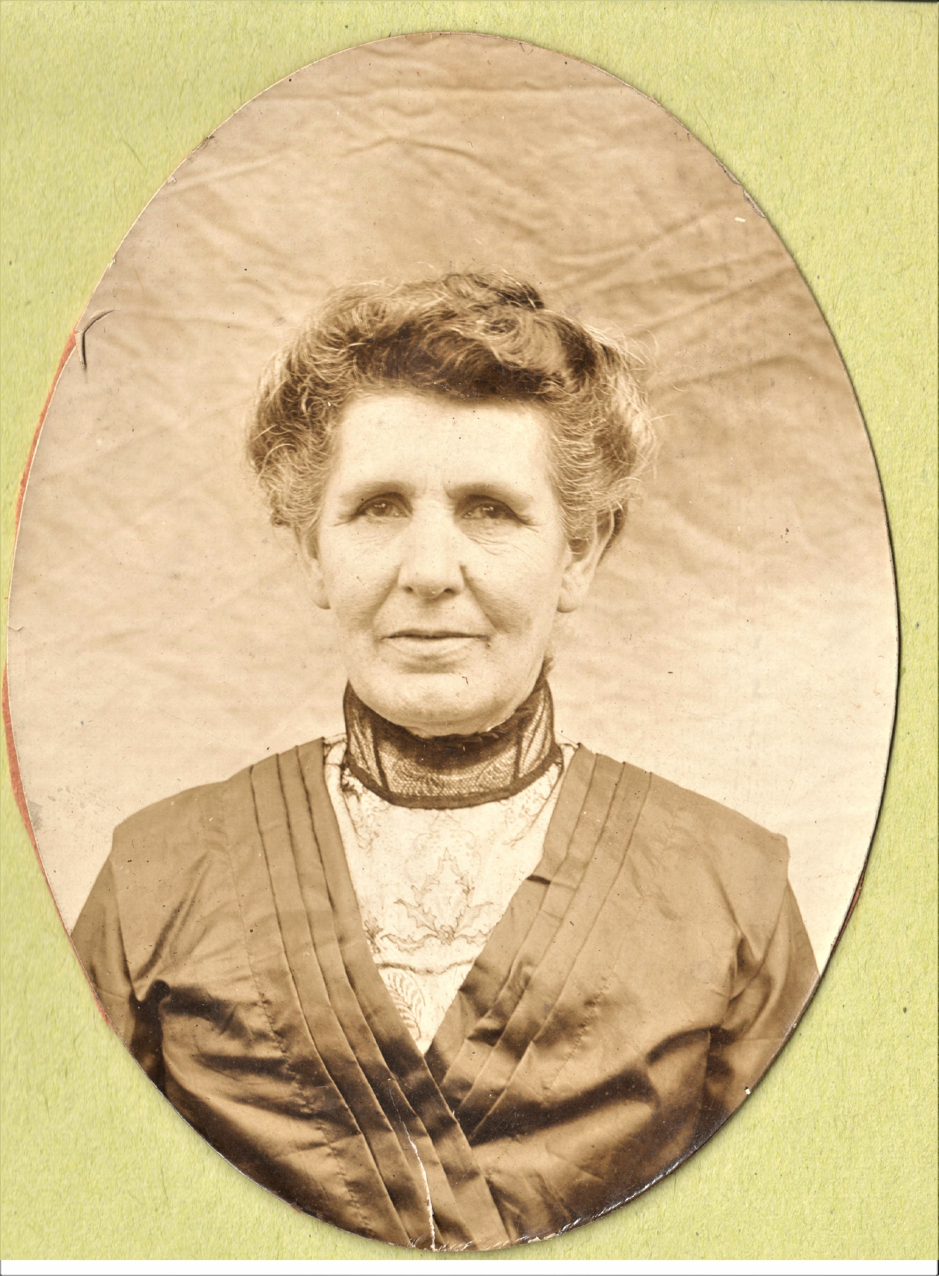
Durham 1910s
Images courtesy Roderic L. Mullen, descendant

Slide 10
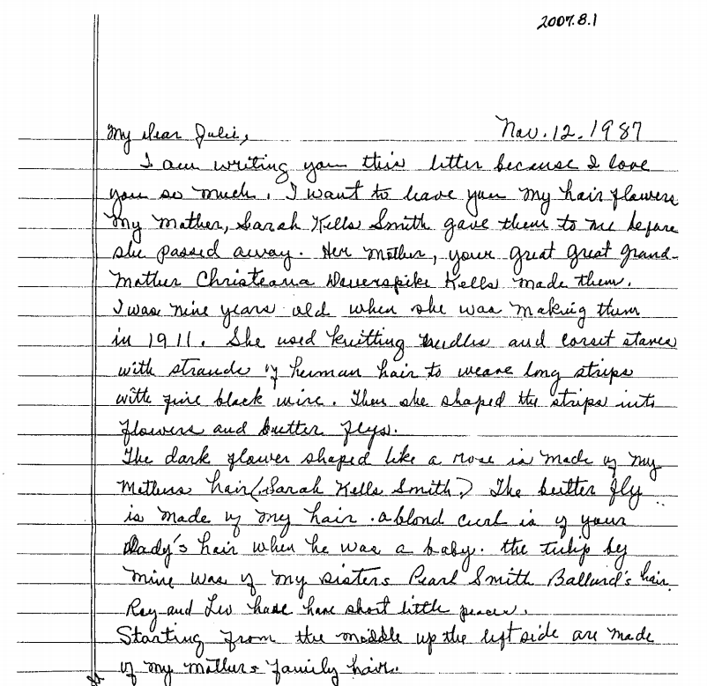
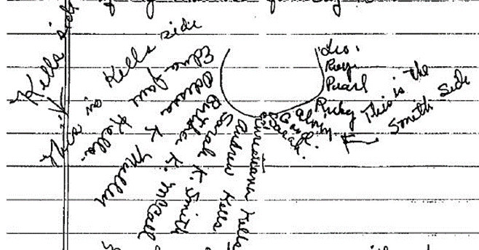
Donation by Great, Great-Granddaughter

Slide 11
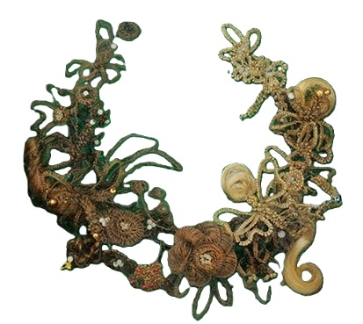
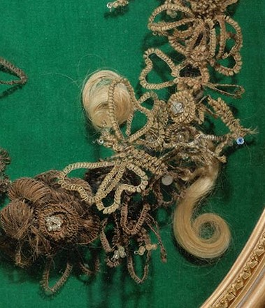

Kells Wreath

Slide 12
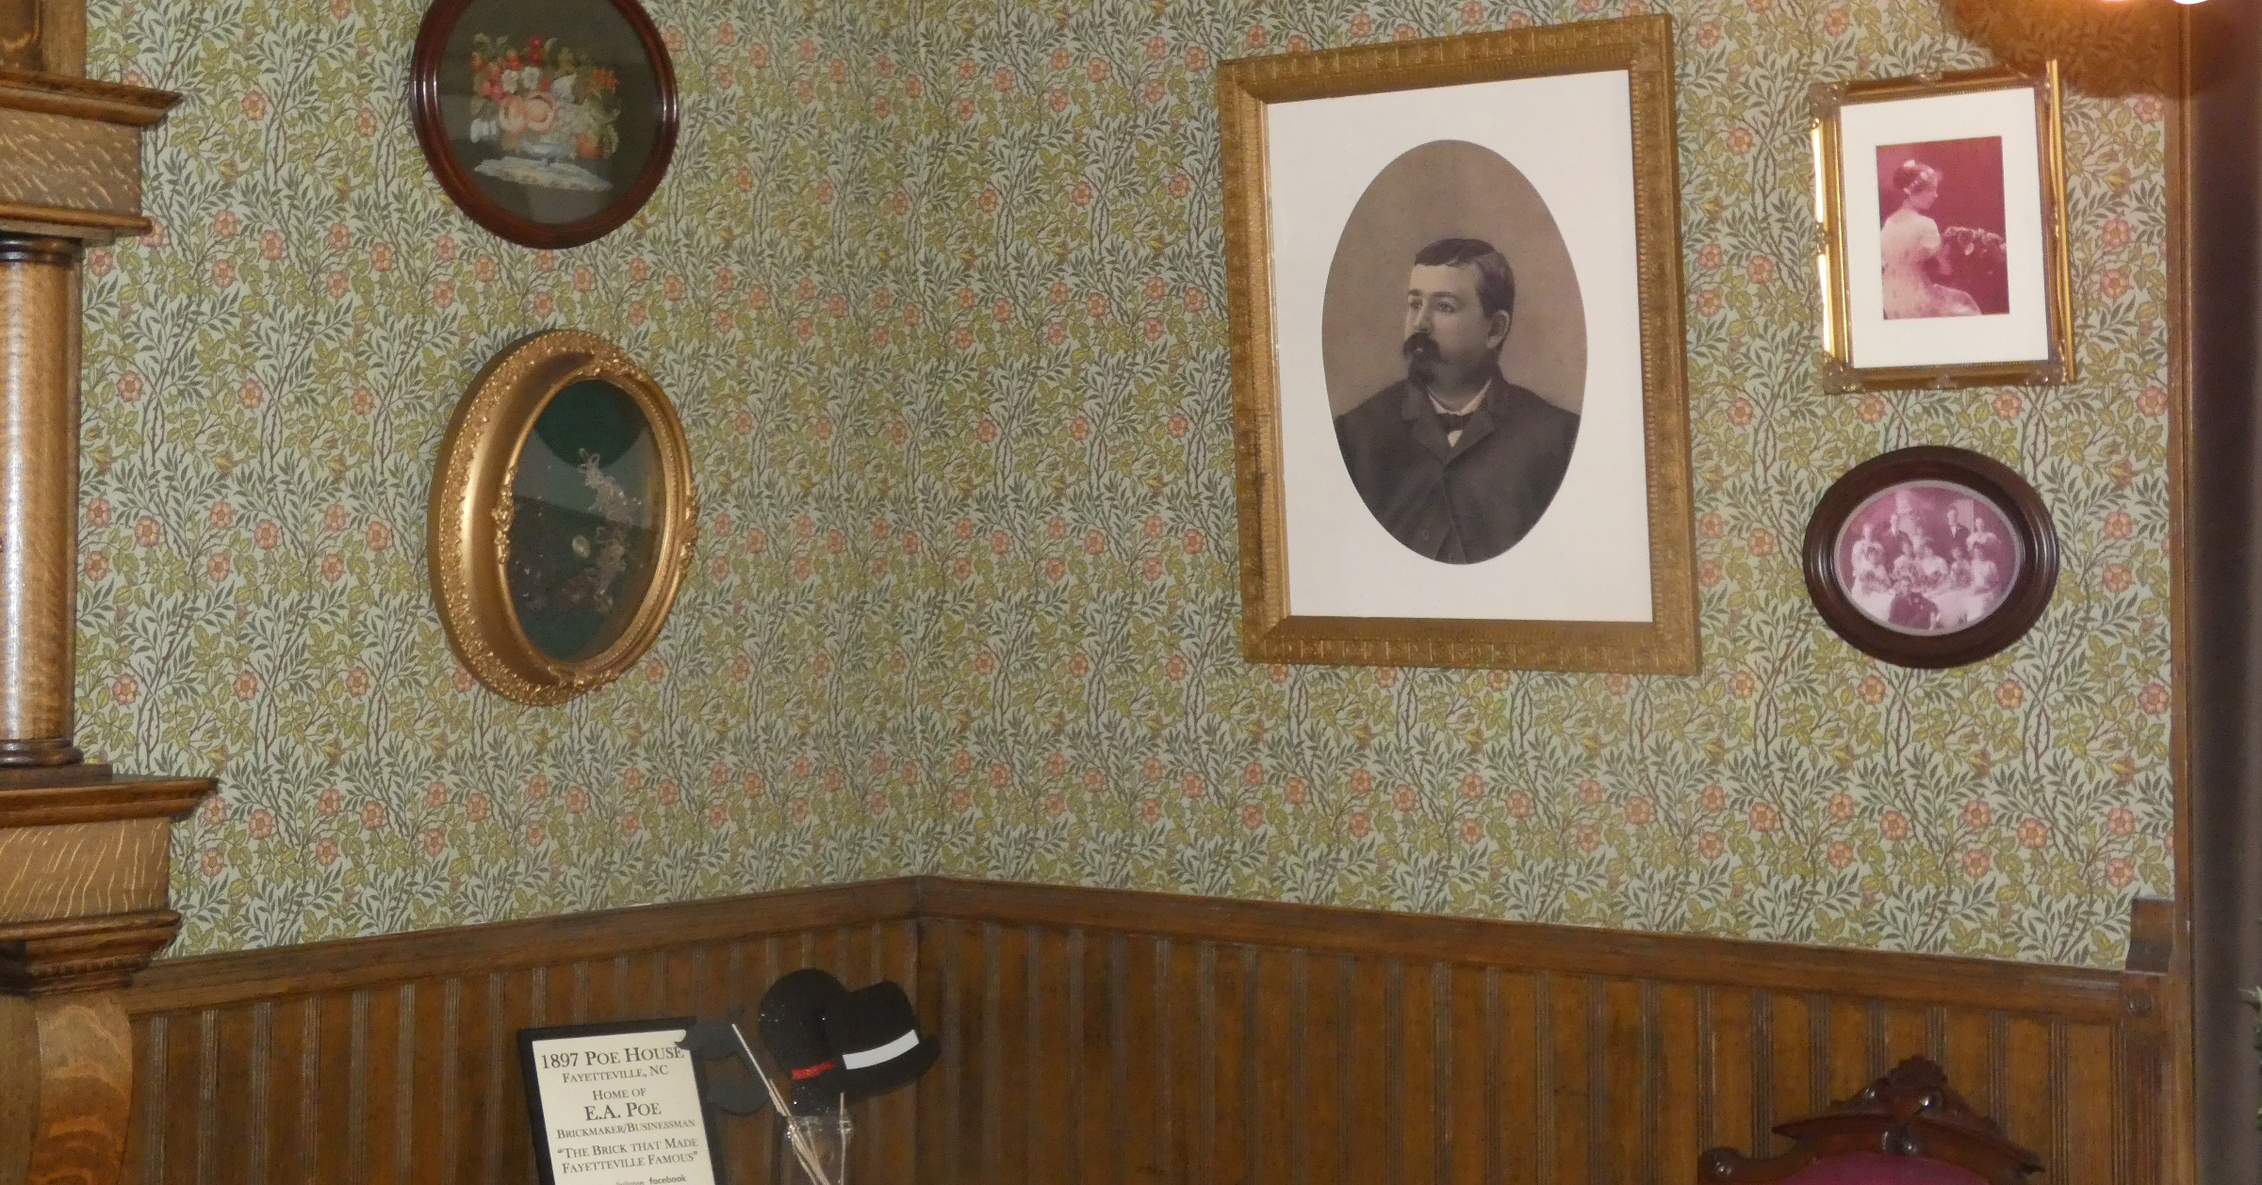
1897 Poe House, Museum of the Cape Fear Fayetteville

Slide 13
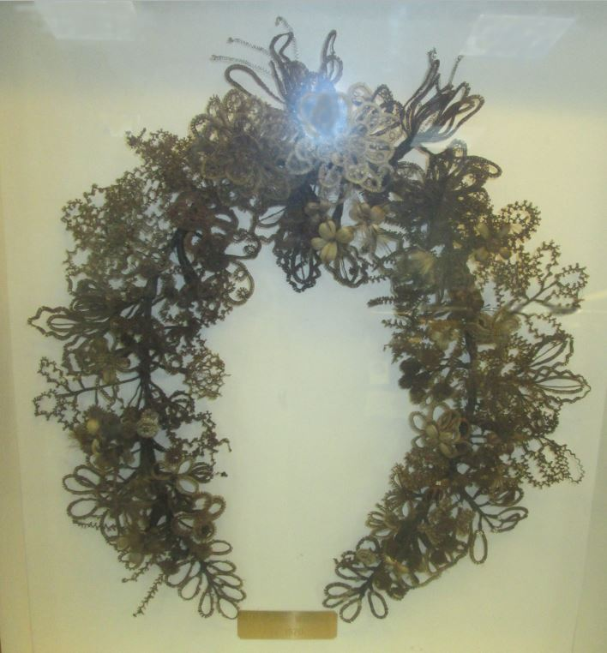
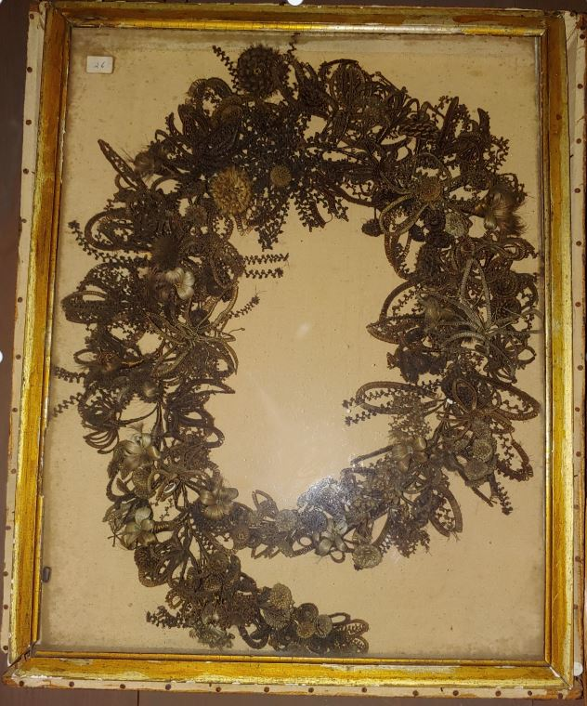
Stanly County & Sampson County
c.1870 attributed 1850s Boykin family
NC Museum of History and May Museum (Farmville) have additional examples.

Slide 14
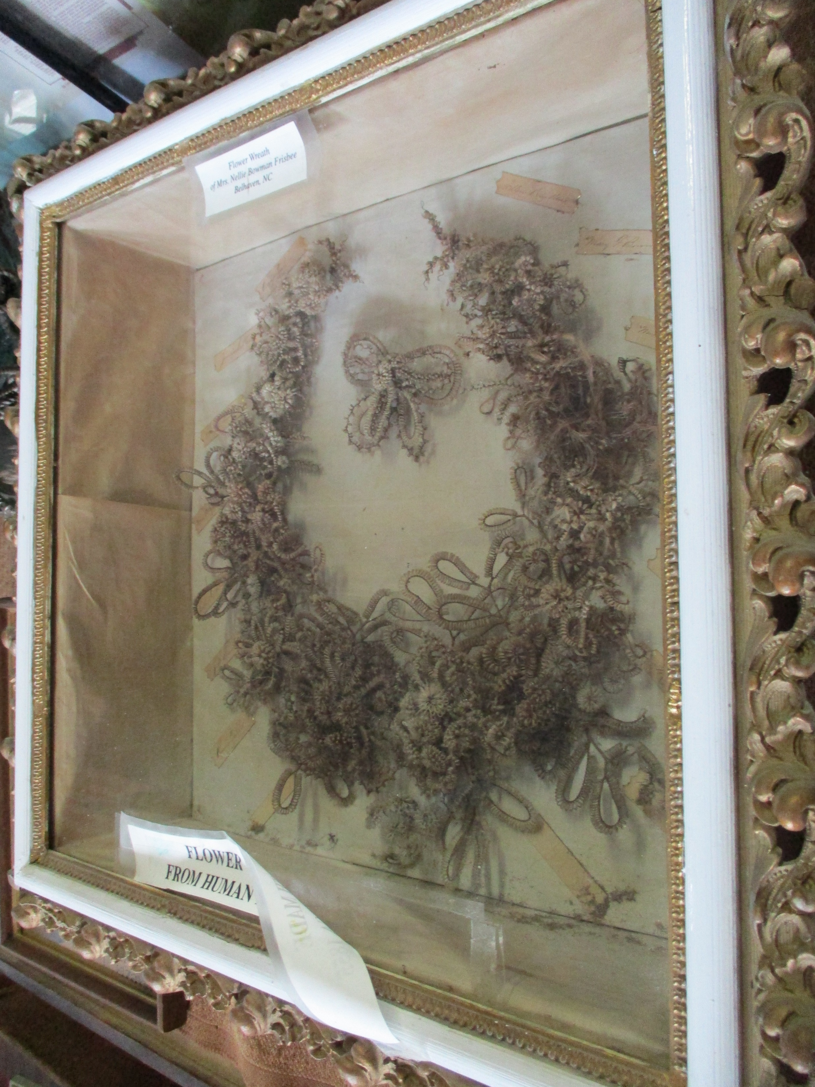
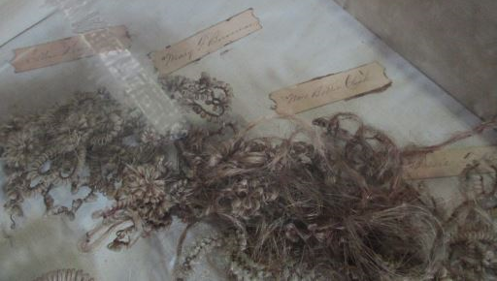
Belhaven Museum
Nellie Bowman Frisbee (1858-1927)

Slide 15
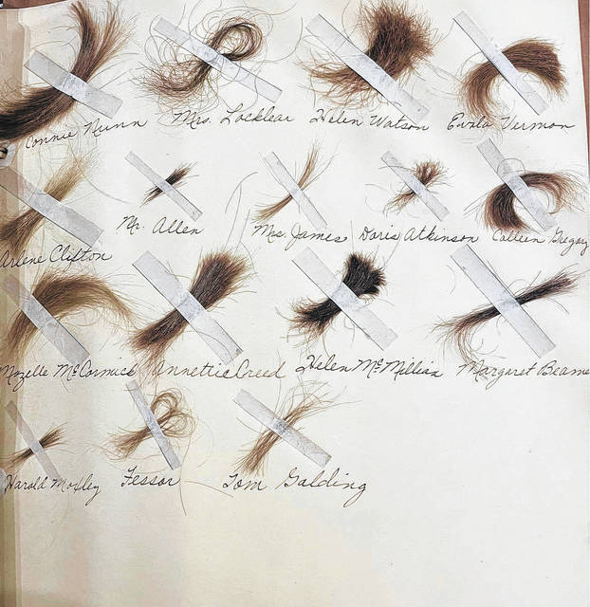
Hair as Memento
Persisted
Mount Airy Museum
1945 Beulah High School yearbook, belonged to Jessie Snow Chilton, who collected hair from her friends

Slide 16
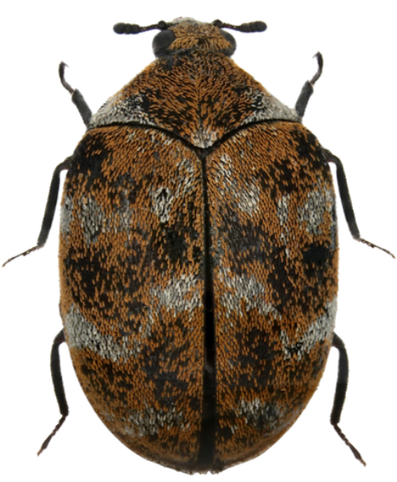
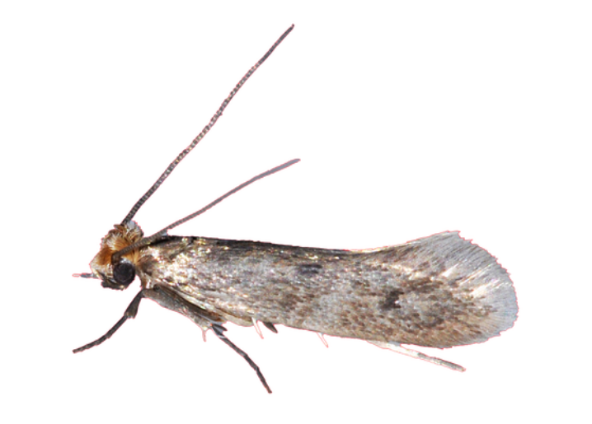

Top
Preservation Danger

