Slide 1

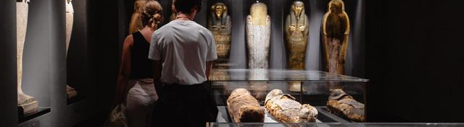


Treating the Dead with Respect:
The Legalities of Displaying Human Remains
Sophia Caci
MA Student- East Carolina University

Slide 2
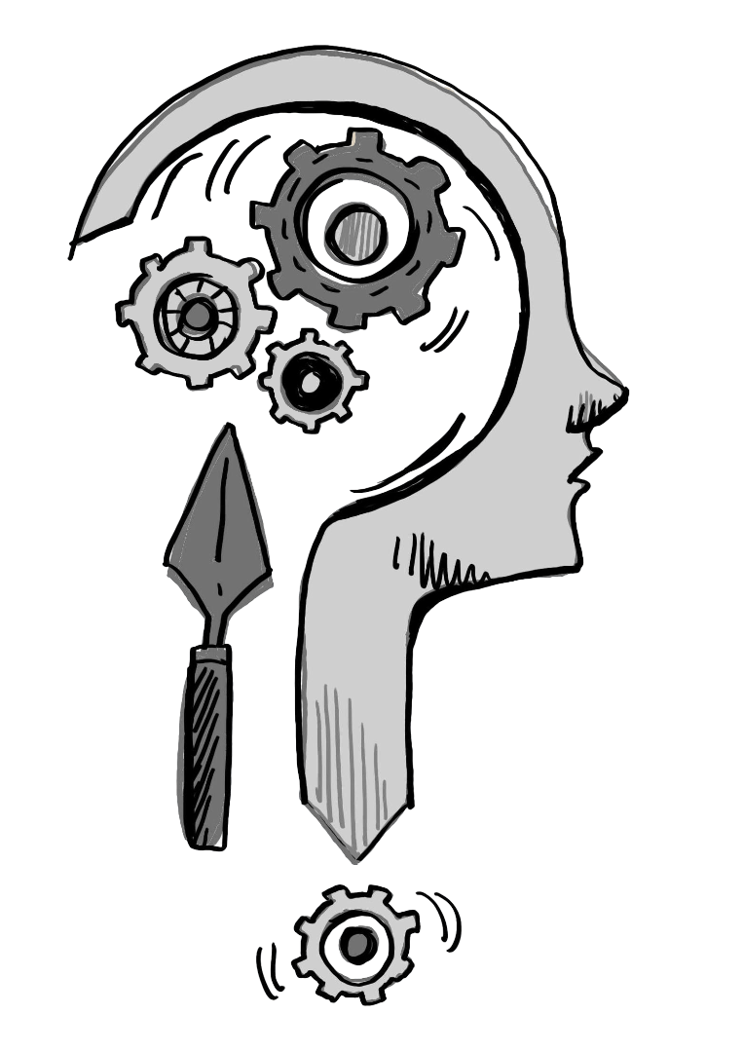

Ethics
01

Slide 3
Ethics of Displaying Human Remains
Despite the obvious and greatly important ethical aspect of the treatment and display of human remains, legalities regarding the acquisition and display of human remains are often overlooked in the process.

Slide 4
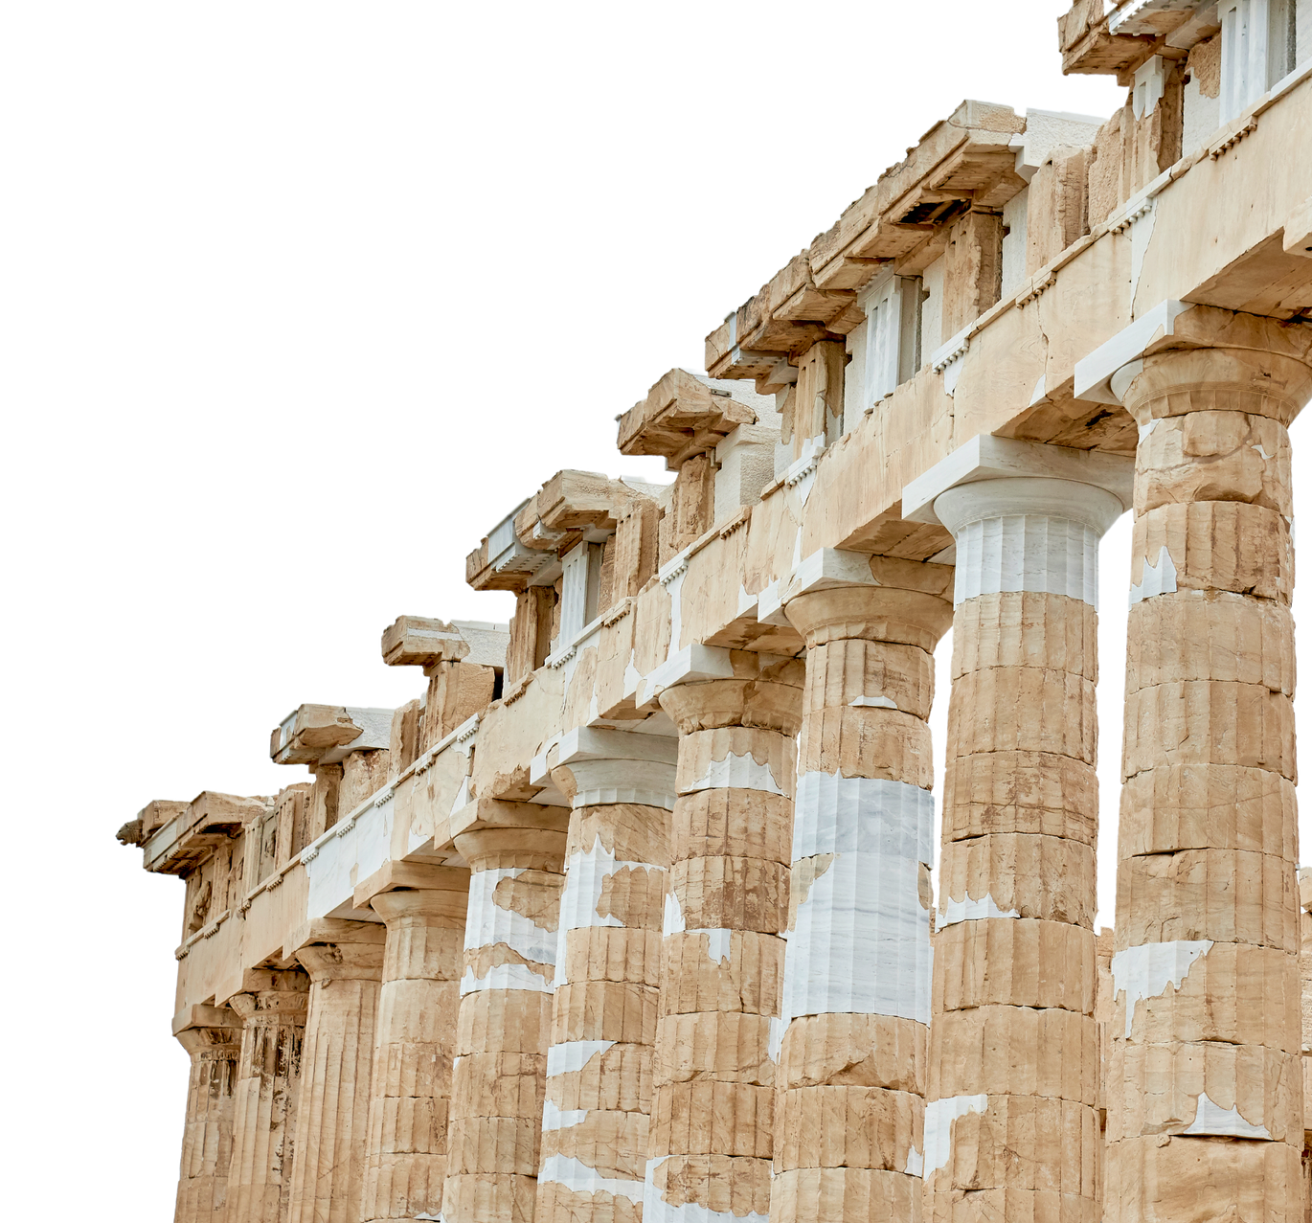

Part One:
Practices in Treating Human Remains

Slide 5
Human Remains
The definition of human remains changes between pieces of legislation and determines the way they are treated.
  It is up to museums to determine the policies they enact and follow.
    The widely accepted definition of human remains is anything from a once-living person, including osteological material, soft tissue, and sometimes hair and nails.
      Some legislation will have more specifics in wording about what constitutes human remains and how they are therefore protected.

Slide 6
Rough Timeline of Human Remains Display
16th Century-
20th Century
1970
1990
Today
Collection of Remains
UNESCO Convention
NAGPRA Passed
Changing Attitudes
Human remains were collected by the wealthy as a status symbol until attitudes began to change in the 20th Century
The first piece of legislation to protect human remains and other pieces of cultural significance
The most well known piece of legislation protecting the rights of indigenous remains in the United States
Museums have been reconsidering many of their displays and creating policies to protect themselves and the remains in their collections.

Slide 7
The Laws of Displaying Human Remains
Museums have policies they will follow regarding the display, storage and repatriation of the remains within their specific collections.
Several laws have been put in place across the world to protect human remains but there is no universal approach to caring for the remains.
  It is left up to specific countries and institutions to determine what is best in their legislation.

Slide 8
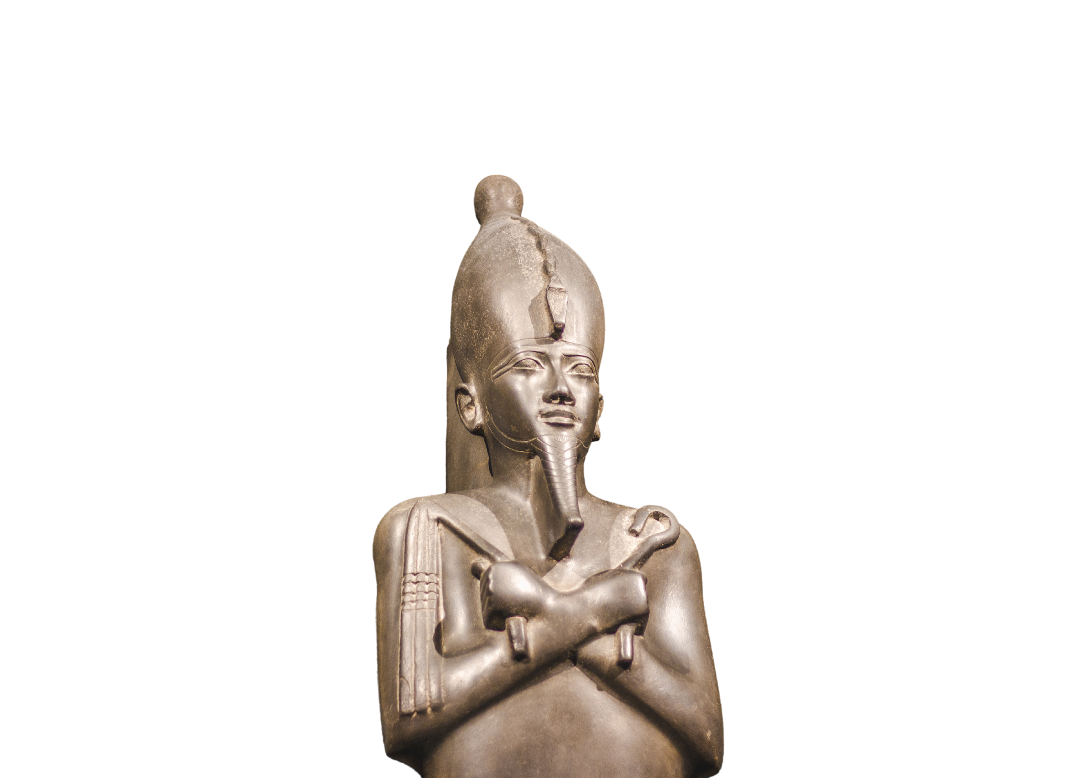
Part Two:
Cultural Associations and Stakeholders

Slide 9
Who Speaks for the Dead?
A debate that has arisen in recent years concerns the distinction between cultural heritage and cultural property, as this determines how many remains are viewed and treated.
  Treating and protecting and the dead as property ultimately disregards the emotions involved with death in many cultures and dehumanizes the remains.
Several pieces of legislation highlight the inclusion of cultural heritage in the display of remains, reducing the likelihood of viewing the remains as property
  In cases of unclear association or lack of living descendants, this can become complicated

Slide 10
Stakeholders in Human Remains Display
Once pieces of cultural significance enter the archaeological record, it is up to stakeholders to determine how they are treated.
  This includes human remains and their associated artifacts.
Differing practices on the treatment of human remains can lead to tension among stakeholders beyond the original culture.
  Archaeologists, museum professionals, and wealthy benefactors.
Many disagreements stem from questions regarding the legal and ethical display of remains, and if they should even be displayed.

Slide 11
Cultural Association and NAGPRA
NAGPRA protects the rights of indigenous burials and seems to set the standard for protection of burials of other ethnicities
  It has not been updated since its creation in the 90s, and puts too much of a time constraint on provenance research and restitution.
While it is an important piece of legislation protecting a historically exploited group, the fact that it is the only federal law protecting the rights of human remains creates more issues than it seeks to solve.

Slide 12
The Role of Archaeologists in Museum Displays
Archaeology has provided access to many of the ancient and historical remains that scientists and museum professionals use for research and display.
  Unfortunately, many of the remains discovered by archaeologists are in disturbed contexts, limiting the amount of research that can be conducted
    However, many archaeologists around the world still remove the remains to be taken to an outside museum for display and research, further removing them from their context.

Slide 13
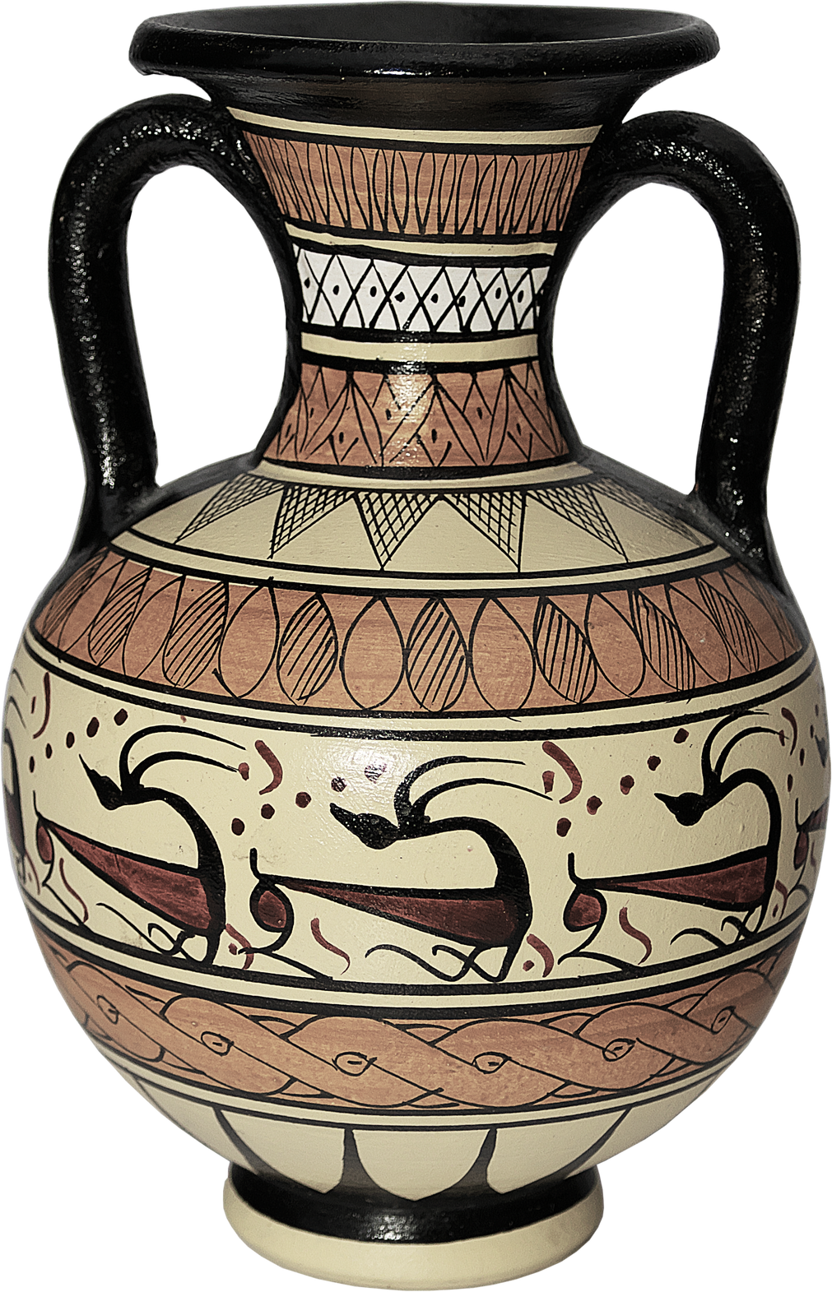

Part Three:
Legal Work and the Future of Museum Displays

Slide 14
Acquisitional History
Many museums across both the United States and the United Kingdom have faced backlash in recent years regarding the remains in their collections and the history behind their acquisition.
  In response, museums have reexamined their policies and began the process of deciding whether to keep some of the remains in their collection.
    Significant work has been done in the last 30 years to distance themselves from racist ideologies, and thousands of remains previously housed in their collection have since been repatriated.
Notes:
Smithsonian repatriated approx 17% of their remains (5,000 out of 30,000 total).

Slide 15
Human Remains in Legislation
Although viewed as fundamentally different than other collections, due to being physical remains of a culture, human remains have not been consistently treated as such.
Ancient and evolutionary remains are largely kept out of legislation, creating further issues of respect and proper treatment of the remains.
  Many policies have a time frame that the remains must fall within in order to be protected, and few protect those that are over 100-1000 years old.
Notes:
Oxford

Slide 16
The Future of Human Remains Display
As museums move to reflect the increasingly digitized world we live in, several concerns have arisen over the digitization of physical remains.
  Respect for and contextualization of the dead is a major concern, as well as diminishing the impact it may have as an educational tool once it is entered into the public domain.
    There is also an issue regarding desensitization of remains and the impact that it may have on the future of museum displays.

Slide 17
References
Alberti, Samuel J. M. M. “Objects and the Museum.” Isis, vol. 96, no. 4, 2005, pp. 559–71. JSTOR, https://doi.org/10.1086/498593. Accessed 18 Oct. 2024.
Antoine, Daniel. (2014). Curating Human Remains in Museum Collections: Broader Considerations and a British Museum Perspective.
Clary, Katie Stringer. “Human Remains in Museums Today.” History News, vol. 73, no. 4, 2018, pp. 12–19. JSTOR, https://www.jstor.org/stable/26975176. Accessed 18 Oct. 2024.
Convention on the Means of Prohibiting and Preventing the Illicit Import, Export, and Transfer of Ownership of Cultural Property, UNESCO, 14 November 1970, https://unesdoc.unesco.org/ark:/48223/pf0000133378. Accessed 14 October 2024.
Curtis, Neil G. W. “Human Remains: The Sacred, Museums, and Archaeology.” Public Archaeology, vol 3, 2003, pp 21-32, https://gooriweb.org/museums/public_archeology2003.pdf. Accessed 14 October 2024.
Fassio, Sarah. Rights of the Dead: Human Remains and Museum Collections, Washington Journal of Law, Technology, and Arts, 28 October 2023, https://wjlta.com/2023/10/28/rights-of-the-dead-human-remains-and-museum-collections/. Accessed 11 November 2024.
Gallagher, Steven. “Museums and the Return of Human Remains: An Equitable Solution?" International Journal of Cultural Property, no.17, 2010, pp.65-86.
Guidance for the Care of Human Remains in Museums, Department for Culture, Media, and Sport, October 2005, https://assets.publishing.service.gov.uk/media/606215c0e90e072d91e8eb59/GuidanceHumanRemains11Oct_V2.pdf. Accessed 14 October 2024.
“Human Remains in Museums.” Museum Mutterings, 28 January 2017, https://museummutterings.wordpress.com/2017/01/28/human-remains-in-museums/. Accessed 14 October 2024.

Slide 18
References
“Human Remains Policy.” Gardens, Libraries, and Museums, University of Oxford, 15 November 2006, https://www.glam.ox.ac.uk/human-remains-policy. Accessed 5 November 2024.
"Human Remains in the Pitt Rivers Museum." Pitt Rivers Museum, University of Oxford, https://www.prm.ox.ac.uk/human-remains-pitt-rivers-museum. Accessed 10 November 2024.
“Human Remains Task Force Report to the Secretary.” Smithsonian Institution, 10 January 2024, https://www.si.edu/sites/default/files/about/human-remains-task-force-report.pdf. Accessed 10 November 2024.
Licata, Marta, et al. “Study, conservation and exhibition of human remains: the need of a bioethical perspective.” Acta bio-medica : Atenei Parmensis vol. 91,4 e2020110. 7 Oct. 2020, doi:10.23750/abm.v91i4.9674.
Page, Kacey M., "The Significance of Human Remains in Museum Collections: Implications for Collections Management" (2011). History Theses. 1. https://digitalcommons.buffalostate.edu/history_theses/1. Accessed 14 October 2024.
Steele, Cassidy, "HUMAN REMAINS IN MUSEUMS AND INSTITUTIONS: LAWS AND POLICIES" (2022). Master of Arts in Art and Design Theses. 1. https://digitalcommons.kennesaw.edu/art_etd/1.
Swain, Hedley. "2 Dealings with the Dead: A Personal Consideration of the Ongoing Human Remains Debate". Curating Human Remains: Caring for the Dead in the United Kingdom, edited by Myra Giesen, Charlotte Roberts, Charlotte Woodhead, Duncan Sayer, Gillian Scott, Hedley Swain, Jacqueline McKinley, Jelena Bekvalac, Jennifer Sharp, Kirsty McCarrison, Liz White, Margaret Clegg, Mark A. Hall, Michael G Parker Pearson, Mike Pitts, Myra Giesen, Rebecca Redfern, Simon Mays and Victoria Park, Boydell and Brewer: Boydell and Brewer, 2013, pp. 25-30. https://doi.org/10.1515/9781782040743-006.
Ulguim, Priscilla. (2018). Digital Remains Made Public: Sharing the Dead Online and our Future Digital Mortuary Landscape. AP Online Journal in Public Archaeology. 8. 153. 10.23914/ap.v8i2.162.
Veiga, Paula. “Studying Mummies and Human Remains: Some Current Developments and Issues.” Journal of the Washington Academy of Sciences, vol. 98, no. 2, 2012, pp. 1–21. JSTOR, http://www.jstor.org/stable/24536526. Accessed 18 Oct. 2024.

