Slide 1
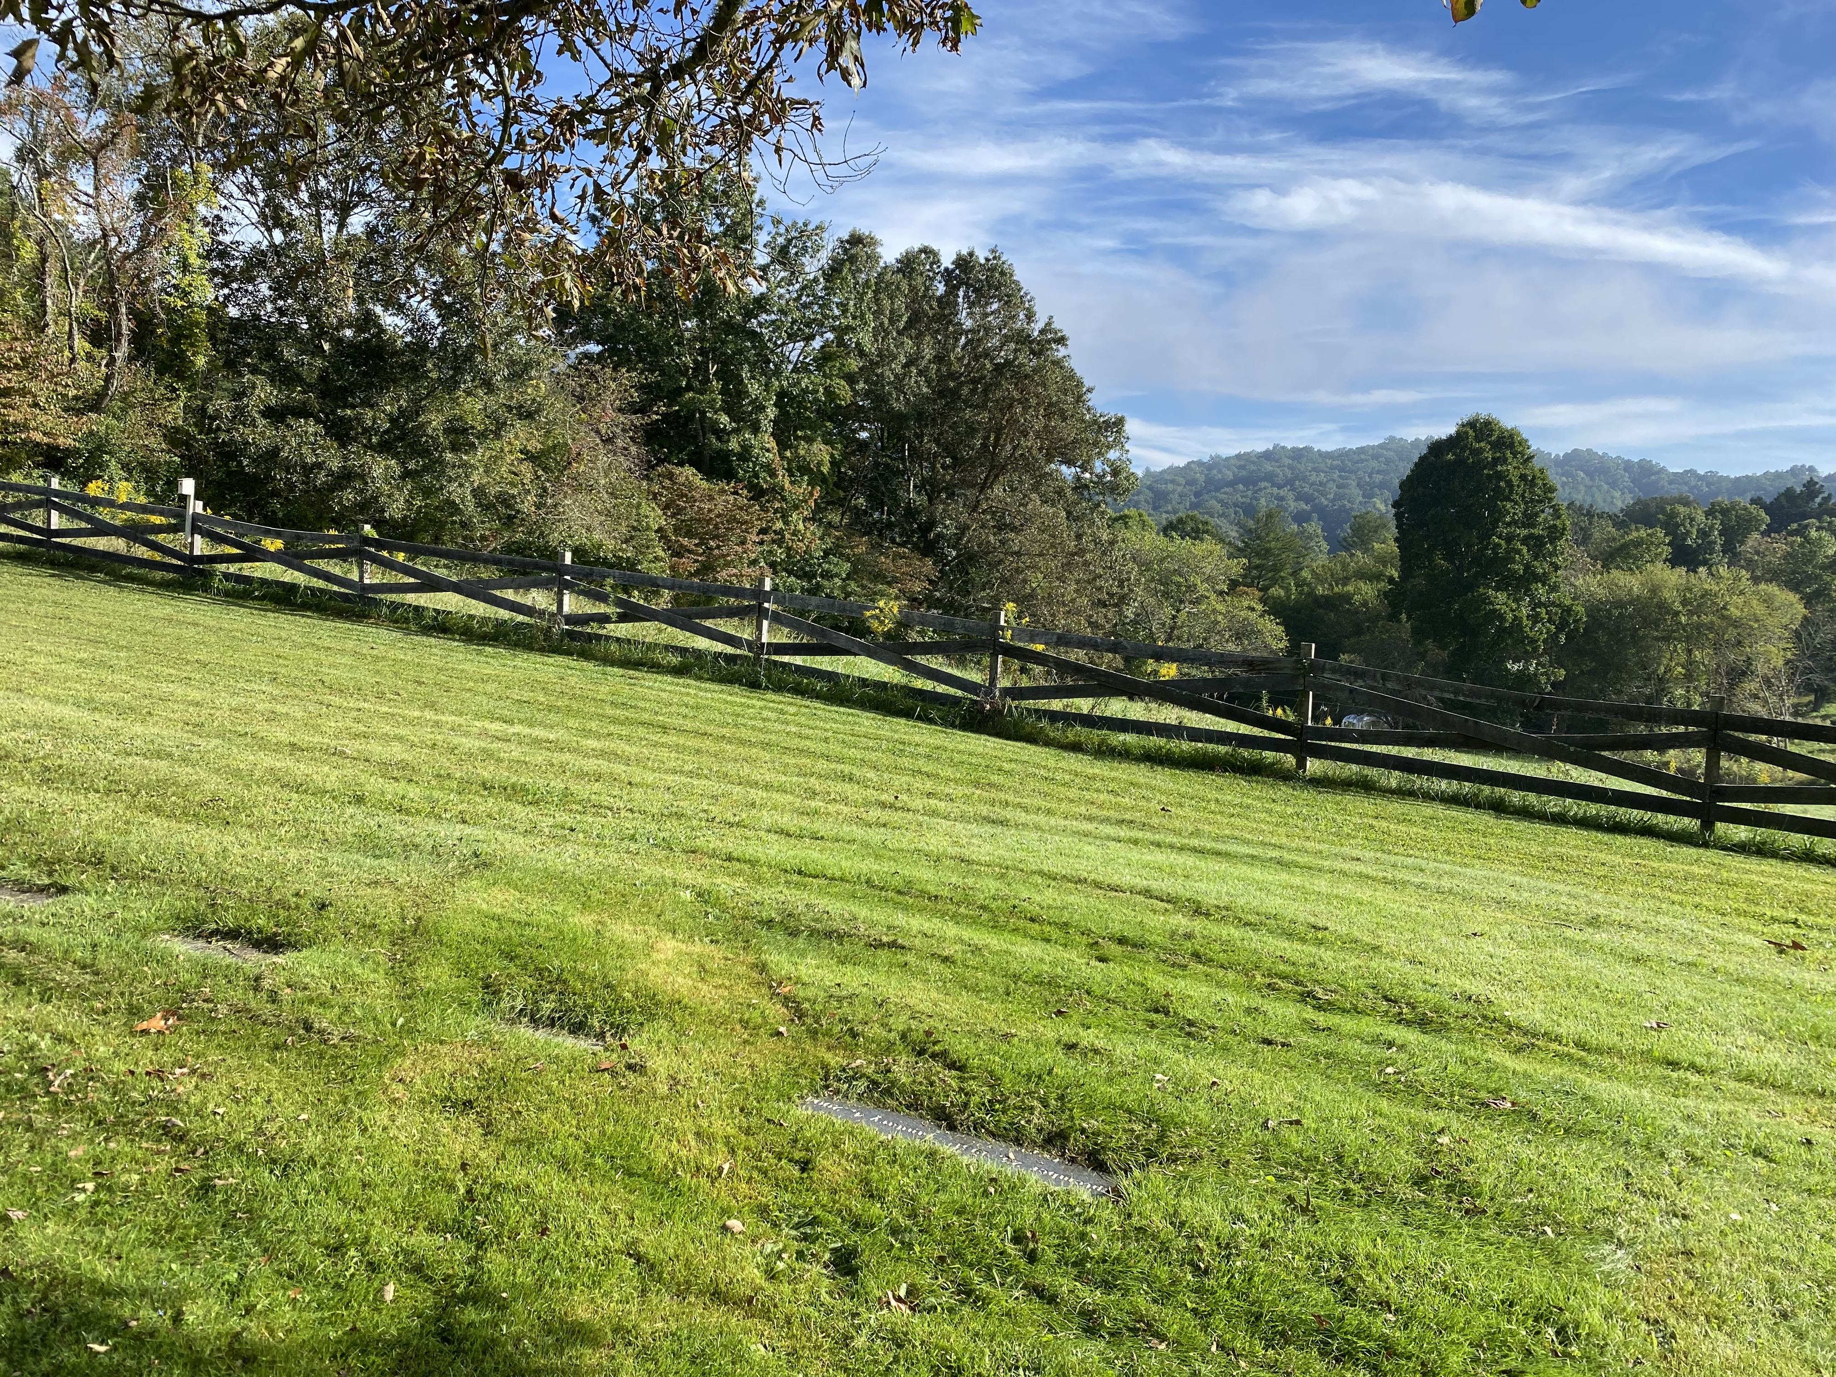
Warren Wilson Cemetery
Swannanoa, NC founded 1959

Slide 2
Warren Wilson Cemetery
Swannanoa, NC founded 1959
Owned by Warren Wilson Presbyterian Church and College Chapel
1 acre plot from college agricultural land
Governed by a Board of Trustees elected by the church (officially)
Trustees decide who is a member of the WW community and thus, who can be buried
Church is in process of finalizing incorporation of the cemetery
Purchased plots for burial (casket, cremains, or green) or a stone in memorial garden/scattered ashes
Each headstone/memorial stone made by Martin Monuments

Slide 3
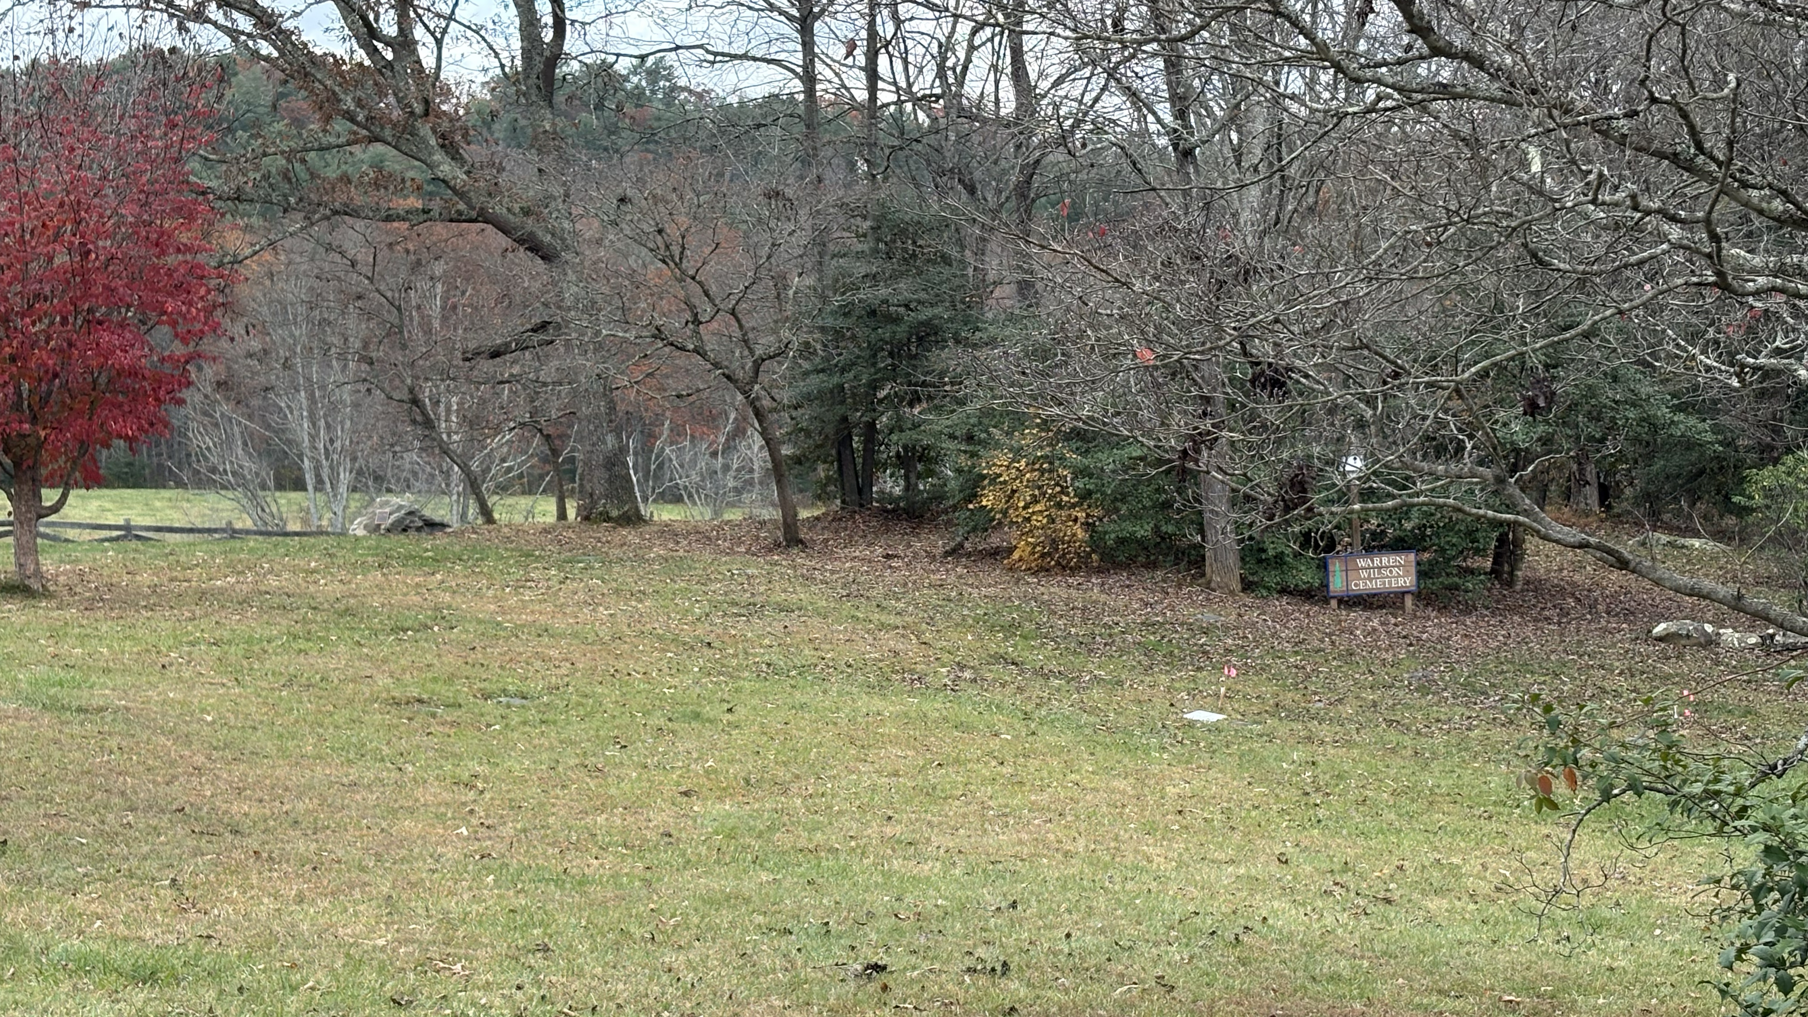

Slide 4
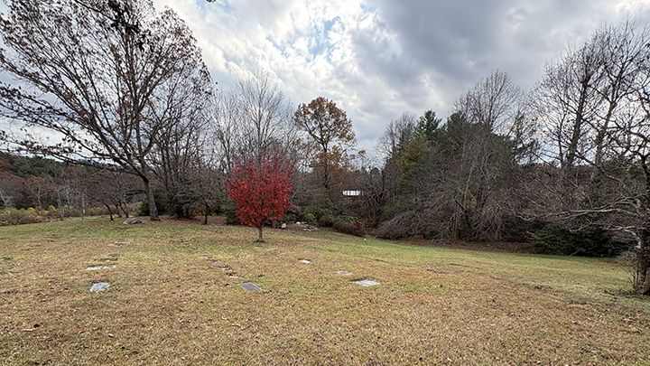

Slide 5
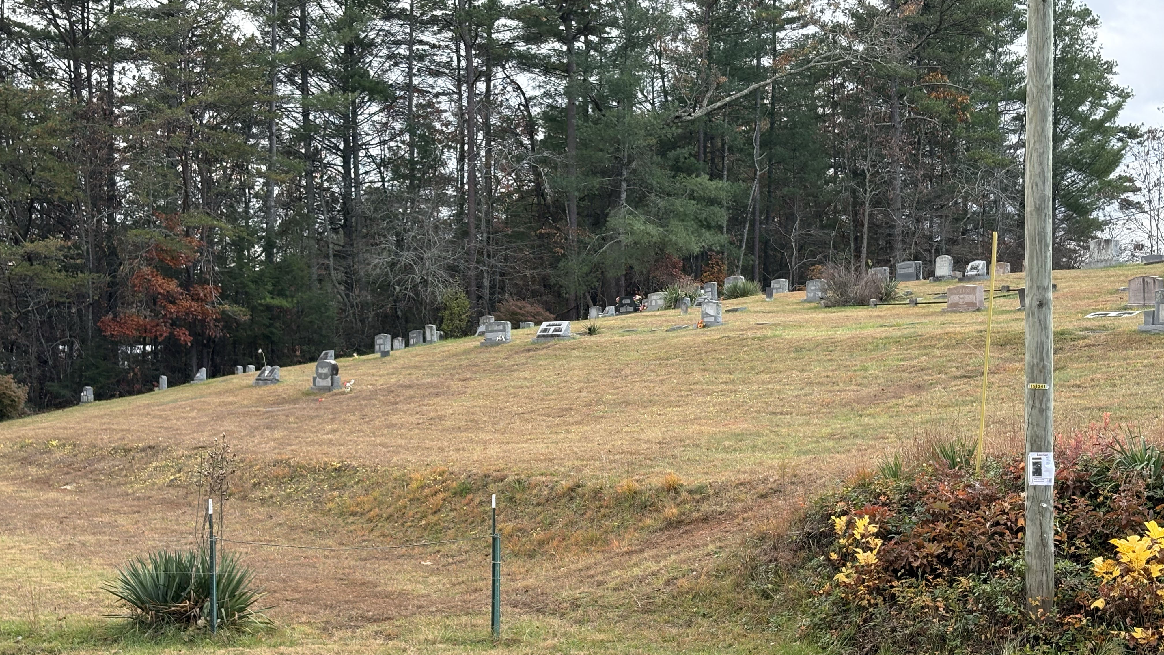

Slide 6
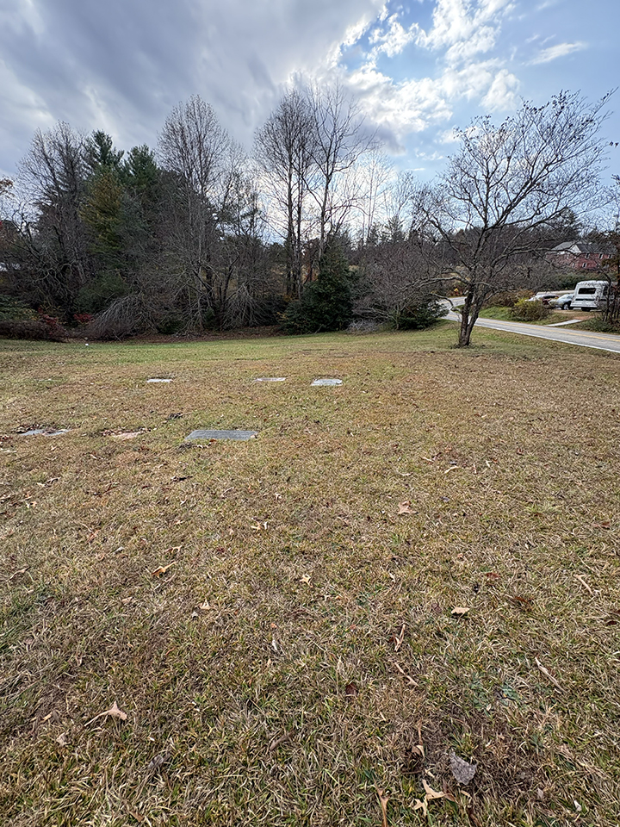

Slide 7
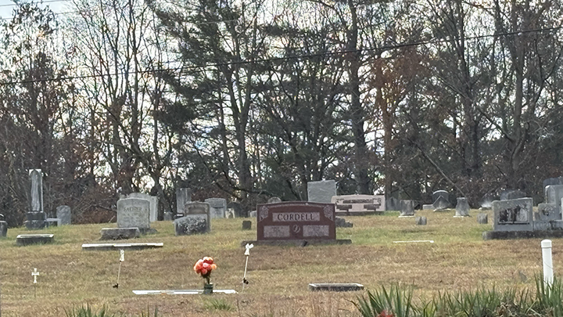

Slide 8
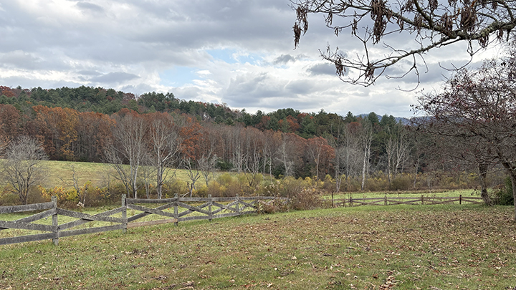

Slide 9
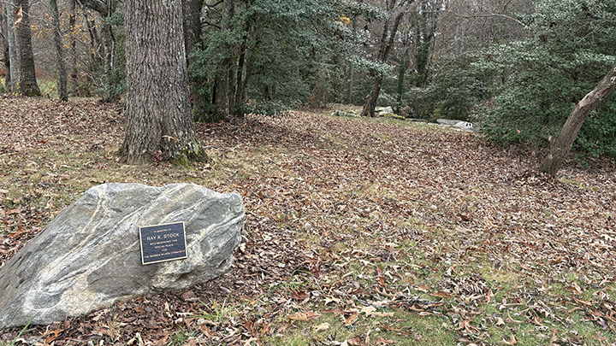

Slide 10
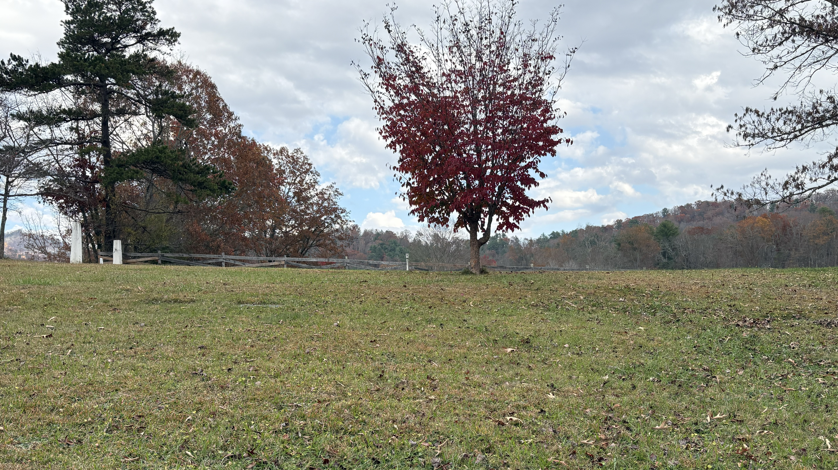

Slide 11
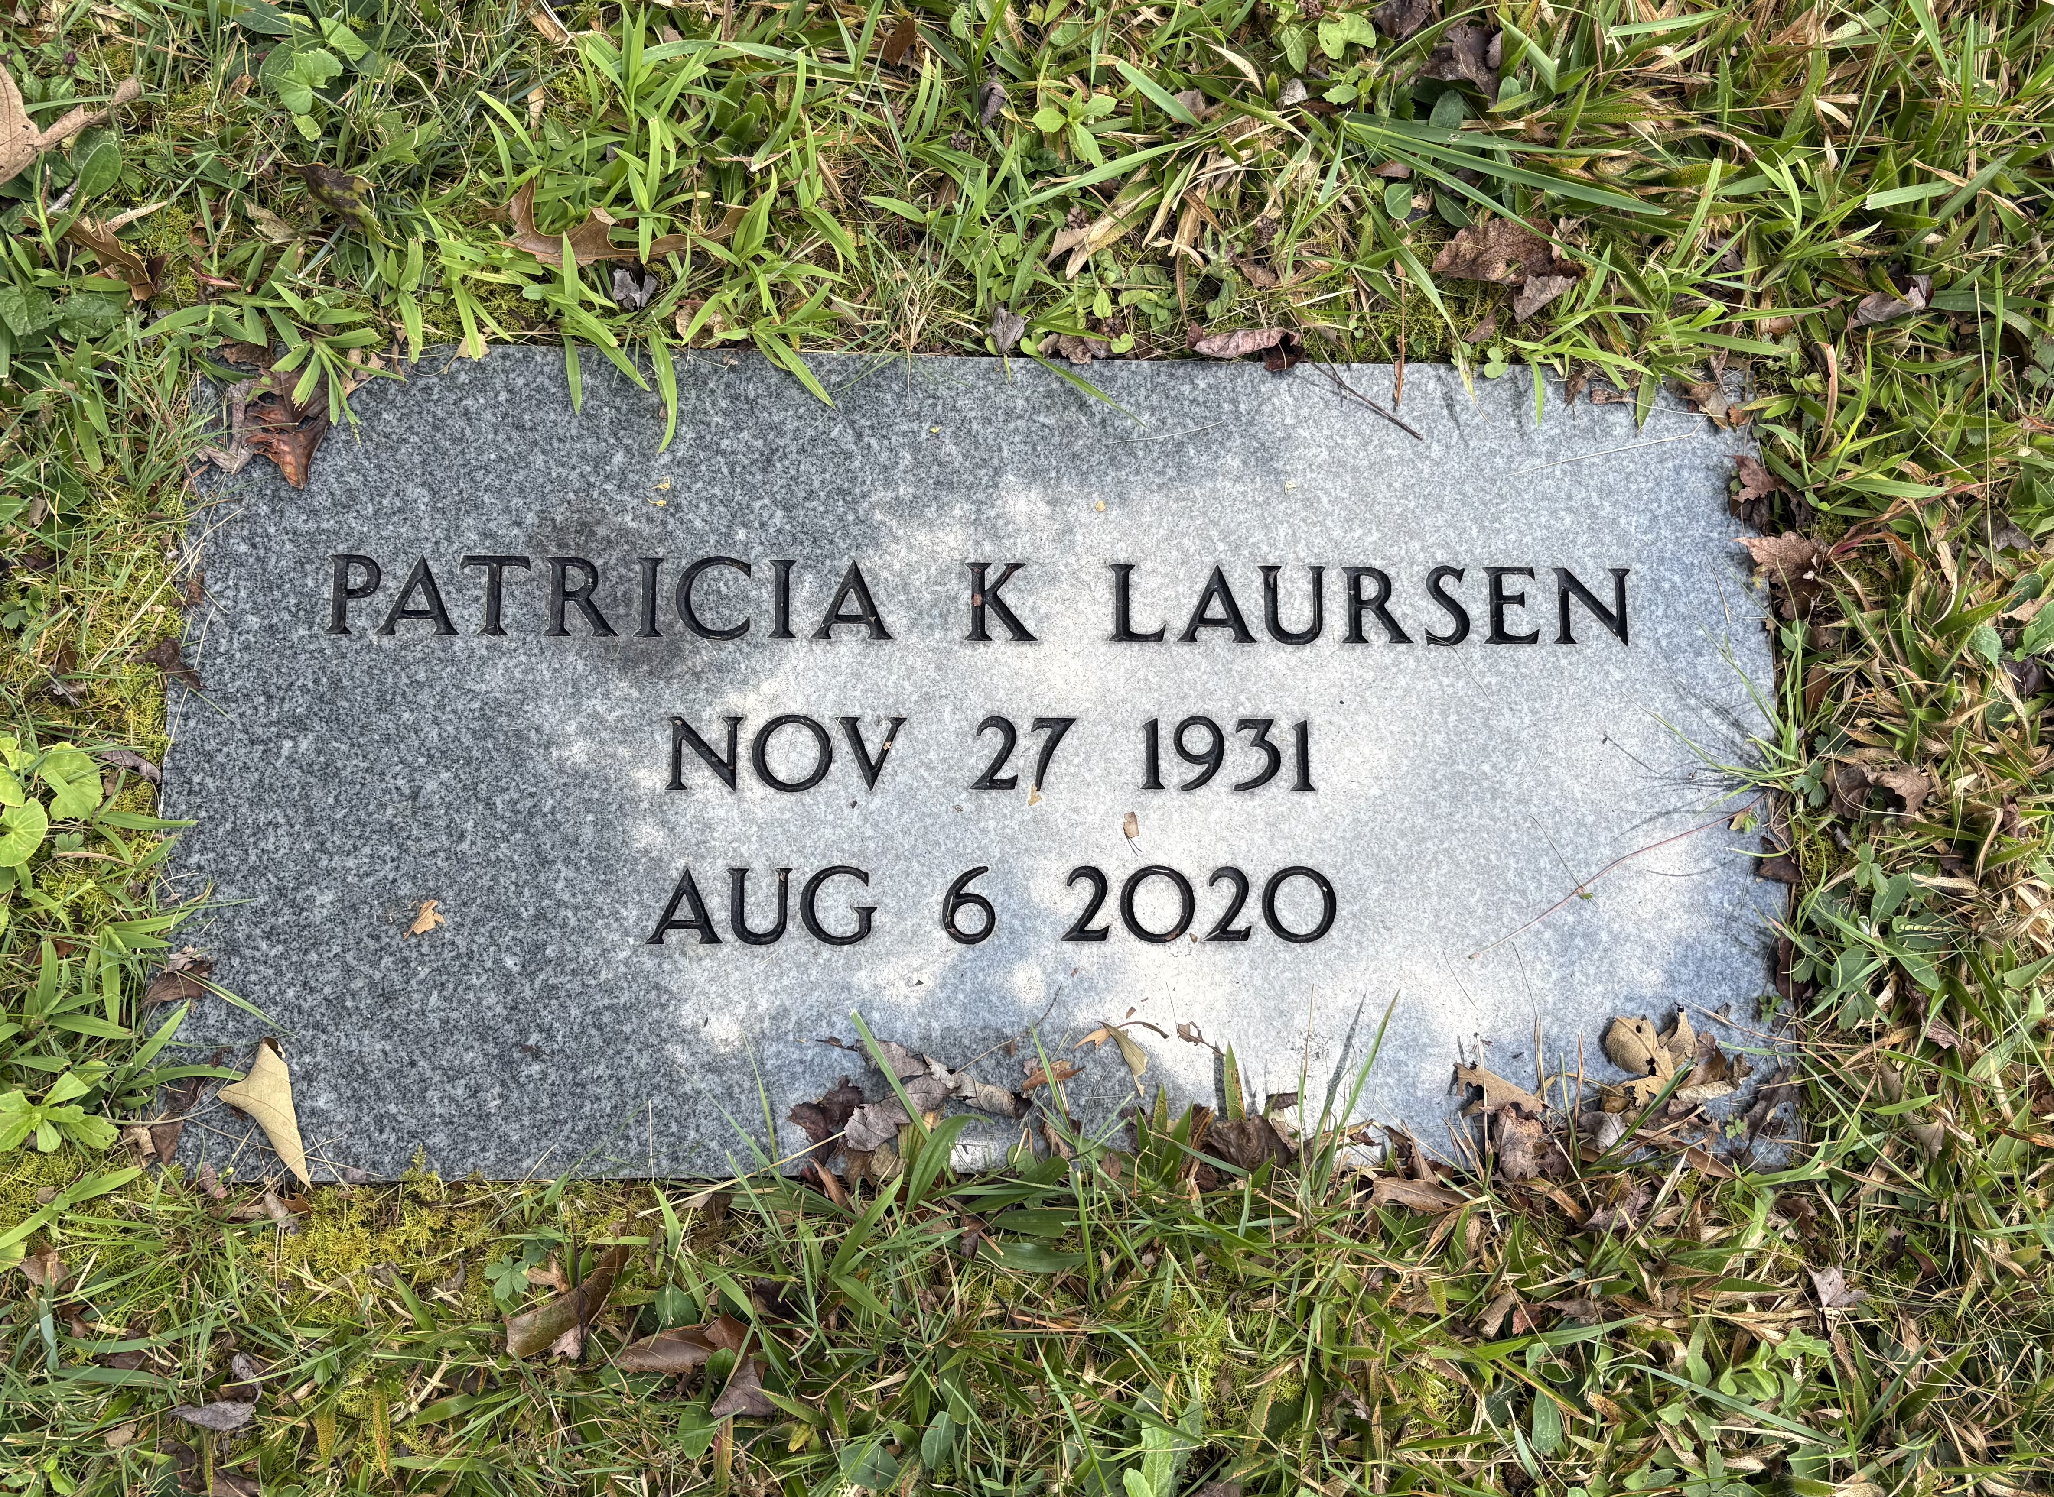

Slide 12
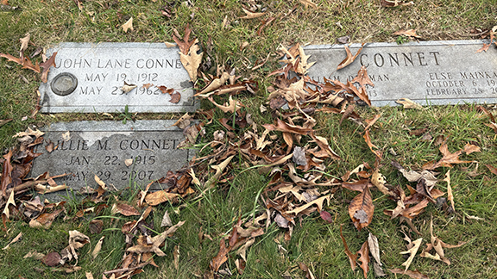

Slide 13
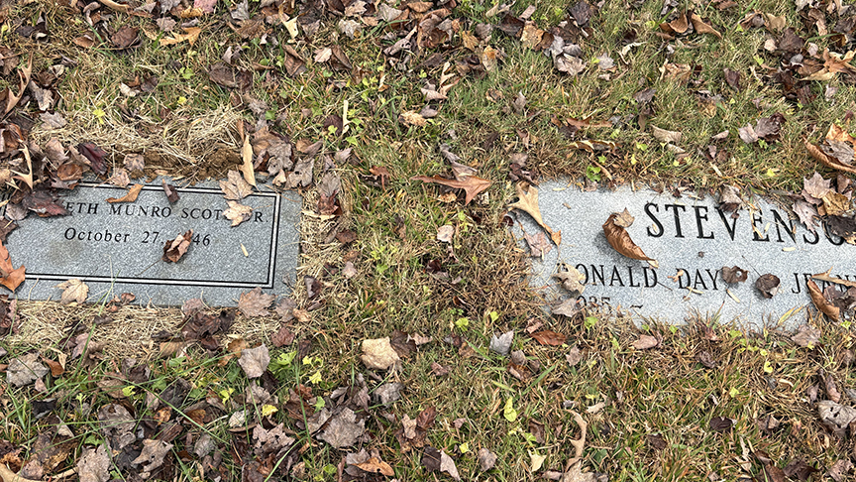

Slide 14
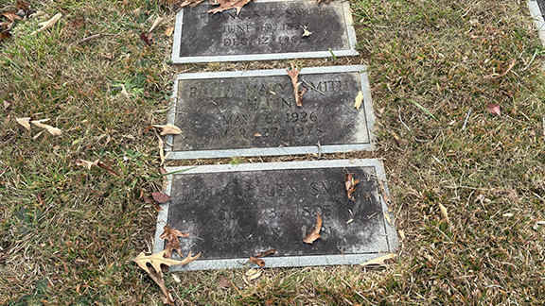

Slide 15
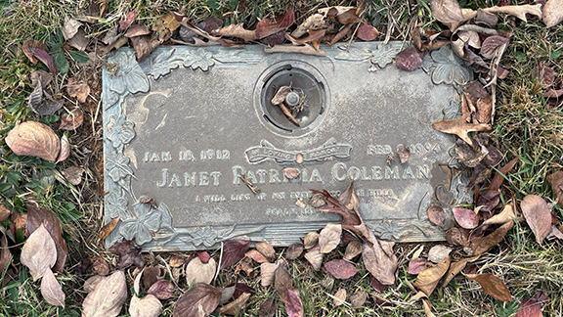

Slide 16
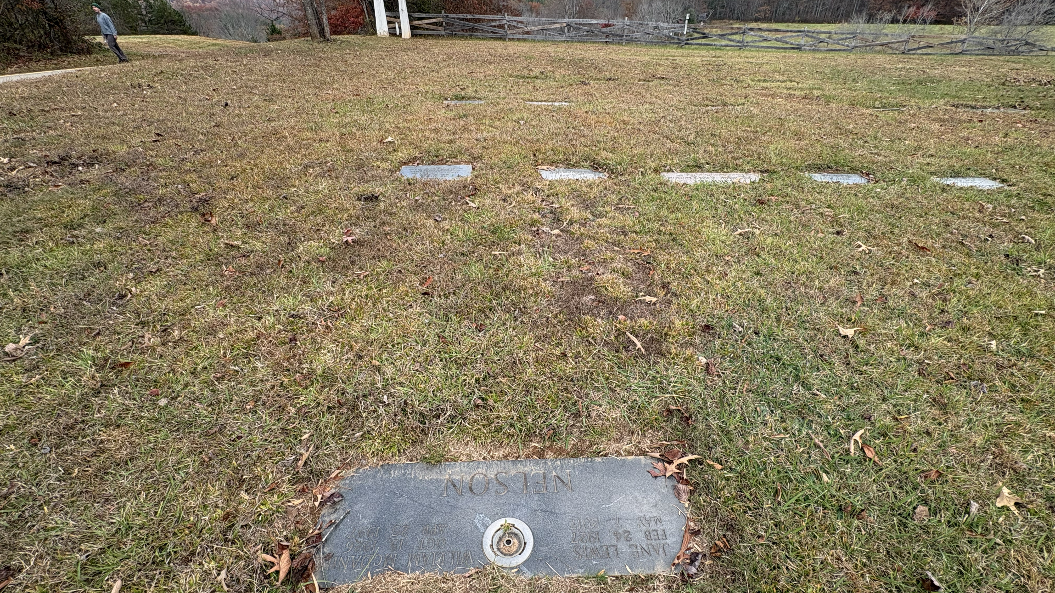

Slide 17
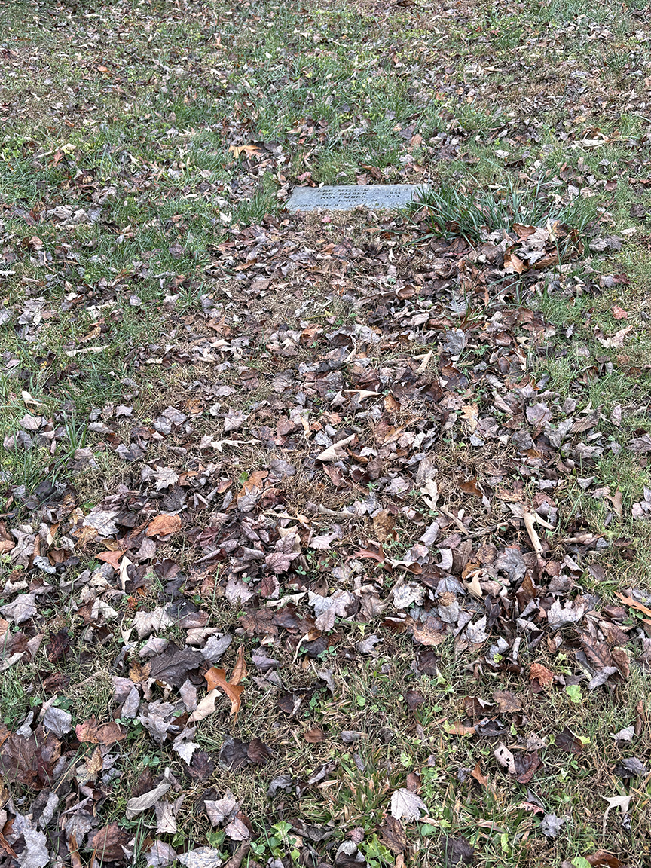
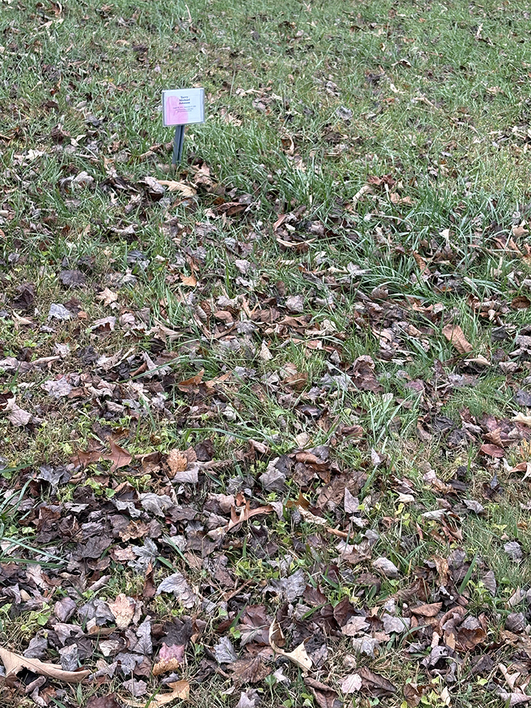

Slide 18
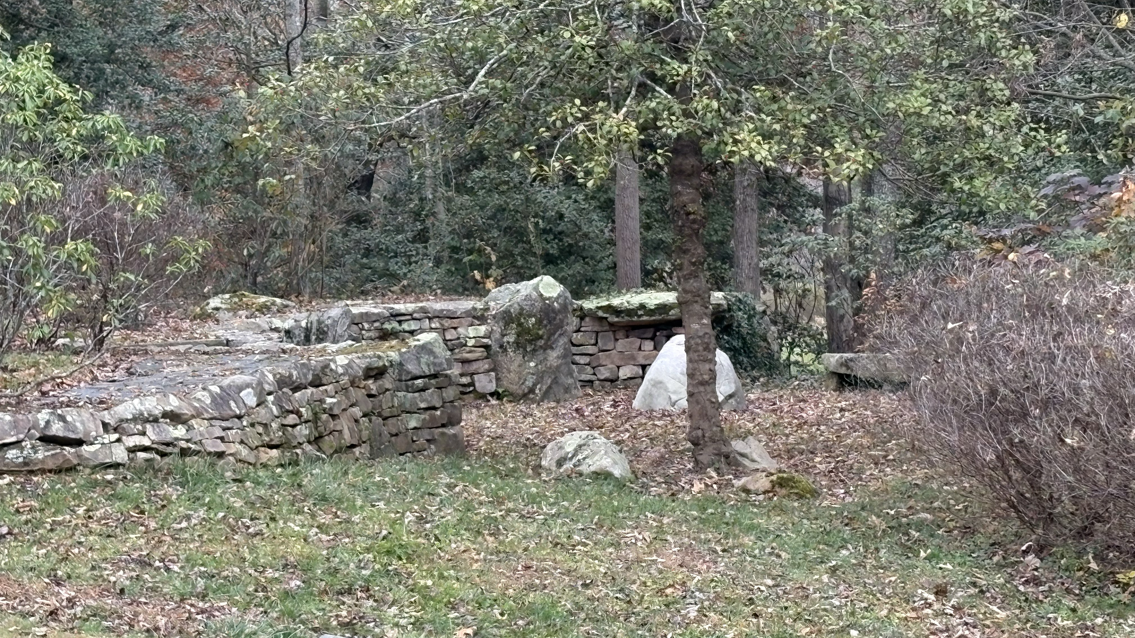

Slide 19
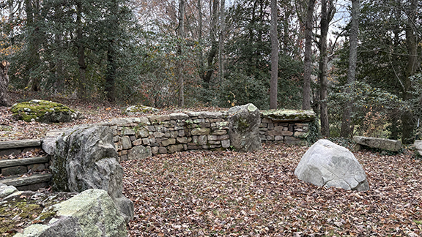

Slide 20
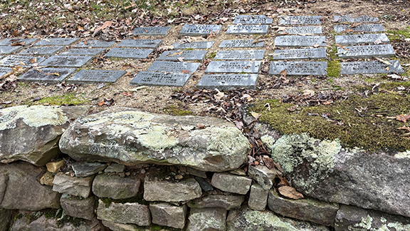

Slide 21
