Slide 1
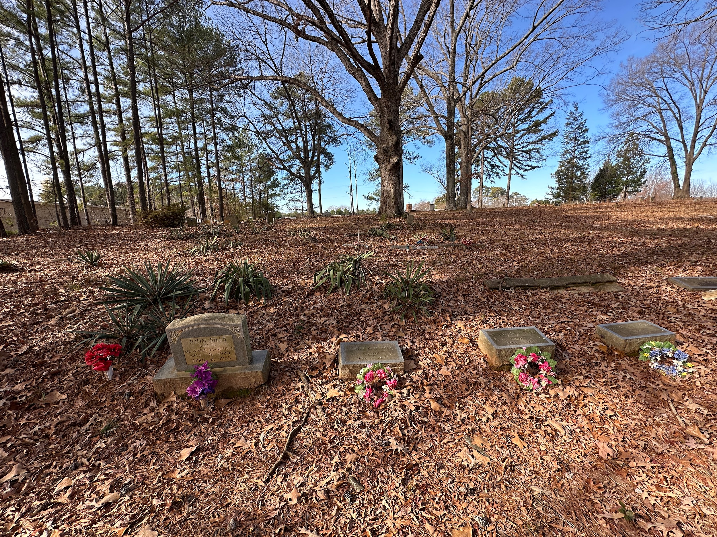
Silent Spaces
Documenting African-American burial grounds in Raleigh, Durham, and Chapel Hill

Slide 2
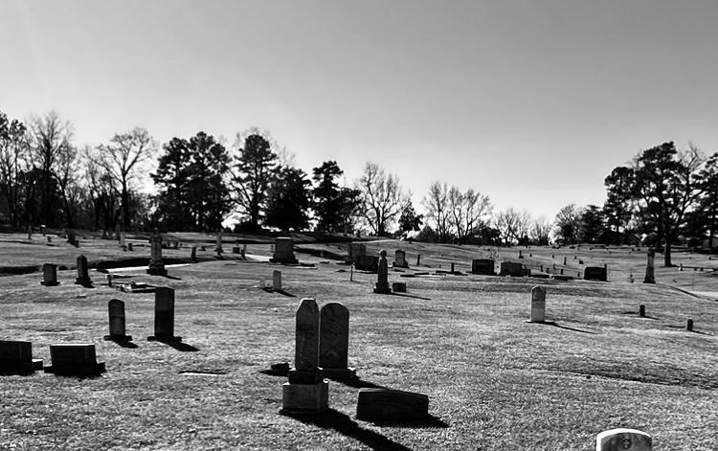
Who am I and what is Silent Spaces?
Kim Suess-2024 graduate of UNCG’s library and information science program.
Community archivist.
Silent Spaces is my capstone project.
Wanted to use what I learned.
Many people have been and are doing this kind of work, this is just my contribution.
https://alkimey281.github.io/caps-proj/

Slide 3
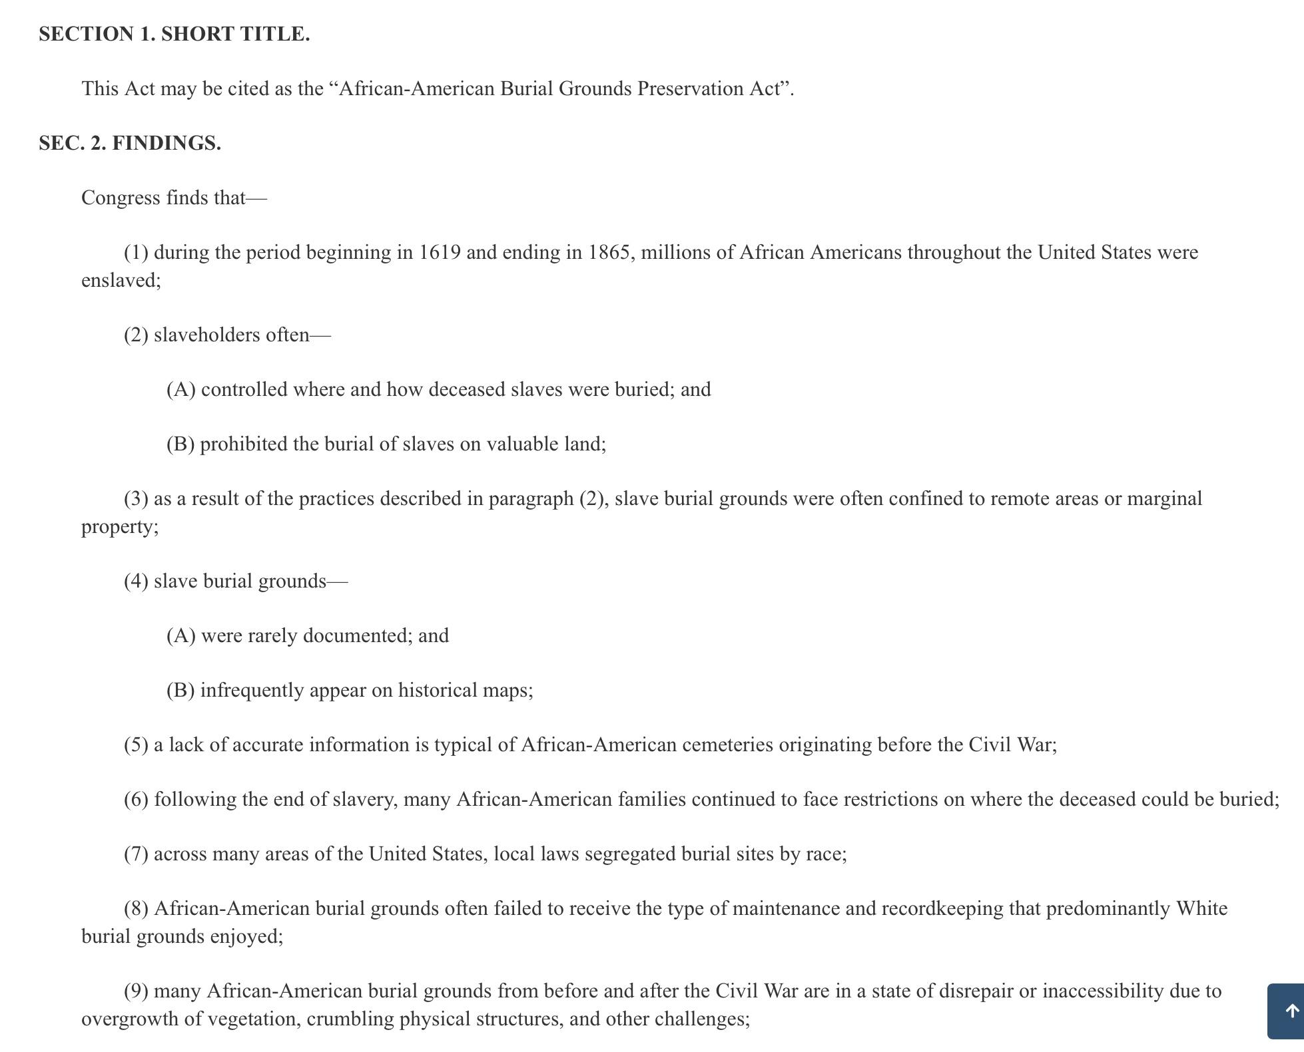
The African-American Burial Grounds Preservation Act
Why it came to pass.
Never funded.
It takes a village:
Find A Grave
NC Office of State Archaeology
Carmen Cauthen and Ruth Little
People Not Property, Wake County Enslaved Persons Project, etc
So many people care about this work.
https://www.congress.gov/bill/117th-congress/house-bill/6805/text

Slide 4
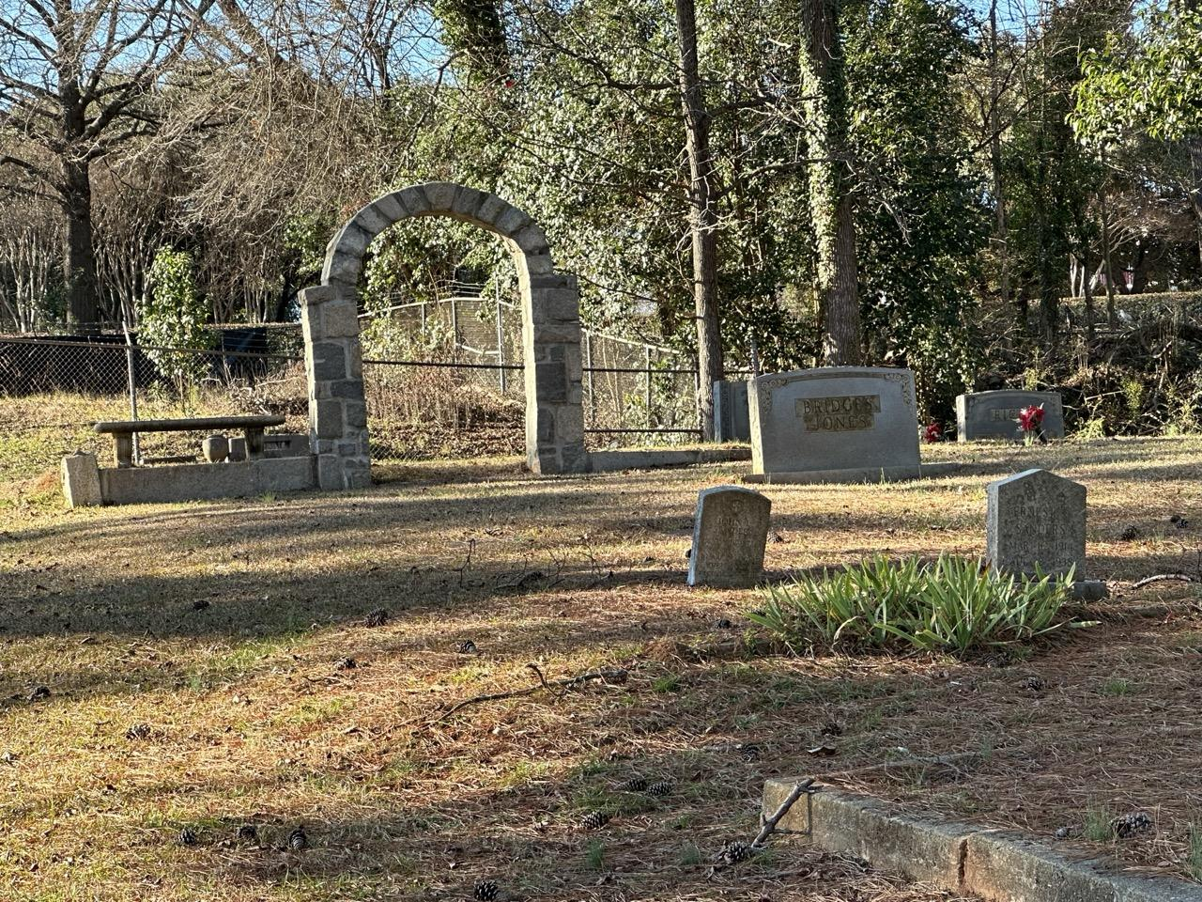
Why this is important
Black individuals and communities are tied to the land.
Prevent development/destruction of these spaces.
Find what you can from the scattered resources.
Reunite living descendants with their ancestors.
Healing as individuals and as communities.
“Marginalized burial grounds are places of structural violence and systemic vandalism, impacting both the dead and living communities connected with them.” - from Cemetery Citizens by Adam Rosenblatt

Slide 5
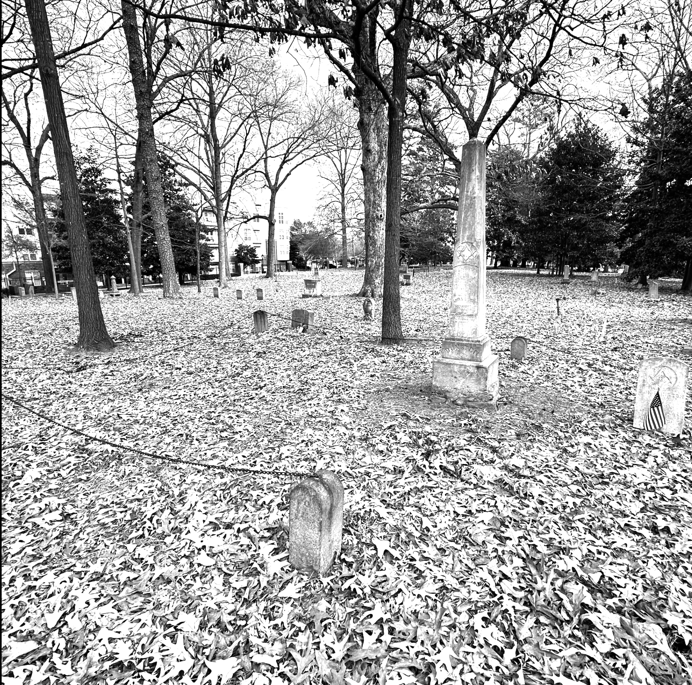
Project Objectives
Create shareable data as well as information for descendants.
Help people find these places.
Starting place with resources and current photographs.
Chose a few residents to illuminate contributions.
The power of a name.
Bring resources together.

Slide 6
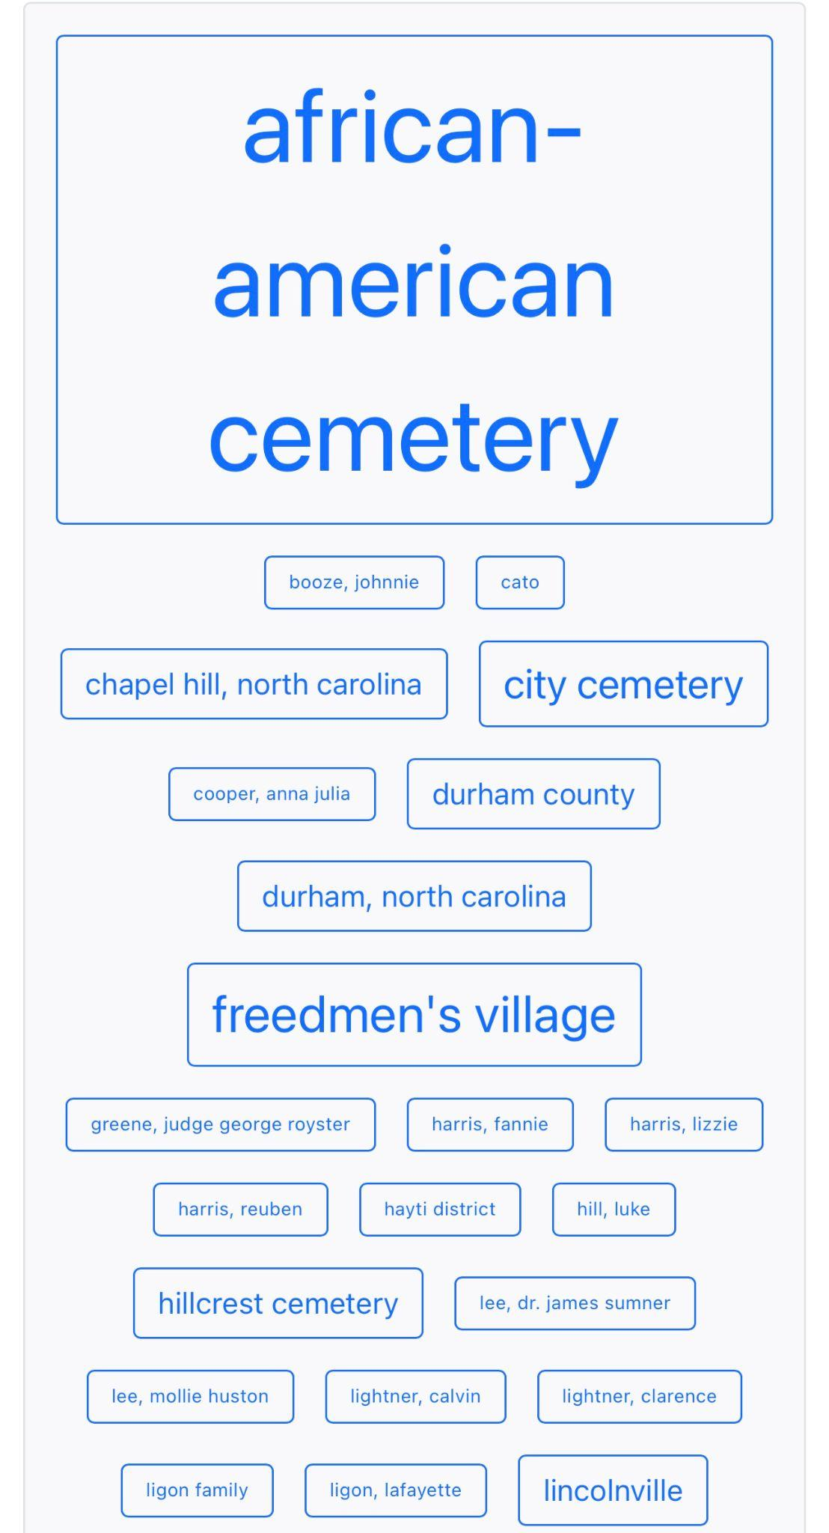
Collection Builder
Maps, timelines, subject heading word clouds.
Downloadable reusable data formats that can be processed by machines.
A few required fields for machine readability, but very flexible metadata.
Regarding archival descriptive standards for Black collections…
“...the language serves the systems, not the subjects”
-Dorothy Berry from The House Archives Built

Slide 7
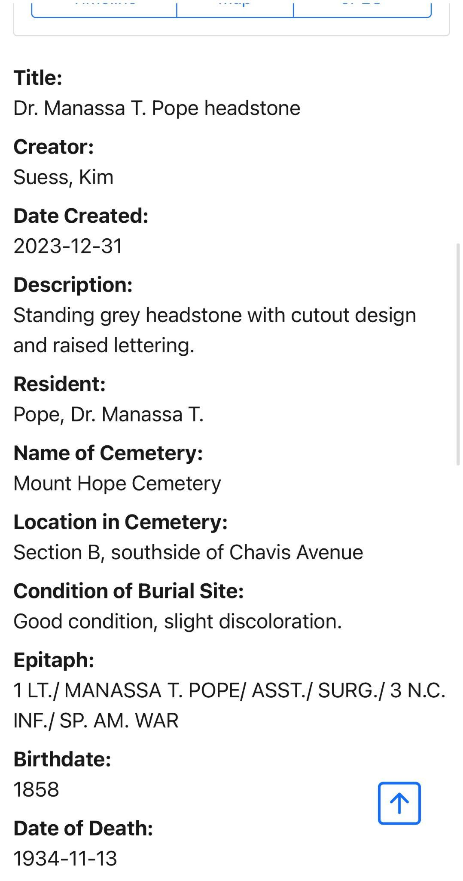
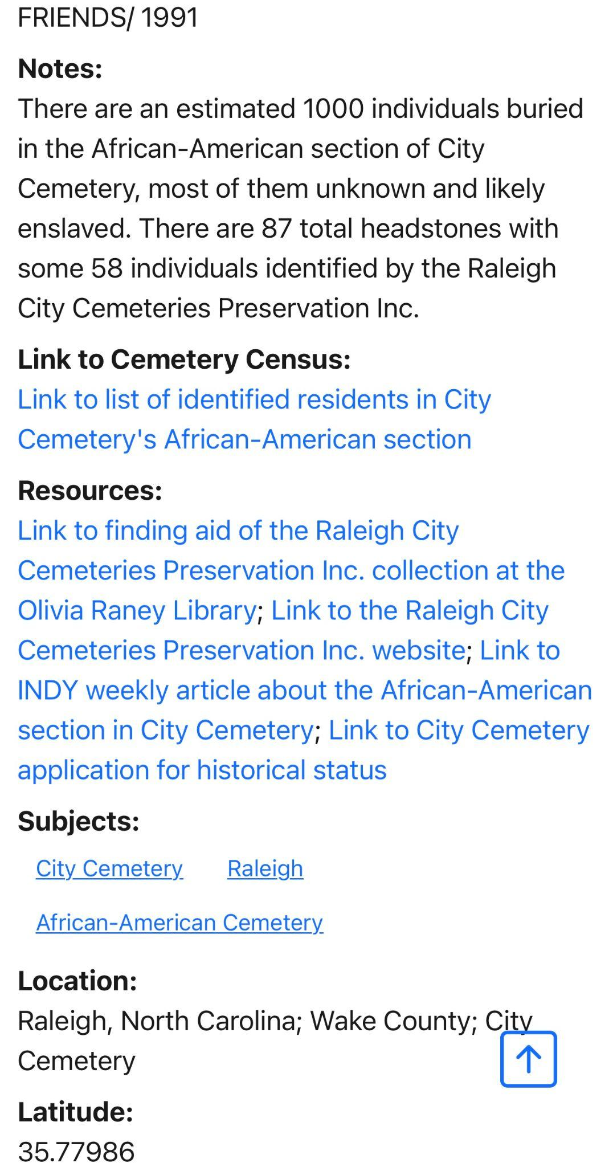
Metadata
Some required fields.
Description.
Resident and epitaph.
Cemetery name, location in cemetery, and site condition.
Notes for background information.
Cemetery census links.
Resources:
Freedmen’s Bureau records.
Databases such as People Not Property, etc.
Historic Landmark Applications.
Tried to send seekers to community sources.

Slide 8
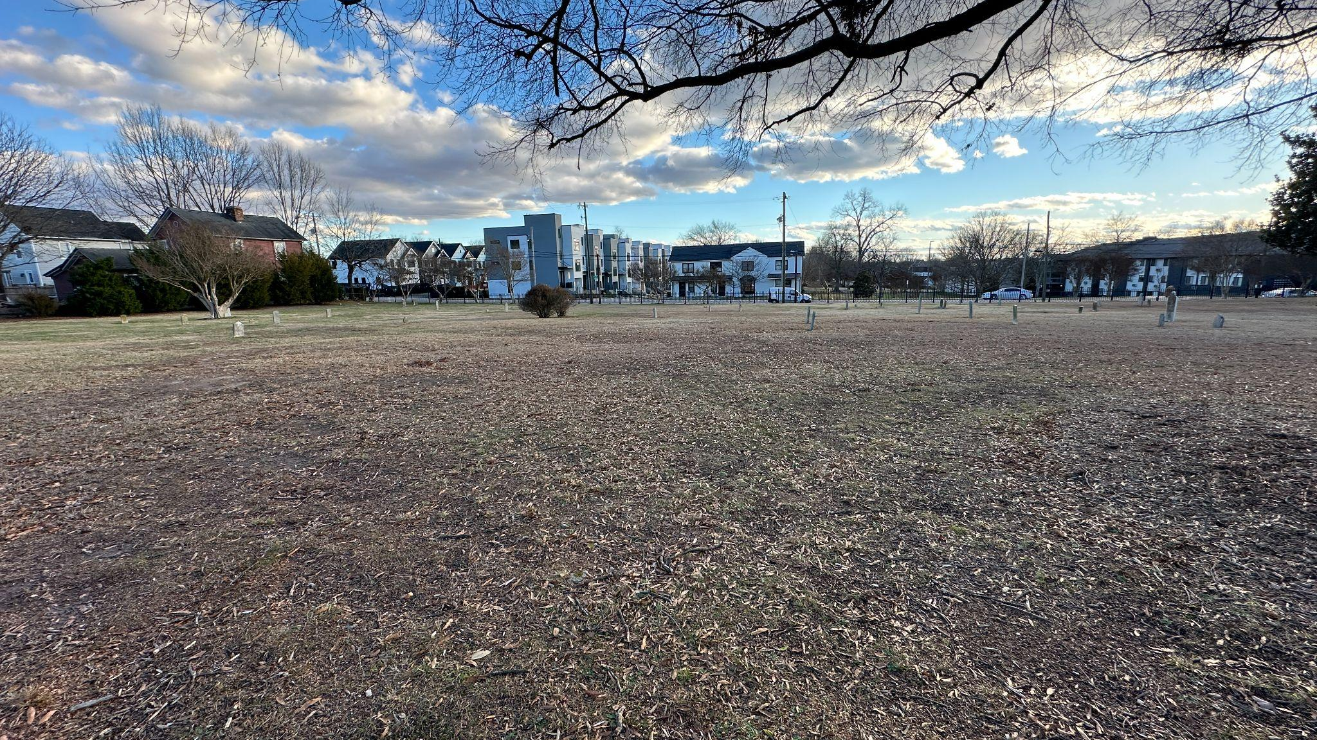
How this work was difficult
Black history is so fragmented (and altered).
A lot of data remains unprocessed in archival institutions or represented by standards that do not truly reflect content.
Respect for narrative control.
Working with the communities when possible.
So much is needed it is overwhelming.

Slide 9
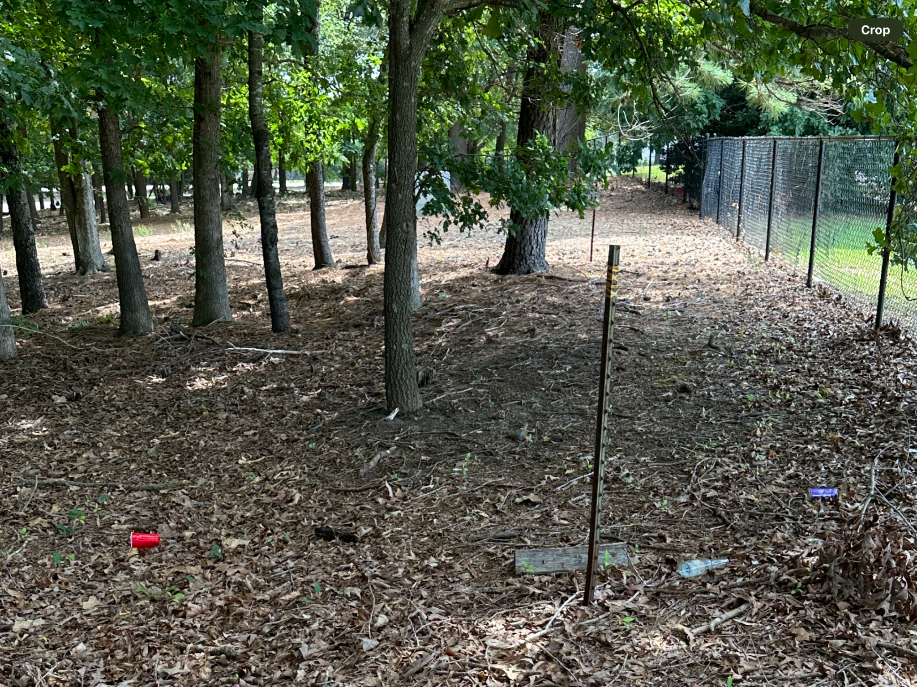
Lincolnville Cemetery
Freedmen’s village, one of thirteen in Raleigh.
Land owned by NC State since 1939.
Originally three cemeteries, only one now.
Residents moved, some to Oakwood in 2015.
Residents are scattered and a ground penetrating radar survey is needed.
No public signage or acknowledgement of the space.

Slide 10
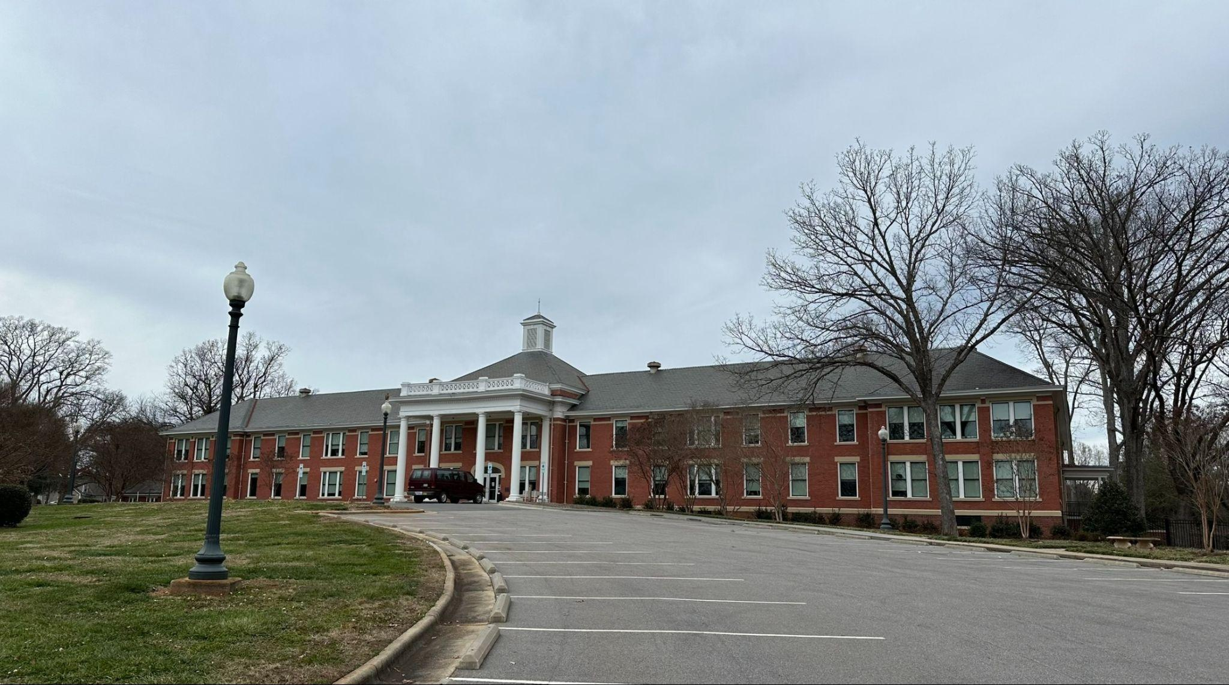
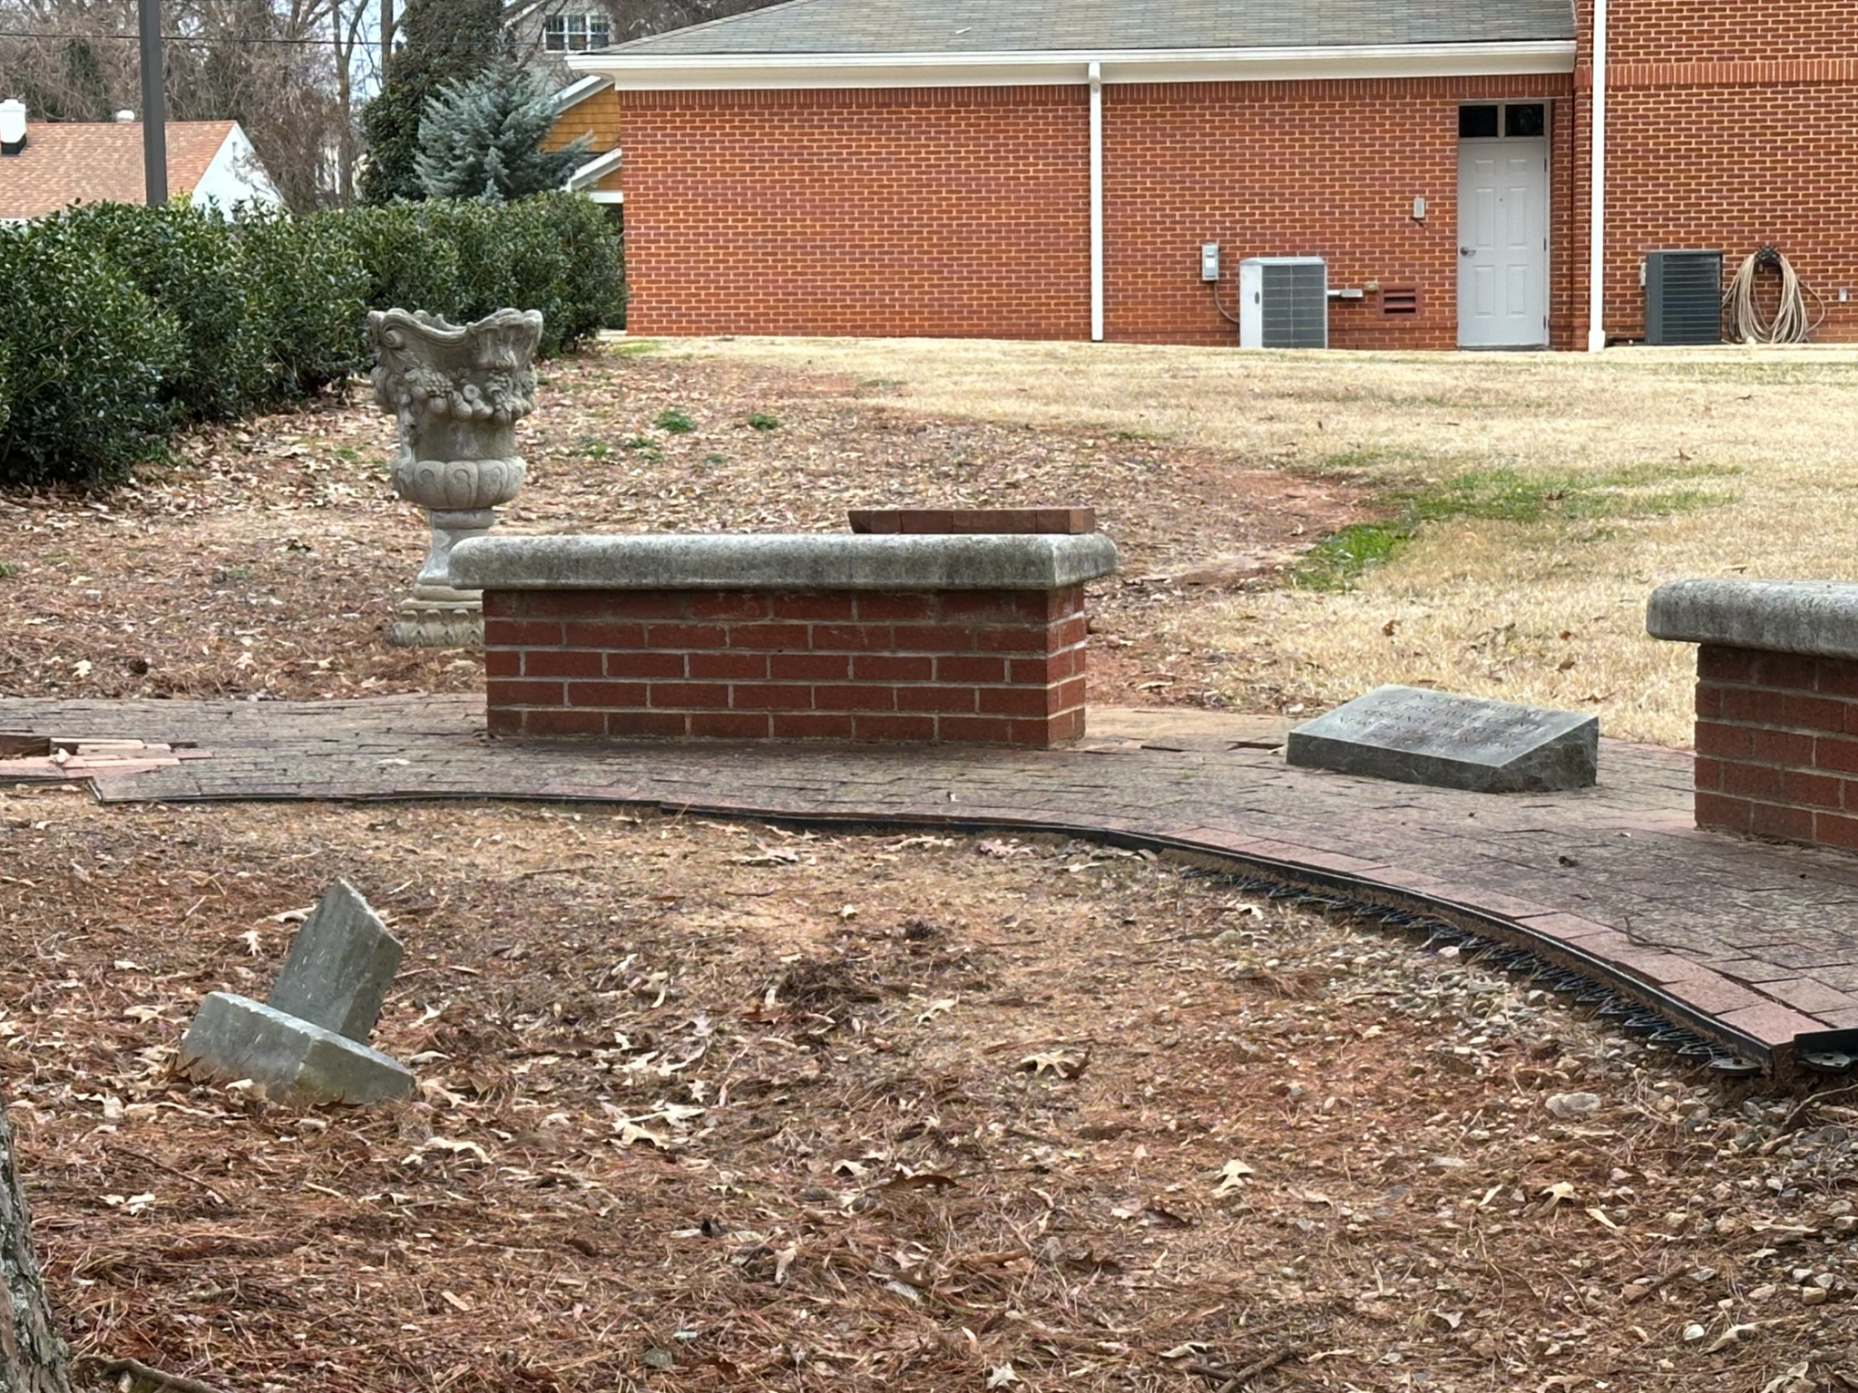
Going forward
Include other cemeteries: O’Rorke (Potter’s Field) and the Wake County Poorhouse cemeteries.
More information on the land.
Add more links and subject headings.
Connect project to oral histories.
Provide access to all the photos I took.
Thank you for your time!

Slide 11
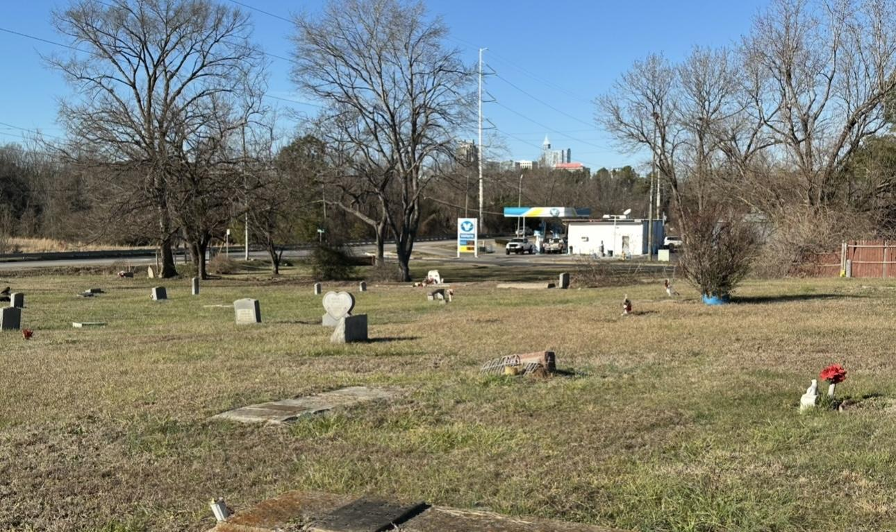
Resources
Berry, Dorothy. “The House Archives Built.” up//root. June, 2021. https://www.uproot.space/features/the-house-archives-built.
Rosenblatt, Adam. Cemetery Citizens: Reclaiming the Past and Working For Justice in American Burial Grounds. Stanford UP, 2024. https://trinity.duke.edu/news/cemetery-citizens-and-practice-care
Carmen Cauthen. Research and Resource of Raleigh. https://researchandresource.com/
Digital Library on American Slavery. https://dlas.uncg.edu
FindAGrave. https://www.findagrave.com
Friends of Oberlin Village. https://friendsofoberlinvillage.org
Friends of Hillcrest Cemetery. https://www.fohci.com
Ruth Little. Longleaf Historic Resources. https://www.ruthlittle.com/longleaf-historic-resources-historic-places
Office of State Archaeologist-Cemetery Specialist. https://archaeology.ncdcr.gov/programs/cemeteries
Olivia Raney Library. https://www.wake.gov/departments-government/libraries/research/research-special-collections/special-collections-wake-county-public-libraries

