Slide 1
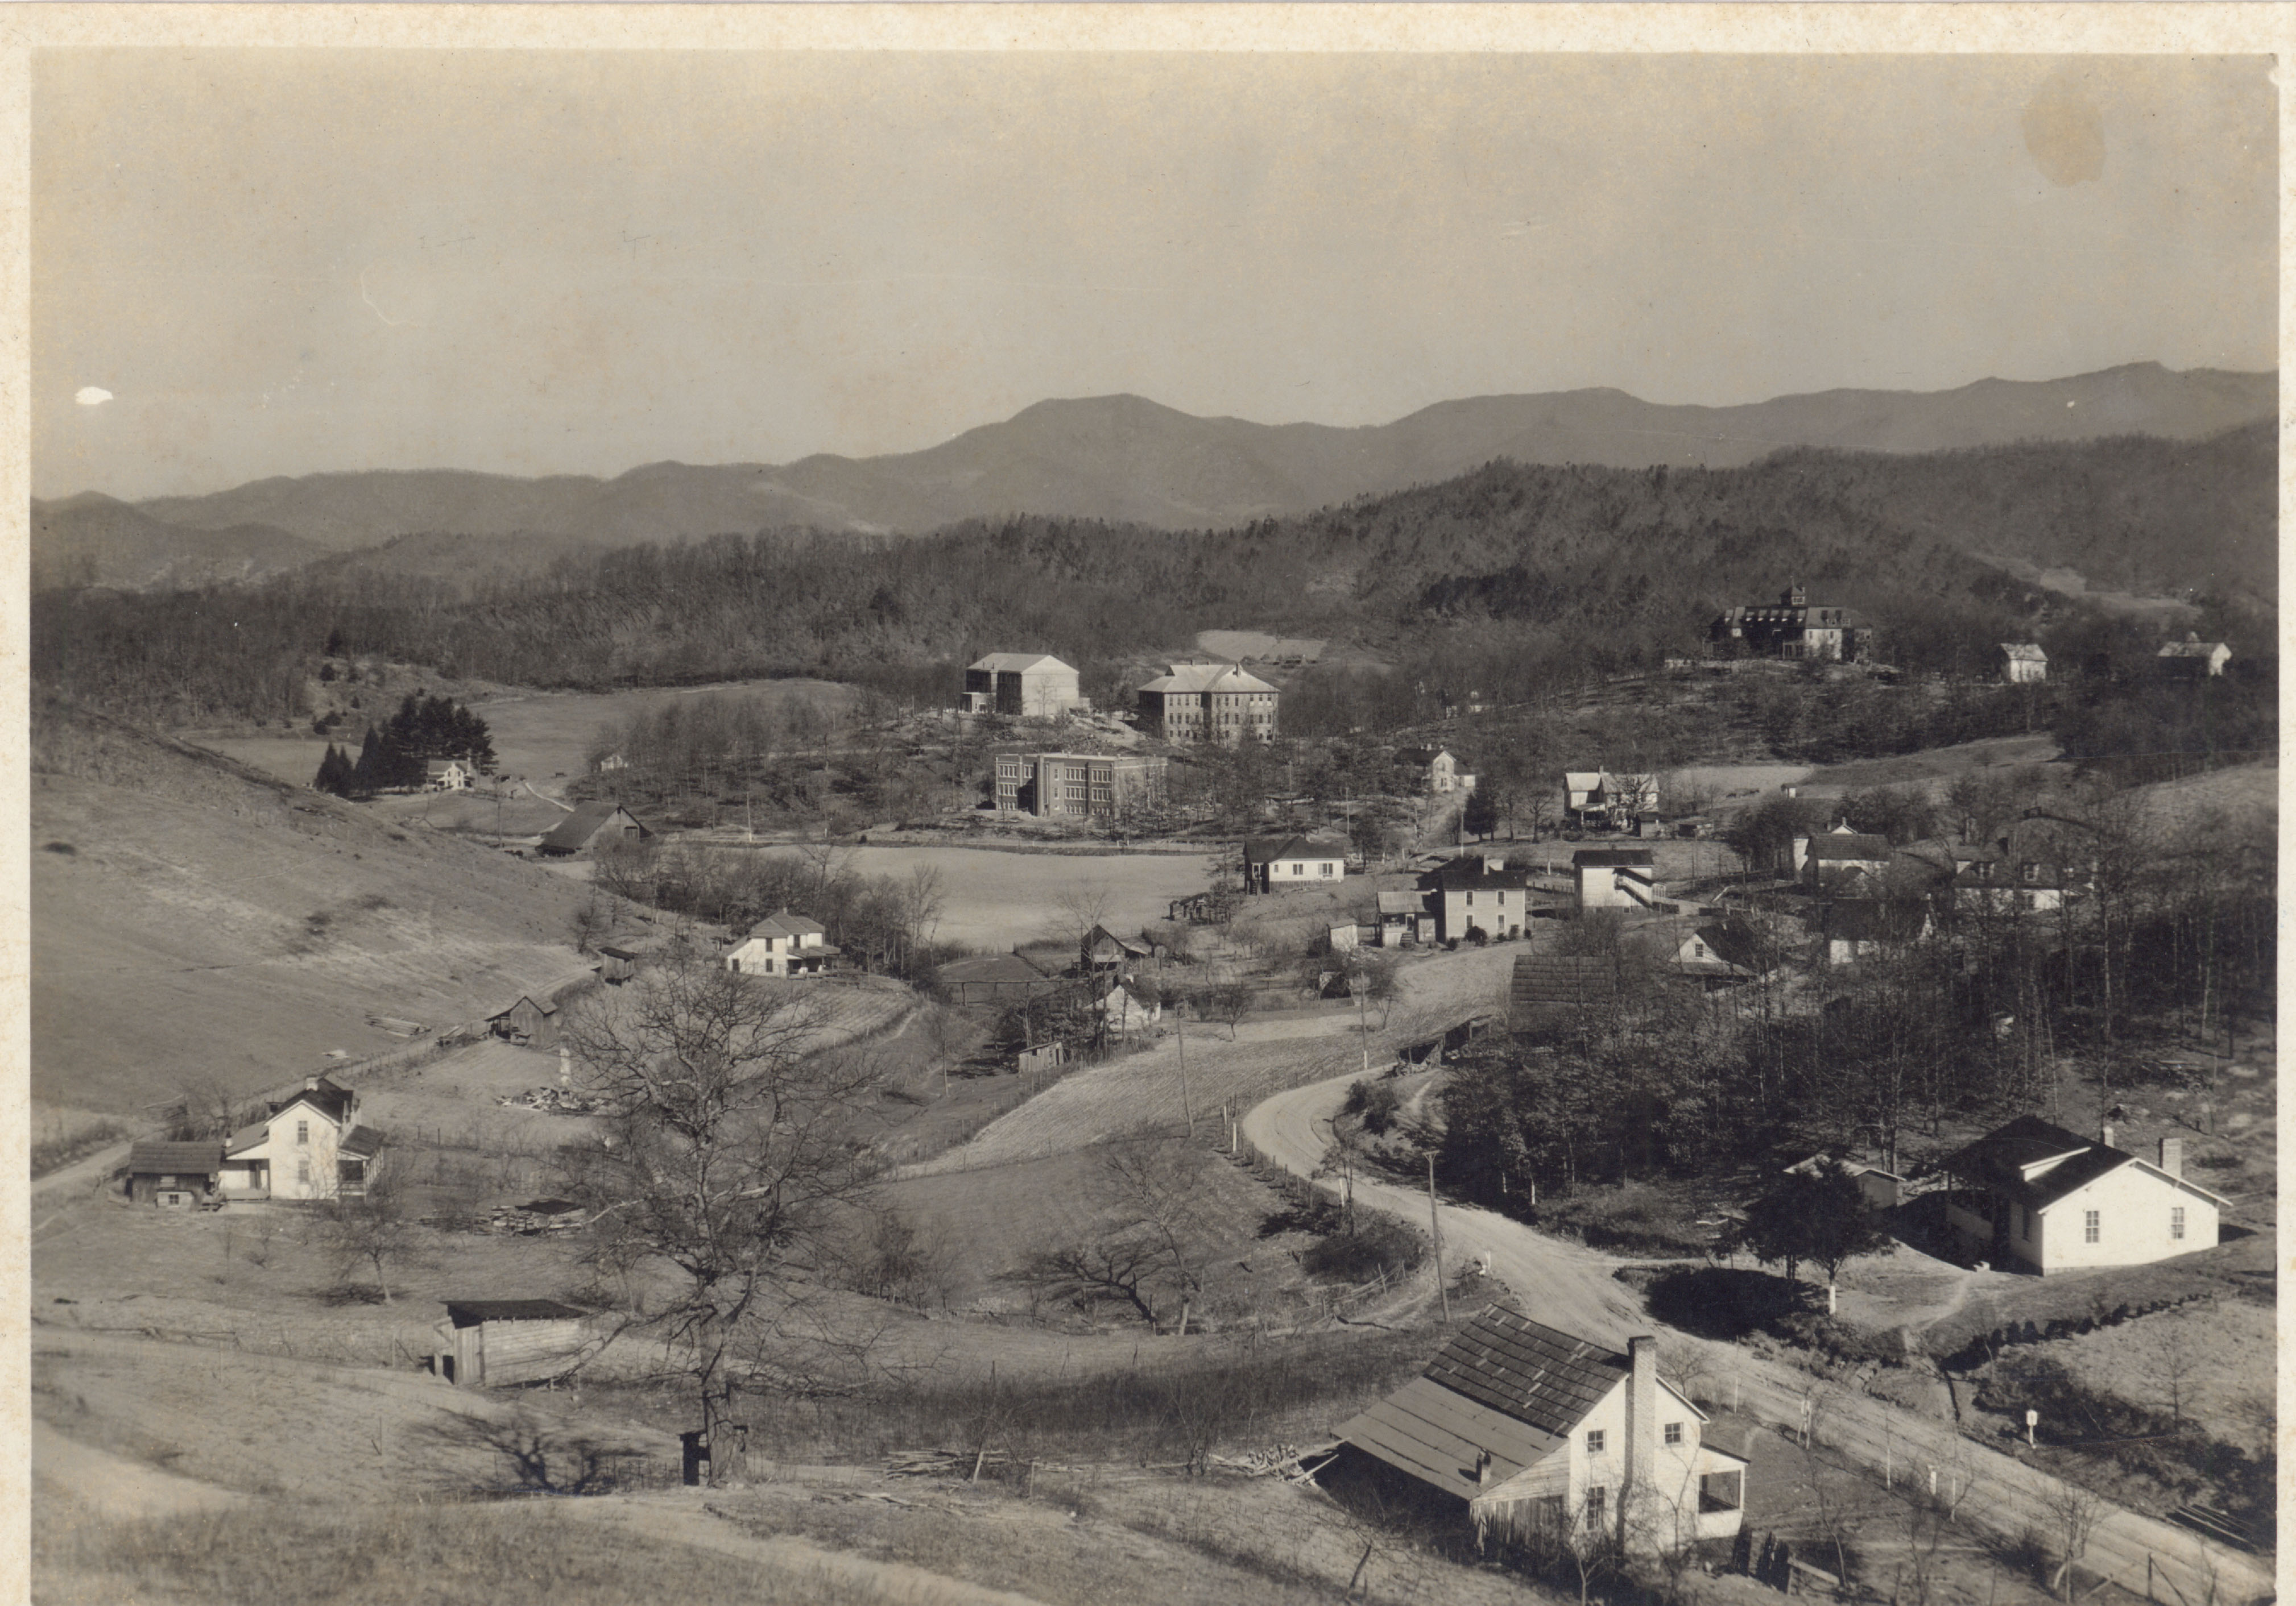
Skeletons in the closet and also everywhere else: Western Carolina University and human remains
Kellen Carpenter
Jenny McPherson
Western Carolina University
November 14, 2025
Notes:
Introductions. Kellen Carpenter, Digital Scholarship Librarian. Jenny McPherson, Special and Digital Collections.

Slide 2
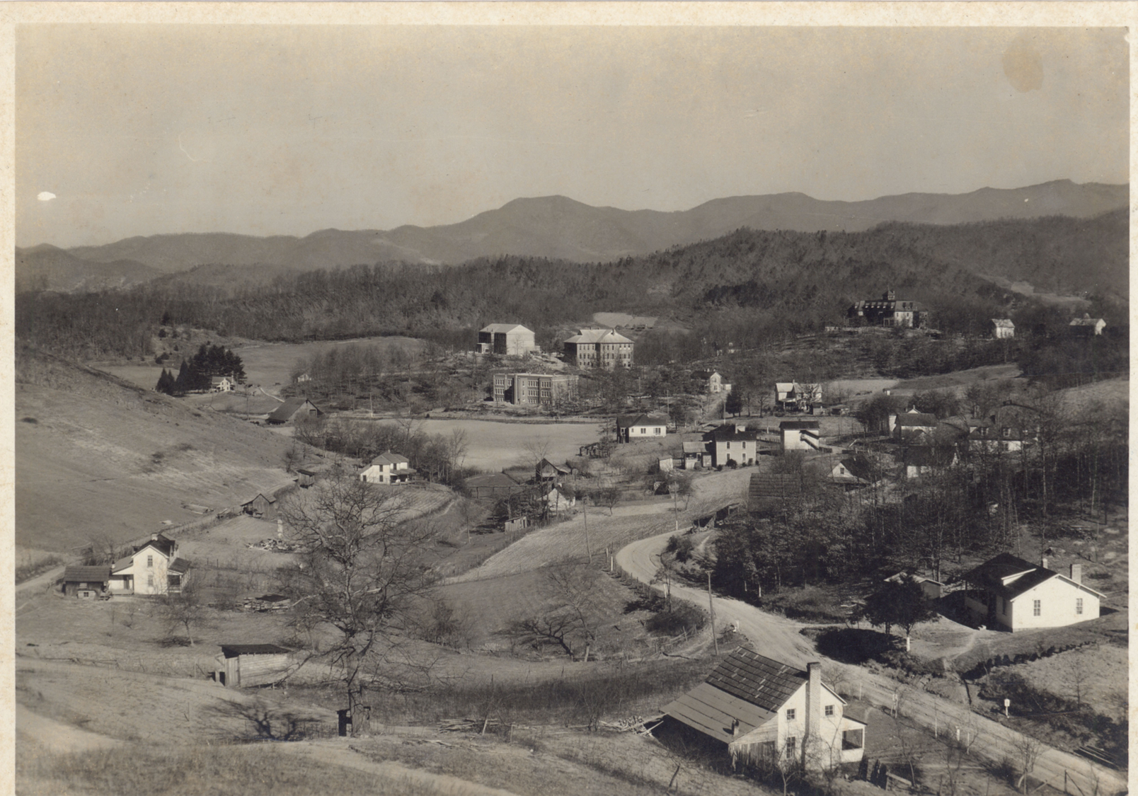
Three Stories
The Mound
The Cemetery
The FOReST
Notes:
This isn’t an attempt at a complete history of human remains at WCU, but rather a set of episodes that paint a picture of changing attitudes and frankly, levels of respect for human remains

Slide 3
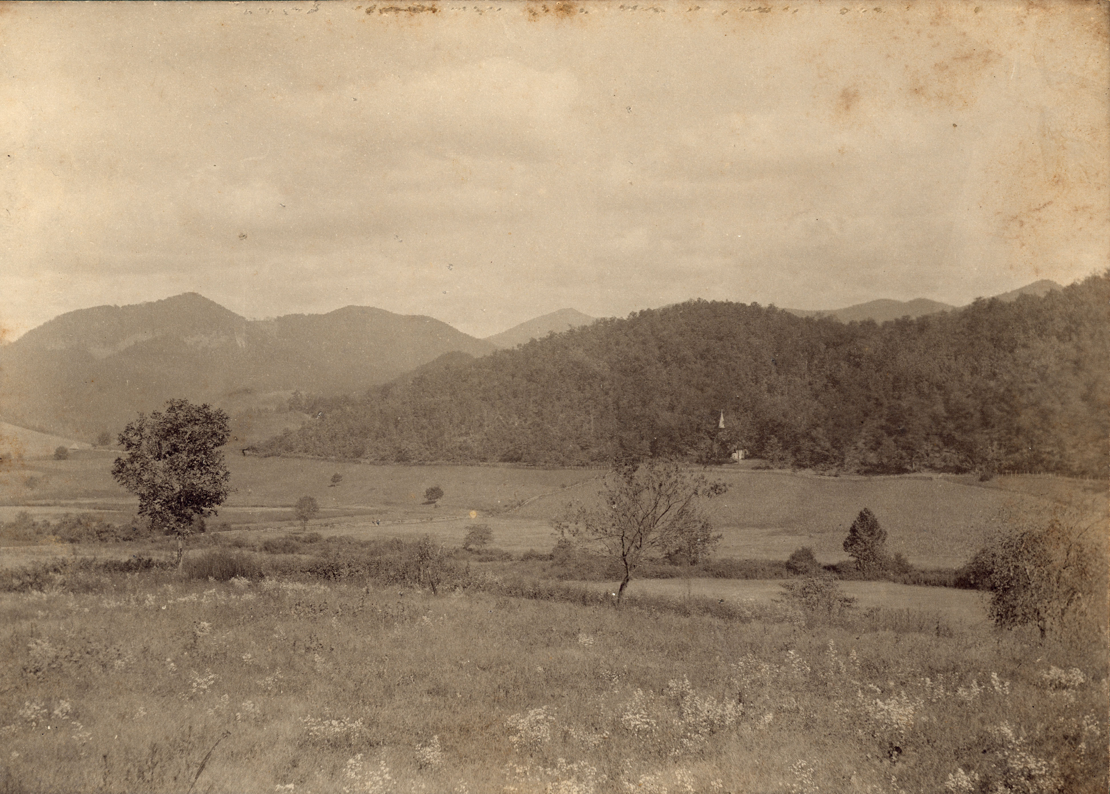
This Place
Notes:
I’m going to refer to present Western Carolina University and all of its predecessor institutions as WCU. I’m also going to refer to the location of the university and it’s surrounding valley as Cullowhee. These are conventions of convenience, but just a heads-up for the sticklers.

Slide 4

The Cullowhee Valley
Archaic-era campsites from 3,000 to 5,000 years ago
Woodland period palisaded village ca. 700-900 CE
Structures from the Mississippian period from around 1000 CE
Palisades from 1500-1650 CE
Larger Cherokee town likely occupied from 1450-1700 CE
Cherokee farms and homesteads all the way up to the Removal Era around 1819.
Notes:
There are a bunch of different sites in this valley, some of these separate but some on top of one another. In short, native people were in the valley for a long time before white settlers and colonists, though colonial settlers started living in the area by the late 1700s, often defying treaty and law to do so. But 1819 marks the beginning of the valley as an official part of the United States, explicitly brought about by the coercive 1819 treaty with the Cherokee.

Slide 5
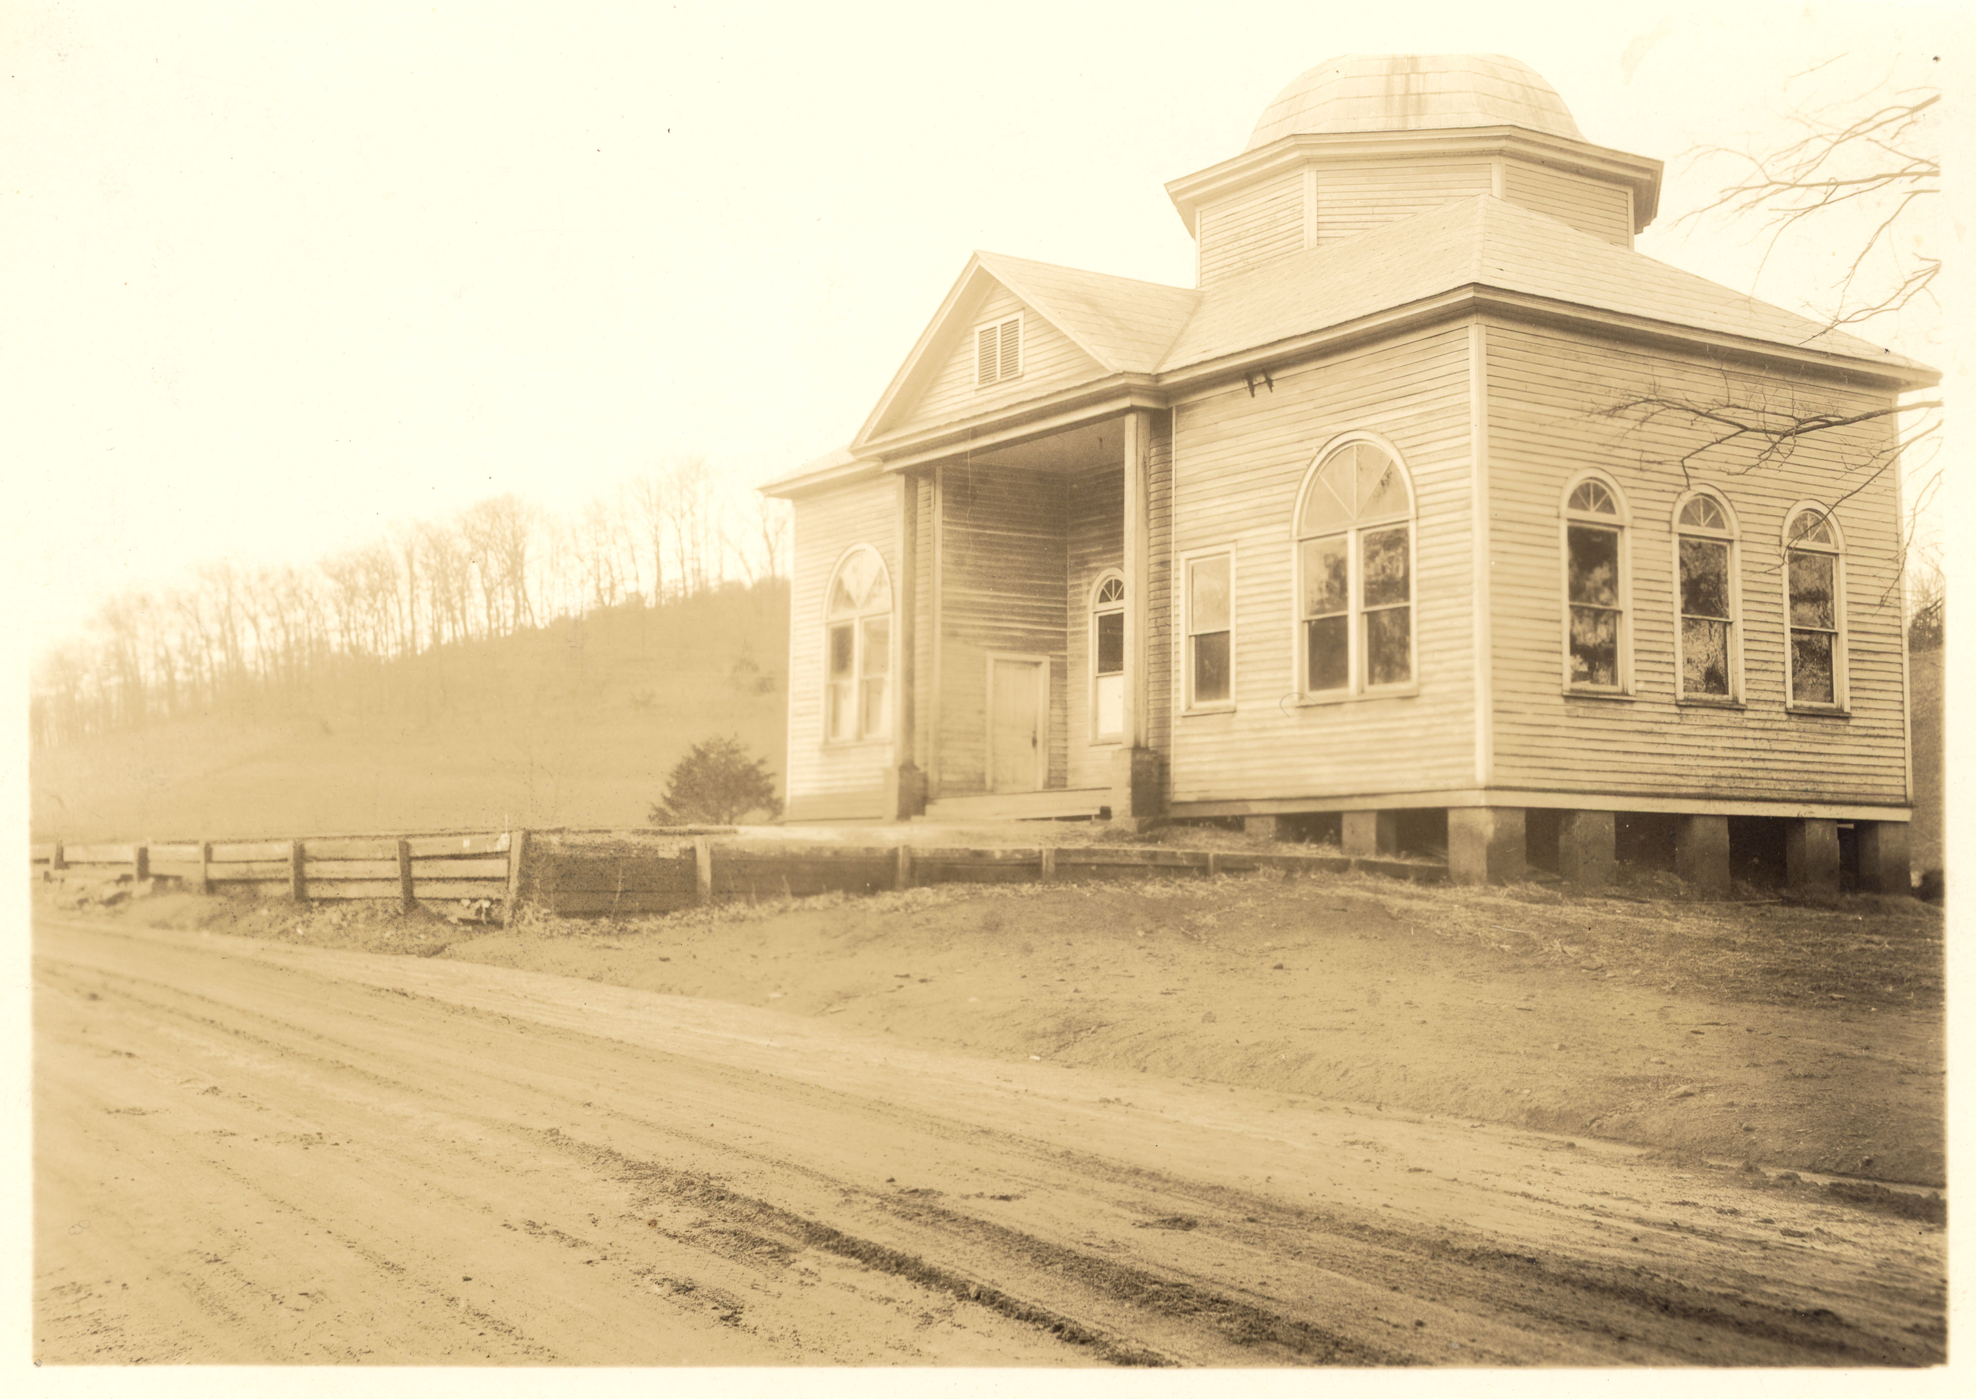
By 1820 the first white settler school was established.
By 1821 the first incarnation of the Cullowhee Baptist Church was established as the “Tuckaseigee Meeting-house.”
Notes:
The white settlers didn’t waste time. This picture is not the first incarnation of the church, but actually the second.

Slide 6

In 1889, Robert L. Madison, with community funding and support, opens the Cullowhee Academy. Classes are first held in the Cullowhee Baptist Church until the first school building was completed.
Notes:
About 70 years later, the predecessor to WCU is founded, located right next to the church, with the first classes actually taking place in the church building.

Slide 7
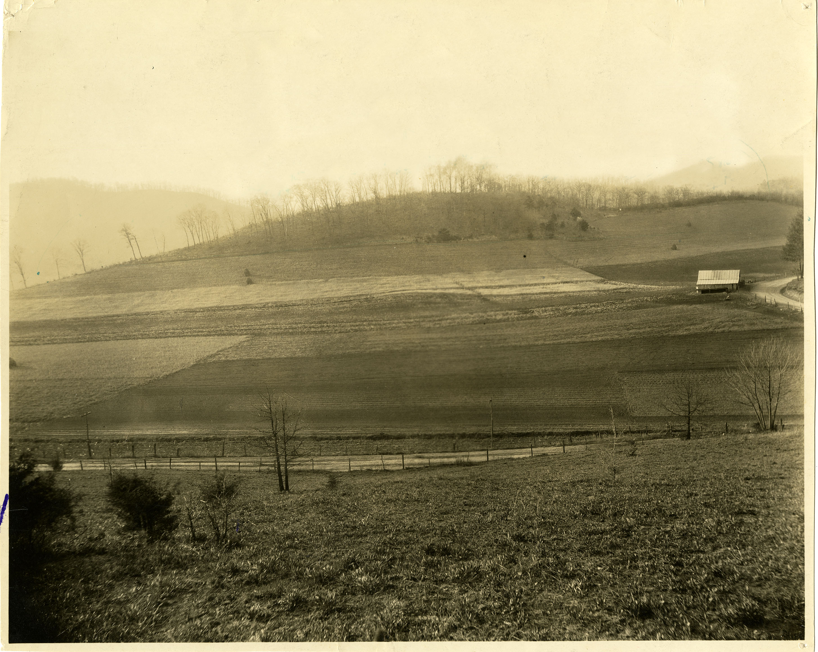
The Mound
Notes:
So this take us to the mound. It’s just barely visible here in the middle of the field, already it's been somewhat flattened. But this was this the site of the council house and the center of the town, called the “Townhouse.” Dave Rogers owned the farm with the mound on it, and his farm came to be known as the Townhouse Farm. It was always known that this was a Cherokee site, and the reason the mound here is already flattened is because it had already been excavated.

Slide 8

Notes:
Valentine’s Meat Juice was a cure-all patent medicine of the 19th century created by basically grinding up a ton of beef until you got a concentrated little bottle of, well meat juice. It made the Valentine family of Richmond, Virginia very rich and once people get rich, their hobbies get eccentric. Mann Valentine and his sons started collecting Cherokee artifacts, mostly obtained by sending their agents around to pay property owners to dig up whatever Cherokee sites and mounds they could find, and take the findings back to Richmond. That’s what happened to this mound in the 1880s: agents of the Valentines paid Dave Rogers, dug up the mound and took whatever they could find.

Slide 9
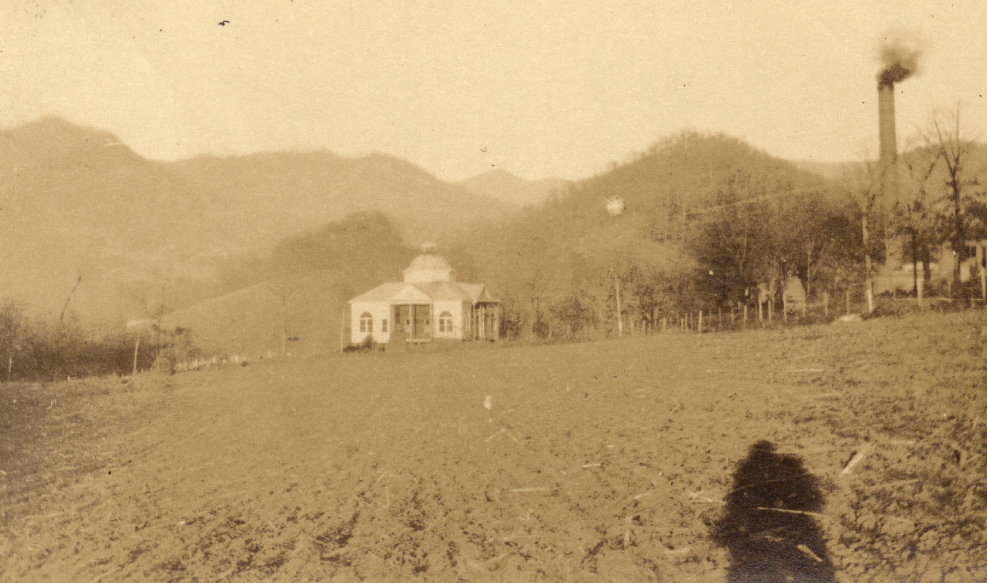
Neighbors
Notes:
So, Dave Roger’s farm butted right up against the new school in Cullowhee. And over time, the school kept buying pieces of the land. By the mid-20s, the school finally made an agreement to pay Rogers up front and then take possession of the farm after he died. Which means that eventually, WCU ends up possessing the land the mound is located on.

Slide 10
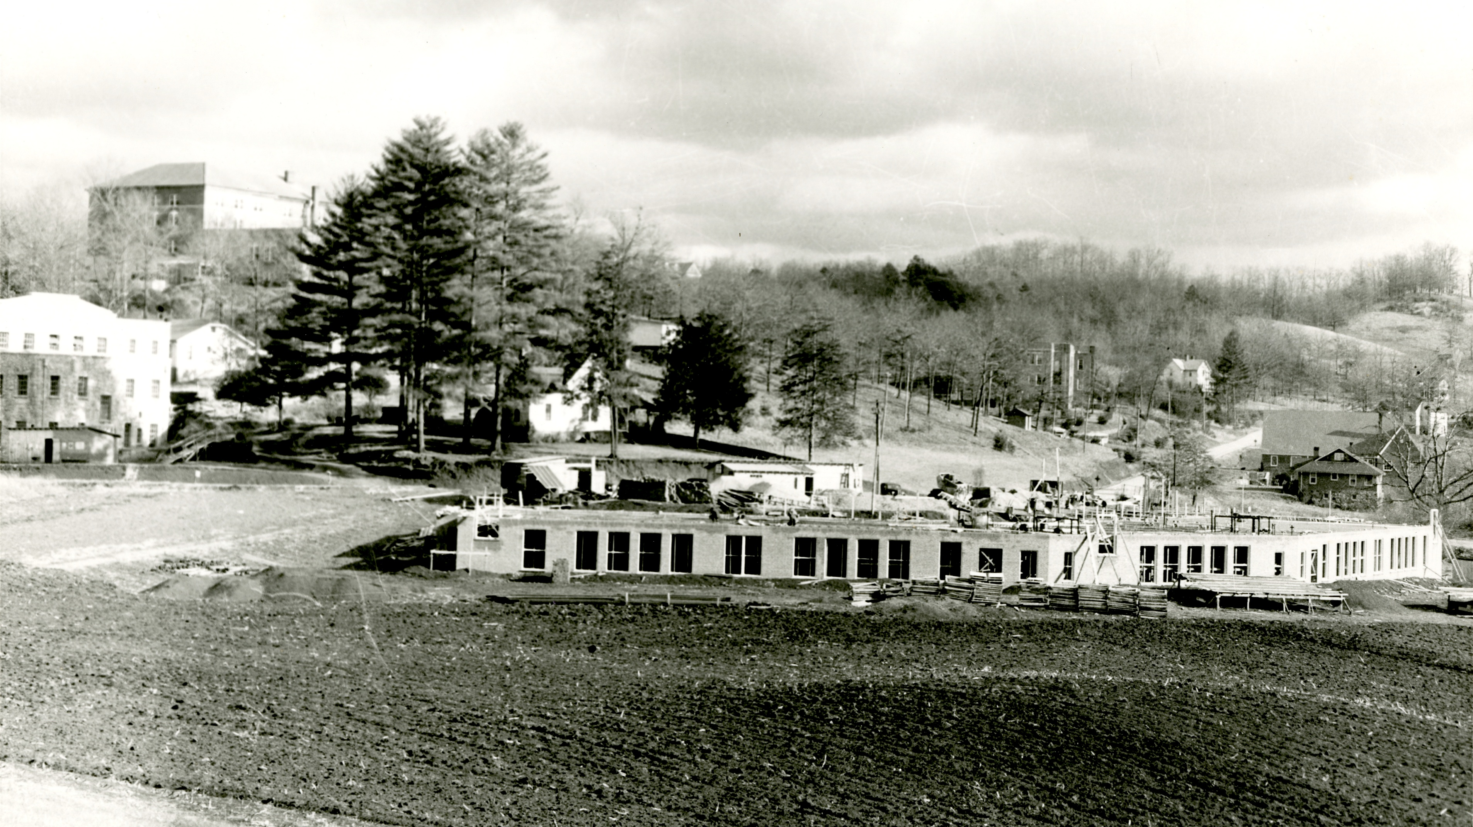
Notes:
So the mound sat on campus. This is in the late 30s when they PWA Training School is being built with the mound in the foreground.

Slide 11
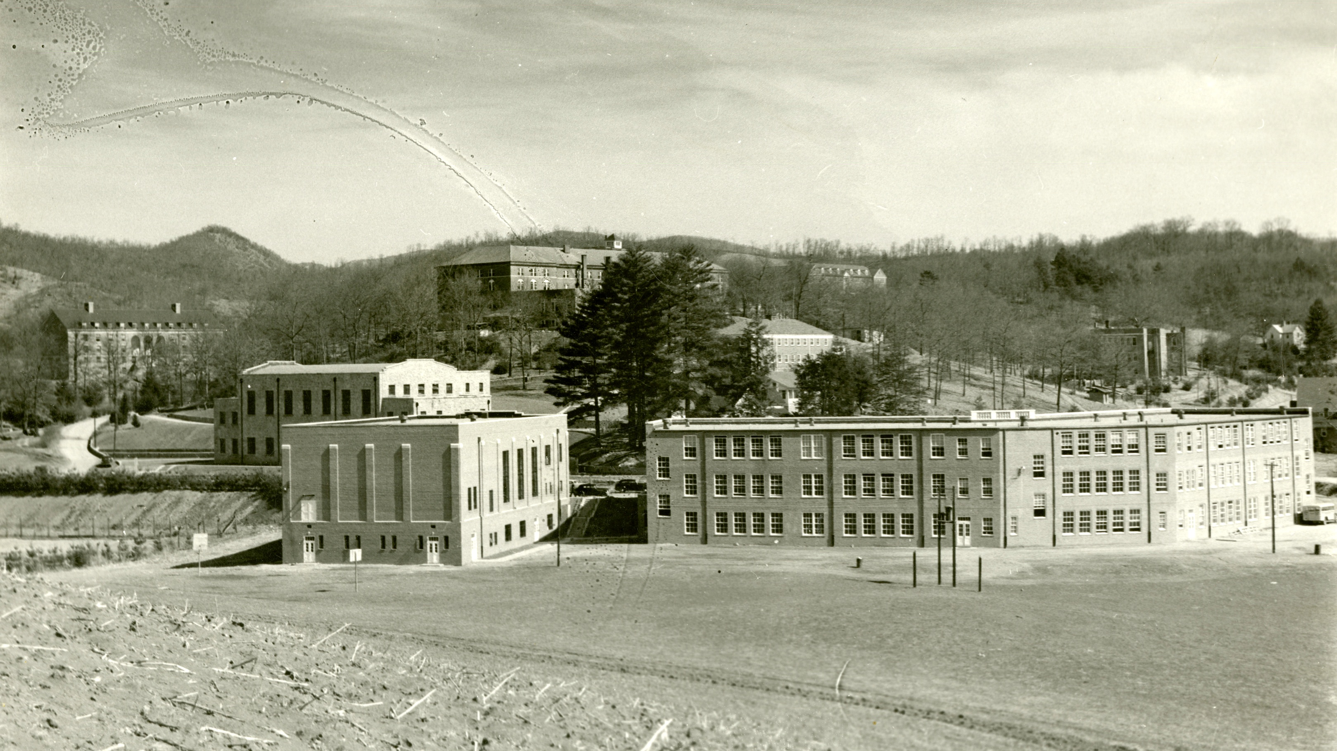
Notes:
This is the early 40s, where you can see the training school and the new auditorium is finished and the mound just sort of sits next to the buildings. It just sort of became a feature of campus life.

Slide 12
“One gazes at the mound and is not particularly struck by it as Time has made it less conspicuous [sic]. The Red Man is gone. Many moons have passed since his war-whoops resounded across the valley of Kullaugh-hee and on the banks of the Tuckaseigee. The conjuors [sic]and the medicine man no longer chant their weird and mystic rites and the warriors from miles around do not celebrate the "green corn dance" at the spot where the mound is today as they did in years long since passed.”
-The Cullowhee Yodel, March 15, 1930
Notes:
The Cherokee heritage of this place was always acknowledged, but always in a romanticized, exoticized, and mythic way. The first yearbooks were named the Oogoocoo after a Cherokee word for screech owl, and stories and traditions about this heritage were passed down. These traditions and stories were often inaccurate and the students and members of the campus community acted like the Cherokee were an ancient, extinct people instead of a very much living nation, literally located in the same county.

Slide 13
“The exact truth of these legends is not known—will never be known and we would not have it to be—that would detract from the beauty of its significance but the old mound will be dear as long as people love Kullaugh- hee! So the sun sinks slowly behind a western peak sending out its longest and most glorifying rays over the valley of Kullaugh-hee and a certain mound that holds secrets never to be revealed.”
-The Cullowhee Yodel, March 15, 1930
Notes:
There was a reverence for the mound but in a superficial way that explicitly resisted deeper interrogation in favor of mystic romance. The campus community was aware of the Cherokee heritage of the place and it was respected, in a way. “A certain mound that holds secrets never to be revealed.” You can probably guess what happens next.

Slide 14
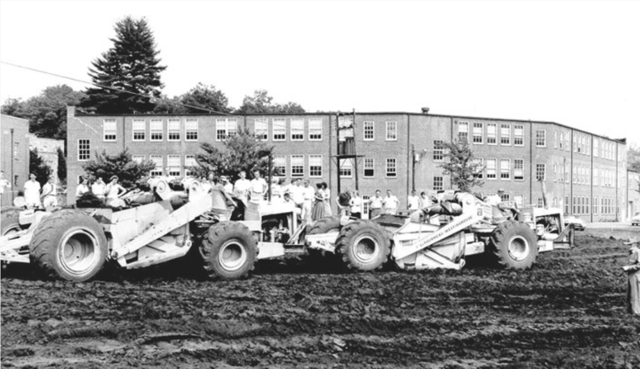
Notes:
Well, you see, they wanted to build a baseball field.

Slide 15
“Local residents, however, felt sure there must still be something of value in the mound and were there to see when the bulldozers went to work in 1956. They were not disappointed. It was quite a sight to see the people—children and adults a- like, running in and out among the earth movers, dipping up and down as they found arrowheads and other artifacts… In spite of the previous excavation, these were fairly impressive, and included numerous fine specimens of arrowheads, pottery fragments, and human bones. By chance, a local dentist was in the crowd, and he was elated to see a skull with a perfect set of teety [sic] intact…”
-The Western Carolinian, June 22, 1967
Notes:
Another account called it a “field day.” There’s a repeated story that there was advance notice of the demolition in the local newspaper that invited community members to come follow the bulldozers and look for souvenirs. There was a significant turnout.

Slide 16
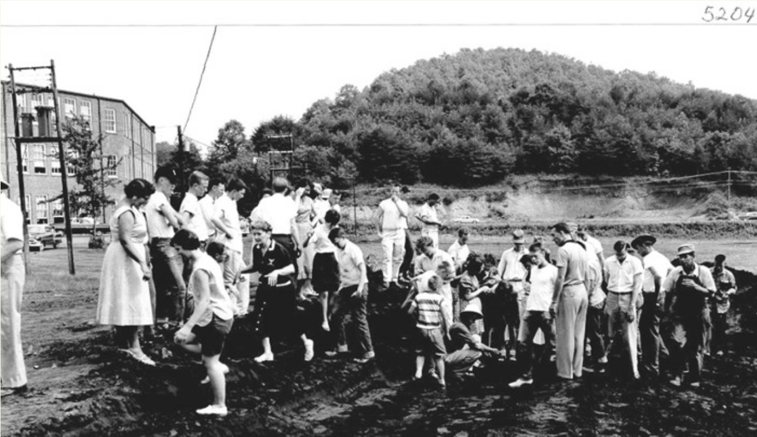
Notes:
It’s a pretty ghastly notion to invite the whole family come root around for bones and artifacts while we demolish this site. The fact that it was for a baseball field really just sort of puts a bow on what was valued at the time.

Slide 17
“In the late forties, when ground was being leveled for a baseball field, the bulldozers had to remove a fourteen-foot layer of earth. One of the first things uncovered was a cooking pit containing an animal skeleton. One after another of these pits came into view, until they totaled seventy, most of them with crude stone grills and the remains of various animals. At that same time, some underground tunnels were discovered near the present site of Reid Gymnasium. All these, of course, had to be destroyed in the name of progress. More recently, excavators on the new dormitory and cafeteria project exposed eleven graves.”
-The Western Carolinian, June 22, 1967
Notes:
This excerpt I’m quoting was from a longer article breaking down all the recent archaeological finds on campus. There’s one thing conspicuously missing in all these accounts: any mention of Cherokee people or even the nearby tribal government. The university had largely acted as if the Cherokee were an extinct people for the bulk of its existence. Fortunately, around this time, WCU began making baby steps in a new direction.

Slide 18
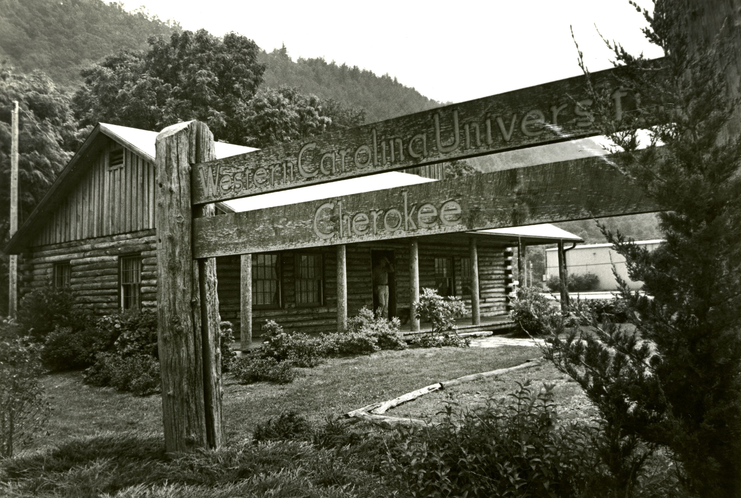
Notes:
In 1975, the WCU Cherokee Center was built on tribal land across from the Old Cherokee High School where it would become a hub of many outreach activities for the university directed towards the EBCI and its members. The Cherokee Center offered evening classes, support and advising for Cherokee students enrolled at WCU and pre-college counseling for Cherokee high school students. It’s important to not ignore the wider national context here. Between 1967 and 1975 is the height of the American Indian Movement’s activist activity including the siege at Wounded Knee and the occupation of Alcatraz. For lots of America, this was a time of rediscovering that Native people were still very much alive.

Slide 19
1980s: the University created an interdisciplinary Cherokee studies program and a Cherokee studies minor.
1990s: the University creates an endowed professorship of Cherokee studies.
2017-2018 Cullowhee’s Cherokee heritage is the annual campus theme.
2018 wi sculpture at the site of the mound.
2019 Tali Tsisgwayahi: Two Sparrows Town Archaeological Collections Curation Facility is dedicated.
2021 formal land acknowledgment
Notes:
The university and the EBCI have really worked to keep this partnership thriving. The university started taking Cherokee studies seriously, started offering courses in the language and built out academic programs and initiatives in the 2000s. In 2013, the former Principal Chief of the Eastern Band of Cherokee Indians, was appointed to the WCU’s Board of Trustees. The current chair of WCU’s Board of Trustees, is Casey Cooper, CEO of the Cherokee Indian Hospital and another enrolled member..WCU and the EBCI are deeply interconnected as partners and it speaks to the hope that Cullowhee’s history as a Cherokee place remains an honored part of WCU’s identity heading into the future.

Slide 20
“ Acknowledging that our campuses lie on Native ground should involve a clear acceptance of institutional obligations toward Native American nations today. It should entail a commitment to contribute to work by Native peoples to protect tribal sovereignty, expand their capacity for self-determination, and enhance the wellbeing of their communities. Without that commitment, an indigenous campus history, no matter how thoroughly recognized, can too easily become an embellishment to institutions that otherwise remain thoroughly rooted in settler colonialism.”
- “Always Cherokee Land,” Andrew Denson, 2022
Notes:
I think clear perspective on this comes from Andrew Denson’s book chapter, “Always Cherokee Land,” which includes a much more thorough discussion of these issues and history. But it truly does seem like WCU is moving on from a truly terrible relationship emblemized by the destruction of the mound to a future with repaired and strengthened bonds with the EBCI and reason for cautious optimism.

Slide 21
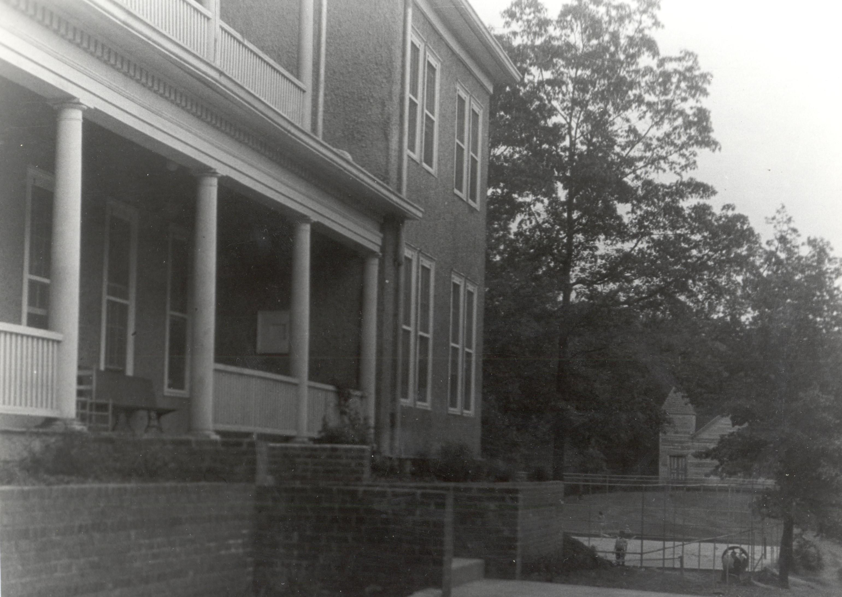
The Cemetery
Notes:
So now the cemetery. The cemetery in question is sort of incidental to the larger issue here. The main issue really deals with the church and the school that the cemetery was linked to. The church is on the background of this photo, just past the dorm and the tennis courts.

Slide 22
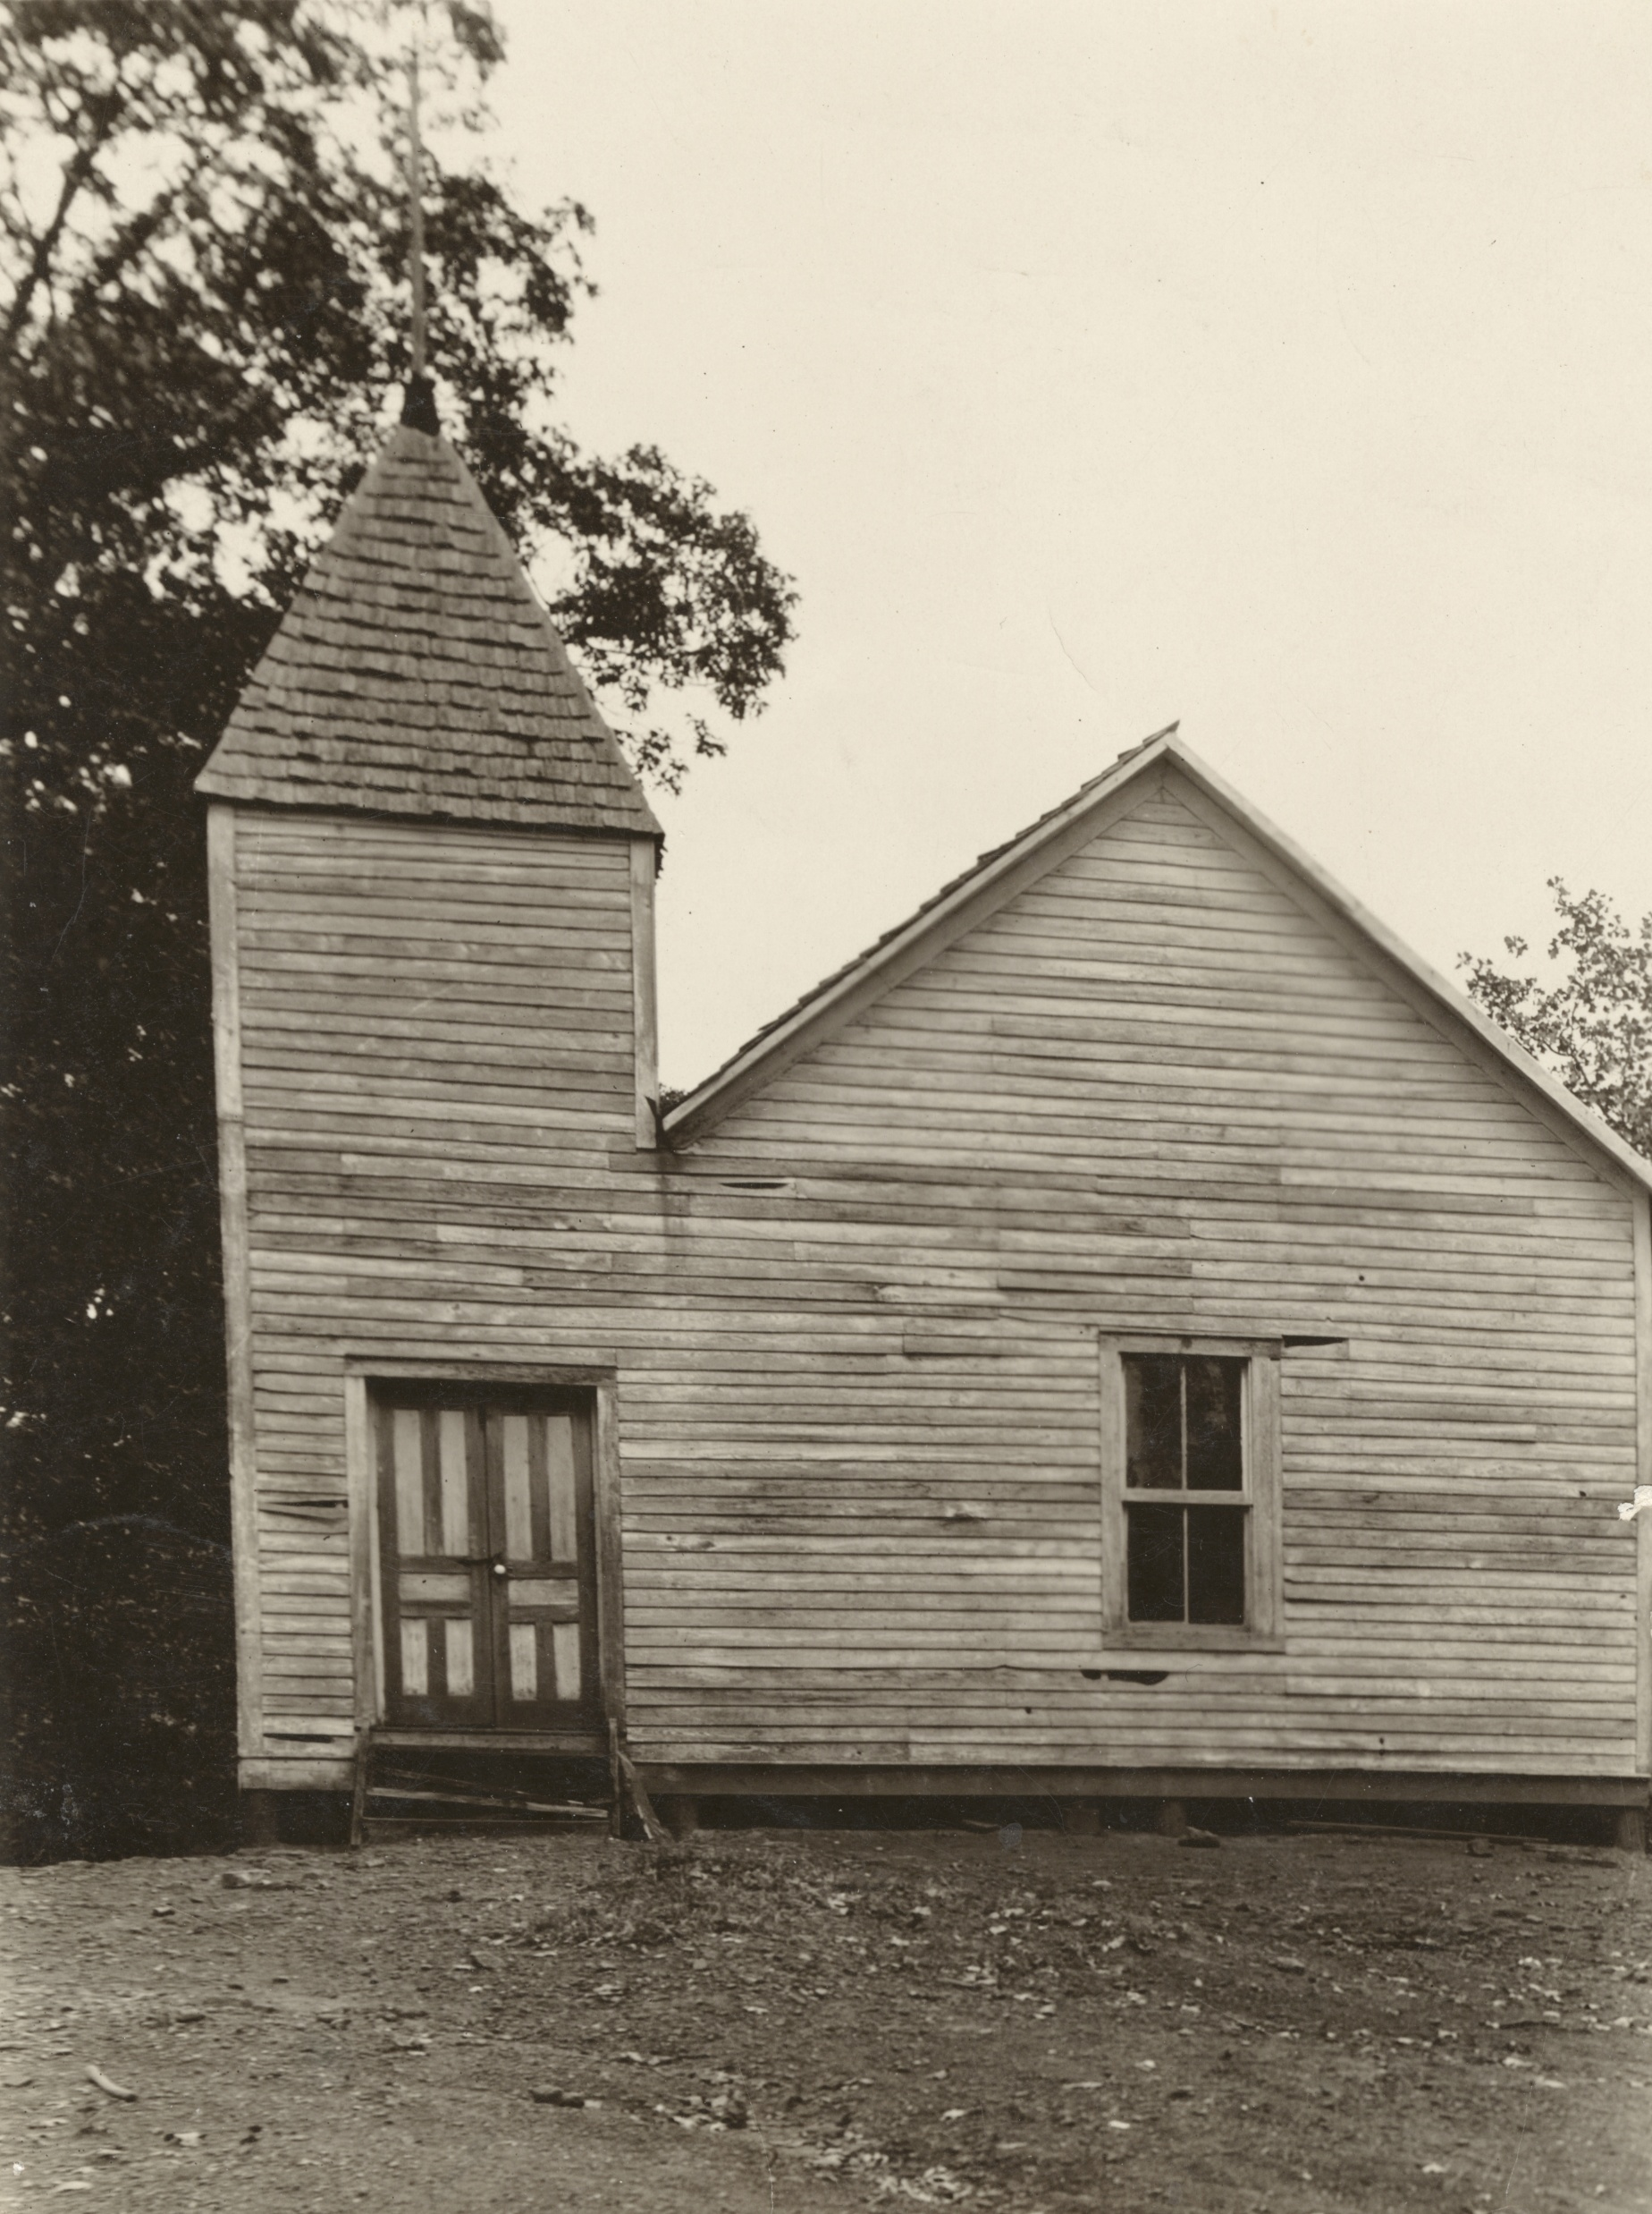
“[It] had become evident that for the natural and normal expansion of the institution that this property under its present ownership would prove a serious handicap and that for both races such proximity of public buildings was undesirable.”
- The History of Western Carolina College (1963), W. E. Bird.
Notes:
Stop me if you’ve heard this one before: the campus wanted to expand and so they wanted to buy out their neighbors property. In this case the neighbors were the AME Zion Church serving the Black inhabitants of Cullowhee. If the issue was simply buying property, it wouldn’t be so complicated, but the presence of a cemetery meant that the community could not simply sell the land without also arranging for a resting place for all those interred in the cemetery. This negotiation took about three years before WCU agreed to pay $3,200 for the property and to also pay the reverend and congregation $1,000 to move the seventy-six graves to a new site, across the highway and away from campus.

Slide 23
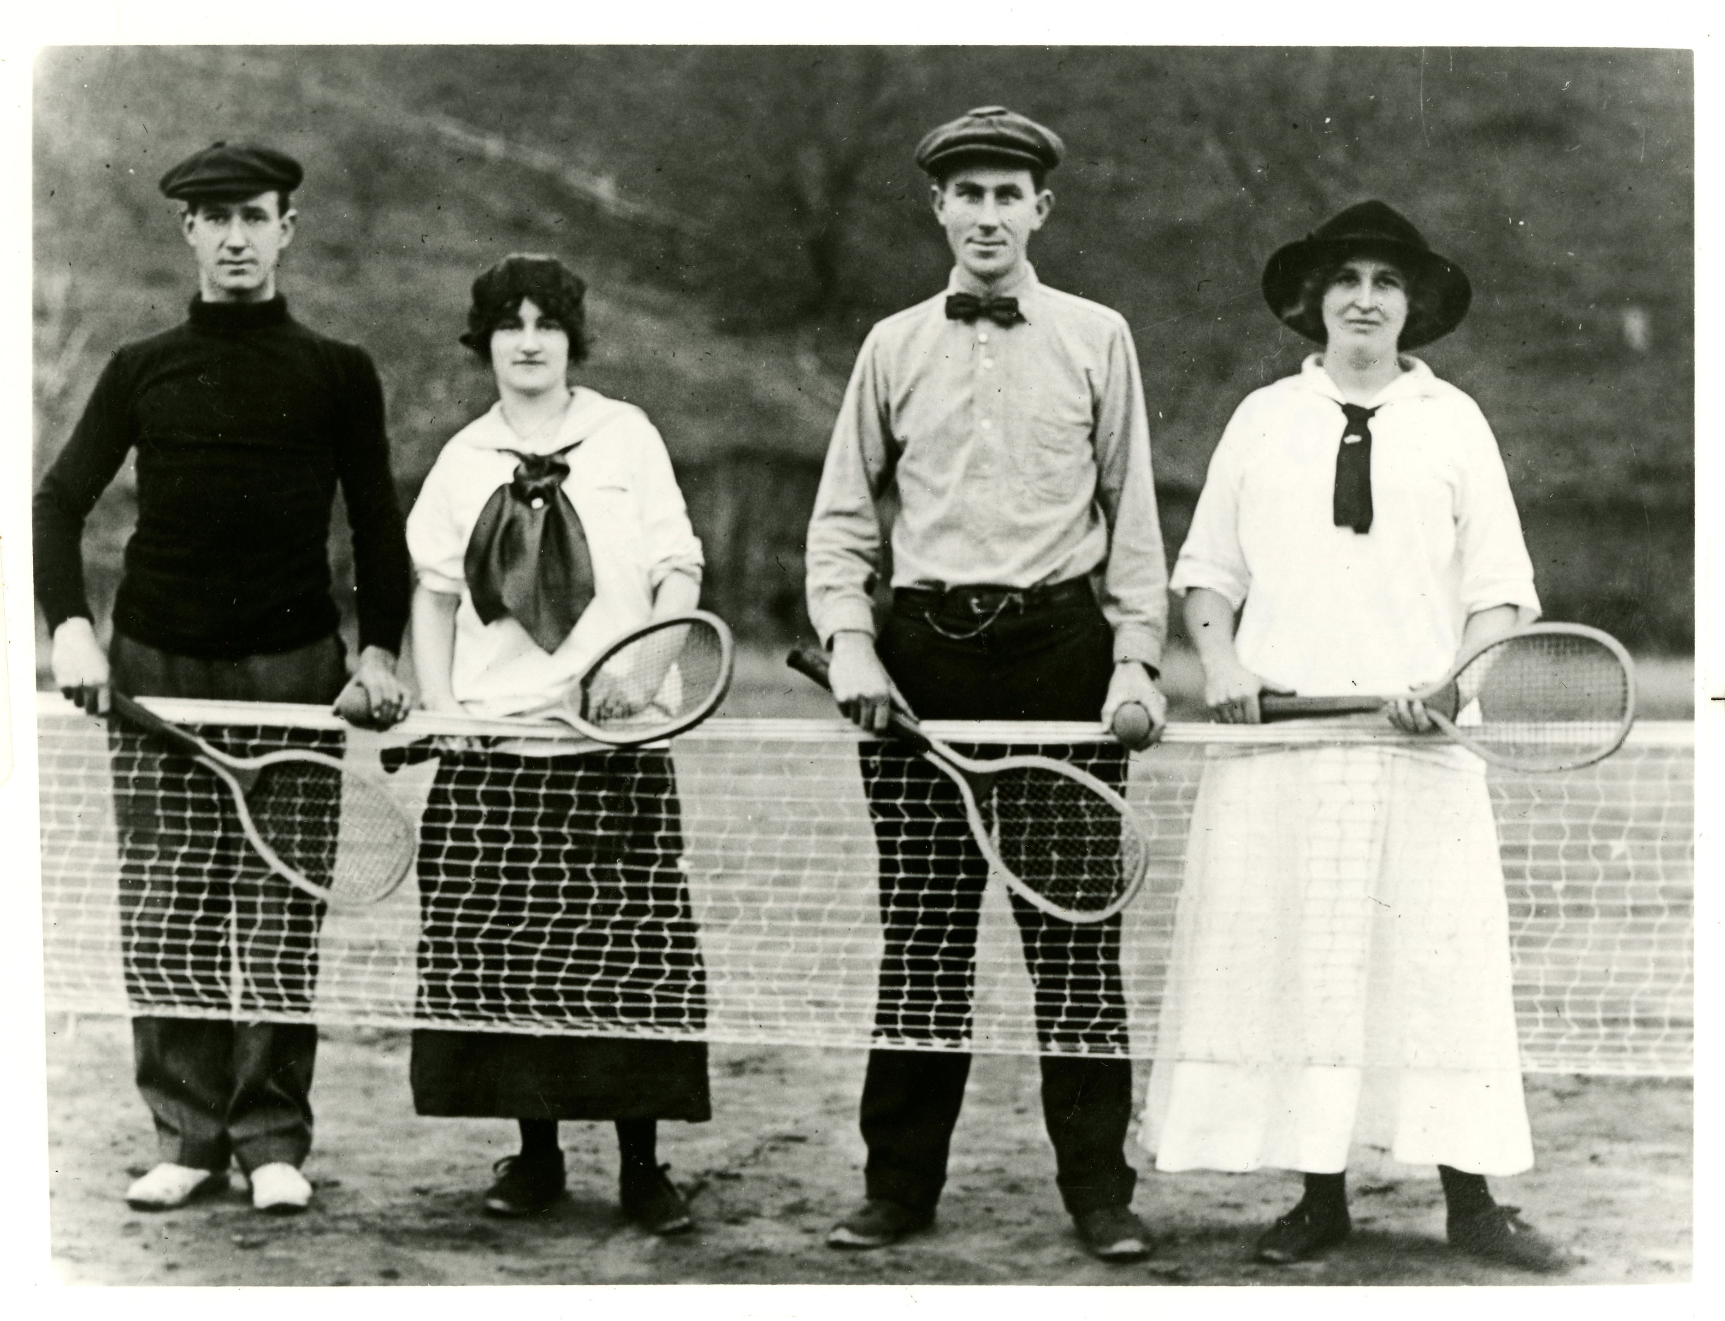
Notes:
This is William Ernest Bird in the middle from around 1920. He attended Cullowhee as a student and then Madison invited him back where he served as the first dean of the college until 1957 when he took on a couple of terms as Acting President.

Slide 24
“The Negroes were not only relieved but were well pleased, fully satisfied with the proposals and with Hunter’s assurance of good faith… The undertaking finally completed, Hunter was accorded congratulations and eulogies by both the colored and white people of the community for the unique achievement. For its attendant harmony and good will, the accomplishment, in view of its peculiarly delicate nature, has perhaps seldom found in history its parallel.”
- The History of Western Carolina College (1963), W. E. Bird.
Notes:
Bird wrote his book in 1963 and it was the first major published history of the institution, so this is kind of the de facto “official” account. It’s not the only account. Folks thought to ask members and descendants of the AME Zion congregation about this and record the interviews for several oral history projects. The tapes and transcripts are now held at WCU Special Collections. So was everyone really in agreement all the way through?

Slide 25
“Despite his efforts, however, rumors had already begun to spread to the effect that it was Hunter’s intention… to take heavy machinery into the cemetery and there to plow up the graves preliminary to removal. Hunter hastened to call together a representative group of the Negroes. Here he succeeded in dispelling such misgivings by revealing openly the plan he had in mind.”
- The History of Western Carolina College (1963), W. E. Bird.
“So when Western planned to buy them out, they first heard rumors that they were going to take the graves and just plow over them. They went back and talked to them and said ‘No we aren't going to do that.’ ”
- Interview with Victoria McDonald, November 12, 2004.
Notes:
Here are two accounts about how the congregation and the University responded to rumors about how the cemetery was allegedly going to be bulldozed. Both could be true, but the difference in who the proactive party is in each account is telling.

Slide 26
“The contractors would be liberally paid to assume such responsibility, which would include the taking up of all bodies and transferring them to a pre-determined locations and there re-interring them in accordance with their own chosen plans and methods.”
- The History of Western Carolina College (1963), W. E. Bird.
“They were paying ‘em a dollar a day to move these… Anyway, somebody in the group was getting paid more than that so they had a strike. They decided they weren't going to dig for a dollar a day… they didn't plan for anybody to support a family with it, but anyway.”
- Interview with Sibyl Blakely, November 3rd, 2004.
Notes:
Bird is telling a story of the brilliant diplomat of President Hunter who had a perfect master plan and didn’t encounter any difficulties. The families and descendants of those involved remembered additional details the undercut this story, like disagreements on pay and work stoppages.

Slide 27
Stanley Rogers: “I remember him talking about when they moved the graves… And he was talking about how he prepared him, they would put 'em on a cooling board and they prepare the body, then they would build a coffin. Of course, they would shave them and everything, and he, he said he was the one who shaved him and got him prepared for the funeral and everything. Then he said when they moved the graves, when they opened up his coffin, he said he looked the same, but he'd grown a beard. He said then his face just kinda crumbled, you know, but I remember him telling those stories about the moving of the graves, ya know.”
Interviewer: “Yeah, that must have been difficult.”
Stanley Rogers: “Yeah.”
- Interview with Stanley Rogers, October 20, 2004.
Notes:
This is Stanley Rogers recounting what his grandfather told him. I suppose you might tell your grandkids stories about moving the remains. But telling them about how you opened a coffin and then attempted to tenderly shave the beard of the deceased only to have the face of someone you had known just crumble in your hands doesn’t feel like a good memory. This doesn’t feel like a mutually beneficial plan that everyone was amazed at how well everything went.

Slide 28
“But I think still it's that question why- what was the real reason, you know? What was the real reason for it, for moving us. If you notice of all the churches here we're the only one that's not you know, the Central- they call it Central Drive. All the other churches, large or small they're right there on Central Drive somewhere and here we are down here in the boonies. But anyway I think that's it- a more or less why. What's the real reason?”
- Interview with Reverend Danita Wilder, October 27, 2004.
Notes:
And what about the why? Why did the church and the cemetery have to be moved in the first place? There are other churches and graveyards in the main part of campus. Everyday I park next to a cemetery and walk past the Baptist Church to get to the library. You saw pictures with the school literally right next to the church.

Slide 29
“[At] $3,200 we deem it an exorbitant price but in as much as the property is practically in the heart of the campus and the negroes are compelled to go through the campus to reach the church and in as much as it is very disagreeable to have a negro congregation going through the campus and likely to sooner or later cause trouble we recommend that the Board of Trustees purchase this property even though the price is high.”
-Report from the state superintendent of public instruction, December 1, 1926.
Notes:
It’s what you think and what Bird obliquely hints at. They didn’t want Black people going through campus. The bitterest irony of course is that many of the members of the congregation were long-tenured employees at the school who likely went through campus every other day of the week. But in the end, of course, that didn’t matter.

Slide 30
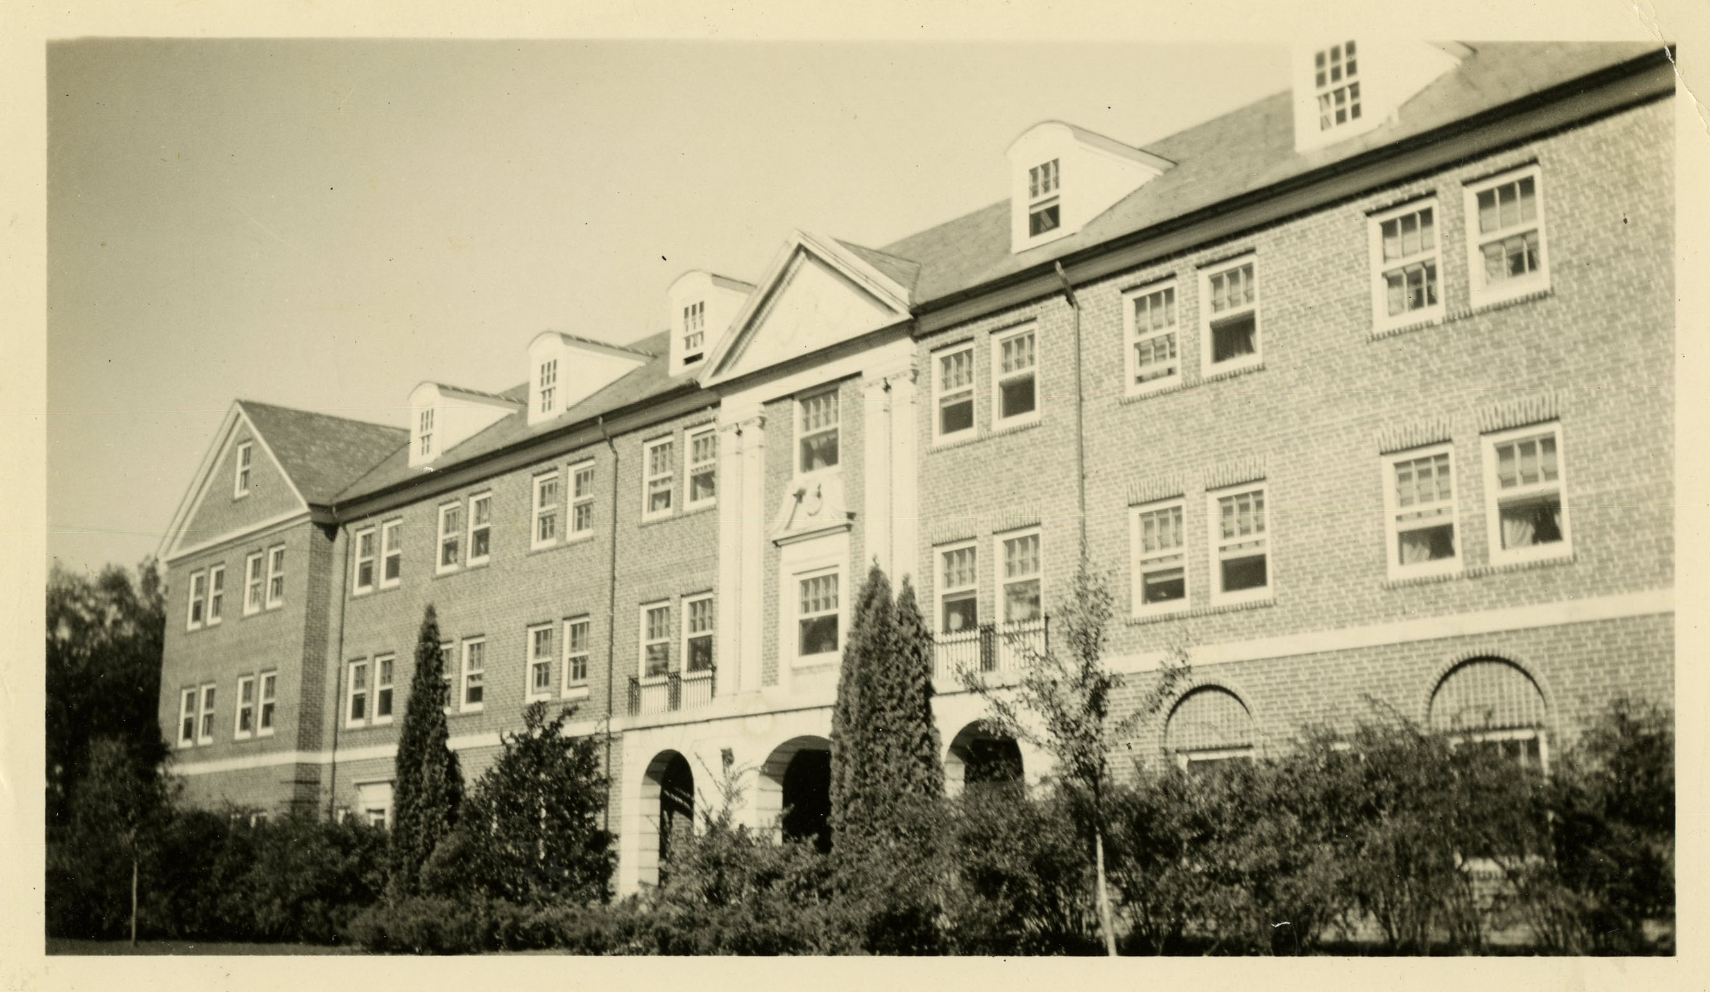
Notes:
Then after the removal of the cemetery and the razing of the structures in 1929, they built a new dormitory. And the former site of the church and the cemetery went almost entirely unacknowledged by the university for the next sixty years. In 1989, the story of the Church was included in Curtis Wood and Tyler Blethen’s new illustrated history of the University. In 1990, Dr. Willburn Hayden, as a part of the University’s centennial celebration led a project to install a marker on the former site of the church, marking it’s founding by eleven formerly enslaved people in 1892 and the church’s removal in 1929.

Slide 31
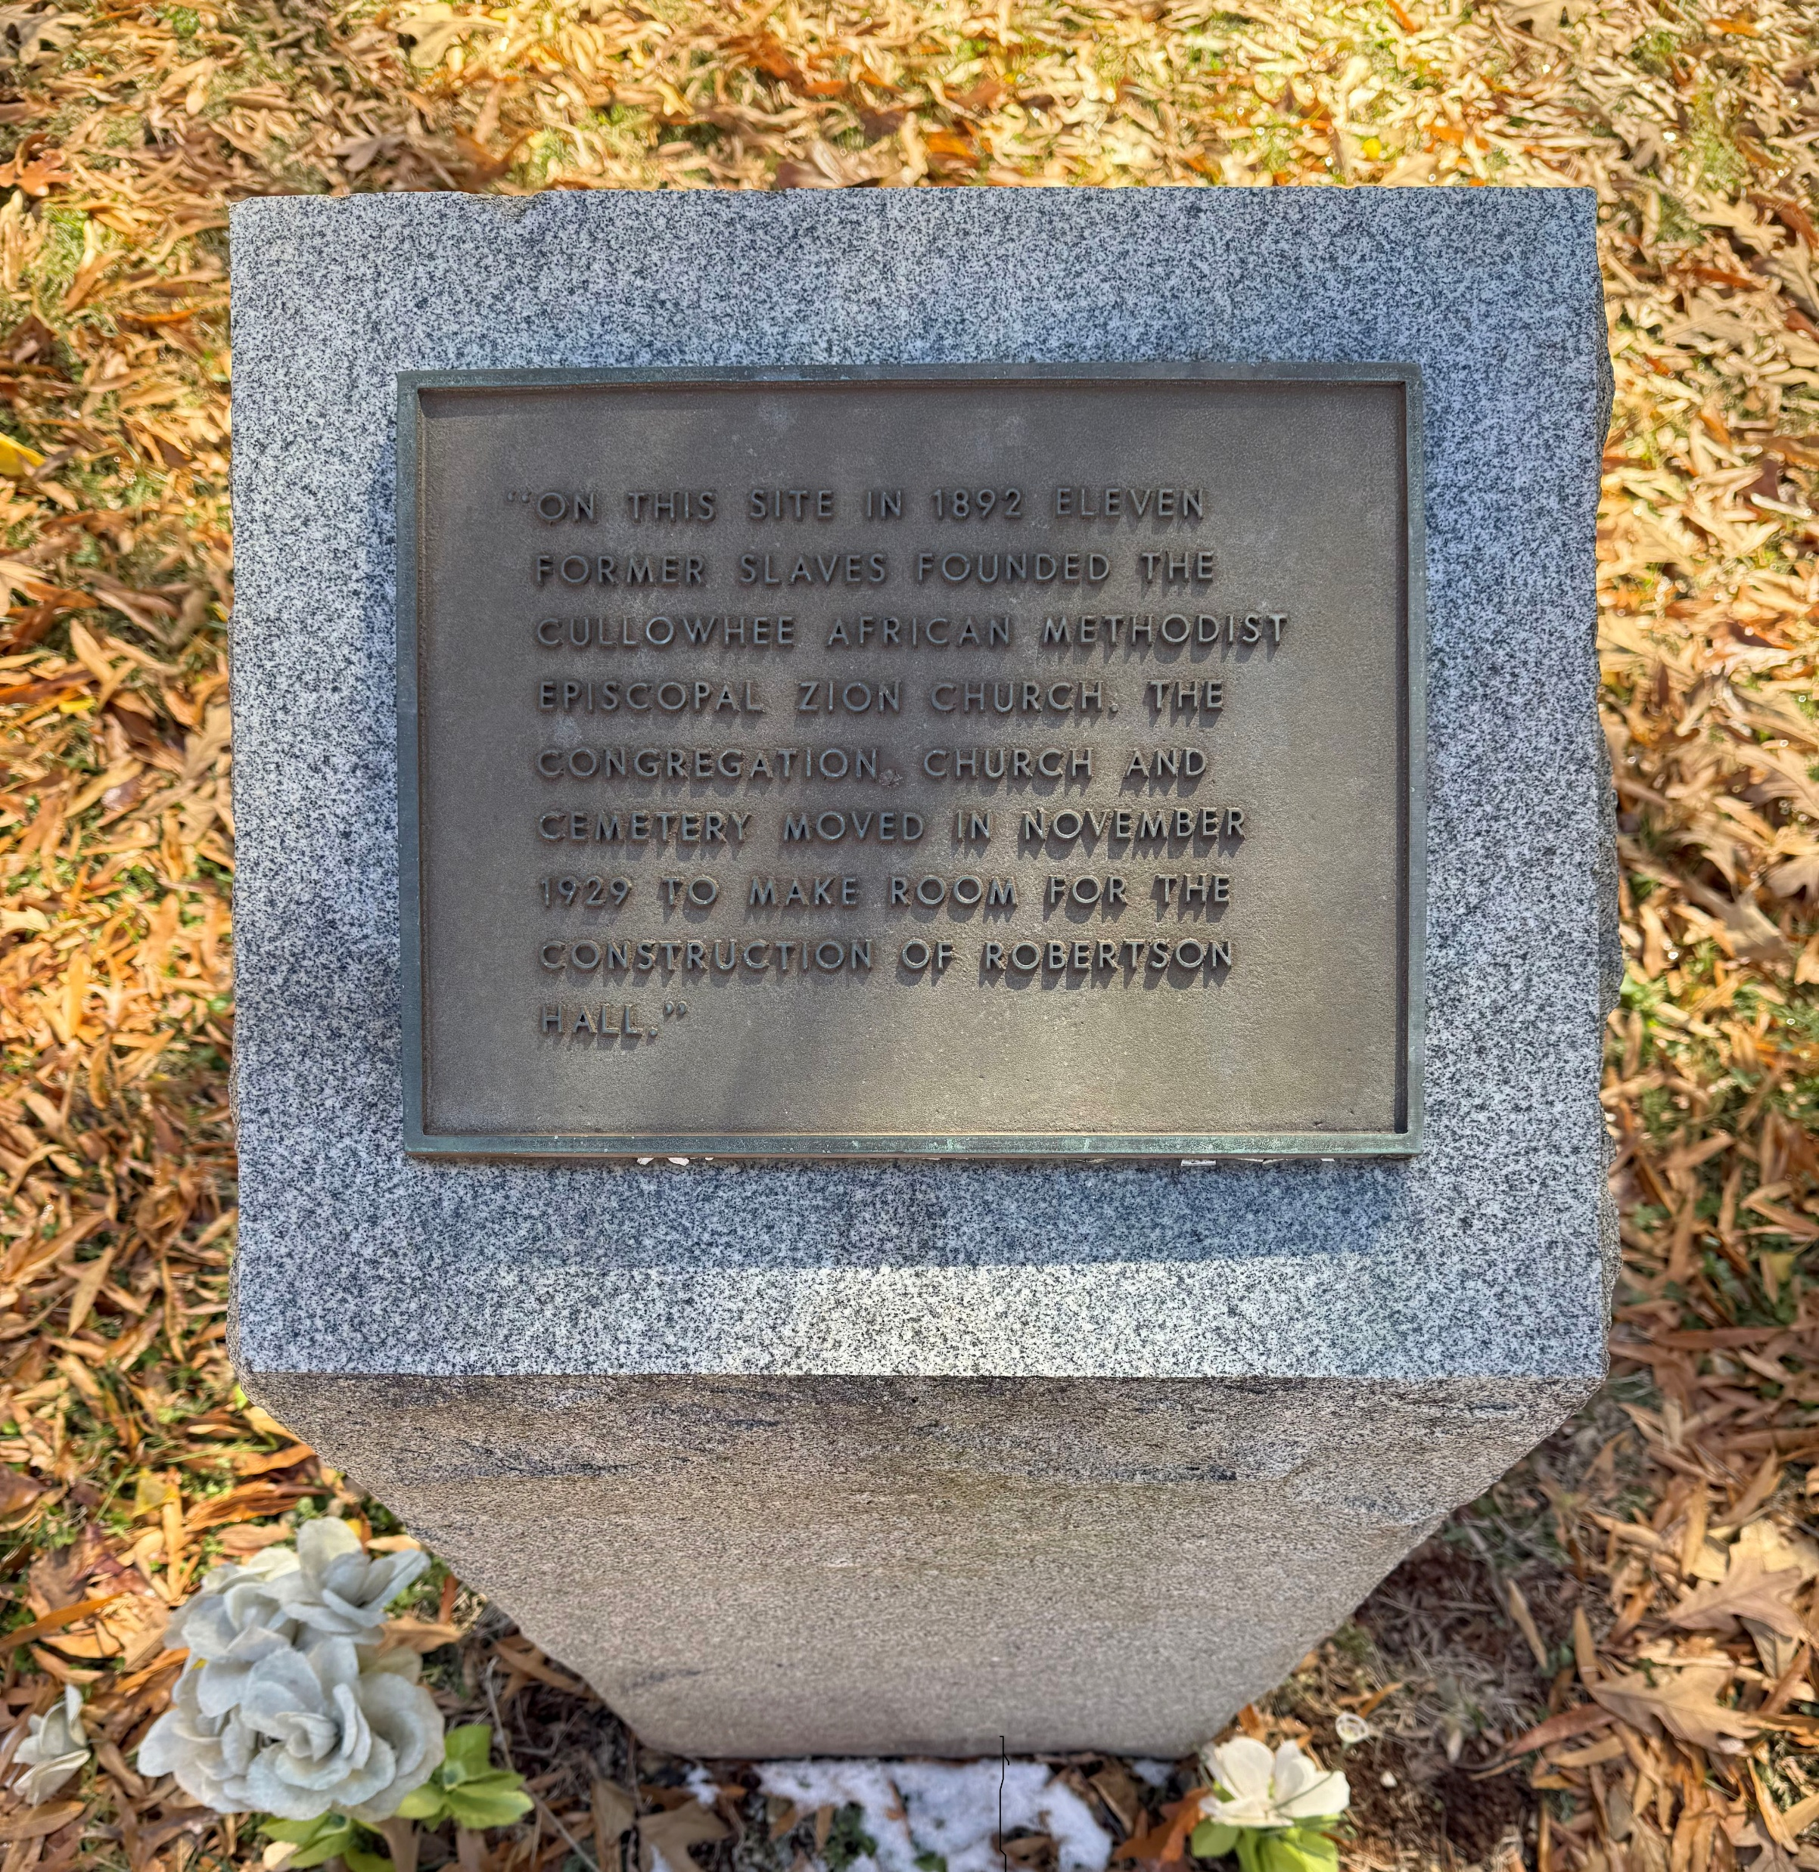
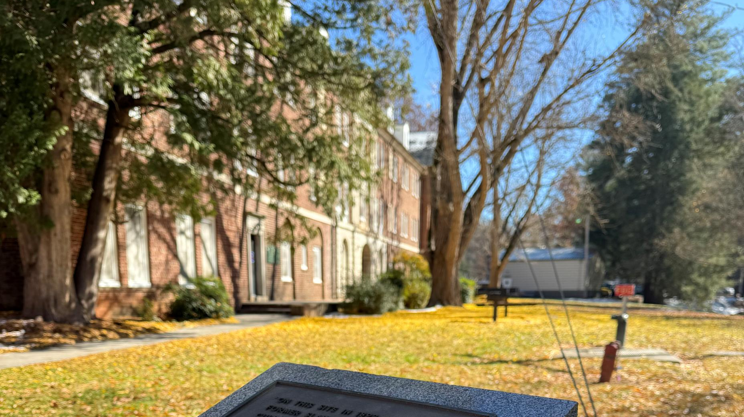
Notes:
Here’s the marker and that’s kind of it. There have been baby steps towards acknowledging the specific history of the AME Zion Church and cemetery, but barely any attempt to recognize the more general history of Black labor at the university and on the land where the university stands. I want to recommend the article “Woven In The Fabric” by Liz Harper and Adam Thomas, that includes a great deal more about the Black community in Cullowhee, it’s history and the episode with the church and the cemetery. That article has some more concrete ideas about steps the University could take to reckon with its history. For now, we mostly have a stone marker and the stories passed down in the community and a grandfather’s recollections of the face of a dead neighbor, just crumbling in his hands.

Slide 32
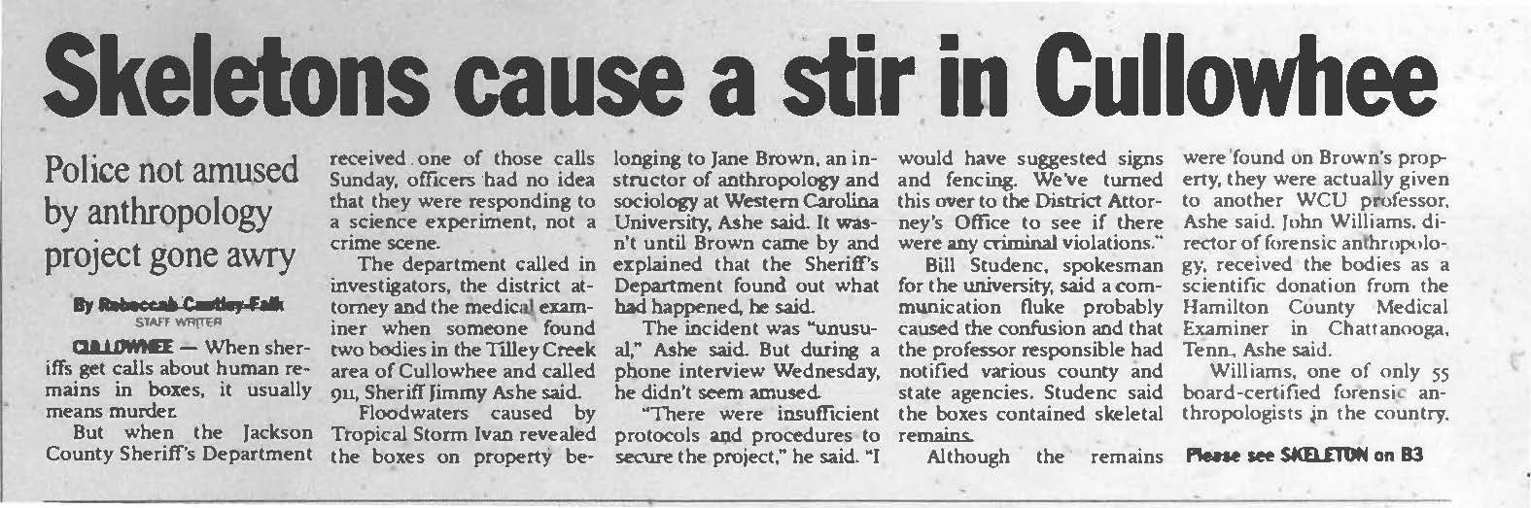
Hurricane Ivan
Notes:
After Hurricane Ivan rolled through western North Carolina in September of 2004, a man was walking on Tilly Creek Road in Cullowhee. He came across a couple of boxes in the road and peaked inside. Quite a surprise to him, he found human skeletons and directly notified the police.

Slide 33
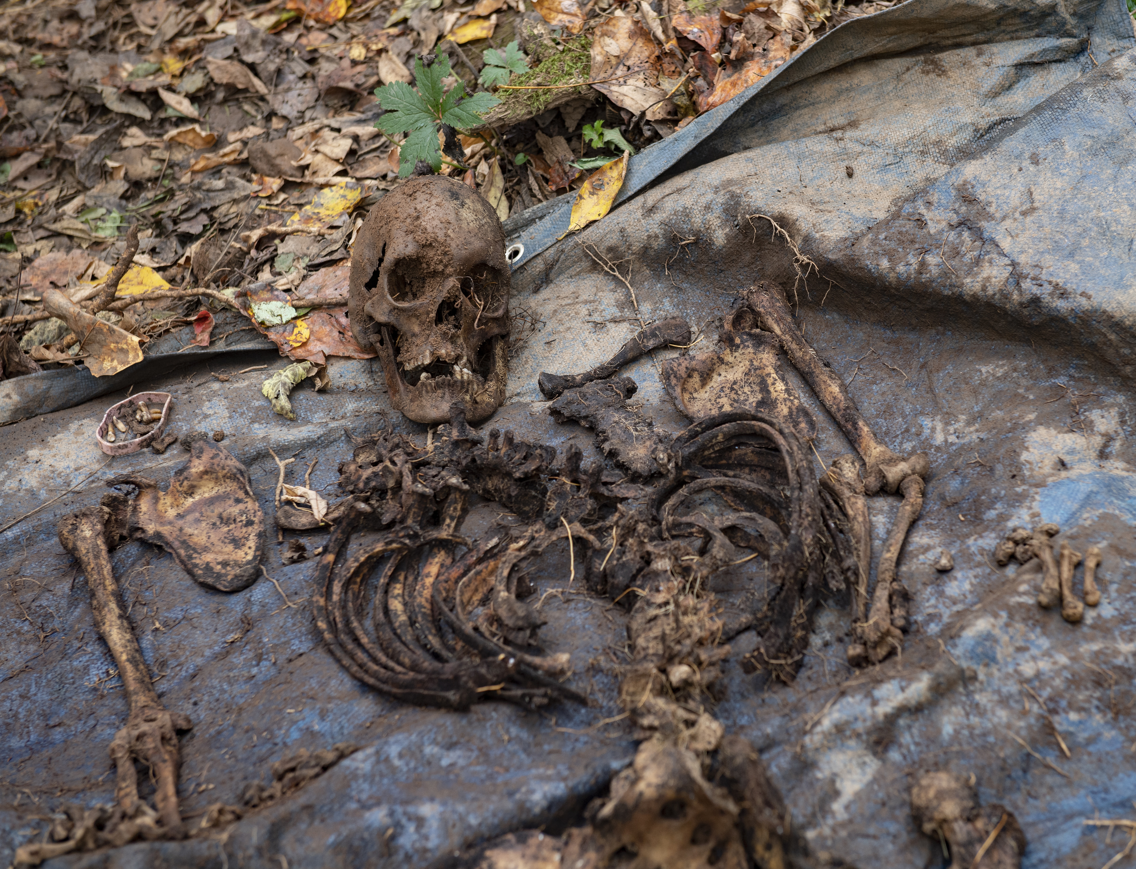
Forensic anthropology starts in the 1970s.
The forensic anthropology program began in the early 2000s
John A. Williams hired in 2003.
FOReST is the second body farm in the world, the first being in Knoxville.
The FOReST
Notes:
John A. Williams had been hired in 2003 in order to boost the forensic anthropology program. Chancellor Bardo had his sights on adding a top-notch forensic laboratory to the relatively new program. Williams was one of 55 board certified forensic anthropologists in the country, he had worked at ground zero after 9/11 and he was already decades into his career.

Slide 34
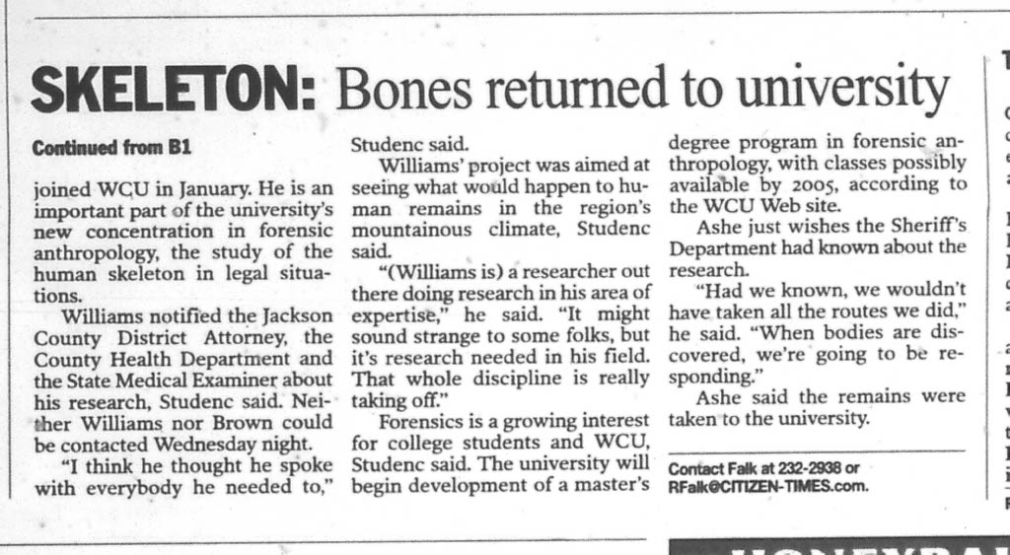
A crude start for a body farm
Notes:
As a new hire, obviously anxious to get things going, John Williams obtained two bodies from Hamilton County Medical Examiner’s Office in Chattanooga, Tennessee, notifying two people, the state medical examiner and the Director of the Jackson County Department of Public Health. One article says he also let the District Attorney know, but what is for certain is that he did not let the police know. Having no great place to put them, he asked another new hire, Jane Brown, visiting instructor for Anthropology and Sociology, to put them in her yard up on Tilly Creek in Cullowhee. They were in a discreet location in wooden boxes covered with brush, that is until the hurricane dislodged them from their hiding place.
Everything worked out, the retired health director confirmed the anthropologists’ story and the new director assured the police that no biological harm was done and Williams set out to legitimately create the second body farm in the world.

Slide 35
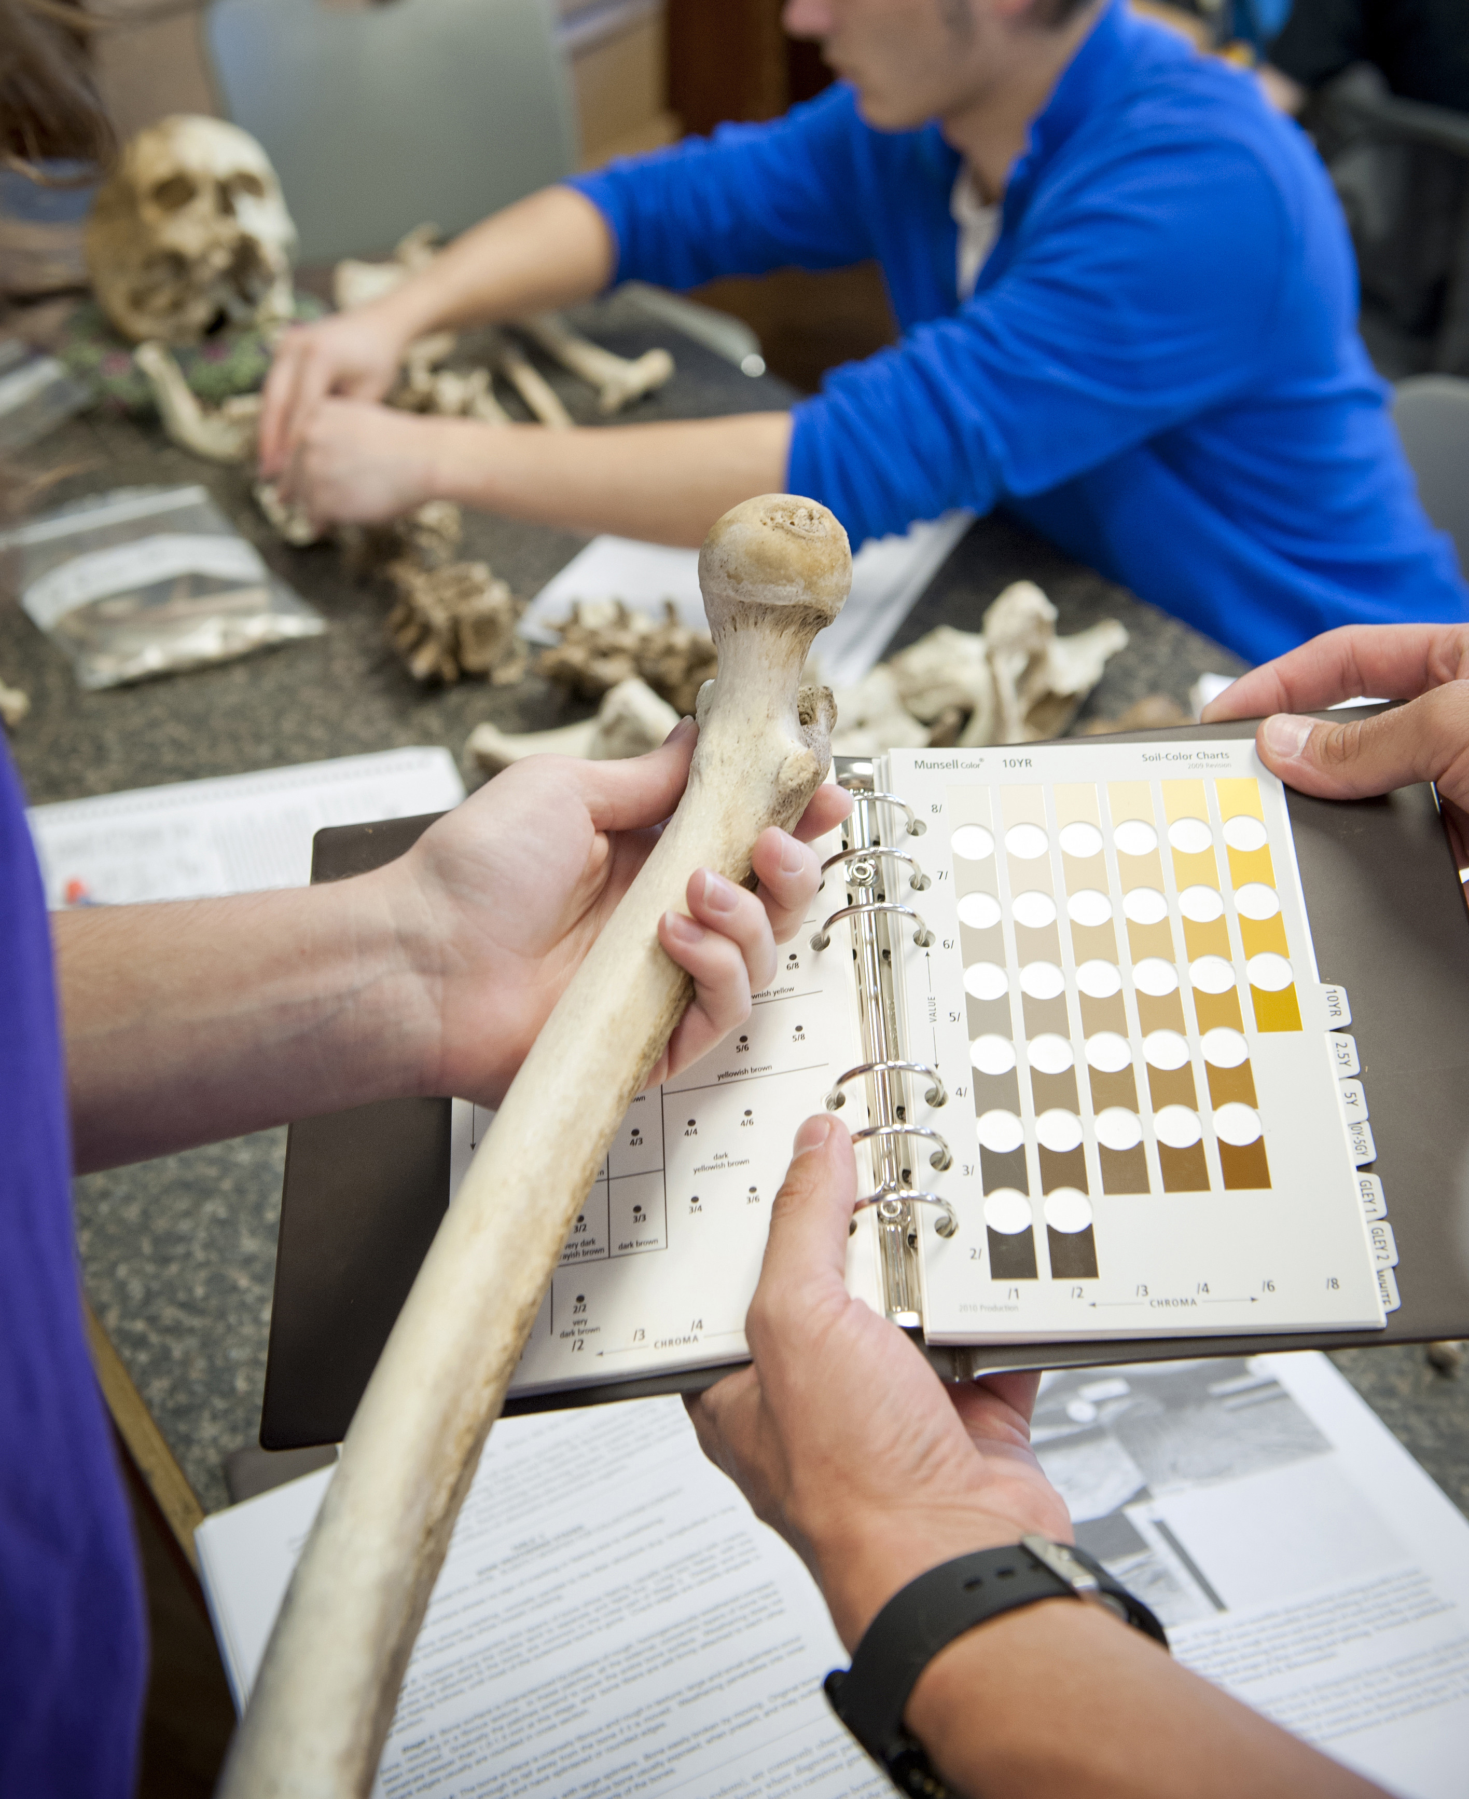
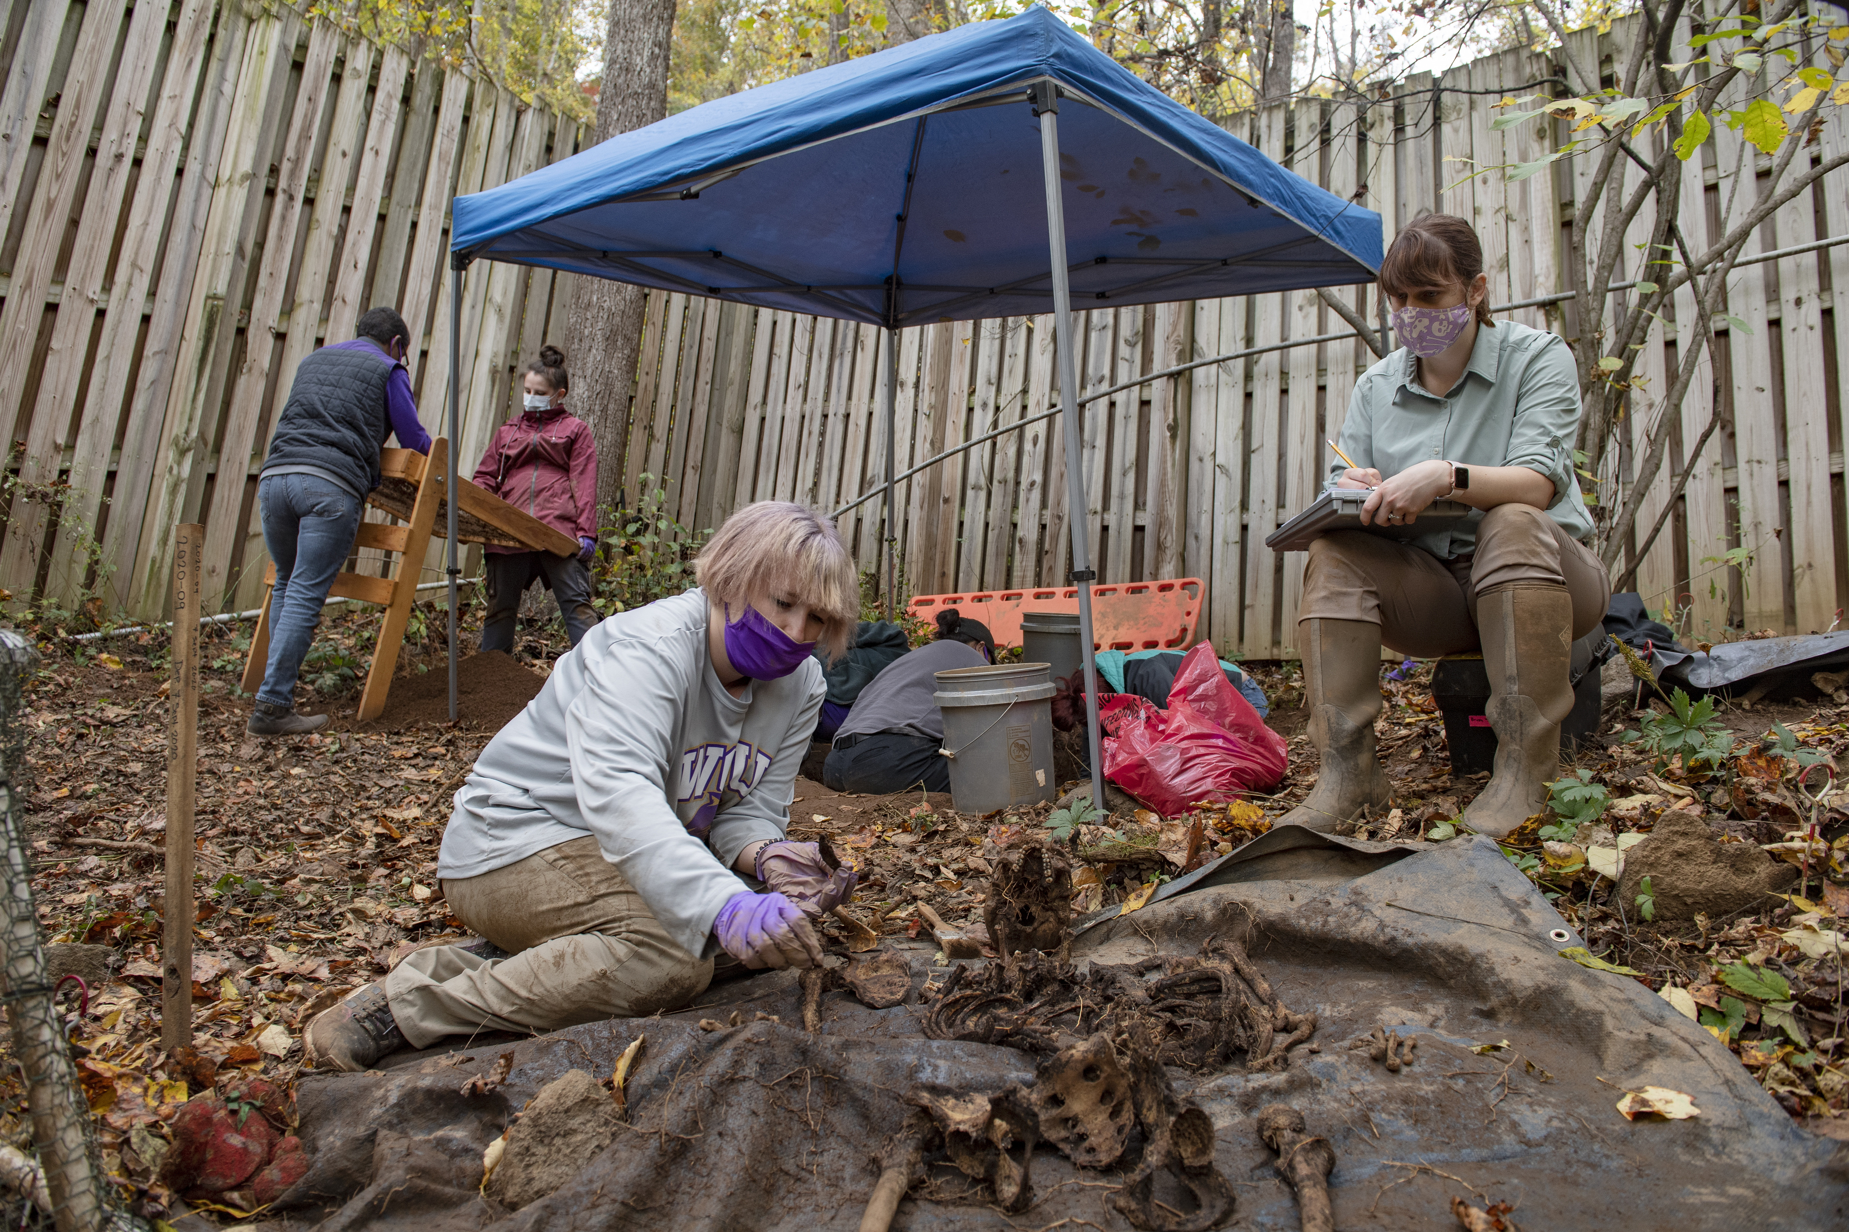
The FOReST
Students working with the human Skeletal Collection
Forensic Osteology Research Station
Notes:
FOReST is a dedicated space in Cullowhee where one can choose to donate their body for the forensic study of human decomposition and human remains. The willed-body program became operational in 2005, with the first donor arriving in 2008. That donor was “recovered,” meaning decomposed and cleaned up in 2009, officially beginning the human skeletal collection, now known as the JAW Collection, named after John A. Williams when he retired in 2020.

Slide 36
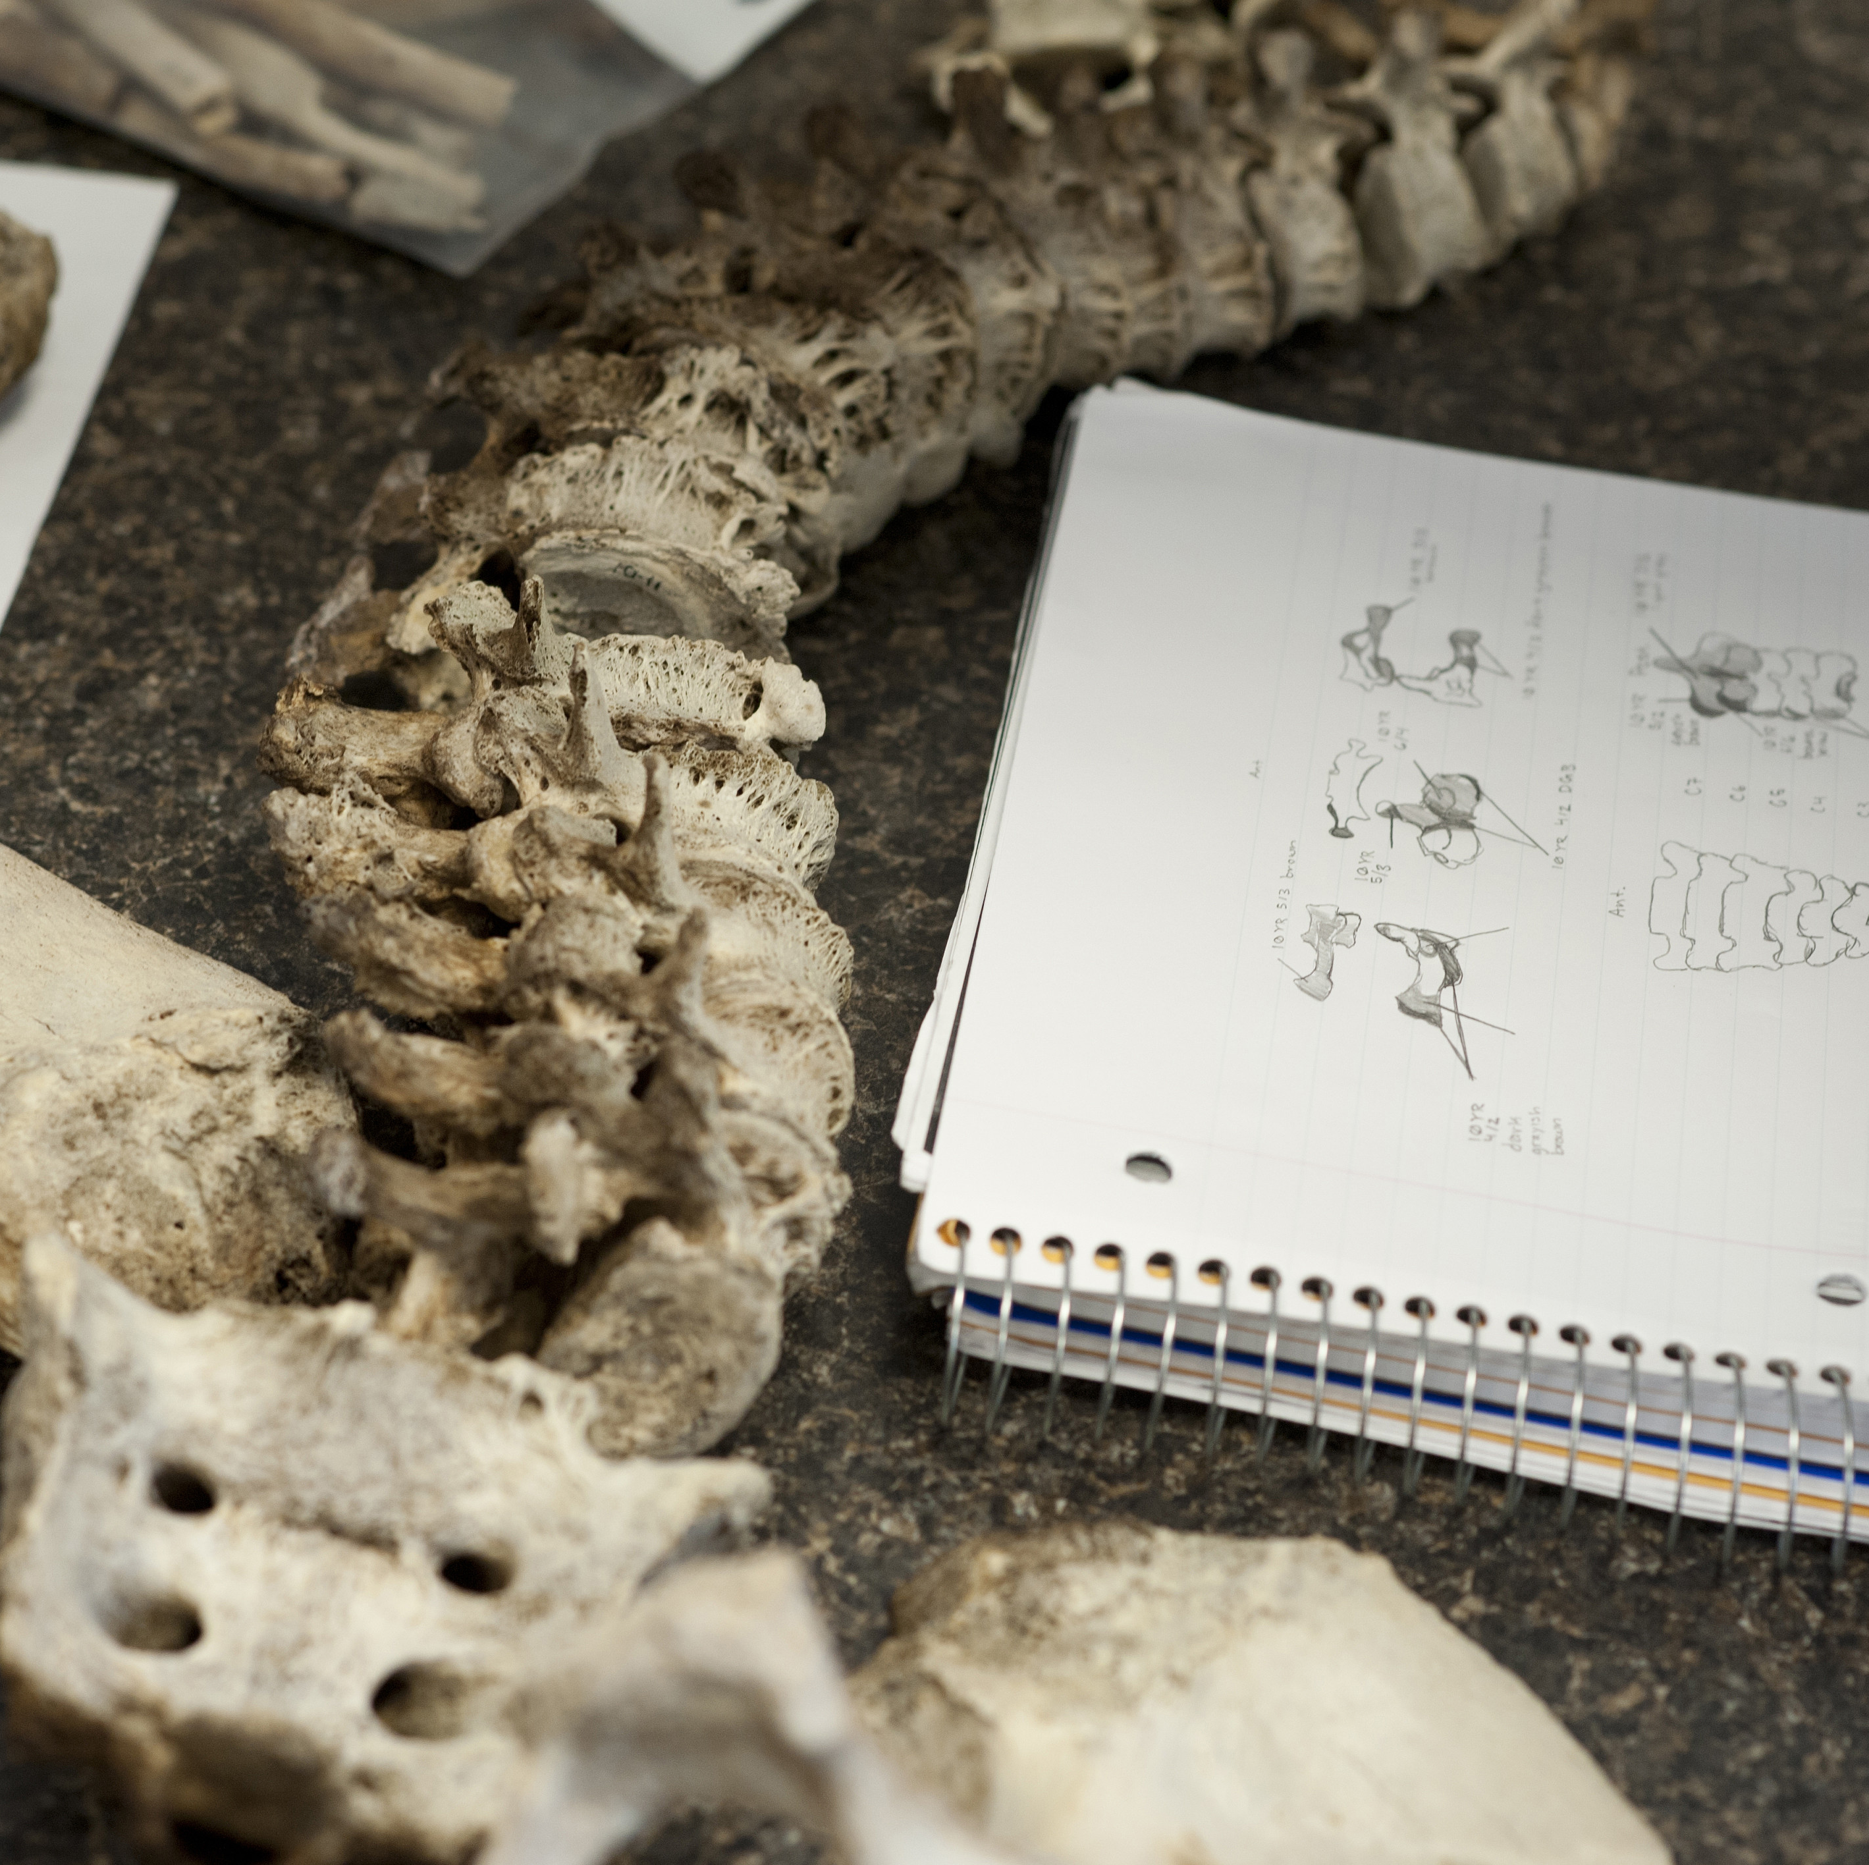
JA
JAW
John A. Williams Documented Human Skeletal Collection
Once the bodies have decomposed, they are "recovered" and brought to JAW for further study and research.
Here the families are able to visit with the deceased
External and internal researchers are welcome
"As curators, stakeholders, and beneficiaries of the deceased, we must treat them, their next of kin, and their communities with reverence. As fellow humans, we must respect the wishes of the deceased, as well as those of their descendants."
Notes:
The first donor was “recovered,” meaning had decomposed and was cleaned up, in 2009, officially beginning the human skeletal collection, now known as the JAW Collection, named after John A. Williams when he retired in 2020.
Pre donors and donor families today appreciate the engaged and personal approach that is taken with the willed-body program. Donors are treated with a high level of respect by the students and professors, the location of FOReST is not readily known by the average community member, donors' names are used, and if a body comes to the farm without any family, the students and professors are their new family.

Slide 37
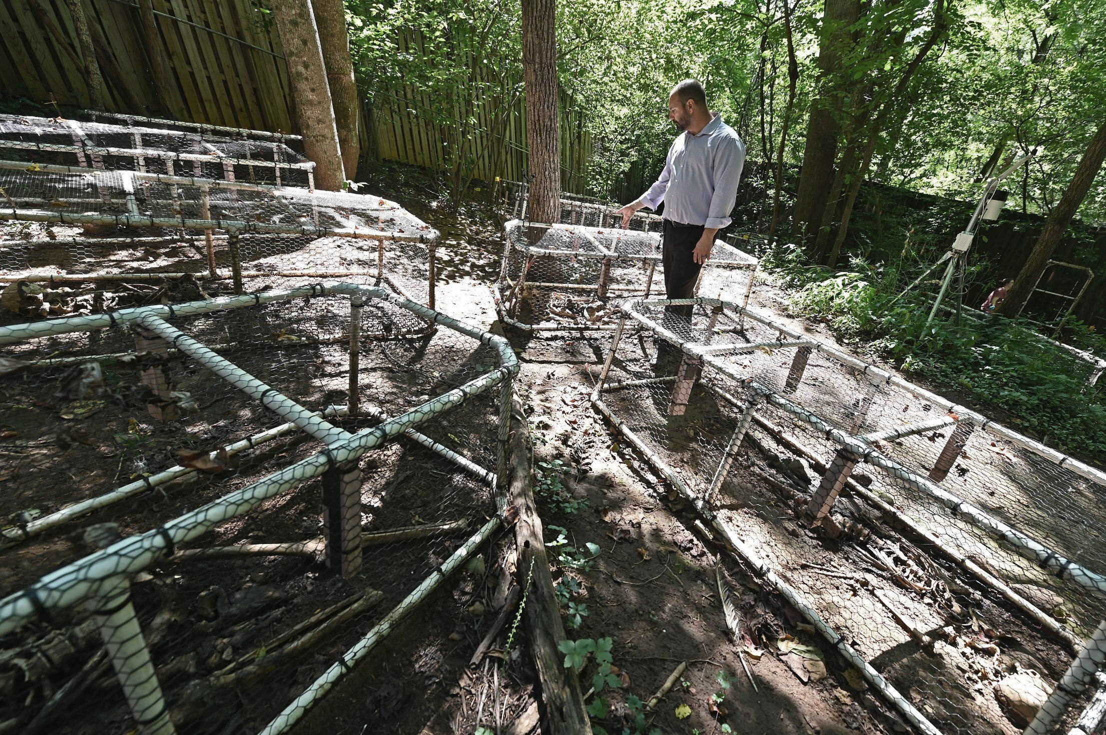
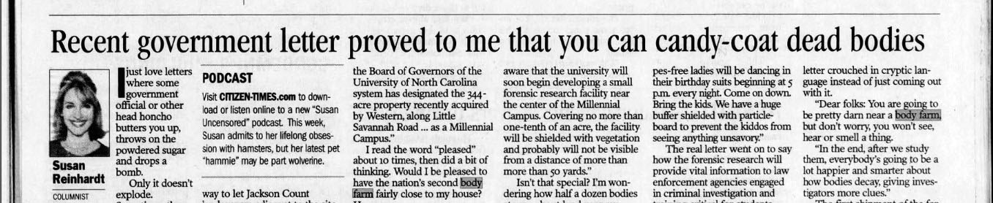
"I write to make you, a university neighbor and friend, aware that the university will soon begin developing a small forensic research facility near the center of the Millennial Campus. Covering no more than one-tenth of an acre, the facility will be shielded with vegetation and probably will not be visible from a distance of more than more than 50 yards."
Notes:
The body farm is located on the millennial campus. WCU’s expanded campus. Before it was built, a letter was sent out to adjacent property owners letting them know that a forensic research facility would be located nearby. It assured folks that the small facility “will be shielded with vegetation and probably will not be visible from a distance of more than 50 yards.” Susan Rheinhardt, a columnist for the Asheville Citizen Times, received the letter and shared snippets of it in a column titled, “Recent government letter proved to me that you can candy-coat dead bodies.” She didn’t have a problem with the benefits the body farm would bring such as training law enforcement agencies and students pursuing careers in forensic anthropology, but she made it clear that she did not appreciate the cryptic language of the letter.

Slide 38
Benefits to the Community
Cadaver Dog Training
Fire Scene Investigation
Bone recovery
Hands-on experience for students
Green Burial and Death Positive
Cost-effective alternative
The unofficial motto of WCU's Forensic Anthropology Facilities is: "the living serve the dead and the dead serve the living."​
Notes:
Of course, we can understand why the realities of the "research facility" were not outwardly stated, and in the end, FOReST has proved to be an extremely useful research facility, and one that students, law enforcement, and emergency management professionals can’t find just anywhere. (There are only ten body farms in the world to date).
Western offers cadaver dog training courses regularly. Important that a dog get the whole scent of a body. In fact many of the dogs used in Helene recovery efforts were trained at the body farm.
You can choose to participate in destructive testing, this could mean that your body is placed in a furnished room created for the purpose of burning it down and learning how various scenarios play out.
The program has come a long way since the skeletal remains were found washed into the road by a passerby. Twenty years later, after Hurricane Helene tore into WNC, students in the forensic anthropology program spent their spring break volunteering in Asheville’s Riverside Cemetery where many prominent citizens are buried. A student shared with me that they got to jump into 12’ deep graves to disentangle bones from roots of trees that had fallen, work that had to be done before the tree removal could begin. They also used many iterations of maps going back 100 years to properly position grave stone markers that had been moved by the fallen trees. She said it was great hands on experience that she appreciated and that the program in Cullowhee was one of the top programs in the country.

Slide 39
But What About The Cherokee Remains?
Notes:
In 2003, WCU quietly entered into an agreement with the EBCI involving the repatriation of the human remains and funerary objects that were taken from the Cullowhee. The agreement was that the place the remains belonged, was back in Cullowhee. The agreement stipulates working directly with the tribe to arrange for the private reinterment of the human remains on campus. The agreement includes stipulations for either public grave markers and interpretive signage, or for the specific locations of the remains to remain largely private to the public, which so far is the option they went with.

Slide 40
Recognition when appropriate
Privacy when appropriate
Respect always
Notes:
The basic lessons from over 100 years of WCU handling or mishandling human remains are pretty simple and reflect more general principles of interacting with the broader community: recognize and acknowledge your partners, your history, and your mistakes, Recognize the importance of privacy when dealing with something as intimate and personal as human remains. And throughout it all, treat everyone, living or dead with respect.

Slide 41
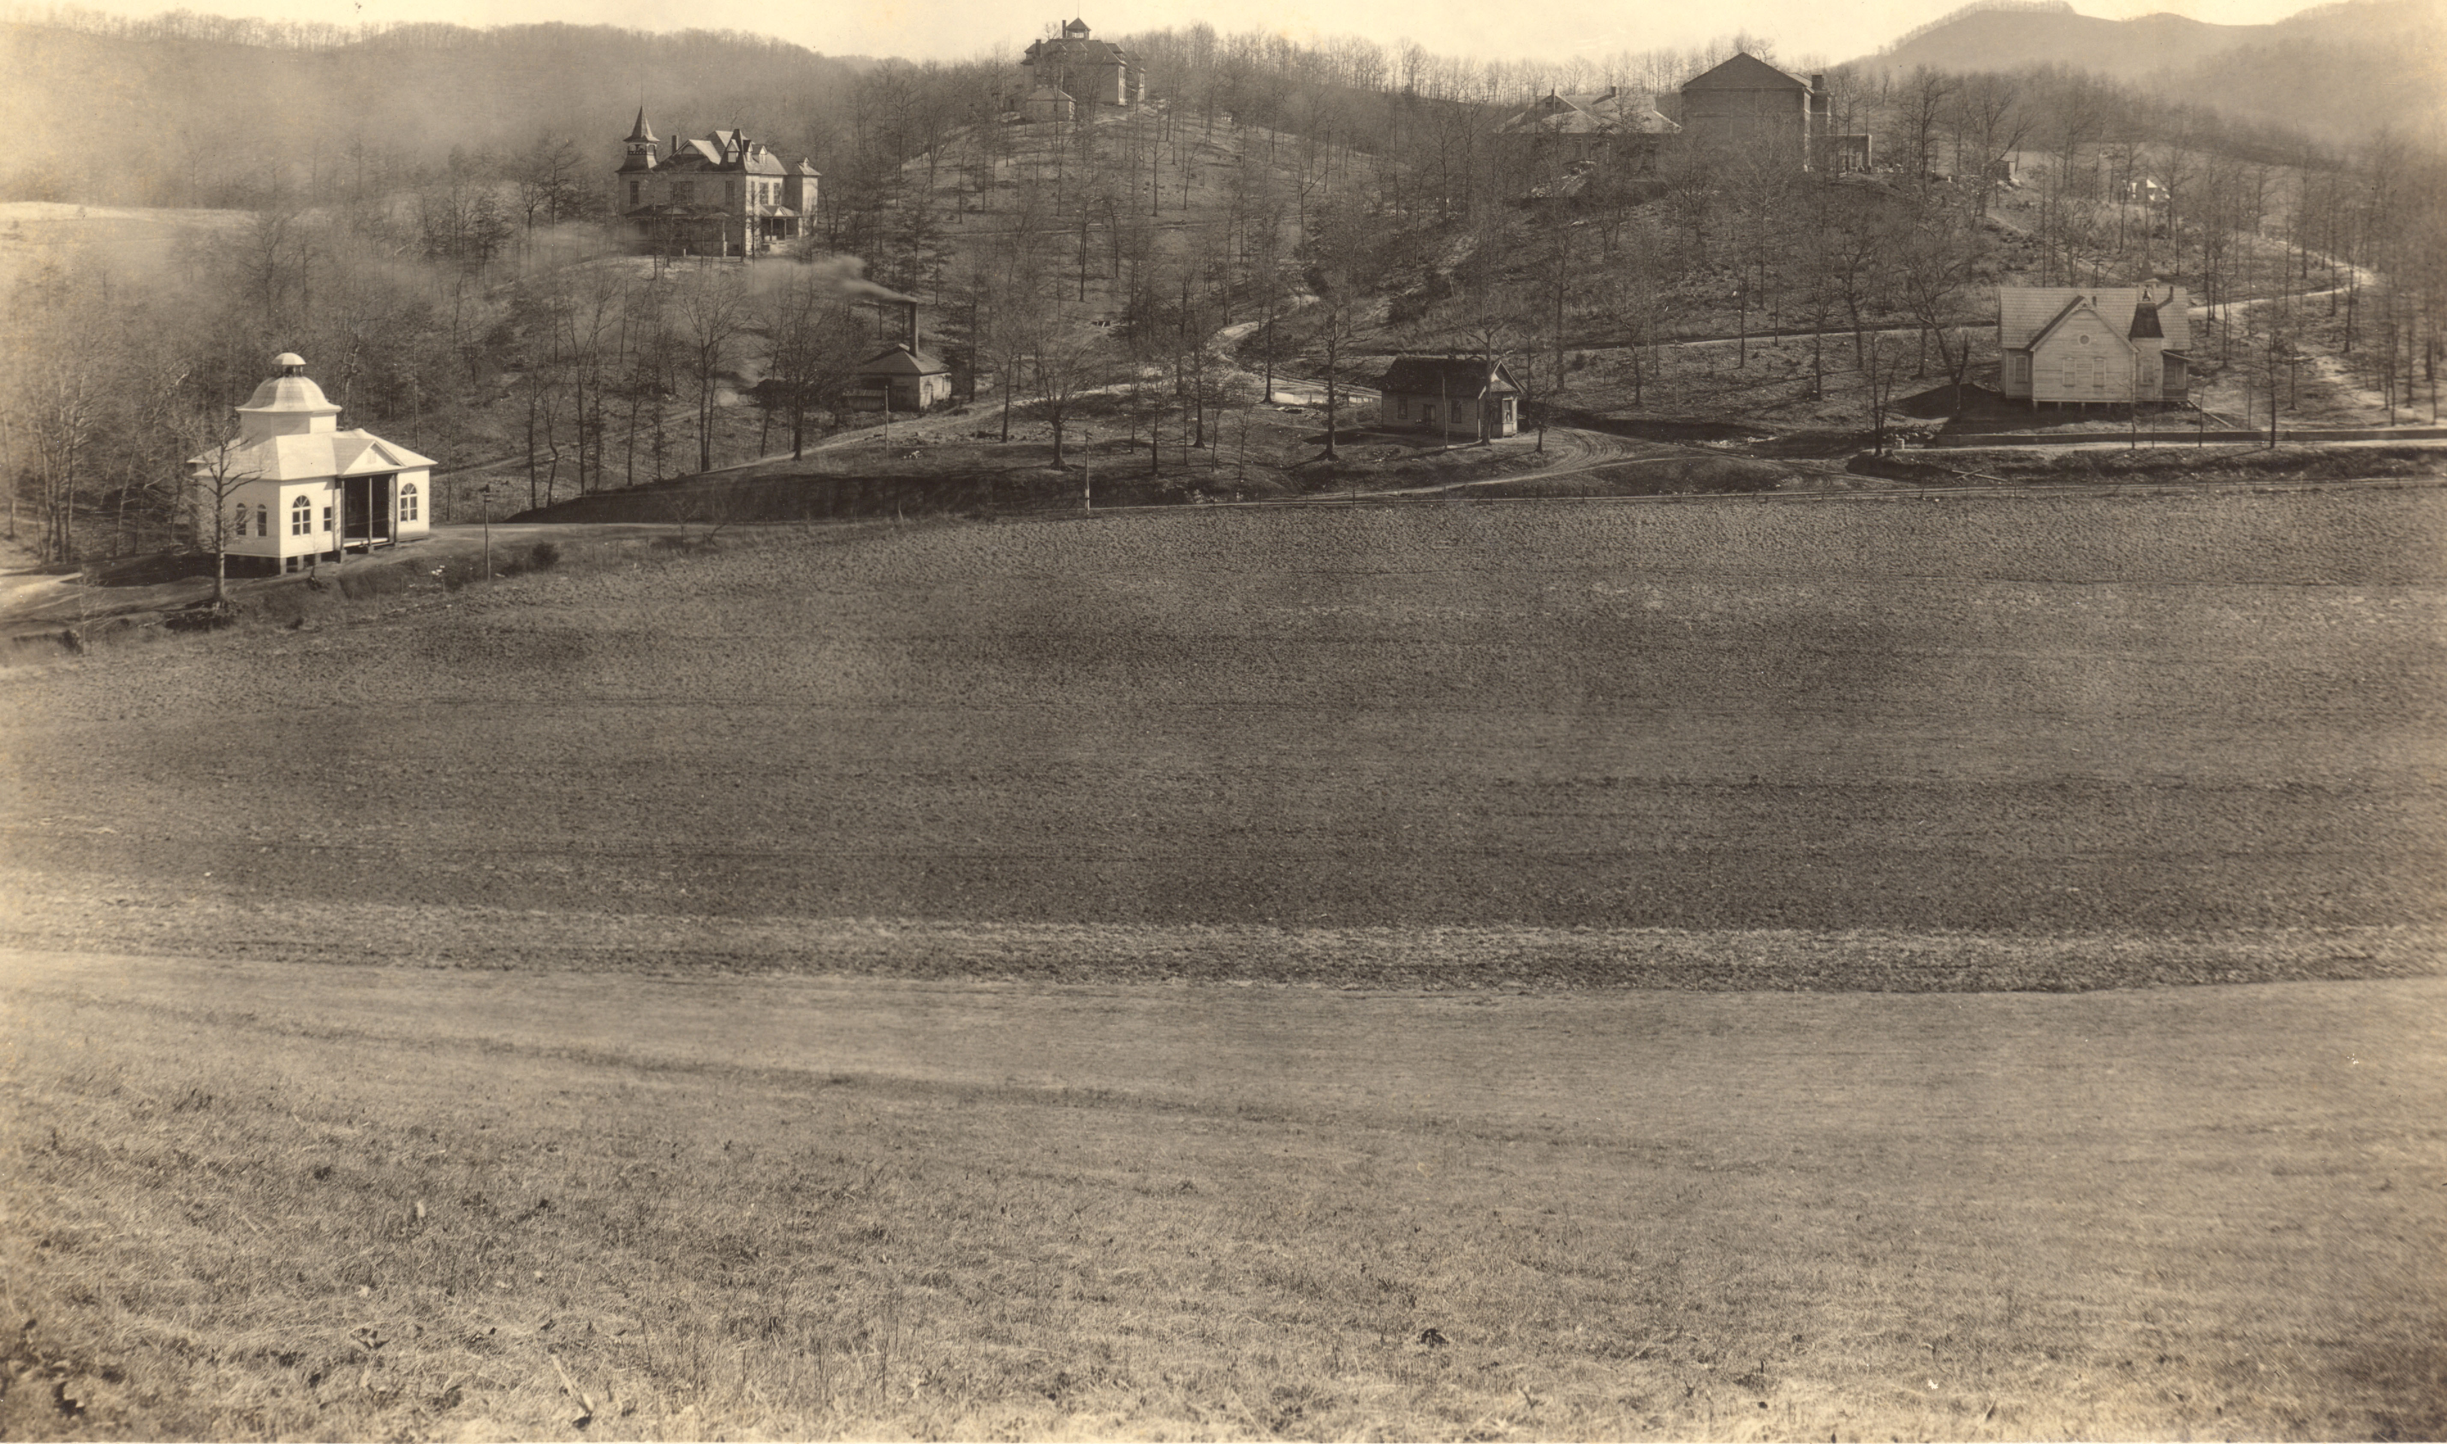
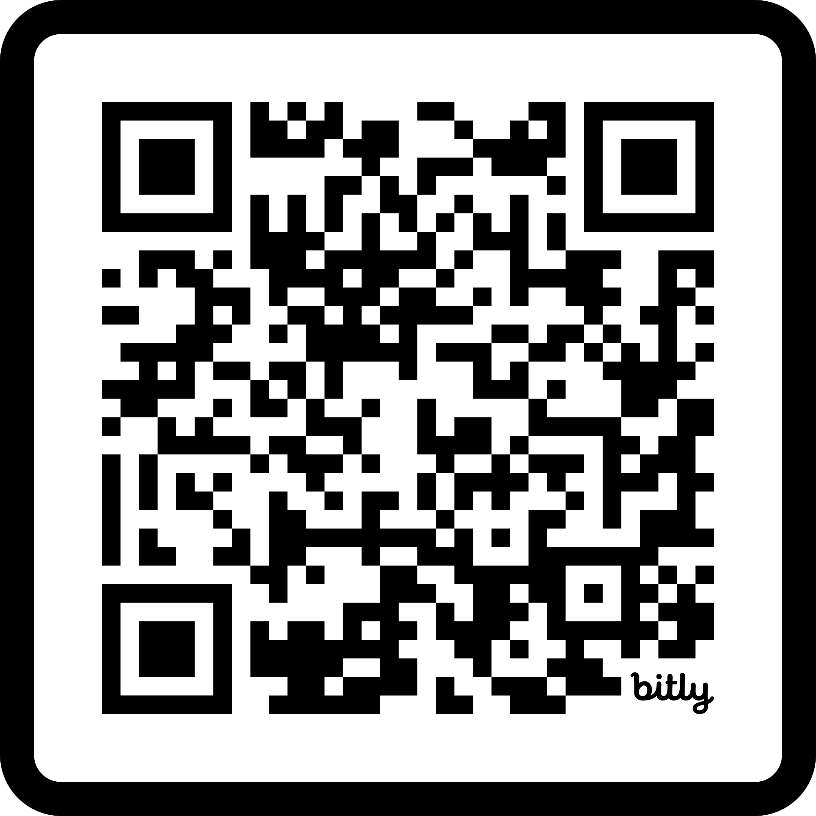
Resources & Works Cited
Thanks for your time!
Notes:
That QR code will take you to our works cited, which is particularly important since we only touched the surface to each of these issues. We’re happy to take questions now!

