Slide 1





Surveying History
How to Conduct County-Wide Cemetery Surveys and Why It Matters
Shellie Taylor
Local History Librarian
Iredell County Public Library

Slide 2
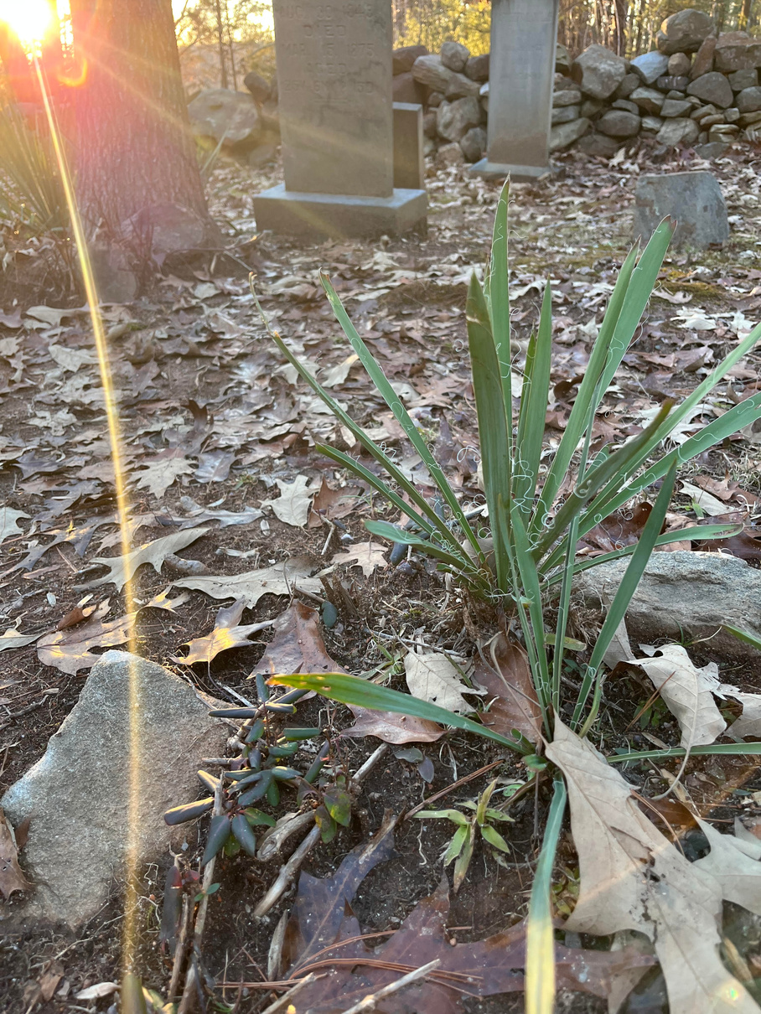
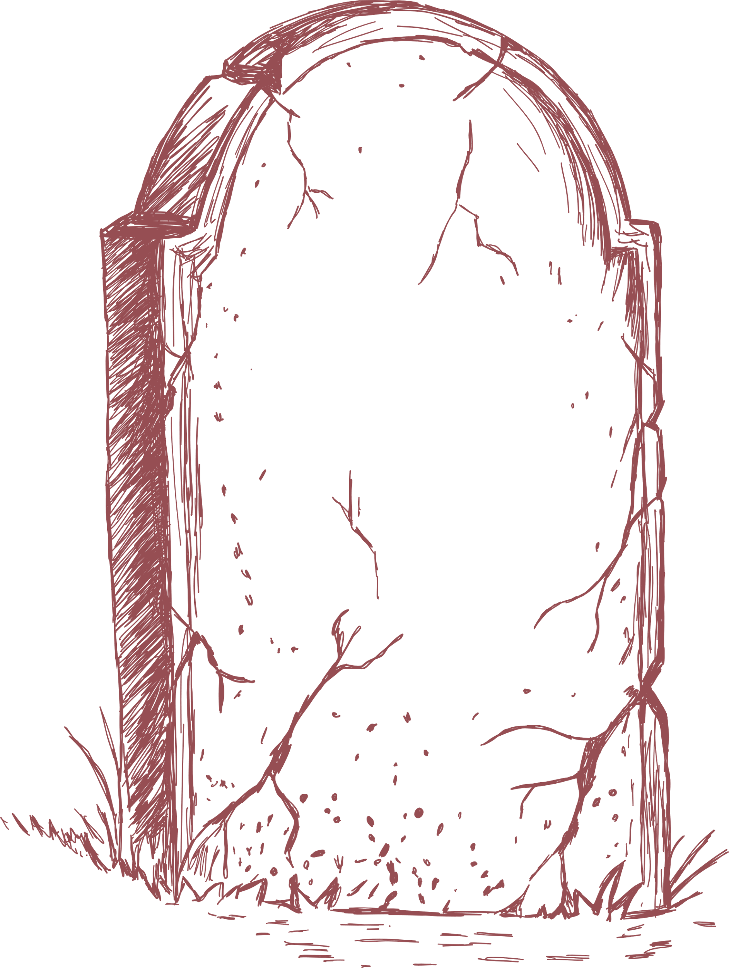
Cemetery Preservation
  Updating old records
  Adding new information
  First time
  Awareness/Publicity
  Credibility
  Permanent records
  You can’t say “I didn’t know”
  Every burial is a story

Slide 3
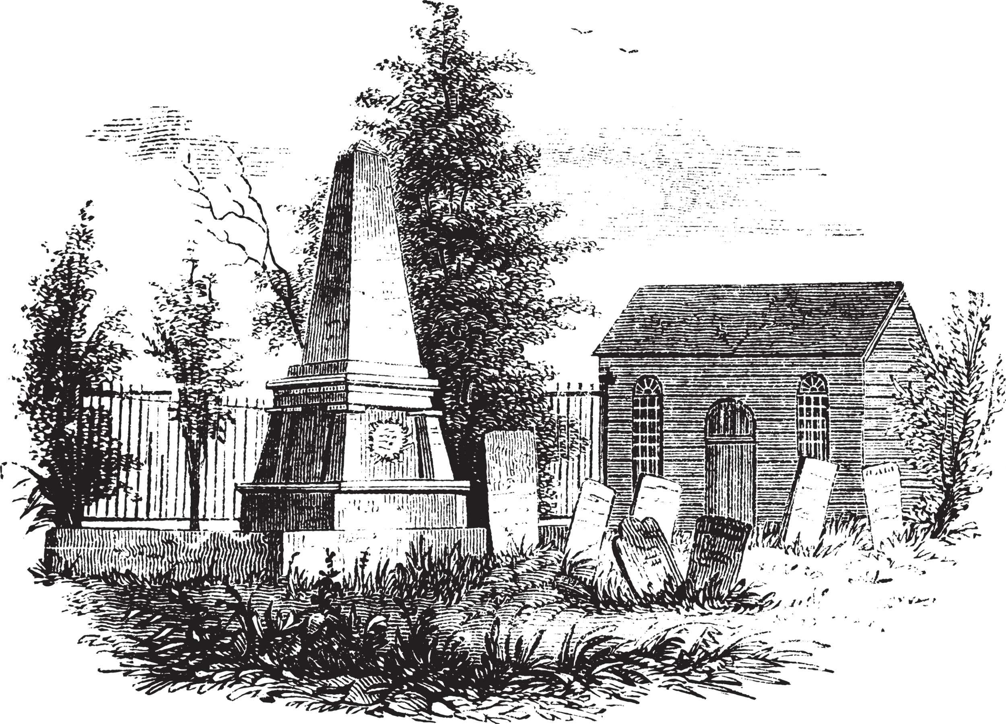
First Steps
  Permission
  Gather existing information
  Map it out
  Spreadsheet
  Property research

Slide 4
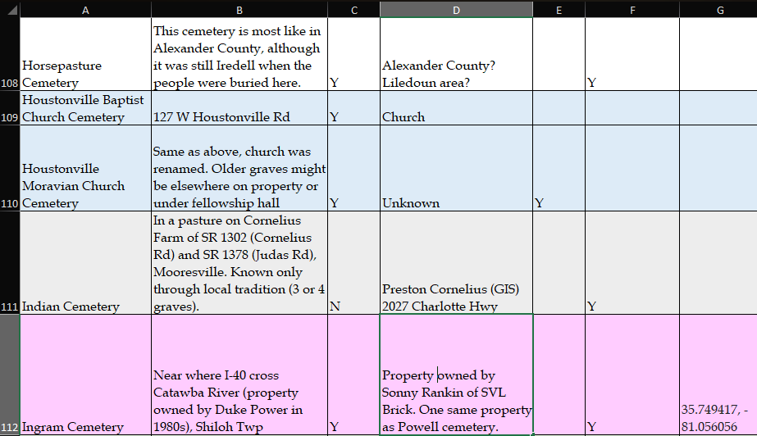
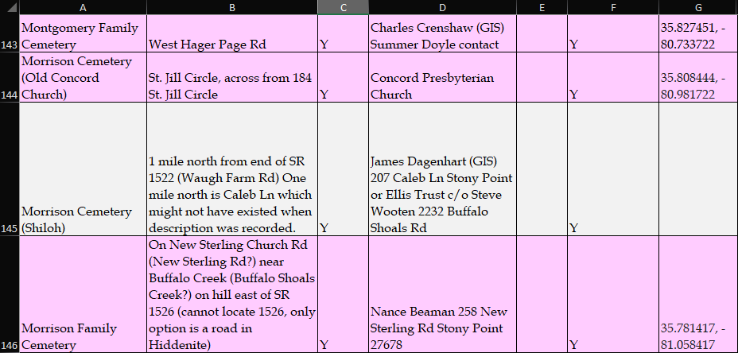
First Steps

Slide 5
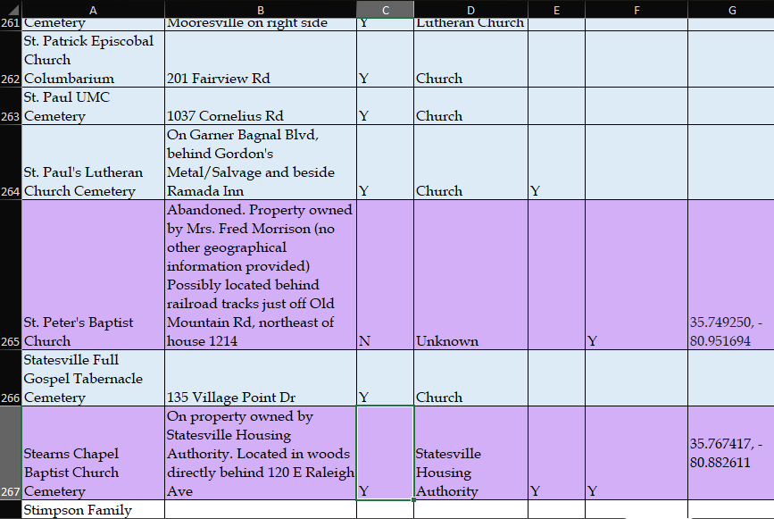
First Steps

Slide 6
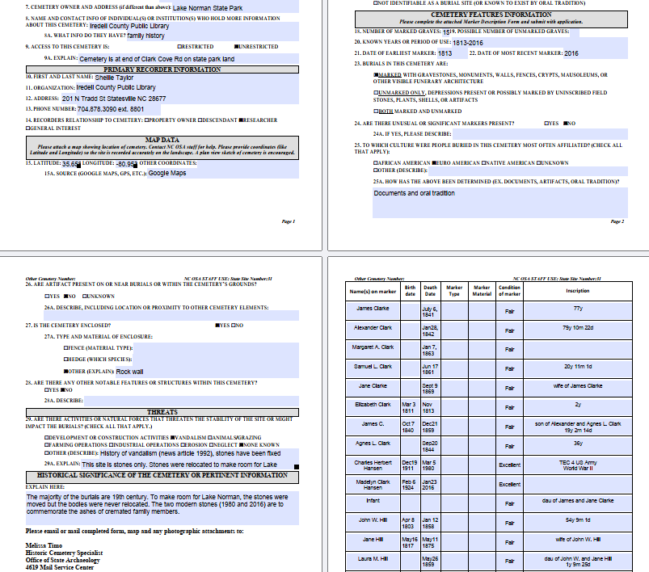
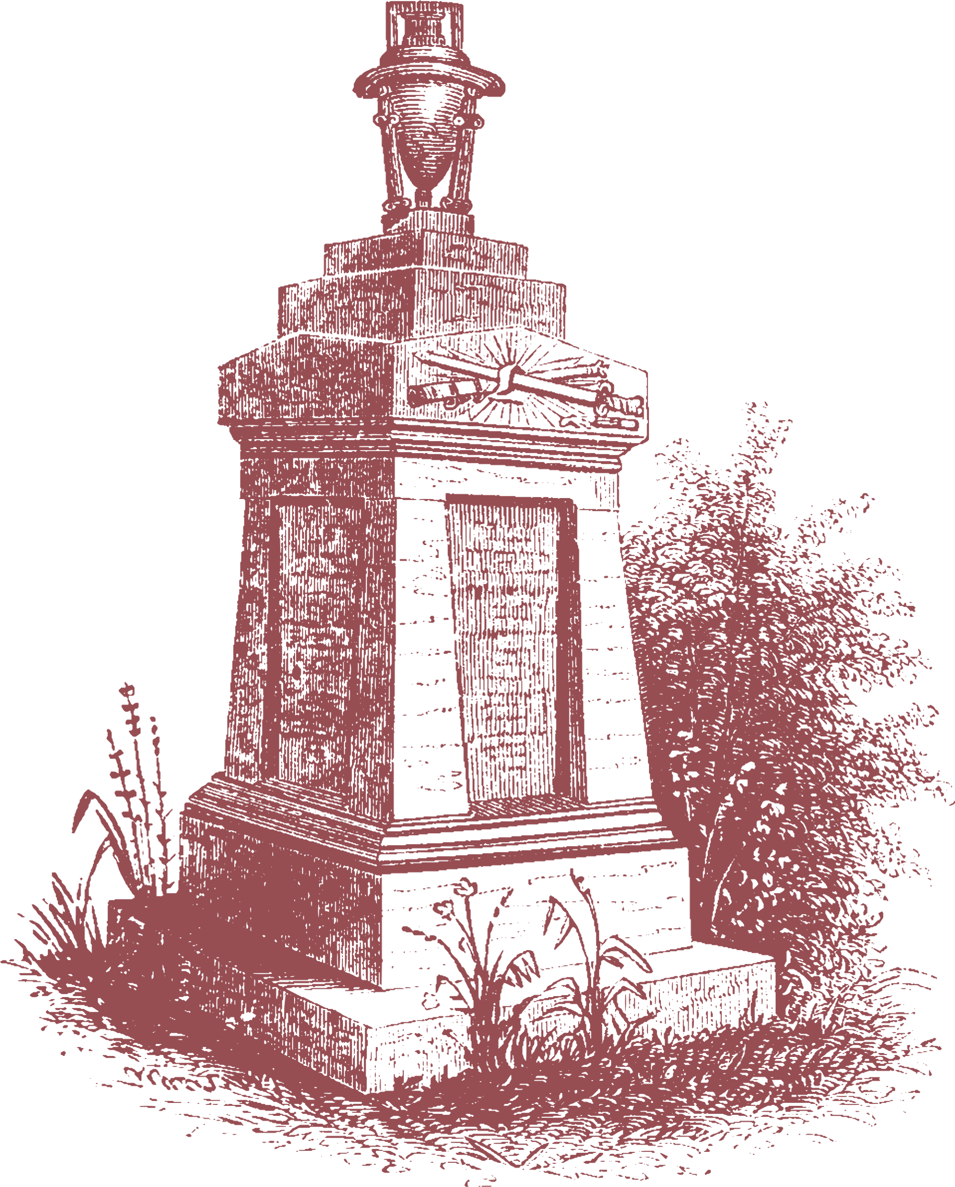
Partnerships
  Local GIS
  NC Office of State Archeology

Slide 7
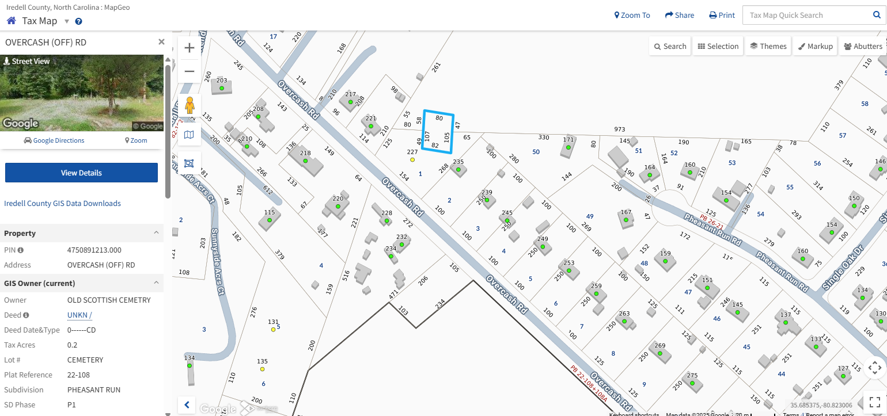
Partnerships

Slide 8
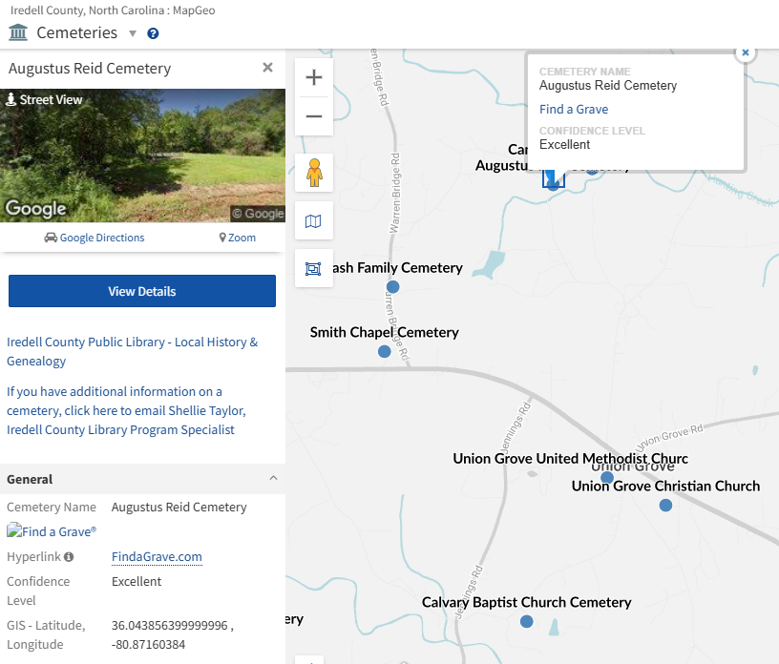
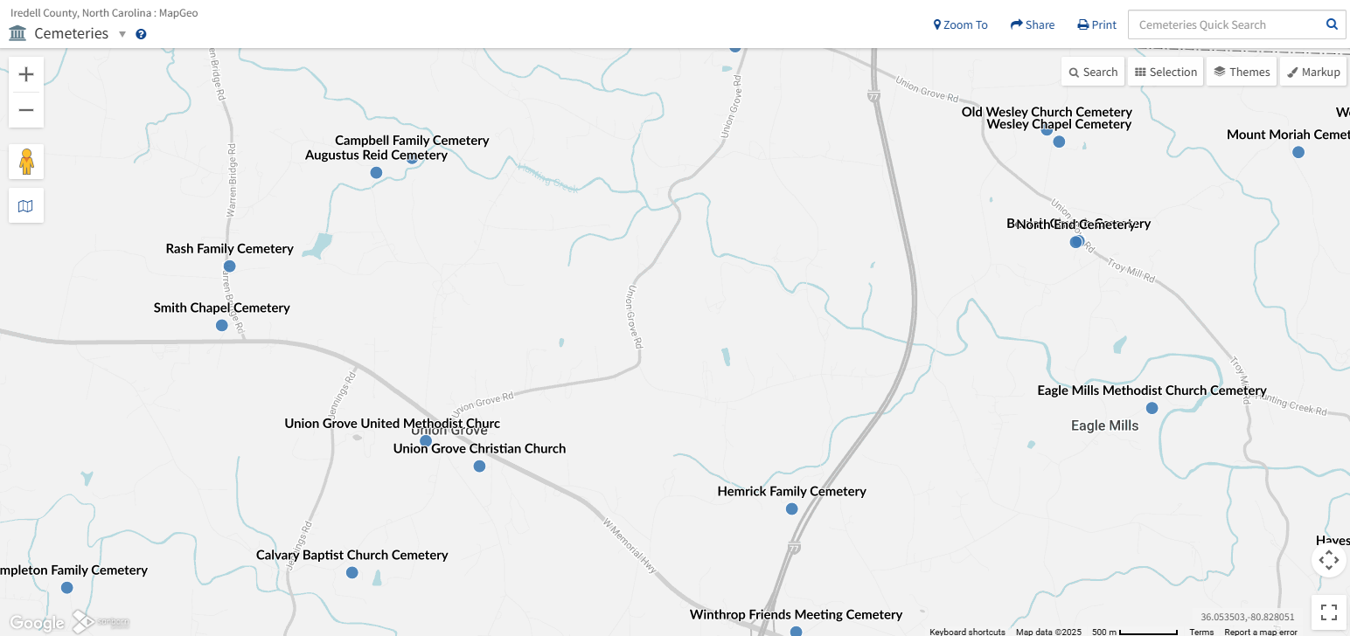
Partnerships

Slide 9



Landowners
Type 1
Type 2
Type 3
  Negligent
  Doesn’t want to be involved
  Pretends there is no cemetery on property
  Ignores letters or other attempts at contact
  Refuses public access to cemetery
  Deliberately hides or destroys cemetery
  History or genealogy enthusiast
  Already aware of cemetery on their property
  Knows a little or much of the history
  Descendant of those buried on property
  Maintains cemetery
  Respectful and understanding
  Eager to learn
  May or may not be aware of the cemetery on their property
  Either maintains cemetery or wants to

Slide 10
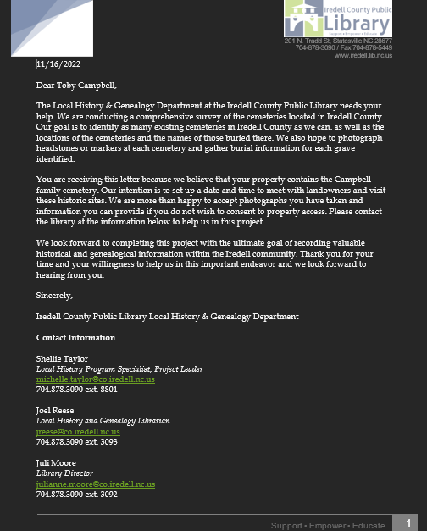
Landowners
  Networking
  Future collaboration
  New resource (for both you and the landowners)
  Building relationships
  Education

Slide 11
Going Forward
  Cemetery preservation is land conservation
    Three Rivers Trust- Central Piedmont and Sandhills
    Blue Ridge Conservancy- Northwest (Alleghany, Watauga, Wilkes, Yancey, Ashe, Avery, and Mitchell)
    Catawba Lands Conservancy- South Central NC, includes Carolina Thread Trail)
    Foothills Conservancy of NC- Foothills counties (Alexander, Catawba, Cleveland, Rutherford, McDowell, Caldwell, Lincoln, and Burke)
    Coastal Land Trust- Entire east coast of NC
    Conservation Trust of NC- Statewide
    Eno River Association- Entire Eno River basin including Hillsborough and Durham

Slide 12


Questions & Discussion
Shellie Taylor, Local History Librarian
Email:
michelle.taylor@iredellcountync.gov
Phone:
704.878.3090 ext. 8801
Website/Social Media
www.mistressofcemeteries.com
@mistress_of_cemeteries

